Slide 1
Predicting the Best Areas to Start an Italian Restaurant in Pune

Slide 2
Need of Implementation
It’s quite a difficult and time consuming task to analyze “Where to start my restaurant” as this “Where” part is most difficult and is an important factor in determining the success of your hefty investment.
A Good restaurant with excellent interior and Food Quality and competent rates can also fail if it’s established on a wrong area. For E.g. if the area is on industrial zone or human presence is far away then in spite of maintaining everything it will cause problem.
So a Good Area with good demand and supply with all above mentioned points related to restaurant will help the restaurant to succeed

Slide 3
Need of implementation(CONTD)
Apart from above mentioned points it is more difficult to analyze for a Specific Cuisine related restaurant which is our case of “Italian Restaurant”.
Besides this a specific cuisine restaurant requires to analyze the most important “Where” question.
A good Italian restaurant can run only and only on areas where there is a Good Demand & Good Supply apart from other facilities and services that a restaurant provides.

Slide 4
Data Acquisition & Cleaning
Data Sources include viz:-
This project will use data from :
• Geopy - For getting the co-ordinated of different locations.
• Foursquare API - To get the list of venues and their details around a given location.
• Geocoder – To extract latitude and longitude from Areas and the city itself.

Slide 5
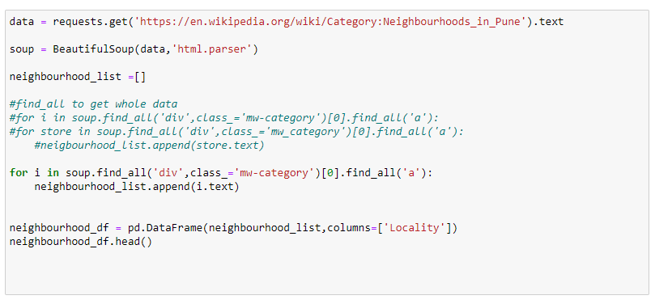
Methodology
Below are the step-by-step points that consists of Methodology steps.
1. Getting the co-ordinates of the target city.

Slide 6
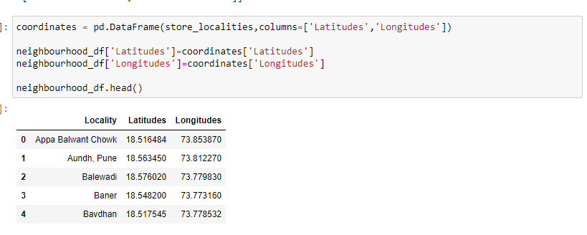
Methodology(Contd)
2. Getting the list of neighborhoods and their co-ordinates.

Slide 7
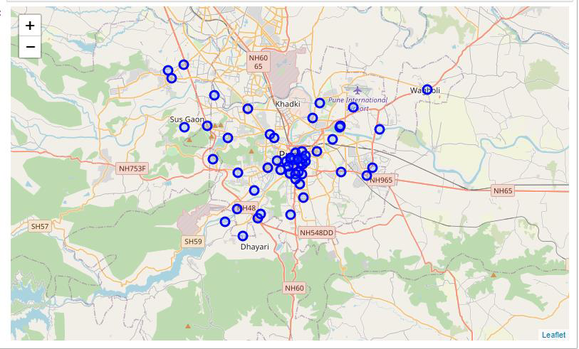
Methodology(contd.)
3. Mapping them on Map Using Folium

Slide 8
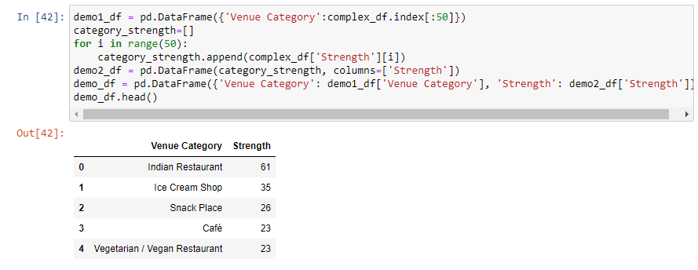
Methodology(contd)
4. Using Foursquare API to extract nearby Venues from all areas
5. Categorizing the Data to get total count venue category wise.

Slide 9
Methodology(contd)
6. Using Word Cloud to visualize frequency of Categories of Venues
Here we come to know Indian Restaurants are having most frequency in Pune.
7. Using OneHotEncoding and Transpose method to convert data into more visualizable form to clearly see details. E.g. if there is Indian Restaurant in Appa Balwant Chowk then it will be displayed with 1.
Encoding is used to make Textual Data more lenient and flexible for statistical modeling. It can be analyzed with ease.

Slide 10
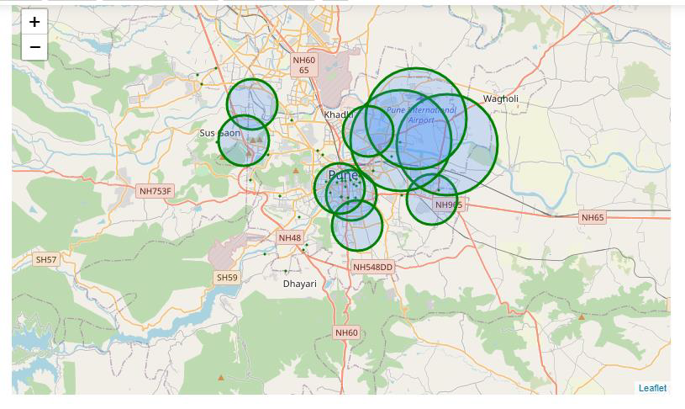
Methodology(contd)
8.To Group By areas to get the mean of Italian Restaurant in Pune .
For better analyzing and clustering areas this step is implemented.
9.To Display a Map where an Area with most Restaurants is displayed in bigger circles.

Slide 11
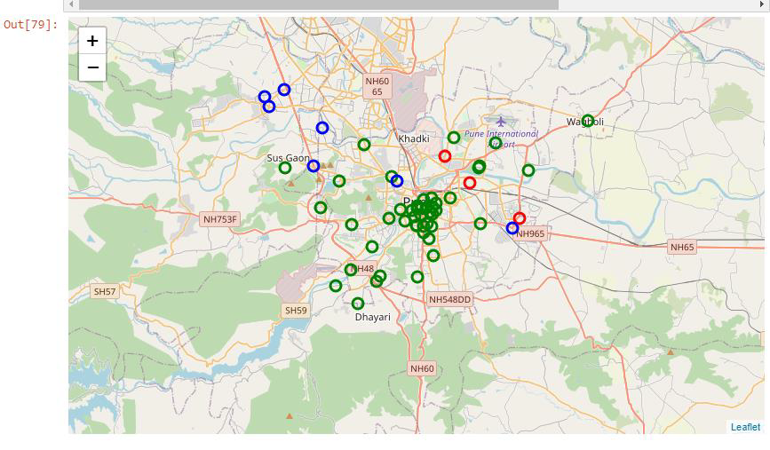
Methodology(contd)
10.Clustering Areas based on Mean of Total restaurants in that particular area.

Slide 12
Result Section
Here we observed that 3 clusters are formed and we need to analyze that which cluster is to be used for decision making.
Ideally 3rd cluster with Shivaji Nagar Area having 0.1 Mean is suitable as it resembles that demand is there but supply is less.
Rather than Magarpatta where Demand and supply both are high

Slide 13
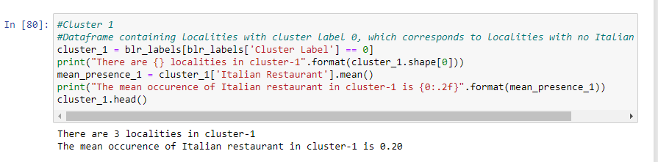
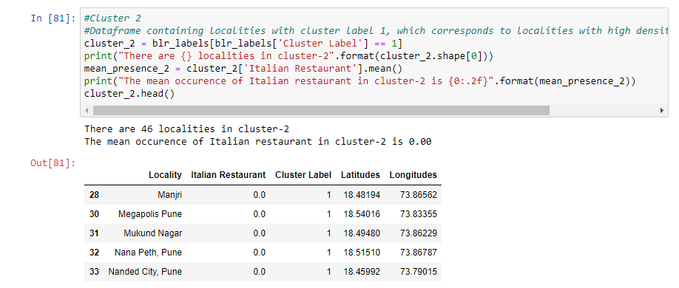
Result section

Slide 14
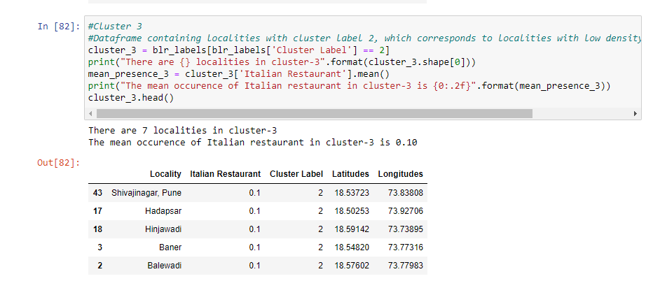
Result section

Slide 15
conclusion
3 Clusters are formed with First and Last Most Significant
1. Thus best Areas to Open Italian Restaurant are Magarpatta,Vishrantwadi,Koregaon Park on basis of Frequency of Italian Restaurants and also this observation seems to be True as these areas are actually good for Italian Restaurant
2. But for A Startup Italian Restaurant with no brand name and less Risk Cluster 3 Seems to be promising as it has a decent amount of Italian Restaurant and that means demand is there but supply is less.
So Shivaji Nagar,Hadapsar,Hinjawadi seems to be more promising for Future Prospective

