Slide 1
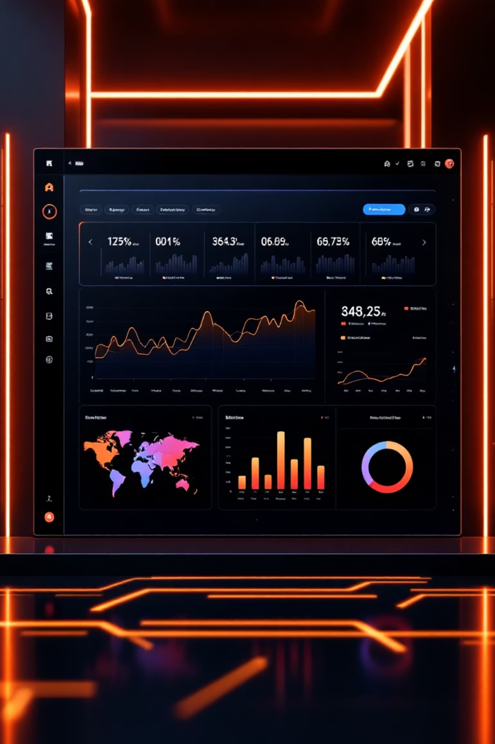
Customer Shopping Behavior Analysis
Uncovering insights from 3,900 purchases to guide strategic business decisions

Slide 2

OVERVIEW
Project Scope
Dataset Size
Customer Data
3,900 transactions analyzed
Demographics, location, subscription status
18 key features tracked
Purchase Details
Behavior Metrics
Categories, amounts, seasons, discounts
Frequency, ratings, shipping preferences

Slide 3

PYTHON
Data Preparation Process
01
02
03
Data Loading & Exploration
Missing Data Handling
Feature Engineering
Imported dataset, checked structure and summary statistics
Imputed 37 missing Review Ratings using category medians
Created age groups and purchase frequency metrics
04
05
Data Consistency
Database Integration
Standardized columns, removed redundant promo code field
Loaded cleaned data into PostgreSQL for analysis

Slide 4

SQL ANALYSIS
Key Business Insights
Revenue by Gender
Shipping Preferences
Male customers: $157,890
Express: $60.48 avg
Female customers: $75,191
Standard: $58.46 avg
Male shoppers generate 2x more revenue
Express users spend slightly more

Slide 5
Top-Rated Products
77%
77%
76%
Gloves
Sandals
Boots
Highest average rating: 3.86
Strong performance: 3.84
Solid ratings: 3.82
76%
76%
Hat
Skirt
Customer favorite: 3.80
Consistent quality: 3.78

Slide 6



Customer Segmentation
Returning
701 customers
18% of base
Loyal
3,116 customers
80% of customer base
New
83 customers
2% of base
Strong loyalty foundation with opportunity to convert returning customers

Slide 7


Subscription Analysis
Key Finding
958 repeat buyers (>5 purchases) are subscribers
27%
Subscription correlates with loyalty
Subscribers
1,053 customers
Avg spend: $59.49
73%
Non-Subscribers
2,847 customers
Avg spend: $59.87

Slide 8
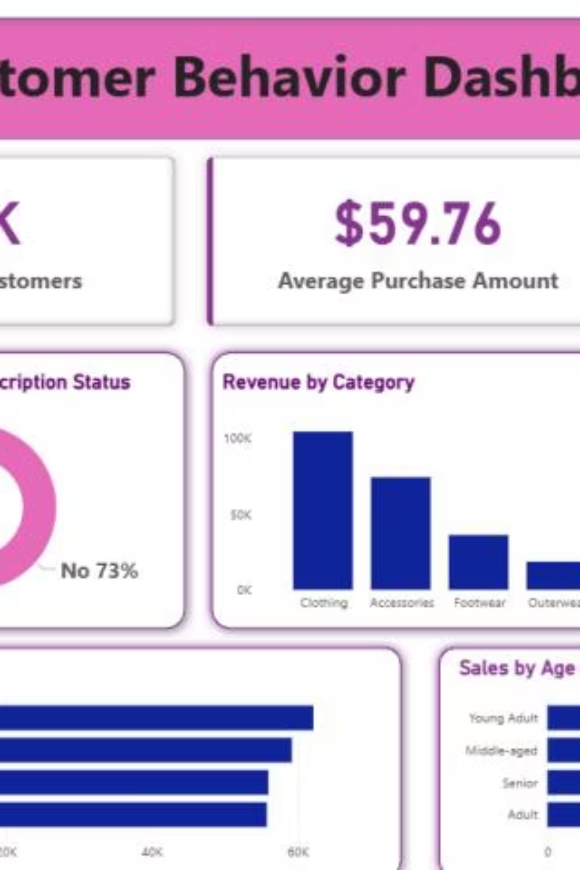
DASHBOARD
Power BI Insights
3.9K
$59.76
3.75
Total Customers
Avg Purchase
Avg Rating

Slide 9

Revenue Distribution
By Category
By Age Group
Clothing: $100K (43%)
Young Adult: $62K
Accessories: $70K (30%)
Middle-aged: $59K
Footwear: $30K (13%)
Adult: $56K
Outerwear: $10K (4%)
Senior: $56K

Slide 10
ACTION ITEMS
Strategic Recommendations
Boost Subscriptions
Loyalty Programs
Review Discount Policy
Promote exclusive benefits to convert 73% non-subscribers
Reward repeat buyers to strengthen loyal segment
839 high-spenders used discounts—optimize margin balance
Product Positioning
Targeted Marketing
Highlight top-rated items like gloves and sandals in campaigns
Focus on young adults and express-shipping users

