Slide 1
Game On!
ECEN 5043 – PSoC Project 3 – Module 4

Slide 2
Tag Team
Jeet Baru jeet.baru@colorado.edu 107189037
Sudeep Kulkarniirlekar suku8854@colorado.edu 106996755

Slide 3
Introduction
In the Module 4 of Project 3, we are required to design a system on either De1-SoC or XILINX PYNQ board make use of its power and flexibility.
We proposed to implement a Game on the De1-Soc device. We planed to implement the game as an application software that runs on linux booted HPS. This application shall communicate with the FPGA fabric via the AXI bus. On the fabric we shall have connections with the Parallel IOs used in 7 segment display and the LEDs.

Slide 4
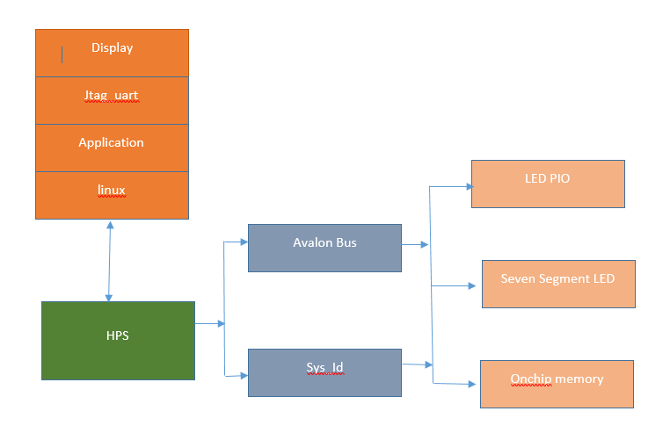
Block Diagram

Slide 5
Hardware Design
The hardware design for our application was done using Qsys in Quartus. We used the available IP blocks and made required connections to create a backbone for our software application to interact.
We built the system on of HPS-LED-HEX project demonstration which is similar to HPS-FPGA demonstration used in Module 3. We added a SEG7_IF block for the 7 segment display connection. And exported the conduit so that it can be used to connect to its module defined in the Verilog top level design.

Slide 6
We have a HPS IP which shall be the master of all connected peripherals. The memory for the HPS is on chip and driven by the Avalon bus.
We also have JTAG UART port which shall be used to display the output of the Linux software and our application to the terminal.
We also have an interrupt capture module that is used to accept user input via the terminal.
Also there is a System ID peripherals IP which takes care of the memory mapping of fabric connected IOs so that it can be used in the application software.

Slide 7
The JTAG to Avalon Master bridge is used as an interface between all connected peripherals and the HPS. The memory mapped master is connected to Parallel IO for LEDs, SEG7 module, Interrupt Capture Module, On chip memory, JTAG UART and HPS.
On completing design in Qsys, we connect the exported conduits in the top level design file, then we make pin assignments and compile our design to generate the .sof to program the device.

Slide 8
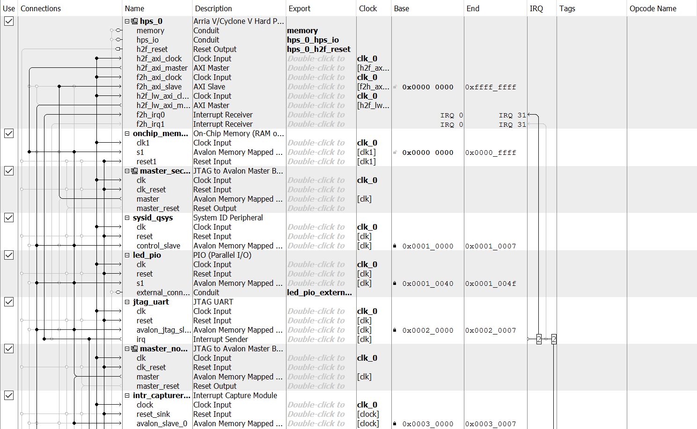

Slide 9
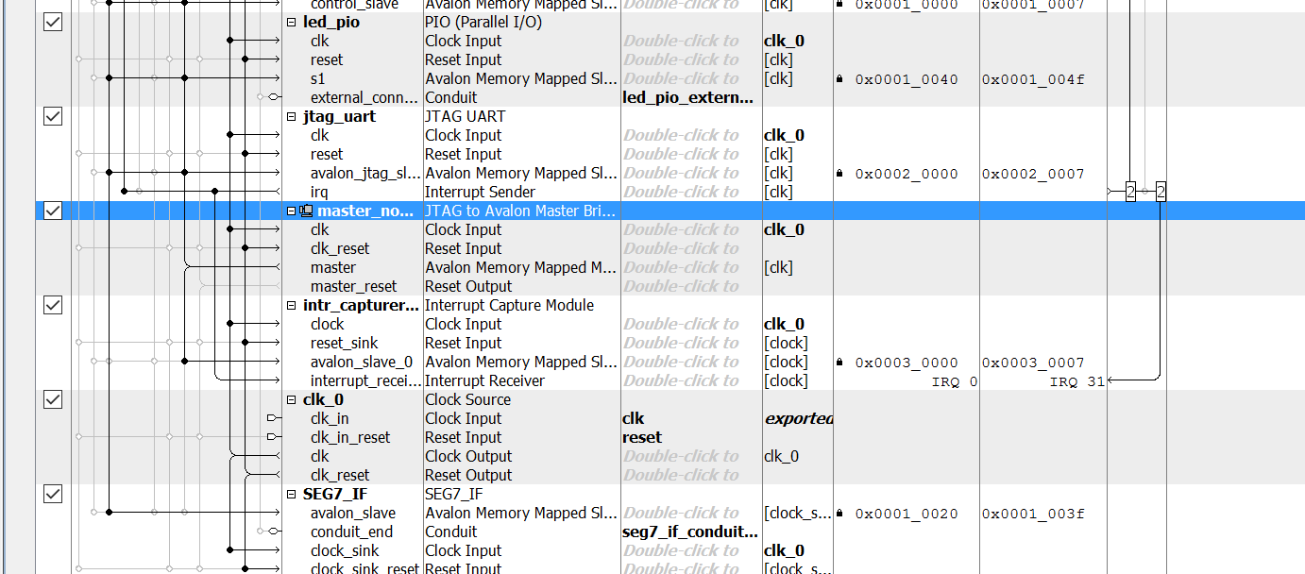

Slide 10
Software Design
Here the bottommost layer of our implementation is taken care by the Qsys design. To run our application software we required a running OS. We hence run Linux – Console on the Arm A9 chip. To load Linux we mount an SD card with a Linux image on it. Since our design has a JTAG UART port connected, we observe the startup on the terminal.
To take care of the virtual memory address for the HPS we shall need a HPS header file that contains MACROs for addresses of the peripheral modules. This header is generated using the shell script provided on the Altera Website, executed in EDS.

Slide 11
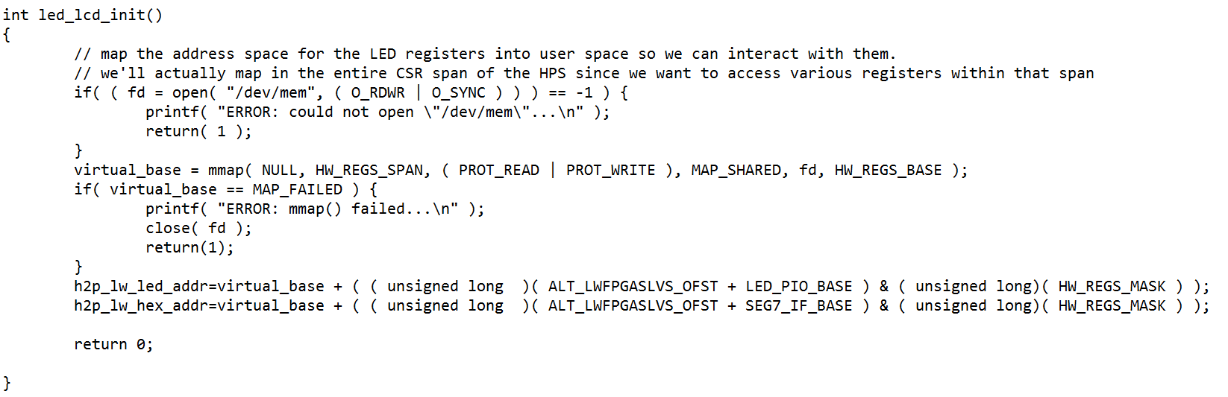
Memory Mapping

Slide 12
LED and HEX display Functions
Now we write functions to display meaningful data on the 7 segment display and LEDs.
Seven segment display can be written to using the function alt_write_word(h2p_lw_hex_addr+index,seg_mask). This function is defined in HW header libraries present the the Quartus directories.
For writing to LEDs we need to write to h2p_lw_led_addr address.
Using the above register and function we wrote meaningful wrapper functions to perform tasks with LEDs and HEX displays.

Slide 13
Makefile
Sample Makefile provided by Altera has few bugs. The addresses for header files are wrong/or refer to a previous version of Quartus install directory.
We hence wrote our own makefile with correct paths for cross compiling our application for the A9 processor with Linux on it.

Slide 14
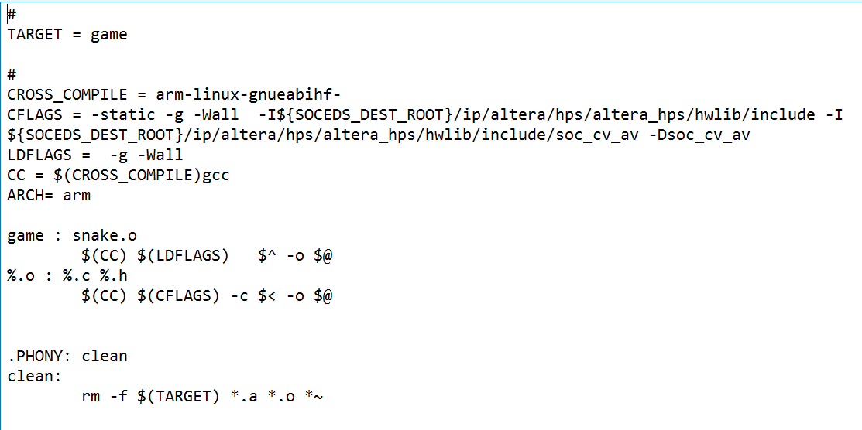

Slide 15
Application Software
We wrote our game application in C. We implemented logic for 3 games: 1. Snakes 2. Tic-Tac-Toe 3. Minesweeper
All three games were tied together under a menu, to ensure good user experience.
All important events in each of the game drive LEDs and HEX displays accordingly.

Slide 16
In the snakes game the 7 segment displays continously updates the user score in the game
In tic-tac-toe the display shows whose turn it is to play next and displays the outcome of the game when completed.
In Minesweeper the player is prompted to play next on the display. Also whether the player won/lost is displayed post the game.
In all 3 games the LEDs function to Blink after the game is completed.

Slide 17
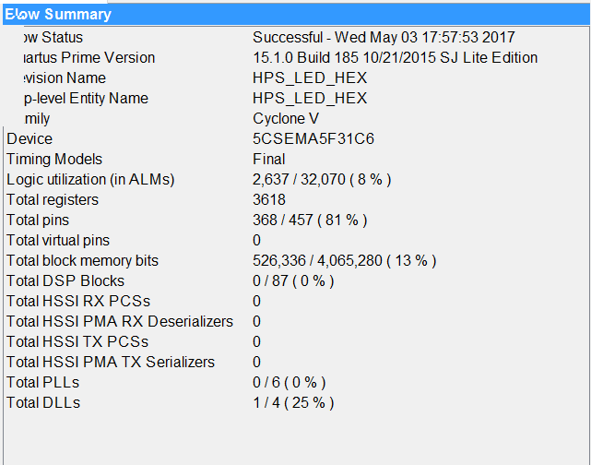
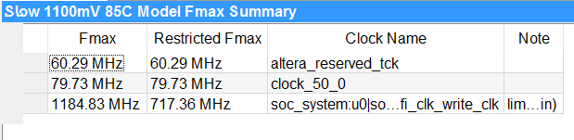
Observation
Percentage utilization : Fmax :

Slide 18
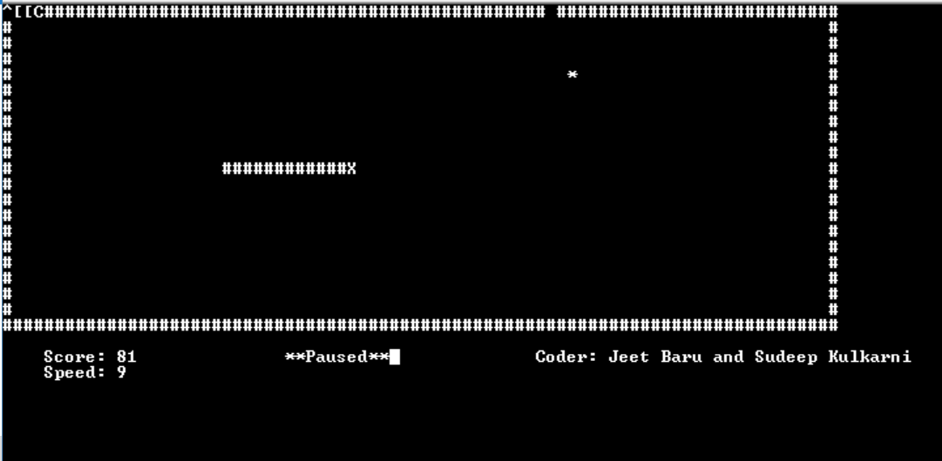
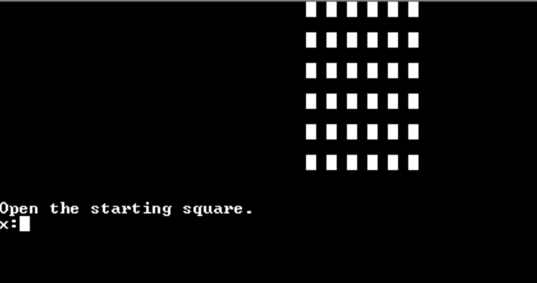
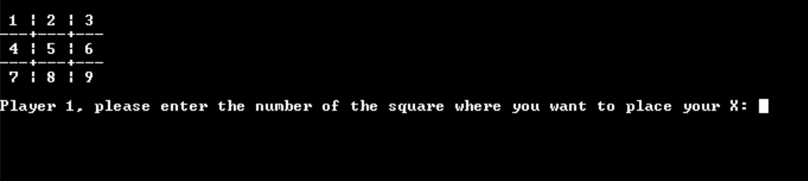
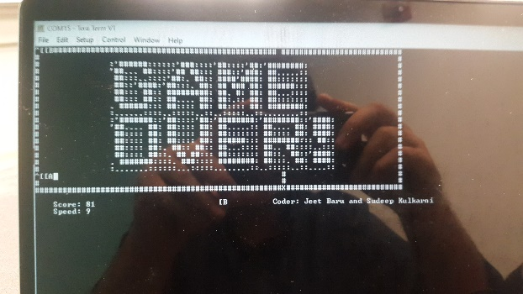
Screenshots of working games
Snake Working Mine-Sweeper
Tic Tac Toe Working Game Over

Slide 19
Demonstration

Slide 20
References
Lab1 pdf: ftp://ftp.altera.com/up/pub/Altera_Material/Laboratory_Exercises/Digital_Logic/DE1-SoC/vhdl/lab1_VHDL.pdf
Lab5.pdf: ftp://ftp.altera.com/up/pub/Intel_Material/Laboratory_Exercises/Digital_Logic/Verilog/lab5.pdf
Getting started with PYNQ: http://pynq.readthedocs.io/en/latest/1_getting_started.html
Using asyncio buttons: https://github.com/Xilinx/PYNQ/blob/master/Pynq-Z1/notebooks/examples/asyncio_buttons.ipynb
HPS LEDs: http://terasic.yubacollegecompsci.com/resources/My_First_HPS-Fpga.pdf
HPS 7-seg: http://blog.embedded.pro/7-segment/
Minesweeper C code reference: http://raitonshiden.weebly.com/uploads/1/7/7/8/17784759/minesweeper_v_1.0.c
Snake C code reference: http://matthewvlietstra.com/data/uploads/Snake_Game/snake.c

Slide 21
Thank You
Questions?

