Slide 1
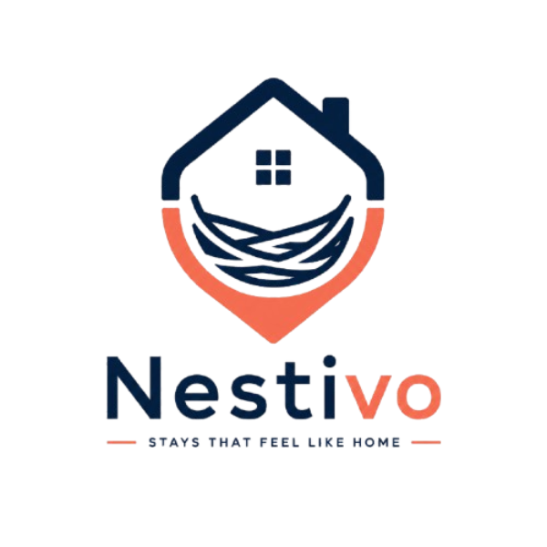
Nestivo Performance Analysis
A dashboard-based review of Nestivo's market presence, pricing, guest ratings, and host trust.
Purpose
Dashboard Pages Included
Understand how Nestivo performs across major global cities
Identify where supply is concentrated and how the business has grown over time
Compare pricing, guest experience, and host trust across the platform
Executive Overview
Ratings & Reviews
Scale, growth, market concentration, and pricing
Overall ratings, detailed dimensions, and seasonality

Slide 2
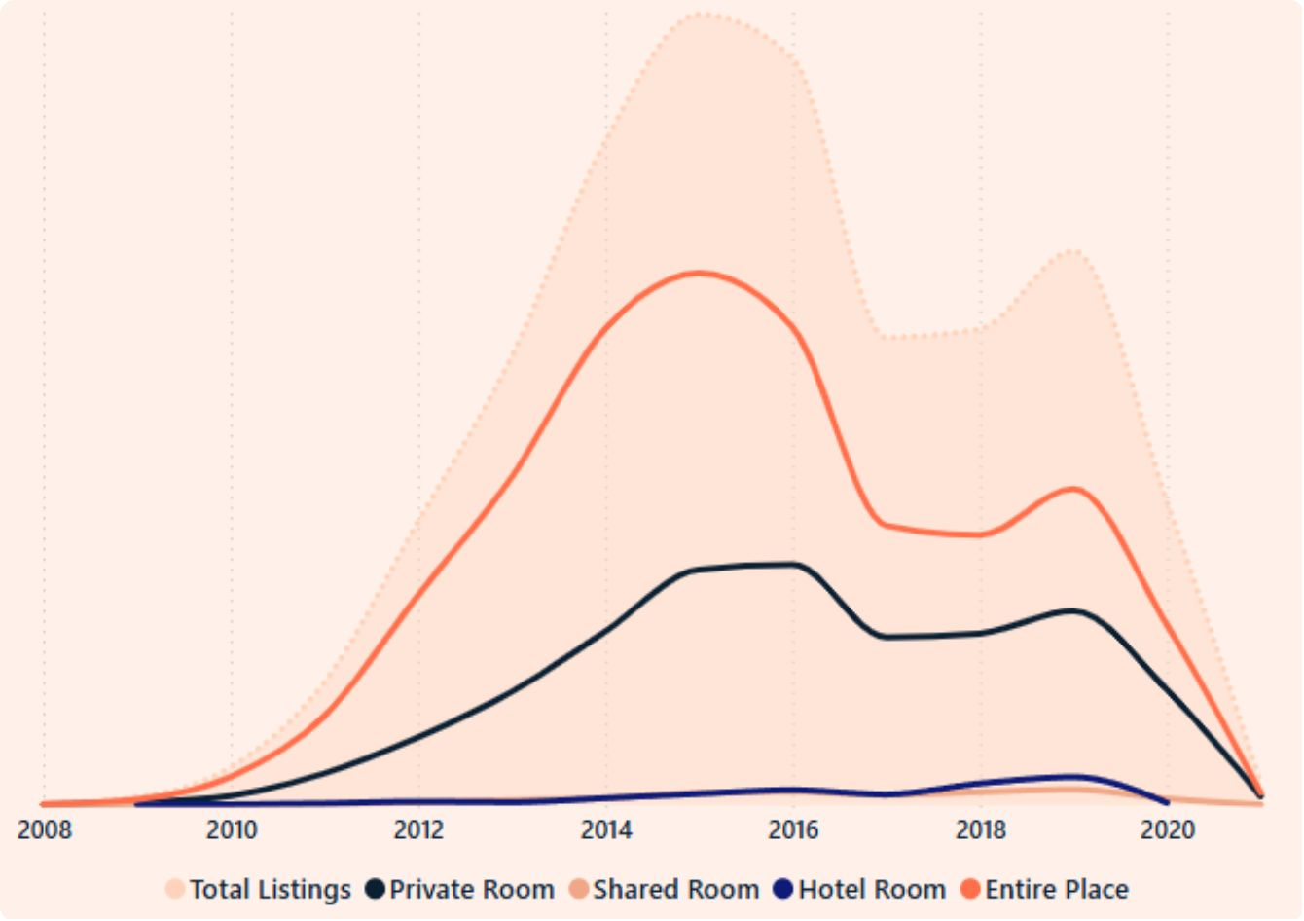

Nestivo's Scale and Growth
Q1: How big is Nestivo's presence across major global cities?
Nestivo shows a large presence with 279,712 listings, 10 cities, 182,024 hosts, 144 property types, and about 5,373K reviews. This shows that the platform already has strong scale and a broad operating base.
Total Listings
279K
Total Hosts
182K
Q2: How has Nestivo grown over time and where did it peak?
Total Reviews
The listings trend starts in 2008, rises sharply through the early and mid-2010s, and peaks around 2015 to 2016. After that, growth slows and the chart shows a steady decline from 2019, which likely reflects the effect of the COVID-19 period.
5.4M
Growth Pattern Observation: Nestivo expanded quickly in its growth phase, but later entered a slower and more stable stage due to global crisis.
Cities
10

Slide 3


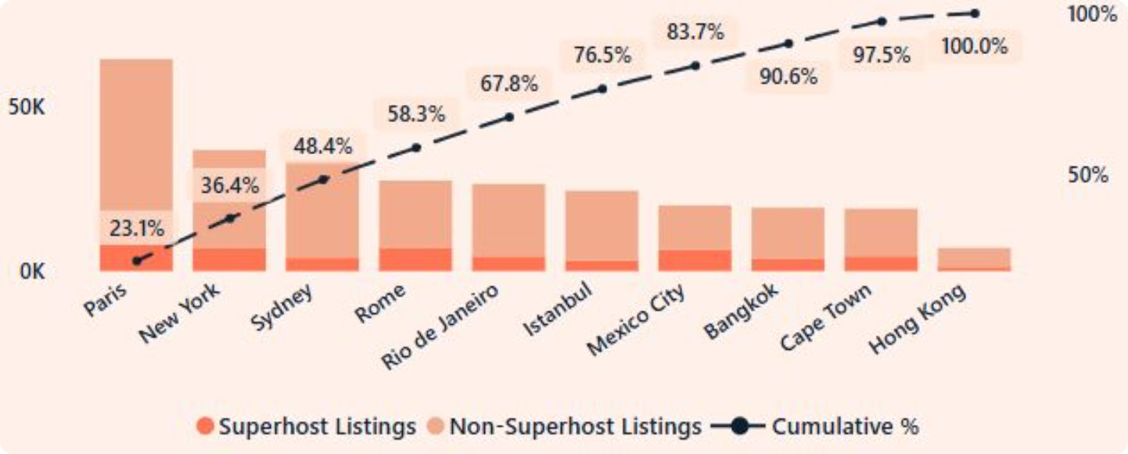
Market Concentration Across Cities
Q1: Which cities contribute most to Nestivo's overall business?
The market share chart shows that Paris, New York, and Sydney contribute the most to Nestivo's supply. Paris is the biggest contributor, making it a core city for the business.
48.4%
67.8%
Q2: Are a few cities driving most of the supply?
Yes. The cumulative share line shows that the top three cities already account for 48.4% of listings, and the top five reach 67.8%. This means supply is concentrated in a small number of cities rather than being evenly spread.
Q3: How much of the total market do top cities control?
Top 3 Cities
Top 5 Cities
The chart shows that the tracked market reaches 100% across the ten cities shown, but the first few cities control a very large portion of that total. This means performance in a few cities has a major impact on the overall business.
Paris, New York, Sydney
Cumulative share

Slide 4
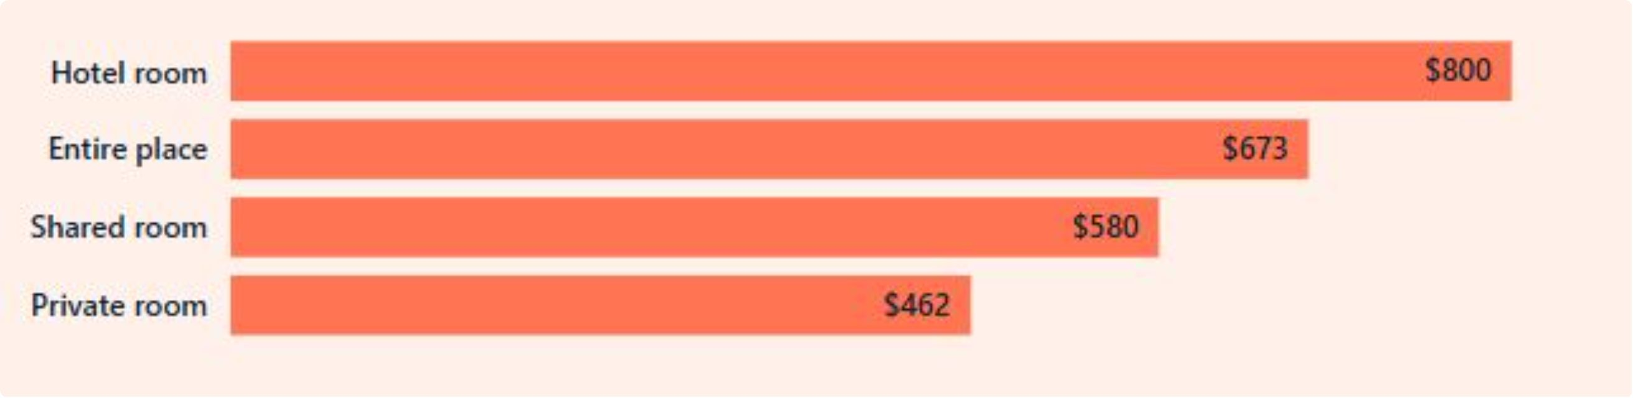

Pricing Insights
Q1: Are hotel rooms more expensive than Nestivo stays?
Q2: What does this price difference mean for the business?
Yes. The average price chart shows a clear hierarchy across stay types. Hotel rooms command the highest price, while private rooms offer the most affordable option.
It shows that Nestivo offers a range of stay types across different price points. This helps Nestivo serve both premium and budget-conscious guests.
$800
$673
Observation & Business Action
Nestivo can use this pricing split to design targeted pricing, promotions, and guest segments. For example, premium cities and room types may support higher margins, while lower-priced categories may help attract more volume.
Hotel Room
Entire Place
Most expensive option
Premium Segment
Volume Segment
$580
$462
Hotel rooms & entire places — higher margins, premium cities
Private & shared rooms — attract budget-conscious guests at scale
Shared Room
Private Room
Most affordable option

Slide 5
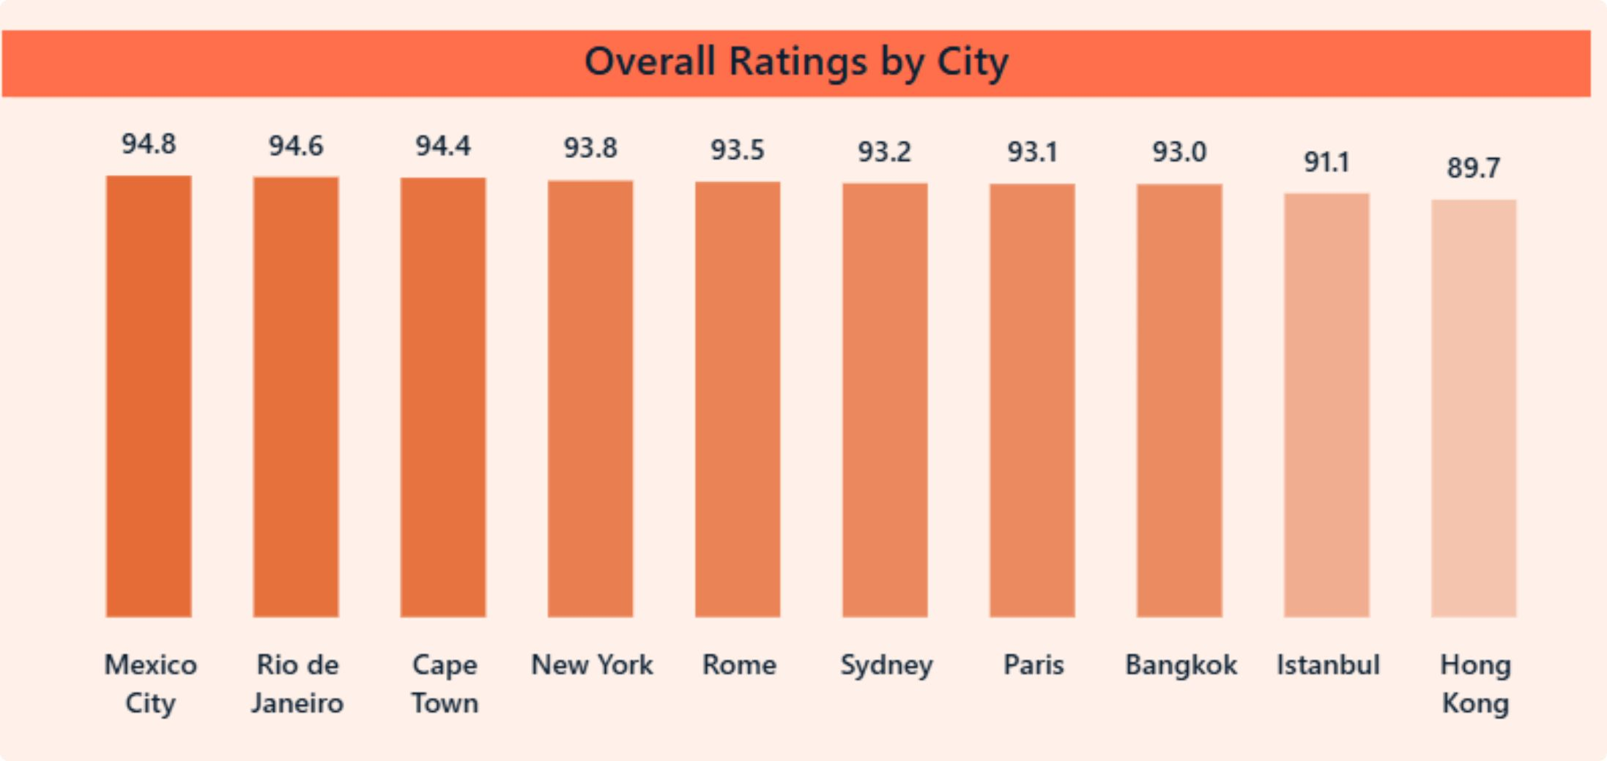


Best and Weakest Cities by Overall Ratings
Q1: Which cities deliver the best overall guest experience?
Q2: Which cities are underperforming on ratings?
The Overall Ratings view shows Mexico City leading with 94.8, followed by Rio de Janeiro at 94.6 and Cape Town at 94.4. These cities represent the strongest guest experience in the dataset.
Hong Kong is the lowest-rated city at 89.7, and Istanbul is also relatively weaker at 91.1. Even though these scores are still strong, they are lower than the rest of the cities and need more attention.
🥇 Mexico City
🥈 Rio de Janeiro
Hong Kong — 89.7
Istanbul — 91.1
94.8 — Top rated
94.6
Lowest rated city in the dataset
Second weakest; below platform average
🥉 Cape Town
Observation: High-rated cities can be used as benchmarks for other locations.
94.4

Slide 6
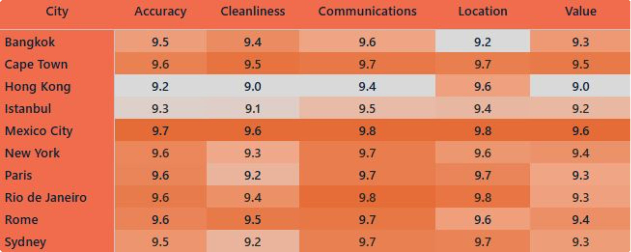

What Drives Rating Differences
Q1: Are low ratings driven by cleanliness, value for money, or communication?
Q2: Is high supply always equal to high quality?
The Detailed Ratings view shows that most cities score above 9.0 across all five dimensions, so there is no single major breakdown. In weaker cities, the softer spots seem to be cleanliness and value, while communication remains relatively strong.
No. The supply chart and the ratings chart do not fully match. For example, Paris is a major supply market, but Mexico City has the best guest ratings. This shows that a city can have a large listing base without being the highest rated.
Cleanliness
Observation & Suggestions
Softest dimension in lower-rated cities
Nestivo should not rely only on supply growth to judge success. It also needs to monitor service quality, guest satisfaction, and local operational standards.
Value
Second area of relative weakness
Paris
Mexico City
Communication
#1 in supply
#1 in ratings
Remains relatively strong across all cities

Slide 7
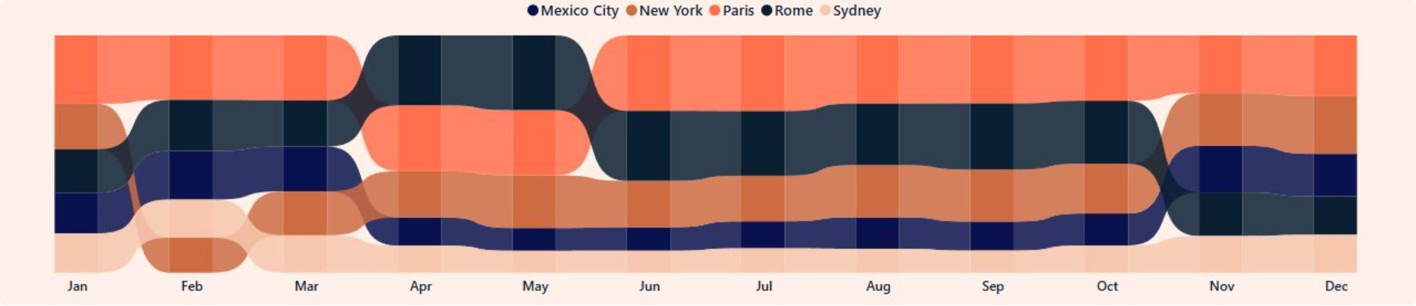

City-Level Performance and Seasonal Patterns
Q1: Which cities peak during which months?
Q2: Do European cities behave differently from non-European cities?
The review seasonality chart shows that the top cities do not peak at the same time. Each city follows its own monthly pattern, which means demand changes by location rather than moving in one universal pattern.
Yes. The monthly patterns show that city behavior is not identical across regions. European and non-European cities have different seasonality patterns, which means Nestivo should use local planning instead of a one-size-fits-all approach.
City-specific seasonality means that a single global promotional calendar will not be effective. Local planning is essential.
European Cities
Non-European Cities
Strategic Implication
Distinct seasonal peaks driven by summer tourism and holiday travel patterns
Different monthly rhythms reflecting local climate, culture, and travel demand
Local planning over global campaigns — each city requires its own demand strategy

Slide 8
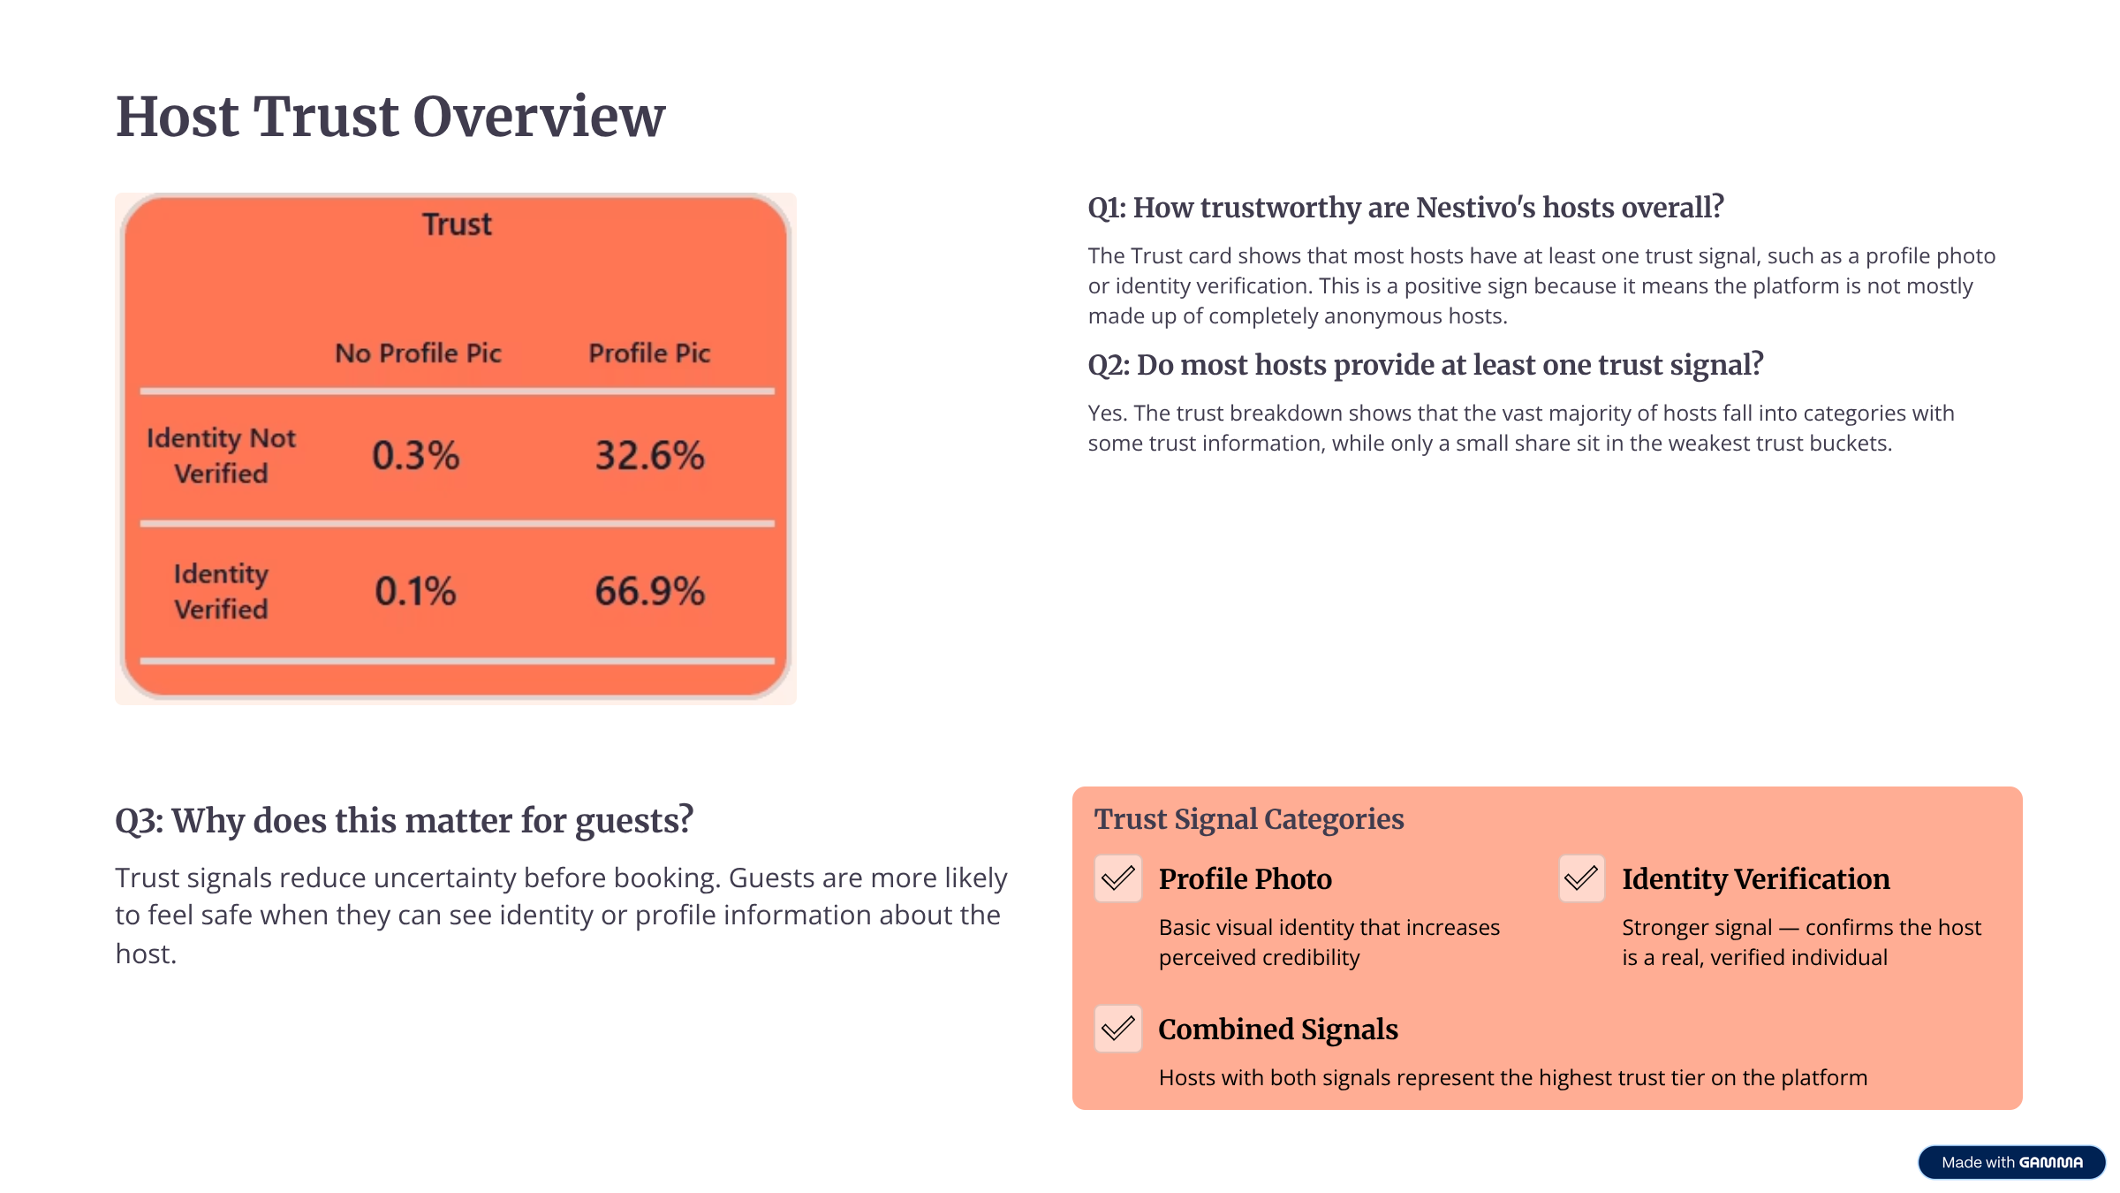
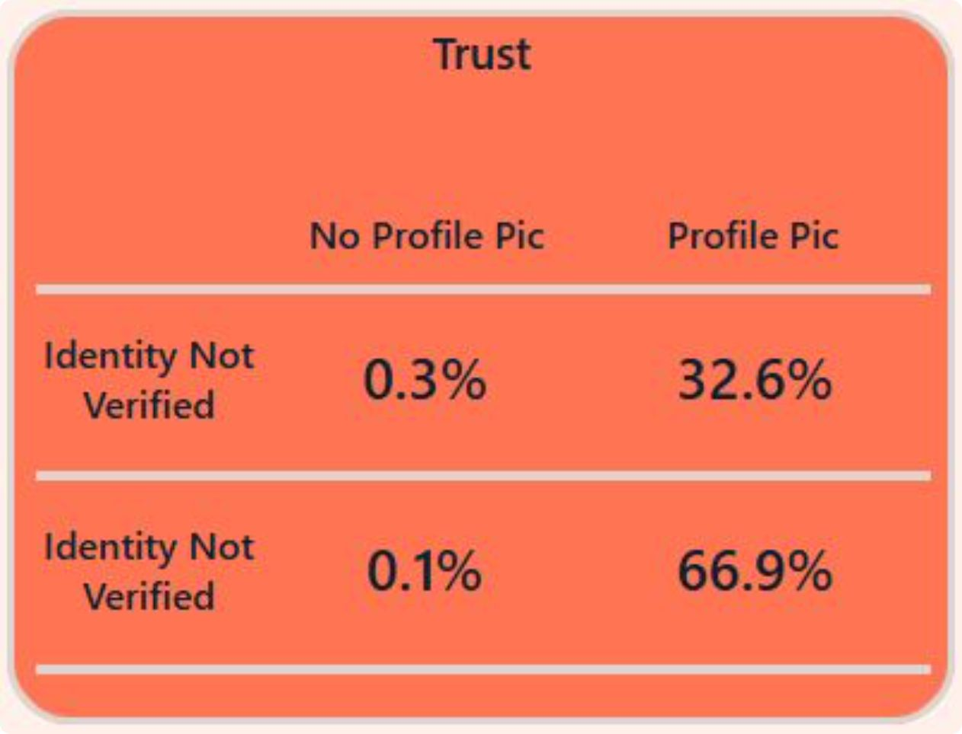

Host Trust Overview
Q1: How trustworthy are Nestivo's hosts overall?
The Trust card shows that most hosts have at least one trust signal, such as a profile photo or identity verification. This is a positive sign because it means the platform is not mostly made up of completely anonymous hosts.
Q2: Do most hosts provide at least one trust signal?
Yes. The trust breakdown shows that the vast majority of hosts fall into categories with some trust information, while only a small share sit in the weakest trust buckets.
Q3: Why does this matter for guests?
Trust Signal Categories
Trust signals reduce uncertainty before booking. Guests are more likely to feel safe when they can see identity or profile information about the host.
Profile Photo
Identity Verification
Basic visual identity that increases perceived credibility
Stronger signal — confirms the host is a real, verified individual
Combined Signals
Hosts with both signals represent the highest trust tier on the platform

Slide 9



Verification and Customer Protection
Q1: What percentage of hosts are fully verified?
Based on the trust visual, the largest trust bucket appears to be around 66.9%. This suggests a strong share of hosts are in the most trusted category, although the visual should be explained carefully because it is presented as a trust matrix.
66.9%
0.3%
Q2: How rare are completely unverified and anonymous hosts?
Completely unverified or anonymous hosts appear to be very rare, around 0.3% in the weakest buckets. That is a good sign for platform trust and account safety.
Fully Verified Hosts
Unverified / Anonymous
Q3: Is Nestivo doing enough to protect its customers?
Largest trust bucket — strongest category
Weakest trust buckets — very rare
Overall, Nestivo appears to have a decent trust baseline, but it should still push more hosts toward full verification. Stronger verification improves guest confidence and strengthens platform safety.
The platform's low rate of anonymous hosts is a meaningful signal of baseline safety — but full verification should remain a strategic priority.

Slide 10

Key Business Takeaways
1
2
Scale with Concentration Risk
Supply ≠ Quality
Nestivo is a large platform with strong presence in a few major cities, but supply is concentrated and not evenly distributed. City-level decisions matter a lot for overall performance.
Paris leads in supply but Mexico City leads in ratings. Nestivo must monitor service quality and guest satisfaction independently from listing volume.
3
4
Pricing Segmentation Opportunity
Trust Baseline is Healthy — But Not Complete
The $338 spread between hotel rooms ($800) and private rooms ($462) creates a clear opportunity for targeted pricing strategies across guest segments.
With ~66.9% of hosts fully verified and fewer than 0.3% anonymous, the platform has a solid foundation. Pushing more hosts toward full verification remains a priority.
Nestivo's Next Focus
The Overall Story
Strengthen core cities, improve weaker rating areas like cleanliness and value, and continue increasing host verification. These actions can improve both guest satisfaction and trust.
The analysis shows that Nestivo has scale, market concentration, strong guest ratings in several cities, and a generally healthy trust base. The main opportunity is to use this insight to improve weaker cities, improve consistency, and make the platform safer and more reliable.

