Slide 1

A Presentation on
☕ COFFEE-MACHINE ☕
Gaikwad N. Jeet
B-tech sem-3 (CE)
Roll no: 01
Enrollment No: 22002170120010

Slide 2
About the project
This project is designed to simulate the functions of a real coffee machine, where the user can select their desired coffee type and the machine will grind, brew, and dispense the coffee accordingly.
The idea for the project
This project contains functionality like starting and stopping the machine, different types of coffee, managing inventory and payment processing.
Functionality
Components
Used
We used in- built modules, libraries and also the class module created.

Slide 3
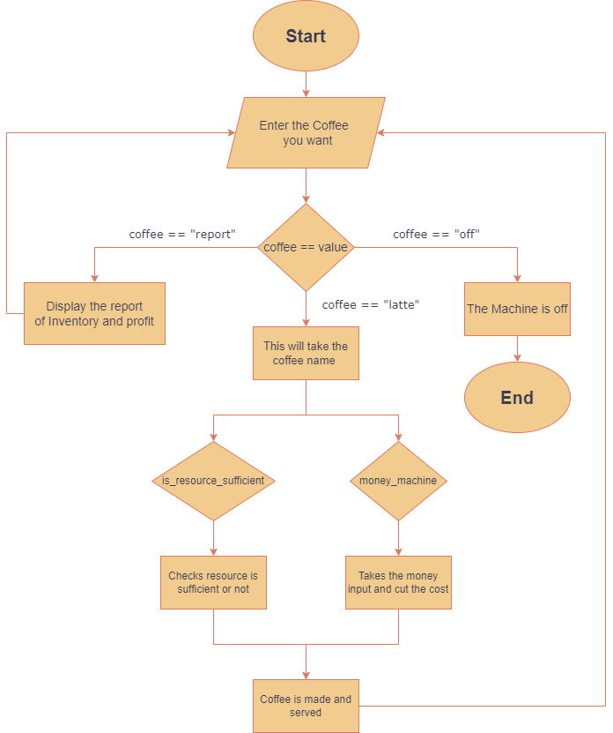
Flowchart

Slide 4
Merits
Demerits
Automation of coffee-making process makes it more efficient and convenient for user.
Very convenient way of making a coffee.
It creates opportunities for learners and programmers.
Complexity of code
Maintenance and safety of machine is crucial
Very Expensive

Slide 5
Future Scope:
The project can be customized to allow users to select their preferred type of coffee, strength, and other options to create a personalized experience.
Integration with IoT devices can allow users to remotely control their coffee machines using their smartphones or other devices.
The use of voice assistants such as Amazon's Alexa or Google Assistant can enable users to control their coffee machines using voice commands.

Slide 6
Thank You
Insert the Sub Title of Your Presentation

