Slide 1


Remote Desktop Control
Name: Gaikwad Jeet
Roll No: 55
Enroll No: 22002170120010
Batch: A2
Branch: CE

Slide 2
Introduction
The project on remote desktop control using Java focuses on creating an application that connects and accesses remote devices using their IP addresses.
This allows users to establish a secure connection to control and monitor remote systems directly from their local devices.
By leveraging IP-based connections, the application provides straightforward access to remote devices, showcasing Java's potential for developing efficient and secure remote desktop control solutions.

Slide 3
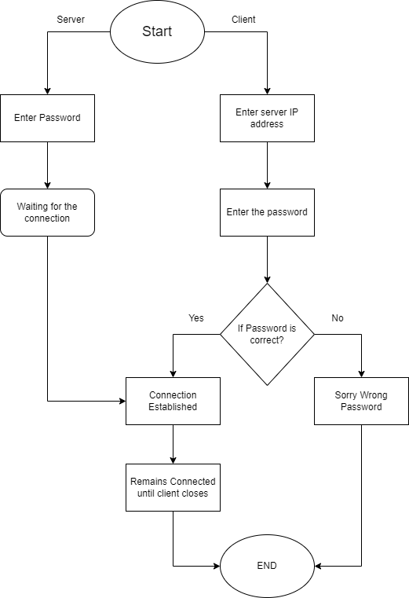
Flow-chart

Slide 4
Functionality
Connection and Access: Establishing a secure connection to remote devices using their IP addresses, allowing users to access and control remote systems from their local devices.
Real-Time Screen Sharing: Providing live view and control of the remote desktop, enabling efficient monitoring and interaction.
Encrypted Communication: Ensuring data safety and privacy by using encryption for secure transmission between the local and remote devices.
The project offers a straightforward way to access remote devices over the network, providing users with the ability to control and monitor systems remotely with ease.

Slide 5
Merits
Demerits
Users can access and control remote devices from any location.
Provides live view and control of remote desktops.
Encryption protects data during transmission.
Works across various operating systems.
Optimized for smooth performance even on slower networks.
Quality depends on network speed and latency.
Potential vulnerabilities if not properly secured.
Handling different systems and devices can be challenging.
May consume significant network bandwidth and CPU resources.
Requires careful management of user access and permissions.

Slide 6
Thanks!
Does anyone have any questions?

