Slide 1
The handler
(webcam based gesture control tool)
by
The handlers
Kavyaa Sheth (AU-1741010)
Muskan Matwani (AU-1741027)
Jeet Shah (AU-1741085)
Course:- Artificial Intelligence, Cloud Computing
Instructor:- Dr. Mehul Raval, Dr. Sanjay Chaudhary
Teaching Assistant:- Mr. Aayush Shah

Slide 2
TABLE OF CONTENTS
01
02
03
INTRODUCTION
GanTT chart
PROBLEM Statement

Slide 3
TABLE OF CONTENTS
04
05
06
EXISting body of work
APPROaCH
FINAL RESULTS

Slide 4
TABLE OF CONTENTS
07
08
09
Conclusion
Role of each group member
REFERENCES

Slide 5
INTRODUCTION
Cumbersome method of interacting with computer
Non-intuitive and less efficient
Gesture based control
Computer Vision approach for devising a solution
Use of cloud computing to deal with computation and provide cost effectiveness
Use of cloud as platform and providing service from cloud

Slide 6
PROBLEM Statement
Need to recognise different hand gestures and track them.
Need to control mouse and keyboard function using python libraries.
Customisation for each user in terms of gesture designated to each class.

Slide 7
Gantt Chart
Click on above for
GANTT Chart

Slide 8
EXISting body of work
Existing literature suggests that 2D-CNNs were widely used in image detection tasks, which was further used for video analysis purposes.
Limitation of 2D-CNNs: high computational costs and failed to capture temporal information. To overcome this limitation, 3-D CNNs were proposed.
The authors of [1] trained different 3D-CNN models (ShuffleNet, MobileNet, SqueezeNet) on classic datasets to perform hand gesture detection.
The authors of [7] proposed a different architecture that contains 2 parts- detector and classifier and trained the 3D-CNN model on the ego-gesture and NVIDIA dynamic hand gesture datasets.
Our approach gives user the flexibility of setting up their own gestures by leveraging the concept of transfer learning.
In addition, object tracking was explored using two object classifiers - Haar Cascade [10] and YOLO algorithm.
Our approach uses YOLO algorithm with the transfer learning model as pretrained model of YOLO gives better accuracy.

Slide 9
Approach

Slide 10
Data Collection and Data preprocessing on Client Side
User to perform gestures for each of the predefined classes for a specific number of times.
Apply temporal transformation on the collected frames for each of the samples obtained for each of the predefined classes to extract 16 frames for each of the samples.
Eg: there are 5 classes (mouse control). Each class contains 5 samples (number of times user has to perform that gesture). Each sample contains 60 frames for 2 seconds (assuming 30 fps). Temporal transformation selects 16 frames out of 60 frames per sample to match the temporal dimension to that of the model. At last, the data is zipped.
2. Model Training on the Server Side
Dataset that came in request body of the REST API is extracted according to the correct naming convention that includes classname, sample number and the frame numbers.
Data Augmentation: Dataset is increased using various data augmentation techniques for a good fit. These techniques include - Blurring, changing contrast, changing brightness, cropping image using 5 ways of crop-centre, Top left, Top right, Down left, Down right. Techniques related to orientation change were discarded.

Slide 11
Transfer Learning: Used to customize the model to train with the given user gestures to perform the control tasks. Implemented by tuning the last layer (classifier) of MobileNetV2 model to output the number of classes according to the user dataset. Dropout layer is also implemented before the classifier layer to avoid overfitting.
Hyperparameter Tuning decision factors: Learning Rate - Loss Curves (GridSearch), Number of Epochs - Loss Curves (GridSearch) and response time, Batch Size - GPU resource limitations
Pretrained Dataset - The 20BN-jester Dataset V1 [27 classes, 148092 videos]
Automatic mixed precision (Autocasting + Gradient Scaling) : used while training and reduced GPU consumption by approx. 30%.
3. Inference/Prediction on the Client Side
Client side scripts extracts the model sent by the server to use it for predicting the live gestures performed by user using Webcam.[~200 ms inference time]
The script runs the webcam infinitely to capture the user’s gestures and gives it as an input to the extracted model. The model outputs the classname which is among the predefined mouse control classes with its confidence.
Certain control actions such as horizontal or vertical scrolling additionally uses a OpenCV based YOLOv3[10] for hand tracking. [~150ms inference time]
1.5+0.5 minutes

Slide 12
4. Server Setup
Apache as HTTP Server. [Reverse Proxy Mode]
File size limit, Request Timeouts, Unix Domain Socket
Gunicorn as Web Server Gateway Interface for python.
Gevent workers, Worker Timeouts
Flask as micro framework to serve to code as a REST API.
AWS EC2 t2.micro instance as public facing server.
SSH Tunnel to Local Machine.
Similar to ngrok, localtunnel.me
SSH Timeouts.
No-ip as Dynamic DNS with hostname: thehandler.hopto.org
Flowchart
Sequence Diagram
Architecture

Slide 13
Final results
Click on above for
Simulation, Code, Report, PPT, Diagrams

Slide 14
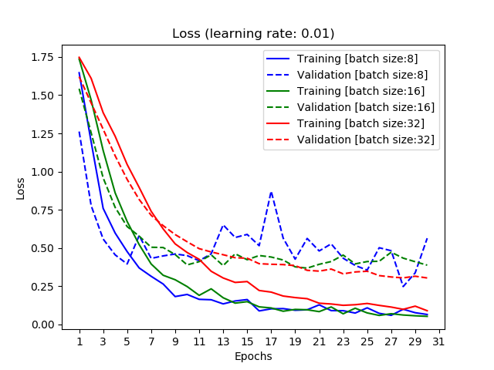
Hyper-parameter tuning

Slide 15
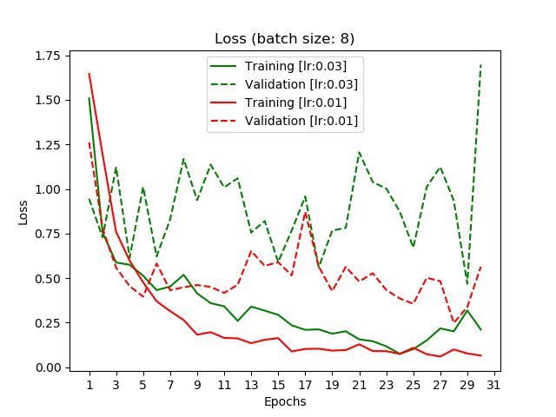
Hyper-parameter tuning 2

Slide 16
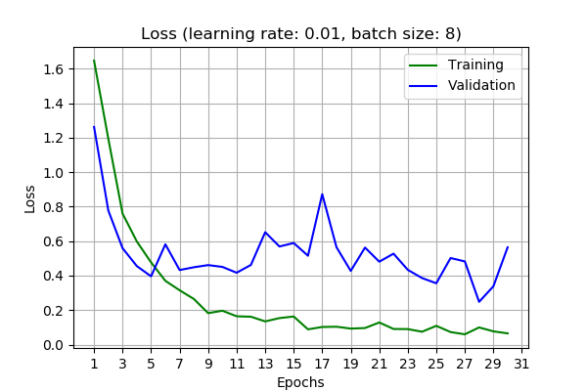
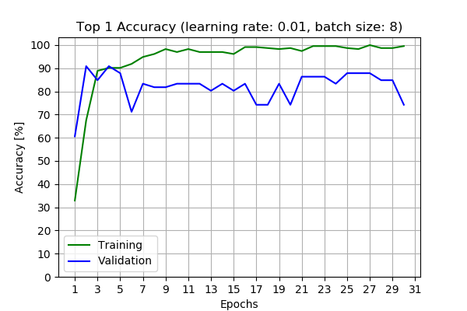
Loss and accuracy curves

Slide 17
conclusions
Training Accuracy - 90%, Validation Accuracy - 88% [batch size = 5, learning rate = 0.01]
Publicly accessible service to train the hand gesture recognition model
Users can perform scroll up, scroll down, scroll right, scroll left, zoom in, zoom out, next slide and previous slide
Future work:
Client side GUI
Reduce model over-fitting
Allow more function like selection of text, copy, paste, etc.

Slide 18
Role of each group member
Jeet Shah - Hand gesture recognition transfer learning model, dataset exploration, data preprocessing and augmentation, Public Server Setup, Documentation, PPT, Literature Review, CC Architecture diagram
Muskan Matwani - Hand gesture recognition transfer learning model, data preprocessing and augmentation,Public Server Setup, Documentation, PPT, Flowchart, Literature Review
Kavyaa Sheth - Pyautogui, OpenCV Hand tracking, Public Server Setup, Documentation, PPT, Flowchart, Sequence diagram, Literature Review
[For a more detailed information, kindly look at GANTT Chart]

Slide 19
References
[1] Okan Kop¨ uklu, Neslihan Kose2, Ahmet Gunduz1, Gerhard Rigoll1 (2019): Resource Efficient 3D Convolutional Neural Networks
[2] J. Donahue, L. Anne Hendricks, S. Guadarrama, M. Rohrbach, S. Venugopalan, K. Saenko, and T. Darrell. Long-term recurrent convolutional networks for visual recognition and description. In Proceedings of the IEEE conference on computer vision and pattern recognition, pages 2625–2634, 2015.
[3] Molchanov, P.; Yang, X.; Gupta, S.; Kim, K.; Tyree, S.; Kautz, J. Online Detection and Classification of Dynamic Hand Gestures with Recurrent 3D Convolutional Neural Network. In Proceedings of the IEEE Conference on Computer Vision and Pattern Recognition, Las Vegas, NV, USA, 27–30 June 2016; pp. 4207–4215.
[4] Jester Dataset: https://20bn.com/datasets/jester/v1
[5] A. G. Howard, M. Zhu, B. Chen, D. Kalenichenko, W. Wang, T. Weyand, M. Andreetto, and H. Adam. Mobilenets: Efficient convolutional neural networks for mobile vision applications. arXiv preprint arXiv:1704.04861, 2017.
[6] F. N. Iandola, S. Han, M. W. Moskewicz, K. Ashraf, W. J. Dally, and K. Keutzer. Squeezenet: Alexnet-level accuracy with 50x fewer parameters and¡ 0.5 mb model size. arXiv preprint arXiv:1602.07360, 2016.
[7] Kopuklu, Okan & Gunduz, Ahmet & Köse, Neslihan & Rigoll, Gerhard. (2019). Real-time Hand Gesture Detection and Classification Using Convolutional Neural Networks.
[8] Okan Köpüklü, Ahmet Gunduz, Neslihan Kose, Gerhard Rigoll, "Online Dynamic Hand Gesture Recognition Including Efficiency Analysis", Biometrics Behavior and Identity Science IEEE Transactions on, vol. 2, no. 2, pp. 85-97, 2020.
[9] Dinh-Son Tran, Ngoc-Huynh Ho, Hyung-Jeong Yang * , Eu-Tteum Baek, Soo-Hyung Kim and Gueesang Lee (2019). Real-Time Hand Gesture Spotting and Recognition Using RGB-D Camera and 3D Convolutional Neural Network.
[10] P. Viola and M. Jones, ”Rapid object detection using a boosted cascade of simple features,” Proceedings of the 2001 IEEE Computer Society Conference on Computer Vision and Pattern Recognition. CVPR 2001, Kauai, HI, USA, 2001, pp. I-I, doi: 10.1109/CVPR.2001.990517 [11] S. Rath, "Automatic Mixed Precision Training for Deep Learning using PyTorch", DebuggerCafe, 2020. [Online]. Available: https://debuggercafe.com/automatic-mixed-precision-training-for-deep-learning-using-pytorch/. [Accessed: 01- Nov- 2020].
[12] "cansik/yolo-hand-detection", GitHub, 2020. [Online]. Available: https://github.com/cansik/yolo-hand-detection. [Accessed: 04- Nov- 2020].

Slide 20
THANKS!

