Slide 1
SAATHI
Your Own Agriculture Expert
AI based Alternate Crop Recommendation
Problem Description
Artificial Intelligence (AI) based Alternate Crop or Crop Rotation proposition is desired for providing suggestions for alternate crops which may increase profitability of the farmers. The system may consider parameters of good agricultural practices. Obtain soil type, water requirement / availability, seasonal parameters (temperature ranges, humidity, etc.) along with location and advise the best crops suitable along with what is required (quality / quantity of seeds, fertilizers, pesticides, labour requirements, animal / machines), duration of cultivation, demand, cost of cultivation and expected revenues / profits.

Slide 2








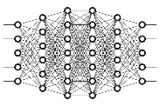
Workflow Diagram
DATABASE-A
DATABASE-D
RECOMMADER
MODEL
SIMPLE MODE
SILECTIVE MODEL
Location
Service
USER
STRAIGHT FORWORD MODEL
OUTPUT
GRAPHICAL REPRESENTATION
ADVANCE MODE
A_SELECTIVE MODEL
DATABASE-C
DATABASE-B

Slide 3
SIMPLE MODE
Less Input from User
ADVANCE MODE
More Specific Input from User
User Mode
Reverse Analysis
After considering inputs from user and database this model also considers privious products (Past 3 Years crops) which is helping it to predict the next alternate crop in favour of user.

Slide 4
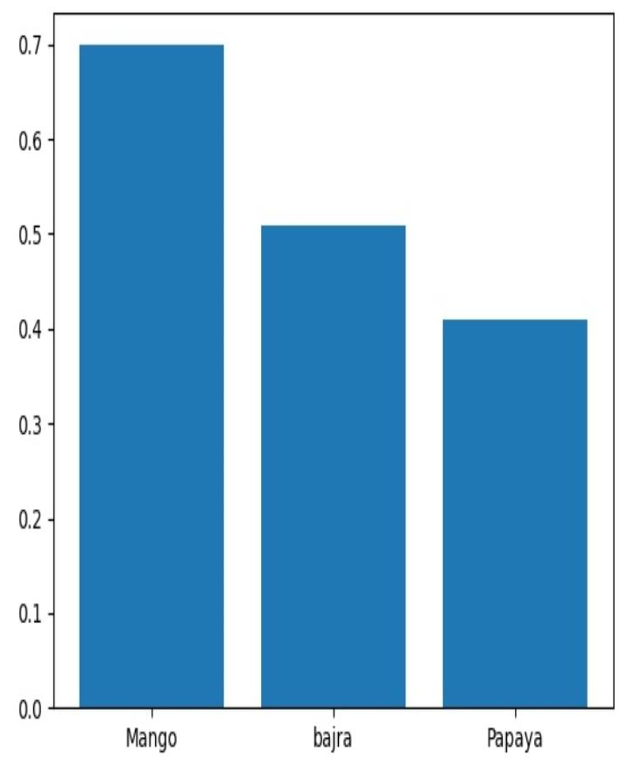
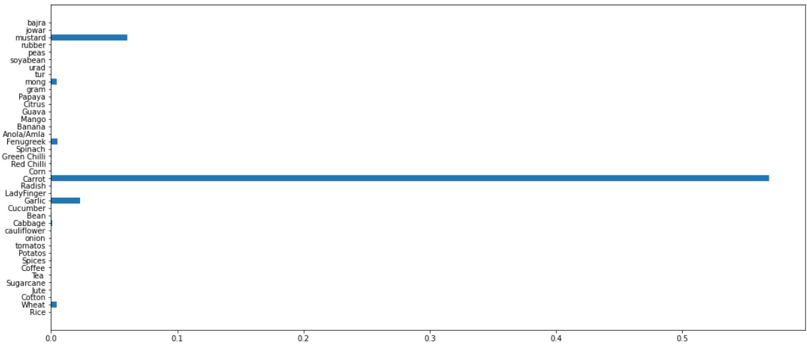
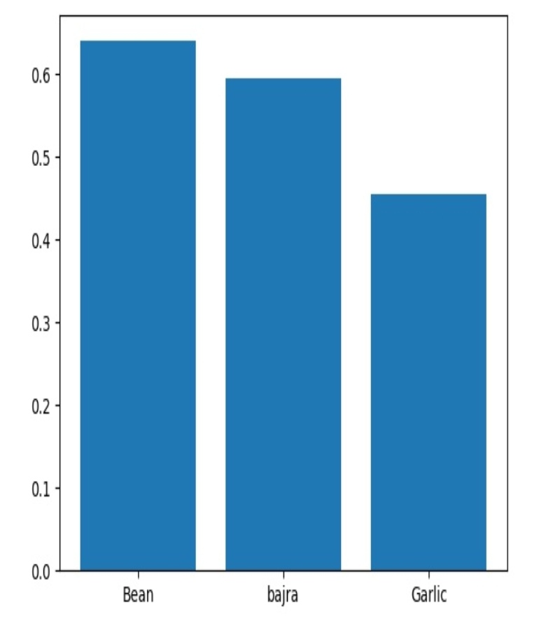
Real Test Cases
Mango Tree Garden
Carrots in Punjab
Gujarat - Winter
Gram
Cotton
Tur
Garlic

Slide 5
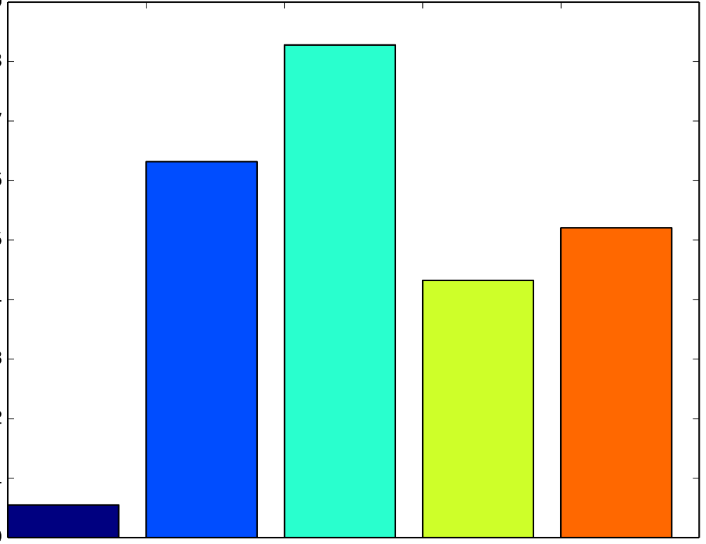
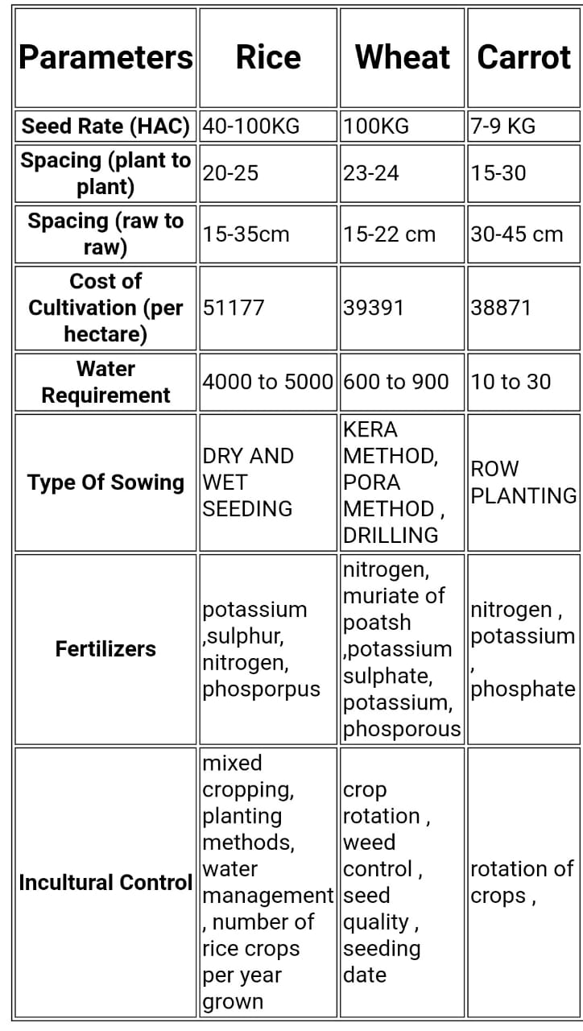
Graphical Representation of Output
Extra Information
(Comparision of Recommanded Crops)

Slide 6
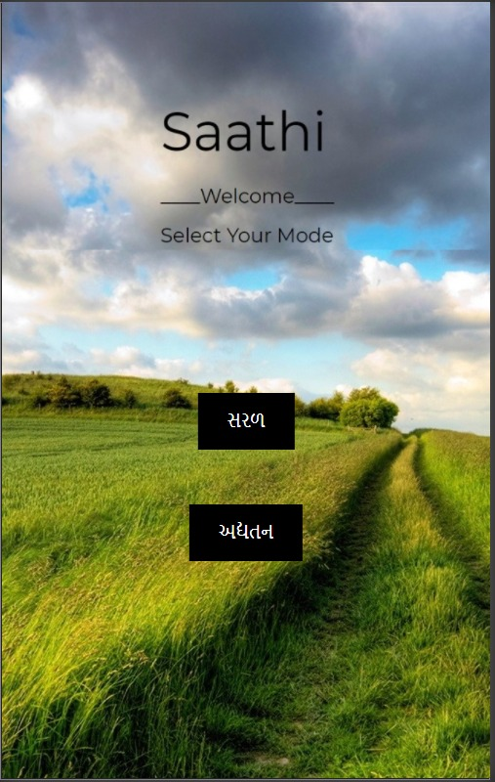

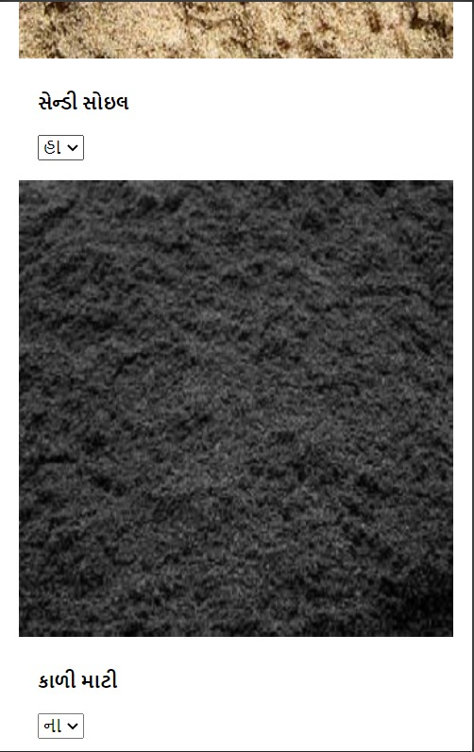
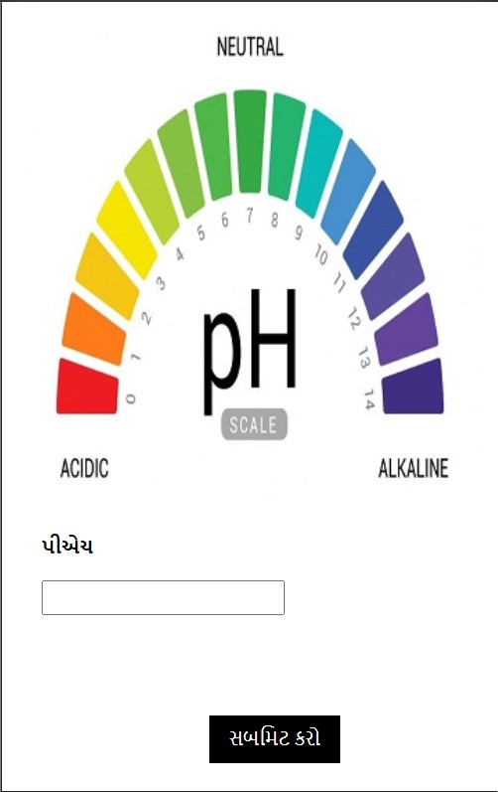
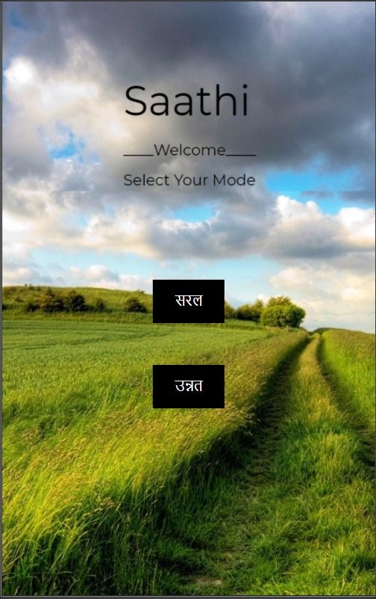

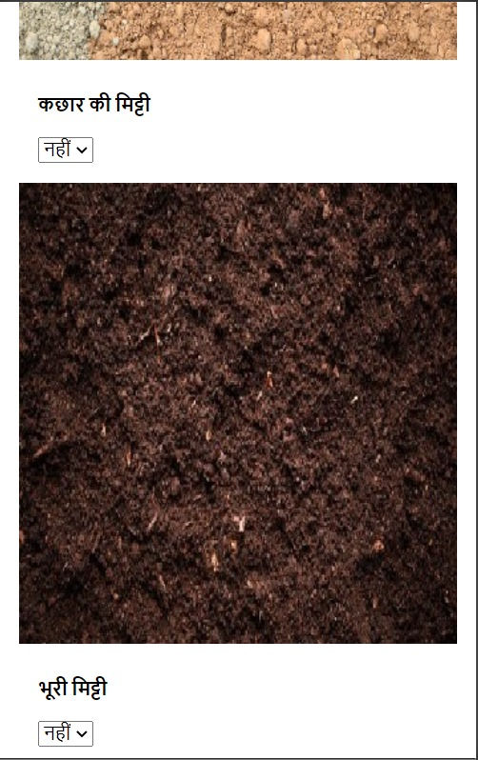
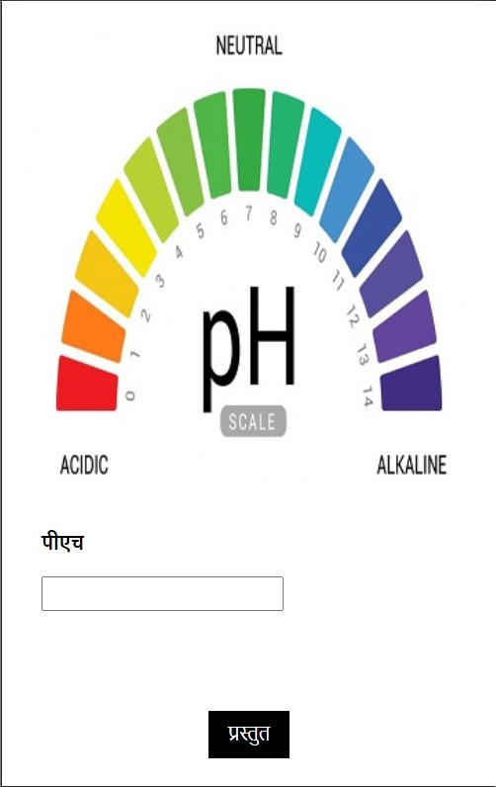
Local Language Support (Gujarati/Hindi)

Slide 7
THANK YOU

