Slide 1
EMPLOYEE SALARY PREDICTION
CAPSTONE PROJECT
Presented By:
Name:- Jeet Majumdar
University:- Jadavpur University
AICTE ID:- STU644e158f20a751682838927
Department:- Chemical Engineering

Slide 2
OUTLINE
Problem Statement
System Development Approach
Algorithm & Deployment
Result
Conclusion
References

Slide 3
Problem Statement
This project is designed to predict whether an individual earns more than $50K per year, based on a combination of personal and work-related attributes. It leverages features such as age, education level, occupation, and weekly working hours to train a classification model.
The model is developed using the UCI Adult Income dataset and incorporates both machine learning and deep learning techniques. Its primary goal is to support organizations in making data-driven decisions around compensation strategies.
An interactive web application, built with Streamlit, enables both single-instance and batch predictions for user-friendly deployment.

Slide 4
System Approach
System requirements:
OS: Windows 10/11, macOS, or any Linux-based system
Python Version: Python 3.9 or higher (recommended: Python 3.10+)
RAM: Minimum 4 GB (8 GB or more recommended for faster performance)
Storage: 512GB SSD – fast read/write for handling datasets and model files
GPU (Optional): NVIDIA GeForce GTX/RTX – helpful for large-scale ML or deep learning (not required here)
Software: VS Code with Jupyter Extension, Jupyter Nootebook or Google Colab Notebook
Internet Browser: Google Chrome or MS Edge (to run and test Streamlit web app)
Library required to build the model:
pandas
Numpy
matplotlib
scikit-learn
seaborn
Joblib
Streamlit

Slide 5
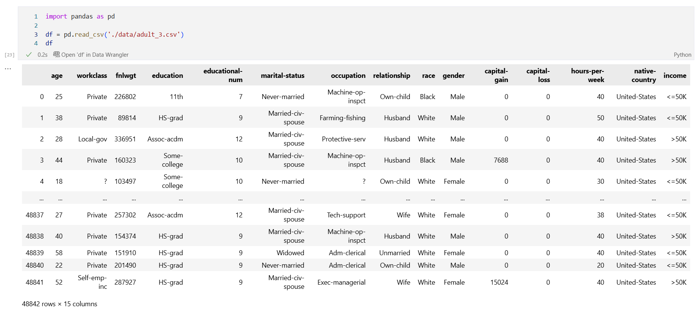
Algorithm & Deployment
Data Collection:
Import the salary dataset (adult_3.csv) containing job-related and personal features.

Slide 6
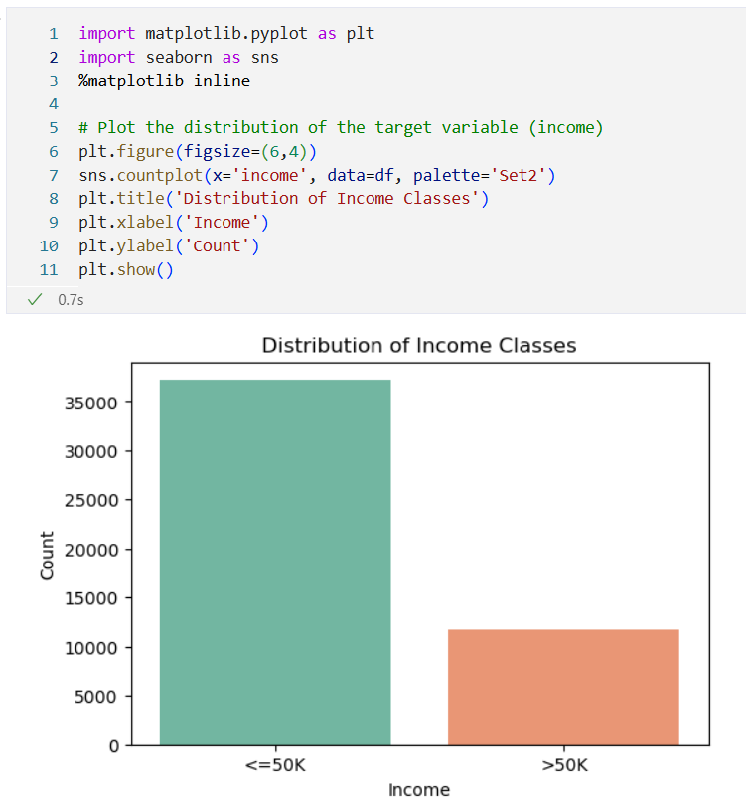
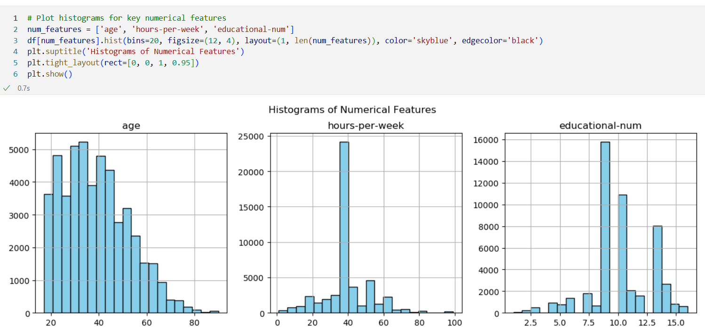
Algorithm & Deployment
2. Data Visualization:
Visualize the data to better understand feature distributions and relationships.

Slide 7
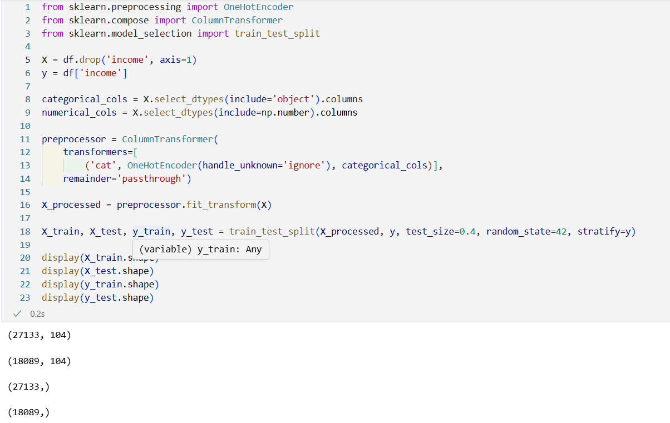
Algorithm & Deployment
3. Data Preprocessing:
Handle missing values, if any.
Encode categorical variables (e.g., job title, location, education level) using Label Encoding.

Slide 8
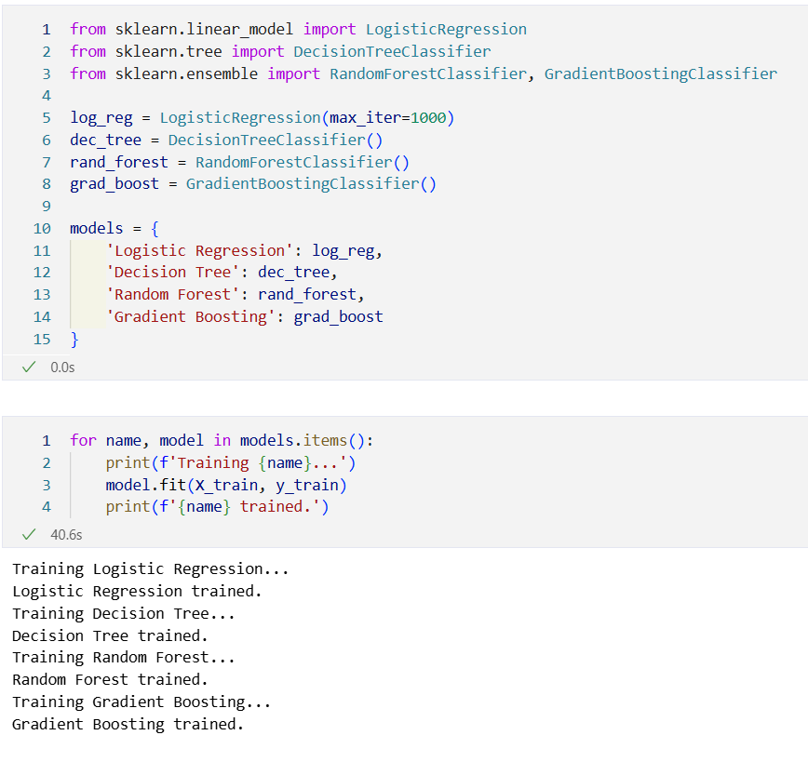
Algorithm & Deployment
4. Model Building:
Split the dataset into training and testing sets.
Train multiple machine learning models (Logistic Regression, Decision Tree, Random Forest, Gradient Boosting) to classify employee salary. Each model is trained on the processed and scaled data.
5. Model Evaluation:
Evaluate performance using metrics like Mean Absolute Error (MAE), R² Score, etc.
Compare with other models.(e.g., Linear Regression, Random Forest).
Select the best performing model and finally train the model.

Slide 9
Algorithm & Deployment
6. Model Serialization:
Save the trained model using joblib to a file (salary_pipeline_streamlit.pkl).
7. Deployment with Streamlit:
Build a user interface (app.py) using Streamlit.
Load the model and accept user input through dropdowns/sliders.
Predict salary and display the output dynamically.

Slide 10
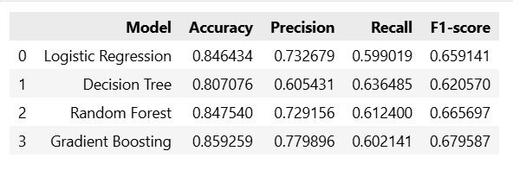
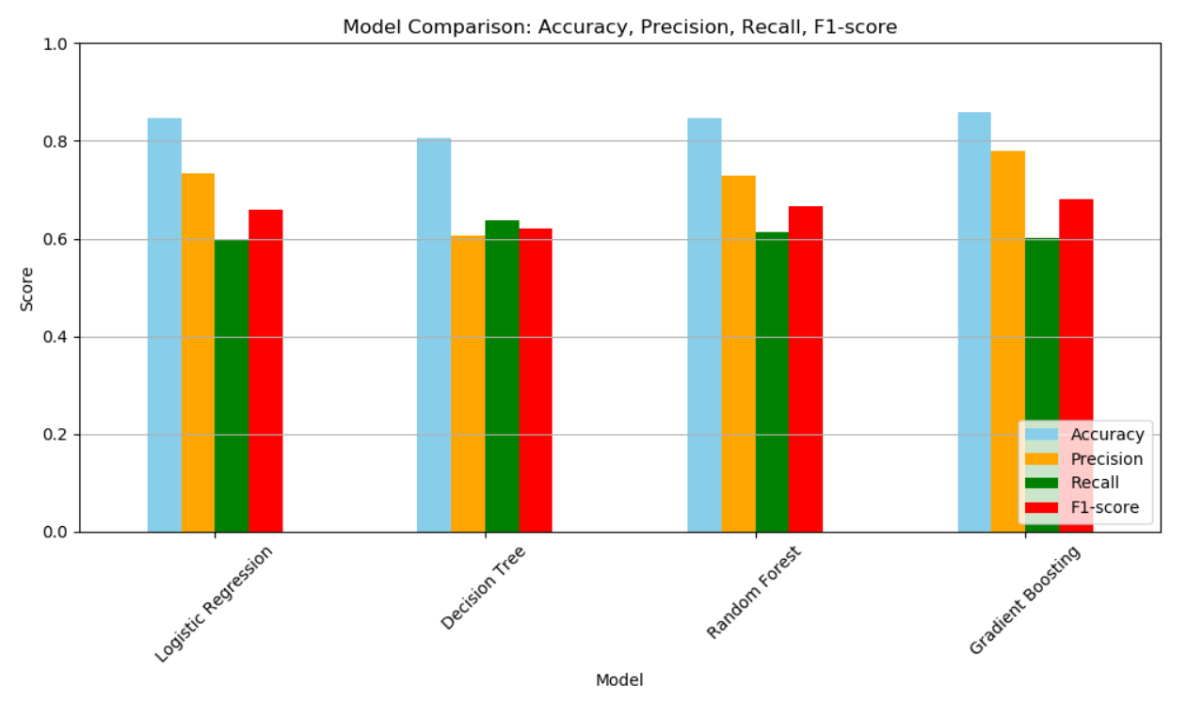
Result
Model Comparison: Accuracy, Precision, Recall, F1-score:

Slide 11
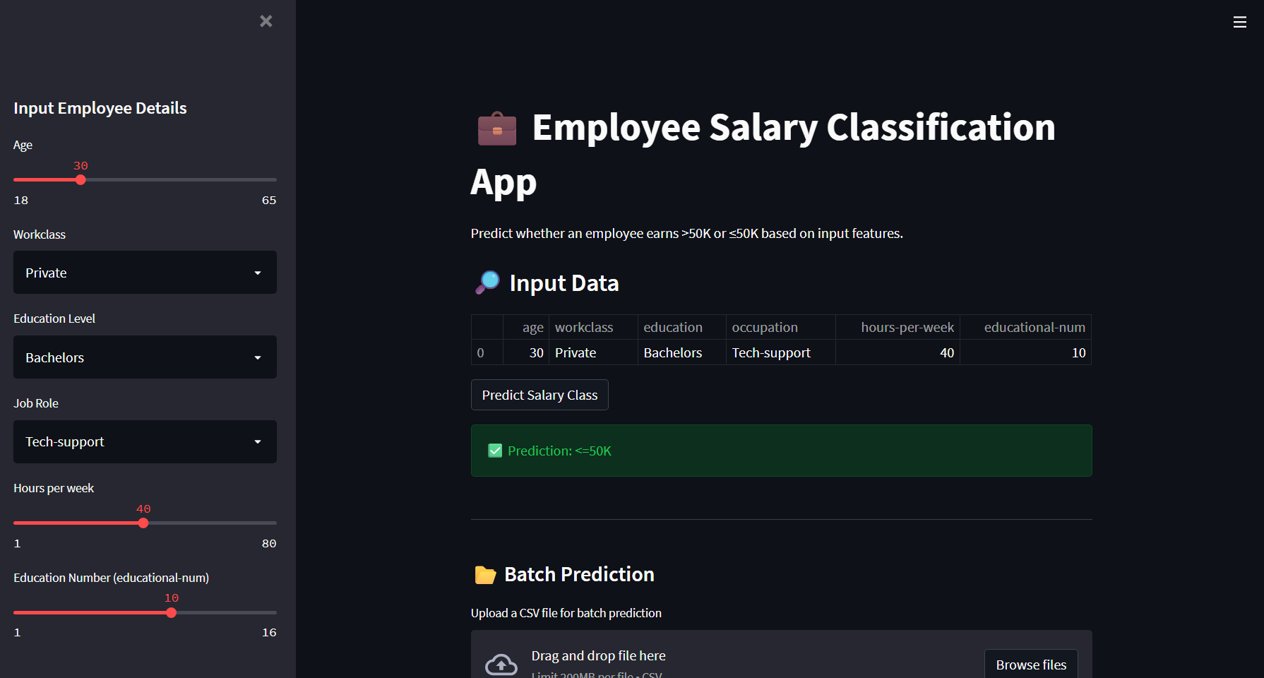
Result
Streamlit App Preview:
Simple, Interactive and Realtime Instant Salary Prediction
Single Prediction:
Enter employee details in the sidebar and click "Predict Salary Class" for an instant prediction.

Slide 12
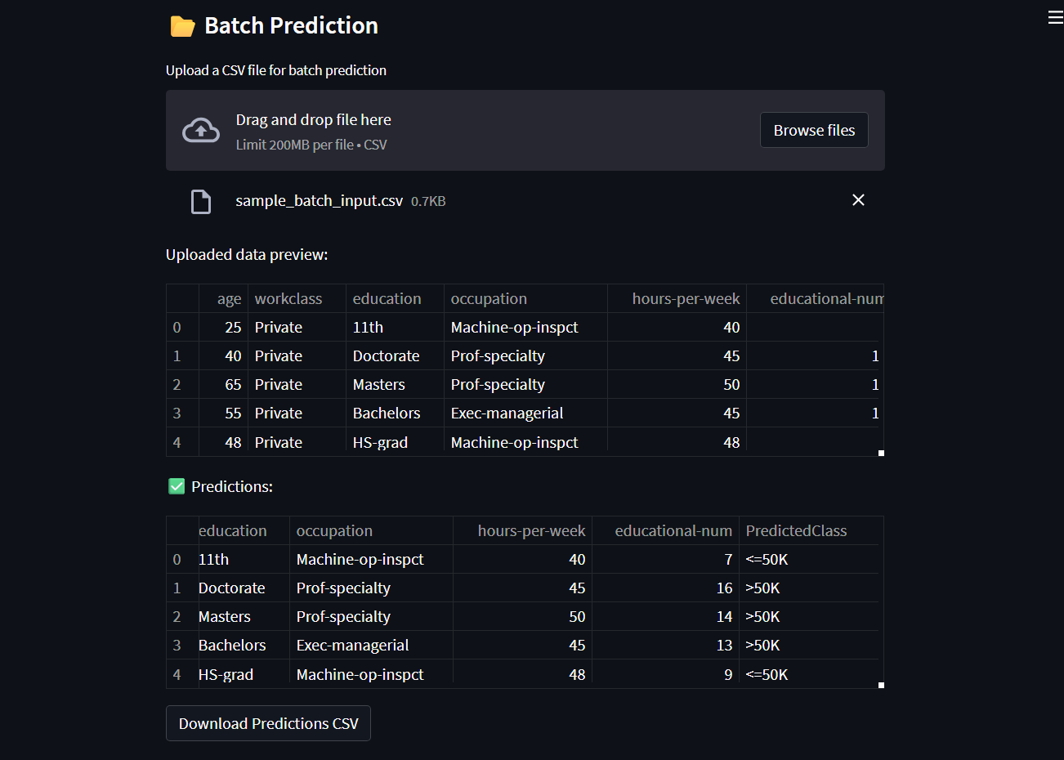
Result
Batch Prediction:
Upload a CSV file (with the required columns in the correct order) for batch predictions.
Download the results as a CSV with predicted classes.
User-Friendly UI:
Clean, interactive interface for both individual and batch use cases.
Preview of uploaded data and predictions.

Slide 13
Conclusion
This project highlights the potential of machine learning in accurately predicting employee salaries by utilizing features such as job title, education level, department, and company-specific attributes.
A Gradient Boosting Regressor was employed for its high predictive power and ability to model intricate, non-linear relationships through sequential learning and error minimization.
Trained on a thoroughly cleaned and updated dataset, the model demonstrated robust performance across key evaluation metrics, affirming its reliability and effectiveness.

Slide 14
References
Pandas Documentation: Data analysis and manipulation tool
NumPy Documentation: The fundamental package for scientific computing
Matplotlib Documentation: Visualization with Python
Scikit-learn: Machine Learning in Python
Streamlit: The fastest way to build and share data apps

Slide 15
Project Assets:
GitHub Repo: https://github.com/JeetMajumdar2003/Employee-Salary-Prediction
Colab Notebook: https://colab.research.google.com/github/JeetMajumdar2003/Employee-Salary-Prediction/blob/main/Employee_Salary_Prediction.ipynb

Slide 16
THANK YOU

