Slide 1




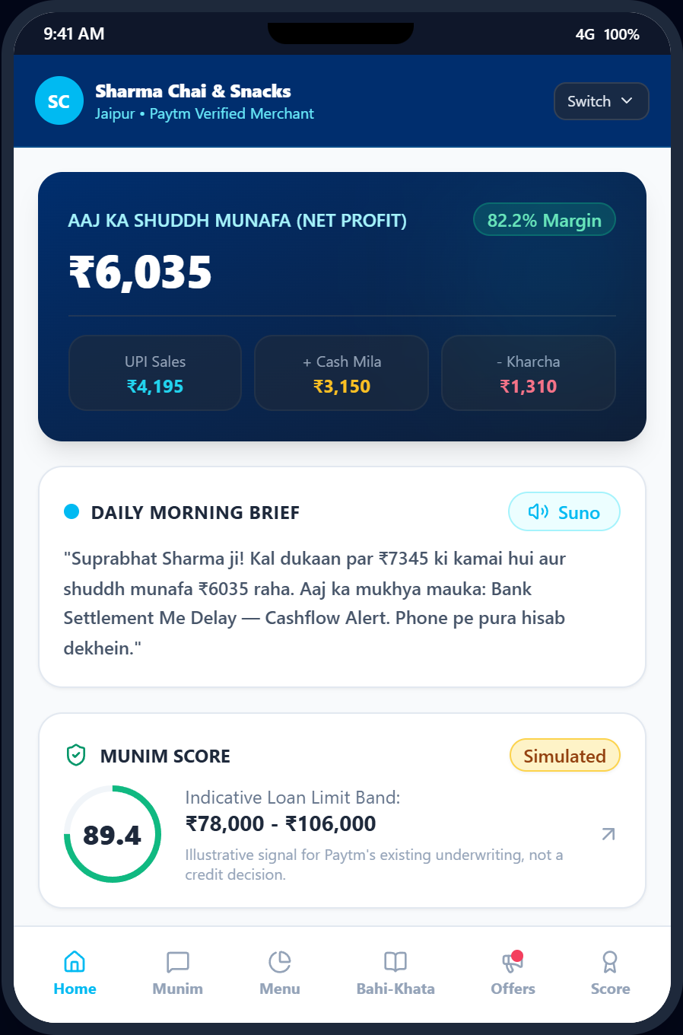


Team Munim
DESIGN SYSTEM COMPONENT PREVIEW
Paytm AI Hackathon 2026
01
02
03
Mint Pill
Sky Pill
Peach Pill
Lavender Pill
Simulated
Soundbox Brief
Output-only audio speaker for merchant daily briefs.
Item Inference
Clusters price points into menu items without POS.
Bahi-Khata Ritual
Captures evening cash expenses for true profit.
Safety Guardrails
Single-use tokens gate external adapter calls.
Street Noise & Chatter
Loud ambient market chatter makes continuous mic listening unreliable.
ACOUSTIC
Output-Only Soundbox
Speaker directs to mobile phone where typing or focused speech occurs.
VERIFIED
Hardware
Uses existing speaker.
Literacy
Voice/Hinglish briefs.
FEASIBILITY
AT A GLANCE
Capability | Traditional Khata | → | Proposed Munim AI | AI Engine / Implementation
Profit Visibility | ✗ Bank balance mistaken for profit | → | ✓ True Net Profit (UPI+Cash-Exp) | Deterministic Python arithmetic
Debt Recovery | ✗ Awkward manual debtor calls | → | ✓ 1-tap polite WhatsApp links | Consent gate + template tone
Economic
Lightweight compute.
Trust
100% human-in-loop.
Working prototype, simulated data
Paytm AI Partner Hackathon 2026 | Munim
1

