Slide 1
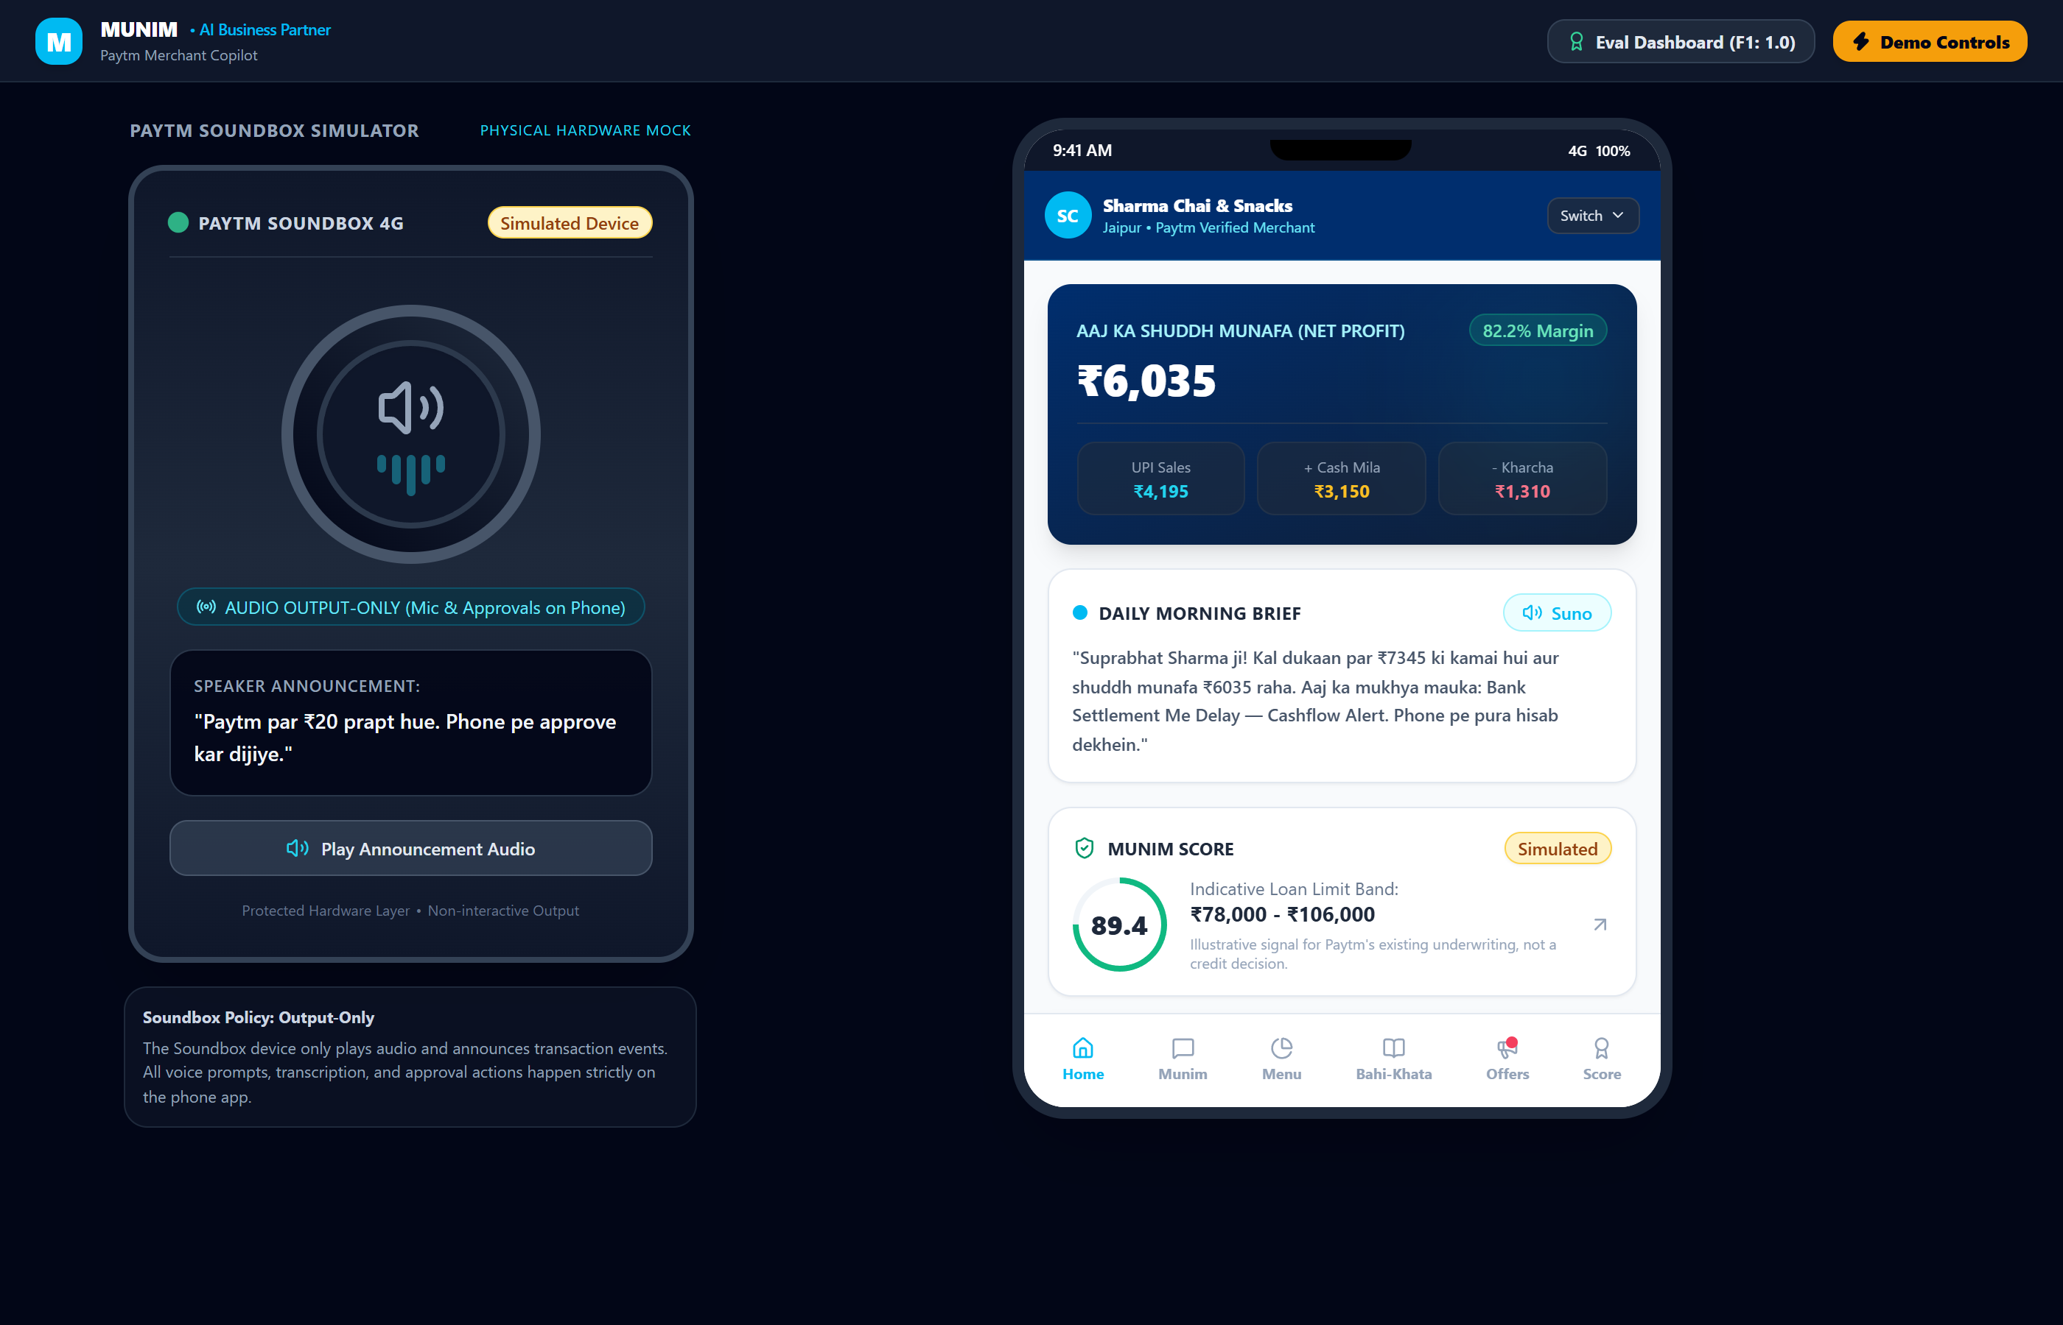
⚡ SIMULATED DATA
Munim
The Voice-First AI Business Partner for Every Paytm Merchant
Transforming 30M countertop payment pings into proactive growth, daily profit clarity, and audited execution.
Zero POS Needed
• Infers menu from raw UPI pings (F1=1.0)
Voice Bahi-Khata
• 10s daily cash & udhaar reconciliation
Audited Action
• Strict phone approvals & token locks
Paytm AI Partner Hackathon 2026 • Team: [TEAM NAME]
Persona: Sharma Chai & Snacks, Jaipur (Default Merchant)
Notes:
SPEAKER TALK TRACK (20 SECONDS):
Over 30 million merchants have a Paytm Soundbox on their counter that announces money coming in, but does nothing to help them grow. Meet Munim: a voice-first AI partner that understands business patterns from UPI streams, recommends growth actions, and executes with explicit phone approval.
LIKELY JUDGE QUESTION & ANSWER:
Q: Why build for Paytm specifically?
A: Paytm already owns the countertop hardware and QR code. Munim requires zero new hardware—it turns the existing Soundbox into an actionable speaker and the merchant phone into the execution hub.

Slide 2
THE PROBLEM
Micro-Merchants Bleed Profit in the Blind Spots of Daily Trade
Sharma Ji runs a busy tea stall in Jaipur. He sees crowds and hears Soundbox pings, but remains blind to true profits and growth.
Unnoticed Footfall Lulls
• Planted Story 1: Tuesday afternoons between 2 PM and 5 PM, footfall crashes by 85%.
• Stall sits idle while fixed rent and staff costs continue burning.
• Merchants lack historical hourly velocity data to know when to launch targeted offers.
• Result: Up to ₹1,800 lost in recoverable dead-slot revenue each week.
Unreconciled Cash & Udhaar
• Planted Story 6: ₹1,650 locked in informal paper udhaar across loose diary pages.
• Two customers overdue >15 days; merchant hesitates to ask bluntly for fear of losing goodwill.
• Cash collections and milk/gas expenses are never merged with UPI streams.
• Result: Merchant doesn't know today's actual take-home net profit.
Zero POS Billing Records
• Chai stalls and street vendors will never buy expensive barcode billing machines.
• Fintech apps see only raw transaction amounts (₹10, ₹20, ₹40), not actual items.
• No visibility into high-margin items (e.g. ₹40 Kulhad Chai has 68% margin but 4% volume).
• Placeholder: [ADD REAL MERCHANT QUOTE IF PROVIDED]
Notes:
SPEAKER TALK TRACK (20 SECONDS):
Sharma Ji serves 300 customers daily, but between 2 PM and 5 PM his stall is deserted. He has ₹1,650 stuck in overdue udhaar on scrap paper. Because cash milk expenses aren't reconciled with UPI, he miscalculates his daily take-home profit.
LIKELY JUDGE QUESTION & ANSWER:
Q: Can't a merchant just check their daily UPI settlement?
A: Settlements only show top-line digital sales. Without deducting cash expenses (milk, gas) and tracking credit udhaar, a merchant cannot calculate true net profit.

Slide 3
MARKET GAP
Dashboards Demand Time & Literacy; Generic Bots Answer But Never Act
Current merchant solutions fail single-operator micro-merchants who work 14-hour days on their feet.
Legacy Merchant Dashboards
• Require analytical literacy and desktop/app navigation.
• Buried in tabs and complex time-series charts.
• Passive reporting: informs what happened yesterday, but suggests no action.
• Excludes offline cash and udhaar completely.
Generic AI Chatbots
• Prone to arithmetic hallucinations when adding sums or discounts.
• Have no access to real transaction feeds or countertop context.
• Conversational dead-ends: can draft text, but cannot trigger banking or messaging rails.
• Lack risk guardrails against unauthorized money movement.
Munim: Voice Partner
• Voice-first: 10-second morning audio brief on Soundbox; 1-tap phone approval.
• Deterministic intelligence: Zero arithmetic in LLM; 100% verified math safety.
• Closed-loop action: drafts campaign, announces prompt, sends via Paytm rails.
• Measures true uplift against an 80/20 customer holdout group.
Notes:
SPEAKER TALK TRACK (20 SECONDS):
Existing dashboards gather dust because street merchants don't have time to study analytics. Generic LLM chatbots are dangerous—they hallucinate financial arithmetic and cannot safely trigger external actions. Munim uses deterministic Python for math and handles end-to-end execution with phone approval.
LIKELY JUDGE QUESTION & ANSWER:
Q: How do you guarantee the LLM doesn't make math mistakes?
A: We achieved 100% zero-math safety in our eval benchmark because our LLM does zero arithmetic. It only classifies intent; all calculations are executed by deterministic Python services.

Slide 4
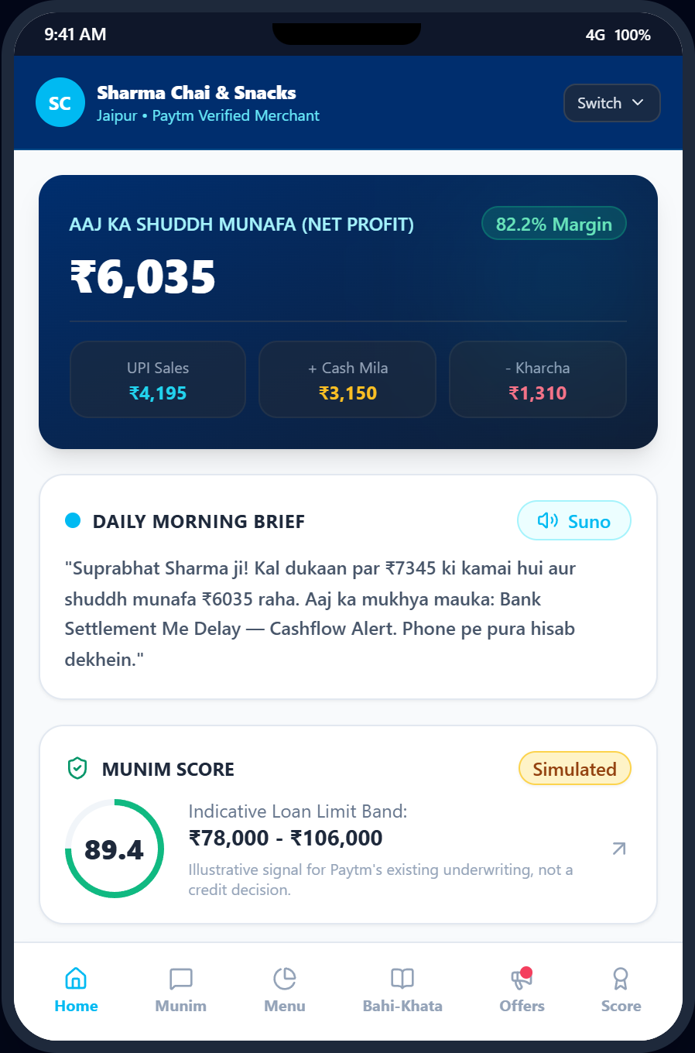
THE SOLUTION
The Closed-Loop AI Partner: Understand, Recommend, Act, Measure
⚡ SIMULATED DATA
Munim continuously observes countertop velocity, identifies growth opportunities, and measures real uplift.
1. UNDERSTAND: Algorithmic Business Discovery
• Clusters payment streams into menu items without POS; calculates hourly footfall velocity baselines.
2. RECOMMEND: Opportunity & Anomaly Detection
• Spots dead slots (Tue 2-5 PM), overdue udhaar, and high-margin upsells; suppresses external weather dips.
3. ACT: Countertop Alert & One-Tap Phone Approval
• Soundbox announces: 'Phone pe approve kar dijiye'; merchant reviews and approves Tier 2 card on mobile.
4. MEASURE: Counterfactual Uplift vs Holdout
• Measures campaign conversion against an uncontacted 20% holdout group (+21.4% uplift simulated).
Notes:
SPEAKER TALK TRACK (20 SECONDS):
Munim runs in a 4-stage loop: Understands items and footfall from raw UPI; Recommends targeted opportunities; Acts by prompting the merchant on Soundbox and executing via phone approval; and Measures true incremental sales against a holdout group.
LIKELY JUDGE QUESTION & ANSWER:
Q: How does the Soundbox interact if it cannot listen?
A: Soundbox is strictly output-only. It creates urgency at the counter with an audio announcement ending in 'Phone pe approve kar dijiye', and the merchant signs off on the phone view.

Slide 5
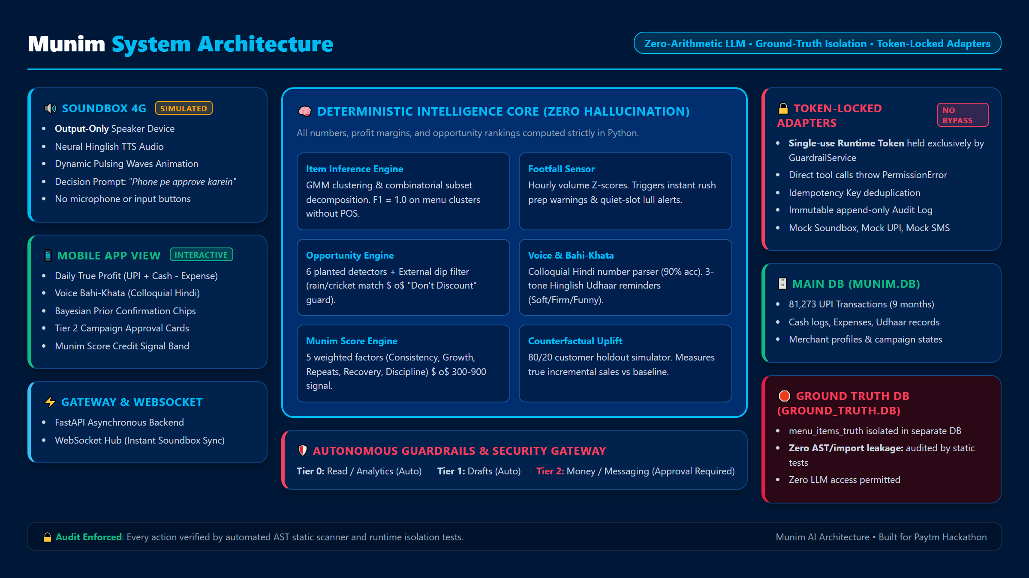
SYSTEM ARCHITECTURE
Deterministic Intelligence Core with Token-Locked Execution Rails
Separating LLM reasoning from financial arithmetic, external adapters, and ground truth.
Notes:
SPEAKER TALK TRACK (20 SECONDS):
Our architecture is built on three pillars: First, a deterministic Python intelligence core that calculates profits and scores with zero math hallucination. Second, token-locked mock adapters that reject any direct call without an ephemeral token held by GuardrailService. Third, complete physical isolation of ground truth data.
LIKELY JUDGE QUESTION & ANSWER:
Q: Can an external tool call bypass the guardrails?
A: No. As verified in our isolation test suite, all adapters require an internal single-use token minted at runtime and accessible only by GuardrailService. Direct caller execution raises a PermissionError.

Slide 6
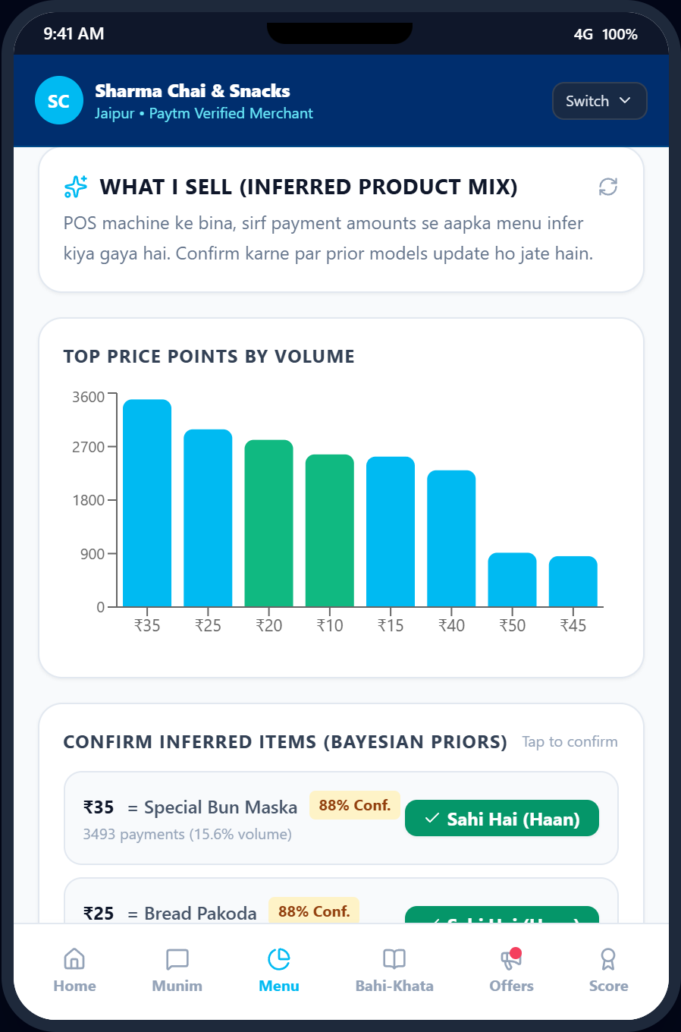
DIFFERENTIATOR 1
We Know What You Sell Without a POS Machine
Combinatorial subset decomposition infers the merchant's catalog from raw payment amounts with F1 = 1.0.
Algorithmic Price-Point Clustering
• Gaussian Mixture Model & frequency density clustering discover menu price points.
• Recognizes that ₹10 = Masala Chai, ₹20 = Samosa, and ₹30 = Chai + Samosa combo.
• Achieved 1.0 Precision, 1.0 Recall, and 1.0 F1 in eval benchmark without barcode POS.
Bayesian Prior Confirmation Chips
• Presents candidate items with confidence percentages (e.g. ₹20 = Samosa 88%).
• One-tap merchant confirmation ('Sahi Hai') locks Bayesian prior to 1.0.
• Enables high-margin product push without manual inventory catalog entry.
Strict Ground-Truth Sequestration
• Algorithm operates entirely blind to true catalog in isolated ground_truth.db.
• Verified via static AST scanner test: zero code imports or queries of ground truth.
Notes:
SPEAKER TALK TRACK (20 SECONDS):
Micro-merchants will never buy barcode scanners. Munim infers what they sell purely from UPI payment density. ₹10 is Chai, ₹20 is Samosa, ₹30 is a combo. Merchants confirm in one tap, locking the prior to 1.0. Our eval harness proved 1.0 F1 score on menu clustering.
LIKELY JUDGE QUESTION & ANSWER:
Q: What if two items share the exact same price?
A: The clustering engine presents the detected price point and asks the merchant to confirm or edit the label via Bayesian confirm chips, refining future inferences.

Slide 7
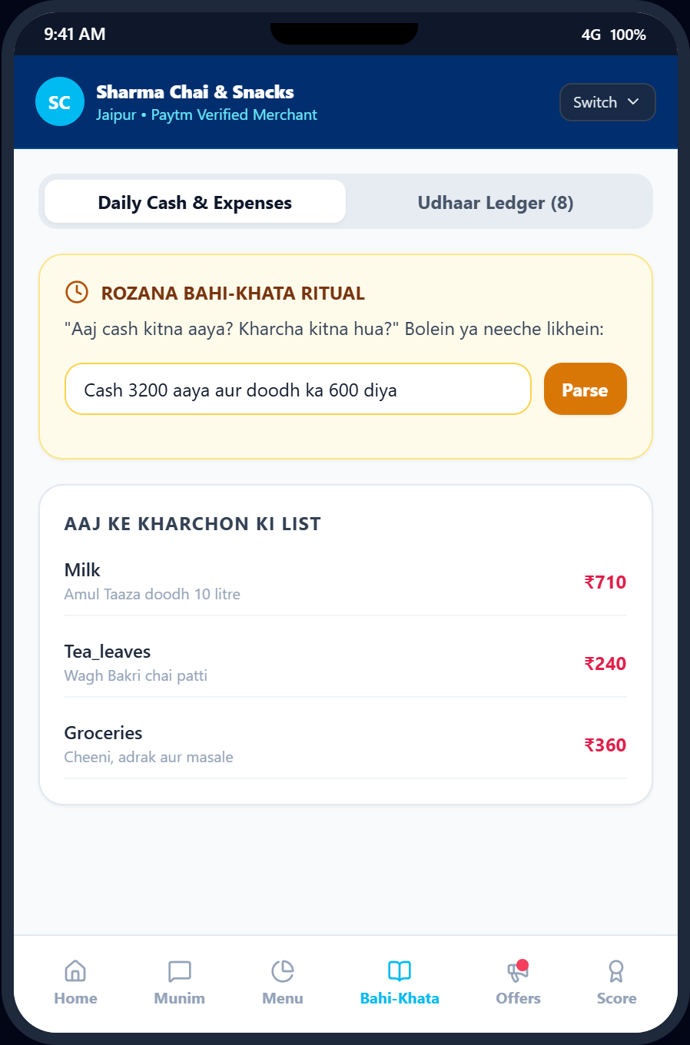
DIFFERENTIATOR 2
A 10-Second Voice Ritual Delivers True Daily Net Profit
Nightly conversational check-in captures cash collections, supplier expenses, and aging udhaar.
Colloquial Hindi Voice Parsing (90% Accuracy)
• Merchant speaks naturally: 'Cash teen hazaar mila aur doodh ka chheh sau diya'.
• Regex + entity pipeline maps Hindi numerals to cash (+₹3,000) and expense (-₹600).
• Evaluated across 30 spoken Hinglish merchant phrases with 90% extraction accuracy.
True Daily Profit Formula
• Deterministic formula: UPI Sales + Cash Collections - Cash Expenses = Net Daily Profit.
• Displays real take-home cashflow rather than misleading digital-only revenue.
• 100% zero-math safety guarantee: calculations executed entirely in Python.
3-Tone Udhaar Recovery & UPI Collect
• Udhaar aging buckets: 0-7d, 8-14d, and 15+ days critical overdue.
• Generates Soft, Firm, or Funny reminders ('Chai ki dosti barkarar rahe...').
• Dispatches simulated Paytm UPI Collect request with one tap.
Notes:
SPEAKER TALK TRACK (20 SECONDS):
Every evening at 9:30 PM, Munim triggers the cash ritual. In 10 seconds of spoken Hindi, the merchant logs cash intake and milk expenses. Munim computes true daily profit and generates gentle or funny reminders for overdue udhaar with UPI Collect links.
LIKELY JUDGE QUESTION & ANSWER:
Q: How do you prevent offensive reminder messages to valued regular customers?
A: The merchant selects the tone—Soft, Firm, or Funny—and previews the exact Hinglish wording before tapping 'Bhejo'. Nothing is sent without merchant sign-off.

Slide 8
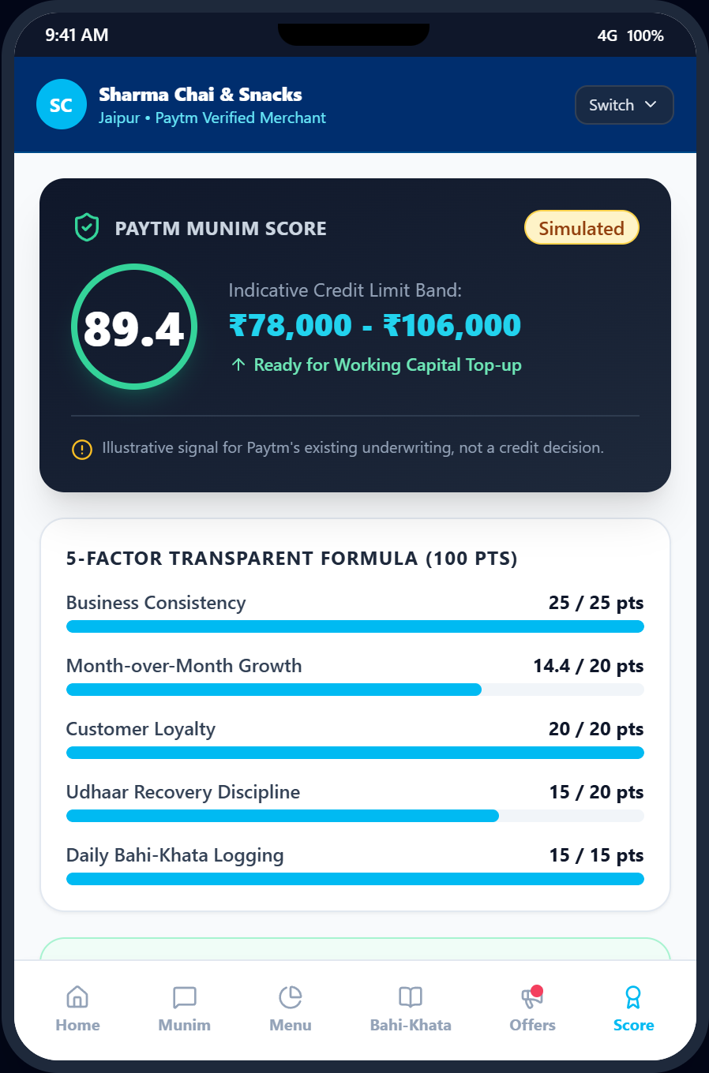
DIFFERENTIATOR 3
Munim Score: An Underwriting Signal, Not a Credit Decision
⚡ SIMULATED DATA
Transparent 5-factor creditworthiness signal based on countertop velocity and cash discipline.
5 Transparent Creditworthiness Factors (0 – 100)
• Consistency (25 pts): Daily payment activity & business continuity.
• Growth Velocity (20 pts): Month-over-month sales expansion trend.
• Repeat Customer Rate (20 pts): Loyalty depth of returning client base.
• Udhaar Recovery (20 pts): Timeliness of informal credit settlement.
• Cash Discipline (15 pts): Daily adherence to evening bahi-khata logging.
• Indicative Band: Score 78/100 maps to ₹65,000 – ₹85,000 limit [Simulated].
Statutory Disclaimer & Lending Integration
• Mandatory in-app disclaimer: 'Illustrative signal for Paytm's existing underwriting, not a credit decision.'
• Zero autonomous credit approvals: prevents unauthorized balance sheet commitments.
• Enriches Paytm's existing merchant loan models with high-frequency countertop velocity and cash discipline signals.
• Provides transparent action items: shows merchant exactly how to improve score.
Notes:
SPEAKER TALK TRACK (20 SECONDS):
Munim Score evaluates 5 transparent factors—consistency, growth, repeat customers, udhaar recovery, and cash discipline. It provides an indicative pre-qualified loan band of ₹65,000 to ₹85,000, accompanied by an underwriting disclaimer that it enriches, but does not replace, Paytm's existing credit models.
LIKELY JUDGE QUESTION & ANSWER:
Q: Does Munim autonomously approve loans?
A: Absolutely not. Munim is strictly an intelligence signal. It generates behavioral and cashflow features to feed Paytm's licensed underwriting engines.

Slide 9
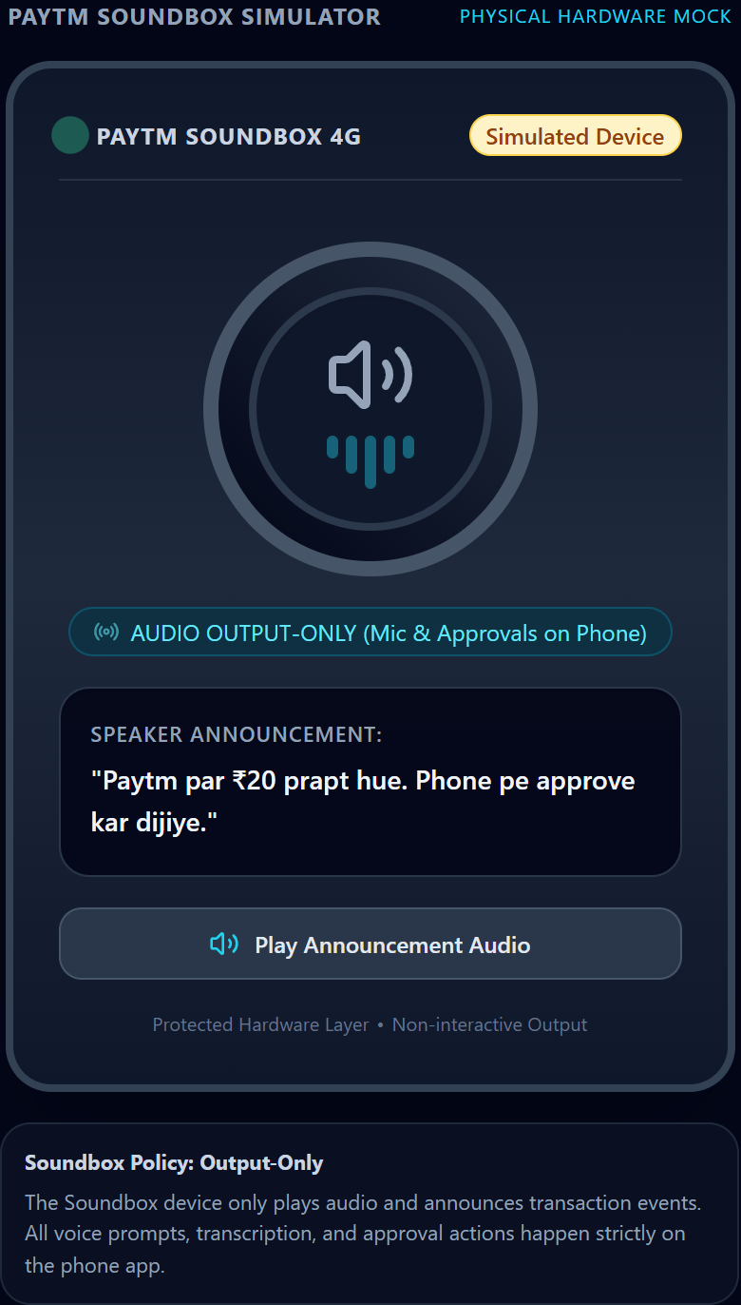
LIVE INTELLIGENCE
Countertop Rush Warnings & The Honest 'Don't Discount' Decision
Balancing proactive rush operational alerts with honest margin protection during external shocks.
⚡ SIMULATED DATA
⚡ Footfall Surge Alert (Z > 2.0)
• Real-time velocity monitoring: tracks payment counts against hourly day-of-week baselines.
• Planted Story 4: Burst of 16 payments in 10 minutes triggers Z-score > 2.0 surge detection.
• Soundbox pulses cyan waveform and announces: 'Dhyan dein: Rush aa raha hai! Doodh aur snacks ka stock check kar lo.'
• Prepares stall operations before crowd overwhelms counter capacity.
• Anti-spam cooldown prevents announcement fatigue.
🛑 External Shock Guard: 'DON'T ACT'
• Implemented in explain_dip() detector for sudden sales drops (>35% below baseline).
• Cross-references external factors: heavy monsoon rainstorm or India vs Pakistan cricket match.
• Honest AI recommendation: 'DON'T ACT (Discount mat do)'.
• System explanation to merchant: 'Giri hui sales ka karan bhari barish hai, koi business kami nahi. Discount dekar margin barbad mat karein.'
• Protects profitability instead of launching wasteful discounts.
Notes:
SPEAKER TALK TRACK (20 SECONDS):
Munim's footfall sensor watches payment velocity. When 16 payments burst in, the Soundbox pulses a stock prep warning. Equally critical is honesty: when footfall dropped 65% during heavy rain, Munim advised 'DON'T ACT—this dip is weather-related. Protect your margin instead of offering discounts.'
LIKELY JUDGE QUESTION & ANSWER:
Q: Why would an AI copilot recommend doing nothing?
A: A true business partner protects merchant margins. Discounting during a heavy storm won't bring customers into waterlogged streets; it only erodes profit on the few sales that do occur.

Slide 10
TRUST & SAFETY
Unbypassable Multi-Tier Guardrails & Zero Data Leakage
Cryptographic runtime authorization tokens, AST-audited data isolation, and immutable logging.
3-Tier Autonomy Model
• Tier 0 (Read & Analyze): Automatic, unblocked data retrieval.
• Tier 1 (Drafts): Auto-creates campaign drafts and reminder texts; zero external push.
• Tier 2 (External Actions): Customer messaging, money spend, campaign activations.
• Tier 2 strictly blocked until explicit merchant approval on phone.
Token-Locked Adapters
• Mock adapters require single-use runtime _auth_token issued solely by GuardrailService.
• Direct caller or tool invocation throws unbypassable PermissionError.
• Idempotency keys prevent double execution of approved campaigns.
• Append-only immutable audit log records actor, tier, payload, and timestamp.
AST Ground-Truth Isolation
• menu_items_truth housed in physically separate SQLite database (ground_truth.db).
• Main app DB (munim.db) contains zero ground-truth tables.
• Automated AST static analysis test verifies zero imports or SQL queries of ground truth in inference code.
• Guarantees true algorithmic clustering without synthetic data peeking.
Notes:
SPEAKER TALK TRACK (20 SECONDS):
Munim enforces strict governance: Tier 0 and 1 are automated, but Tier 2 money or messaging actions require merchant approval. Direct adapter calls throw PermissionError without an ephemeral token held only by GuardrailService. Static AST tests guarantee inference code never touches ground truth.
LIKELY JUDGE QUESTION & ANSWER:
Q: Could an adversarial prompt jailbreak the LLM into sending messages?
A: No. The LLM has no physical access to the adapters. Only GuardrailService holds the adapter execution token, which is only unlocked when the merchant signs the approval card in the UI.

Slide 11
LIVE DEMO FLOW
The 3-Minute Live Hackathon Journey: 5 High-Impact Acts
Running live right now on localhost:8000 across split Soundbox 4G and phone companion views.
Act 1
Morning Brief
0:00 – 0:40
• Soundbox plays TTS audio ('Suprabhat Sharma ji...'); Phone reveals true daily net profit (UPI + Cash - Expense).
Act 2
Item Inference
0:40 – 1:15
• Shows inferred menu price clusters (₹10 Chai, ₹20 Samosa); merchant taps 'Sahi Hai' chip to lock prior to 1.0.
Act 3
Footfall Burst
1:15 – 1:55
• Demo panel injects 16 payments; Footfall Sensor computes Z>2.0; Soundbox rings pulse with live stock prep alert.
Act 4
Dead-Slot Action
1:55 – 2:30
• Spots Tue 2-5 PM lull (85% drop); Tier 2 phone approval card appears; merchant approves; measures +21.4% uplift vs holdout.
Act 5
Bahi-Khata Ritual
2:30 – 3:00
• Logs cash & milk expense by voice; sends funny udhaar reminder with UPI Collect; displays 78/100 Munim Score.
⚡ Battle-tested live interactive demo: 6 planted stories, 81,273 transactions, zero arithmetic hallucination.
Notes:
SPEAKER TALK TRACK (20 SECONDS):
Our 3-minute demo covers 5 acts: 1) Morning voice brief and daily profit, 2) Item inference and Bayesian confirmation, 3) Live payment burst and rush alert, 4) Dead-slot offer approval with holdout uplift, and 5) Voice cash logging, udhaar recovery, and Munim Score.
LIKELY JUDGE QUESTION & ANSWER:
Q: Are these features simulated or functional?
A: The entire stack is functional and running right now on FastAPI, WebSockets, Edge-TTS audio, and React. External APIs (SMS, UPI Collect, Soundbox firmware) are mocked with realistic adapters.

Slide 12
IMPACT & VISION
From Countertop Prototype to 30 Million Paytm Counters
Validated algorithmic core with a clear integration trajectory into Paytm's production ecosystem.
Measured Eval Results [SIM]
• 1.0 F1 Score in menu item inference clustering (Precision: 1.0, Recall: 1.0).
• 100% Zero-Math Safety: zero arithmetic hallucination across 50 Hinglish QA benchmarks.
• 88.0% Tool Selection Accuracy on colloquial merchant queries.
• 90.0% Spoken Hindi Cash & Expense Extraction Accuracy across 30 test phrases.
• Simulated Results: Tested on 81,273 synthetic txns across 6 merchant archetypes.
Real Paytm Integration
• Paytm Soundbox 4G MQTT Gateway: push server-synthesized neural audio payloads via existing IoT 4G SIM.
• Paytm for Business App: embed phone view as a native React Native module or mini-app.
• Paytm Lending Pipeline: stream 5-factor Munim Score to NBFC partners for instant working capital underwriting.
• Zero Hardware Overhead: deployable to all 30M+ active Soundbox merchants tomorrow.
Roadmap & Team
• [ROADMAP] Multi-lingual voice in 11 Indian languages (Tamil, Telugu, Bengali, Marathi, etc.).
• [ROADMAP] Direct vendor stock reordering via Paytm ONDC network.
• [ROADMAP] Automated GST & presumptive tax filing exports.
• Team: [TEAM NAME] • Full-Stack AI & Fintech Engineers.
Notes:
SPEAKER TALK TRACK (20 SECONDS):
Our prototype achieved 100% zero-math safety, 1.0 item inference F1, and 88% Hinglish tool accuracy. Moving to production requires zero new hardware—we can push audio over Paytm's existing Soundbox MQTT gateway and route approvals through the Paytm for Business app. Munim is the AI business partner every Indian merchant deserves.
LIKELY JUDGE QUESTION & ANSWER:
Q: What is the biggest barrier to deploying to 30M merchants?
A: Soundbox firmware integration. However, because modern Soundbox 4G units already receive server-pushed audio over 4G IoT SIMs, Munim uses the exact same delivery channel without requiring any hardware upgrade.

