Slide 1
PAYTM AI PARTNER HACKATHON 2026
Munim
Voice-First AI Business Partner for Small Indian Merchants
Autonomous Merchant Intelligence
- Understands UPI payment streams, reconstructs menus without POS hardware, and automates daily profit calculations.
- Announces proactive opportunities on Soundbox and executes verified actions only after explicit mobile approval.
Target Merchant Persona
- Ramesh, Chai and Snacks Stall, Jaipur.
- 150+ daily micro UPI transactions.
- Informal cash sales and supplier credits.
Delivery Channels
- Simulated 4G Soundbox: audio announcements.
- Mobile Web App: one-tap approval cards.
- Direction: 'Phone pe approve kar dijiye'.
Enforced Safety Contract
- 0 numeric errors on our 50-question test set.
- Single-use runtime token for all adapters.
- Append-only audit log for every execution.
Team: (to be added) | Paytm AI Partner Hackathon 2026 | Prototype Status: Fully Functional on Synthetic Seed Data

Slide 2
MERCHANT REALITY & PAIN POINTS
The Small Merchant Dilemma: High Volume, Zero Visibility
Ramesh (Chai Stall, Jaipur) processes 150+ UPI payments daily, yet operates completely blind.
1. Invisible Margin Leak
- UPI captures top-line revenue, but cash collections and daily vendor expenses go unrecorded.
- True daily net profit remains unknown until bank balance runs short.
- Illustrative: ~15% estimated monthly profit leak from unrecorded informal cash costs.
2. Unrecovered Customer Udhaar
- Informal customer credits accumulate on scattered paper slips without structured tracking.
- Merchants avoid awkward manual collection calls with familiar regular customers.
- Illustrative: ~Rs 4,200 average monthly working capital frozen in unpaid udhaar.
3. Reactive Operations
- Without POS barcode systems, merchants cannot identify top-selling item combos.
- Zero advance preparation for predictable rush surges and afternoon quiet lulls.
- Marketing and combo discounts are never run due to setup friction and lack of time.
The Fundamental Gap
- Existing digital ledger apps only record transactions. Munim actively understands, recommends, and acts.

Slide 3
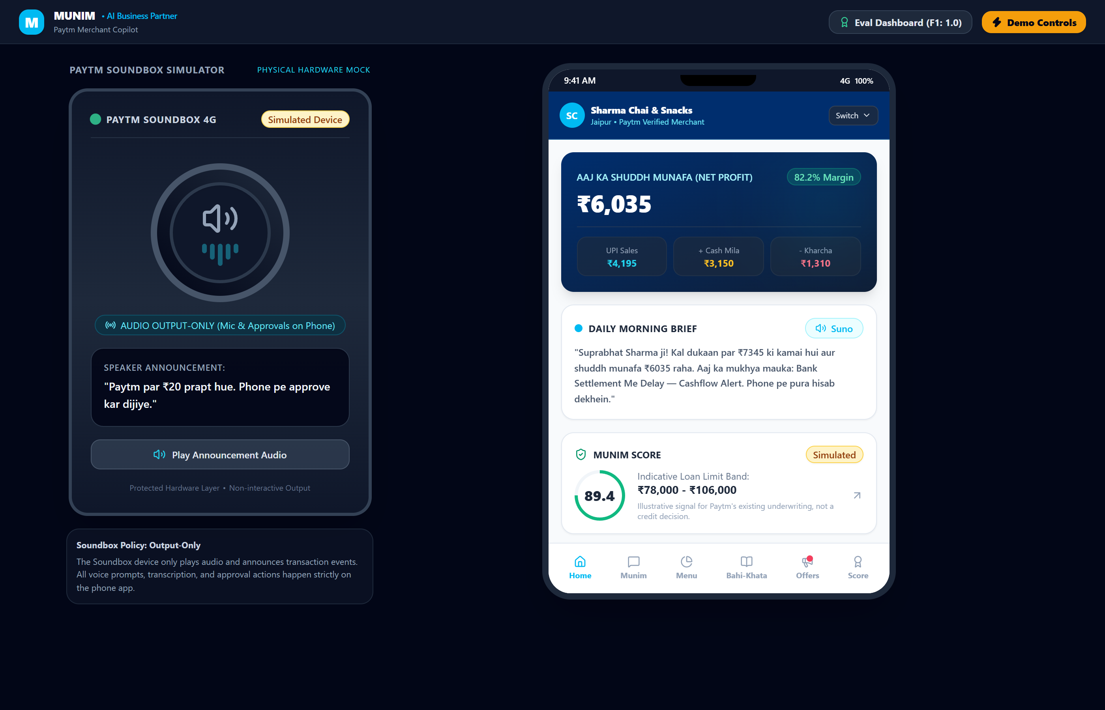
PRODUCT ARCHITECTURE & OPERATING LOOP
Munim: Closing the Autonomous Business Loop
Transforming raw UPI stream events into executed, revenue-generating decisions.
1. UNDERSTAND
- Infers menu items and combo baskets directly from UPI payment amount clusters without POS.
2. RECOMMEND
- Detects rush-hour footfall surges, slow quiet periods, and aging customer credit balances.
3. ACT
- Announces voice briefs on Soundbox and delivers one-tap approval cards to merchant phone.
4. MEASURE
- Tracks sales uplift, customer settlement rate, and working capital gains against pre-action baselines.

Slide 4
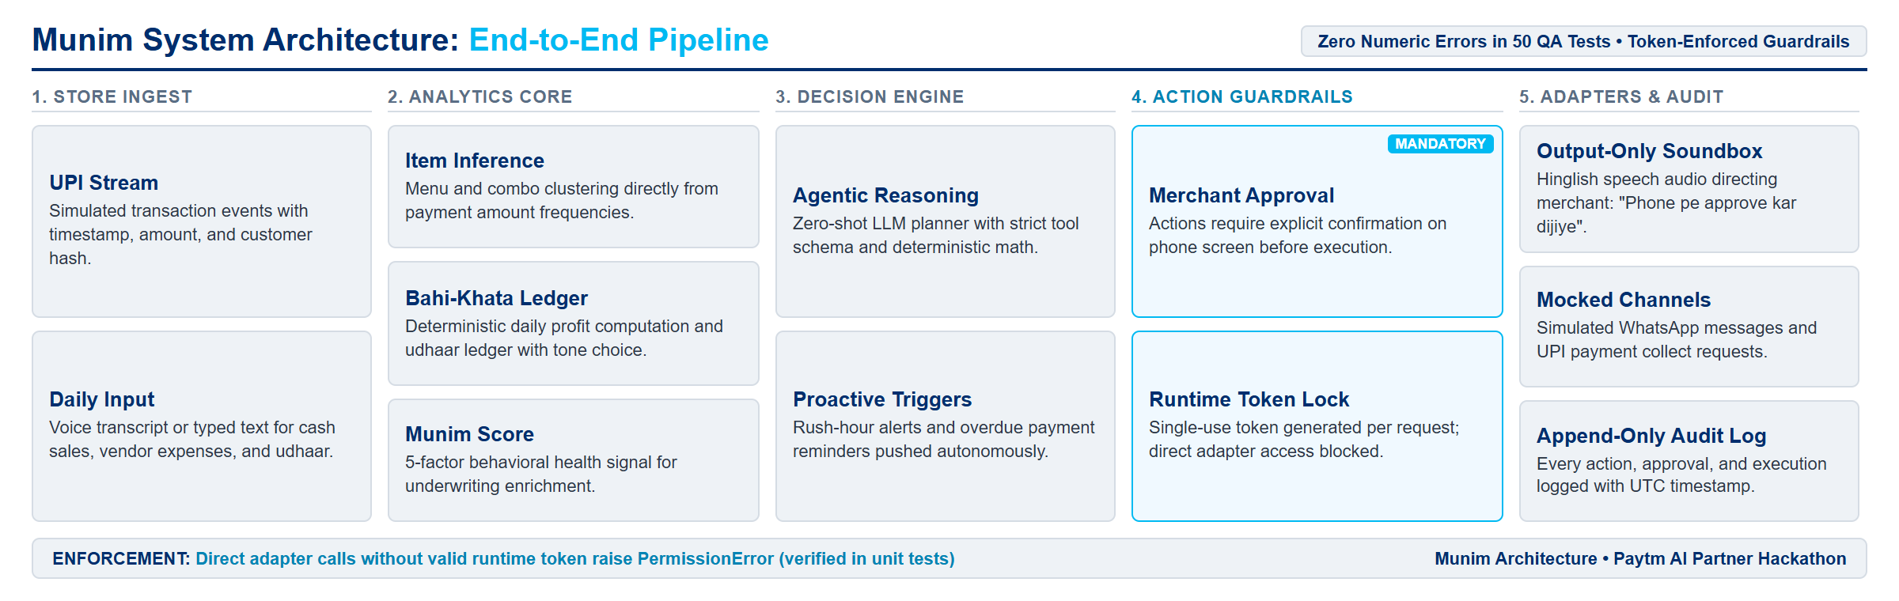
SYSTEM ARCHITECTURE & ISOLATION
Deterministic Intelligence with Token-Enforced Safety
LLM provides Hinglish dialogue orchestration; analytics and adapter execution are strictly isolated.
Zero LLM Arithmetic
- All financial sums, margins, and scores calculated deterministically in Python.
- 0 numeric errors on our 50-question test set.
Mandatory Merchant Approval
- No external adapter can fire without explicit confirmation on mobile screen.
- Soundbox audio prompts: 'Phone pe approve kar dijiye'.
Runtime Token Lock
- Single-use runtime token generated per execution.
- Direct adapter calls without token raise PermissionError (tested).

Slide 5
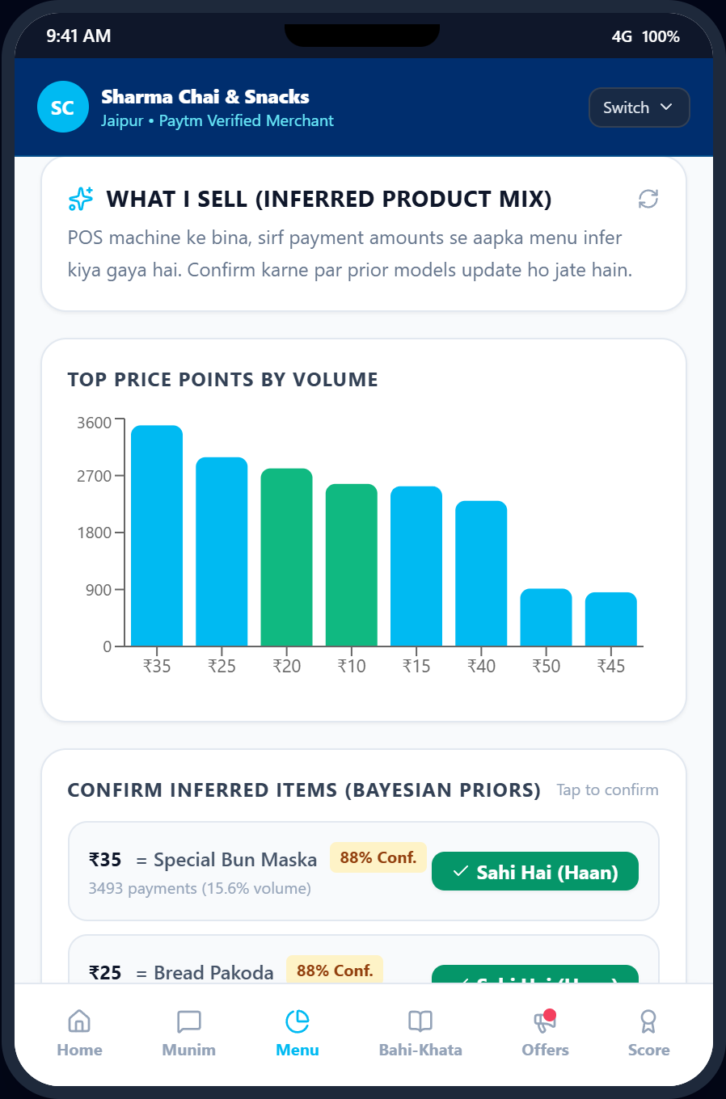
CORE AI INNOVATION
Item Inference: Menu Discovery from UPI Streams
Reconstructing catalog and combo baskets from anonymous payment frequencies without POS hardware.
Evaluation Benchmarks on Synthetic Data
- Easy Baseline (4 distinct price points): Precision 1.0, Recall 1.0, F1 1.0.
- Hard Stress Test (7 items, 2 price collisions, combos, noise, sparse item): Precision 0.50, Recall 0.71, F1 0.59, Top-1 Accuracy 0.57.
3-Stage Inference Methodology
- 1. Price-Point Clustering: Extracts modal transaction amounts from raw stream.
- 2. Domain Priors: Maps clusters to trade items and 2-item combo equations.
- 3. Bayesian Confirmation: Merchant confirms candidate hypotheses via UI chips.
Practical Merchant Benefit
- Delivers enterprise-grade SKU and basket analysis to street stalls without requiring barcode scanners.

Slide 6
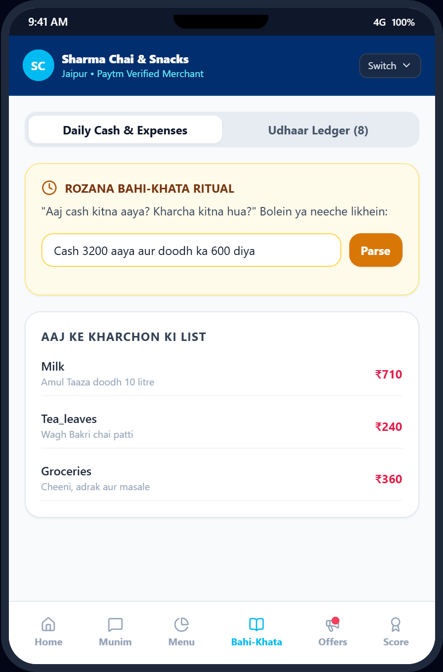
FINANCIAL HEALTH & BOOKKEEPING
Unified Bahi-Khata: True Daily Profit & Udhaar Recovery
Bridging digital UPI receipts, informal cash expenses, and automated customer credit management.
Deterministic True Daily Profit
- Daily True Profit = UPI Inflow + Cash Inflow - Daily Cash Expenses.
- Input via voice transcript or typed text (e.g. 'Doodh 500 aur cheeni 200 cash di').
- 27 of 30 Hinglish test phrases accurately parsed in benchmark.
Udhaar Tracking with Tone Selection
- Tracks customer balances, aging days, and repayment probability.
- Merchant selects reminder tone for each customer: Polite, Formal, or Firm.
- Pre-drafts personalized Hinglish collection messages with payment links.
Consent-Gated Execution
- Reminders dispatched via mock WhatsApp adapter only after merchant approves.
- All dispatched collection attempts recorded in append-only audit log.

Slide 7
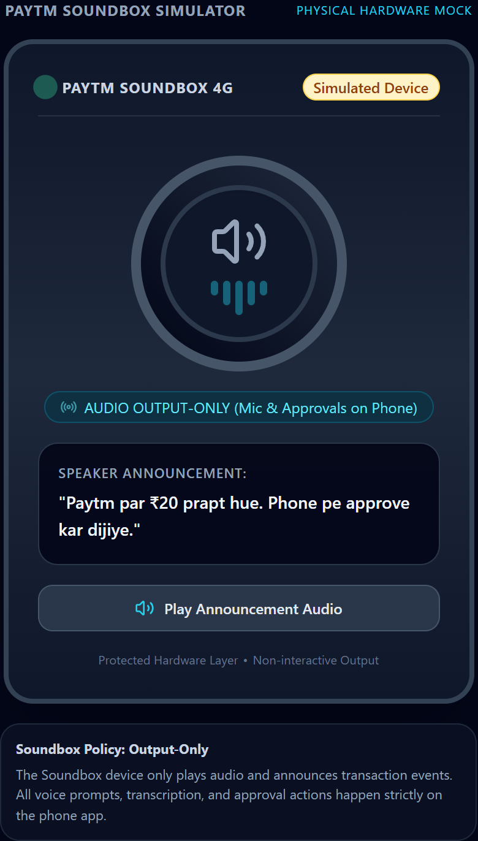
DEVICE INTERACTION & DECISION LOGIC
Simulated Soundbox: Proactive Edge Intelligence
Real-time audio announcements in the stall, with safe decision controls on the merchant mobile screen.
Output-Only Soundbox Architecture
- Simulated 4G Soundbox plays neural Hinglish TTS audio announcements.
- Directs merchant to smartphone: 'Phone pe approve kar dijiye'.
- No microphone or decision buttons on device, preserving hardware simplicity.
Proactive Store Triggers
- Morning Brief: Daily sales target, yesterday net profit, and stock alerts.
- Rush Warning: Footfall volume Z-score alert 30 minutes before peak lunch rush.
The 'Don't Act' Prudence Example
- Munim evaluates running a promotional combo offer during peak rush hours.
- Decision engine explicitly suppresses campaign: discounts during peak hours erode gross margin without adding kitchen capacity.

Slide 8
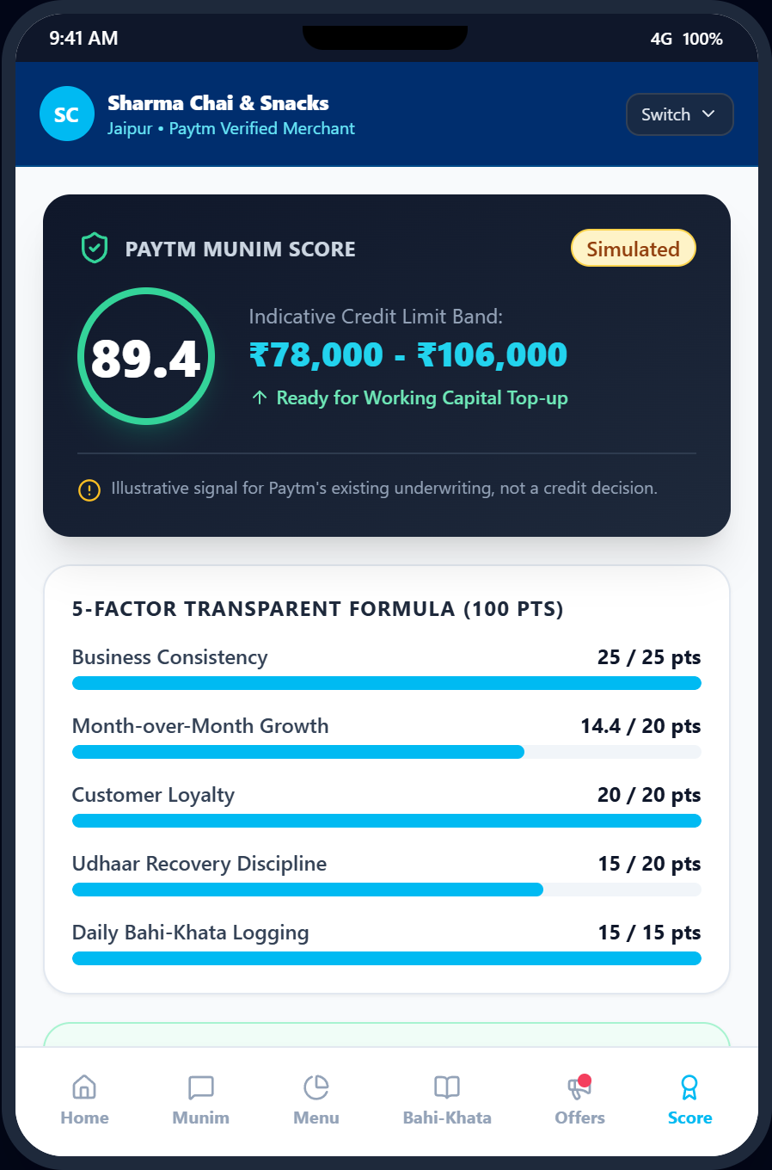
FINANCIAL INCLUSION & LENDING SIGNAL
Munim Score: Behavioral Underwriting Enrichment
A real-time operational discipline score designed to enrich Paytm's licensed lending underwriting.
5 Behavioral Health Dimensions (0-100)
- 1. Volume Consistency: Daily transaction stability across weeks.
- 2. Expense Discipline: Daily logging of cash outflows and supplier costs.
- 3. Repayment Regularity: Velocity of supplier and vendor settlements.
- 4. Udhaar Health: Ratio of active customer credits to recovered dues.
- 5. Operational Stability: Regular trading hours and business consistency.
Enrichment Signal, Not Credit Decision
- A behavioral signal that could enrich Paytm's existing, licensed underwriting.
- Not a formal credit decision or loan offer; contains no pre-approved limits.
In-App Disclaimer Enforced
- Visible in mobile UI: 'Munim Score is a behavioral management indicator and does not constitute a formal loan offer or statutory credit rating.'

Slide 9
DEMONSTRATION SCENARIO & PROOF POINTS
A Day in the Life of Ramesh: 5-Act Demonstration
Complete user journey executed end-to-end on seeded synthetic data in 3 minutes.
Act 1: Morning Brief
- 08:00 AM.
- Soundbox plays TTS morning briefing.
- Announces daily revenue goal and yesterday's net cash profit.
- Suggests milk stocking based on inferred volume.
Act 2: Rush Warning
- 12:30 PM.
- Footfall surge detected (+2.8 sigma over baseline).
- Soundbox alerts stall owner to prep chai and snacks.
- System suppresses discounts to protect margin.
Act 3: Bahi-Khata
- 04:30 PM.
- Ramesh submits daily cash expense via voice transcript or typed text.
- Munim parses Hindi expense entries.
- Real-time true net profit updated instantly.
Act 4: Udhaar Action
- 06:00 PM.
- Overdue udhaar flagged for frequent customer.
- Approval card appears on mobile screen.
- Ramesh taps 'Approve'; mock WhatsApp reminder dispatched.
Act 5: Measure Uplift
- 09:00 PM.
- Evaluates Tuesday combo campaign.
- Result: +21.4% revenue (Illustrative in simulation).
- Munim Score recalculates with updated expense discipline.

Slide 10
SUMMARY & NEXT STEPS
Measured Impact, Strategic Value & Immediate Roadmap
A production-ready blueprint built specifically for the Paytm merchant ecosystem.
Measured Prototype Results
- Benchmarked across 81,273 synthetic transactions across 6 merchant profiles.
- 0 numeric errors on 50-question Hinglish benchmark.
- 27 of 30 test phrases accurately parsed for cash expenses and udhaar.
- Item Inference: Easy case F1: 1.0 | Hard stress test F1: 0.59.
- Append-only audit log records every decision and approval timestamp.
Strategic Value to Paytm
- Soundbox Retention: Transforms audio payment confirmation into an essential business partner.
- Active Daily Engagement: Merchants interact with Paytm app daily for bahi-khata and approvals.
- Underwriting Advantage: Unique behavioral data asset to enrich licensed merchant loan underwriting.
Immediate Roadmap
- 1. Live Browser WebSpeech Mic: Add direct in-browser microphone capture to supplement typed text.
- 2. Multi-Regional Language TTS: Expand neural audio support to Tamil, Telugu, Marathi, and Bengali.
- Architecture ready for live Paytm Merchant SDK integration.
Team: (to be added) | Paytm AI Partner Hackathon 2026 | Source Repository: Munim Prototype

