Slide 1
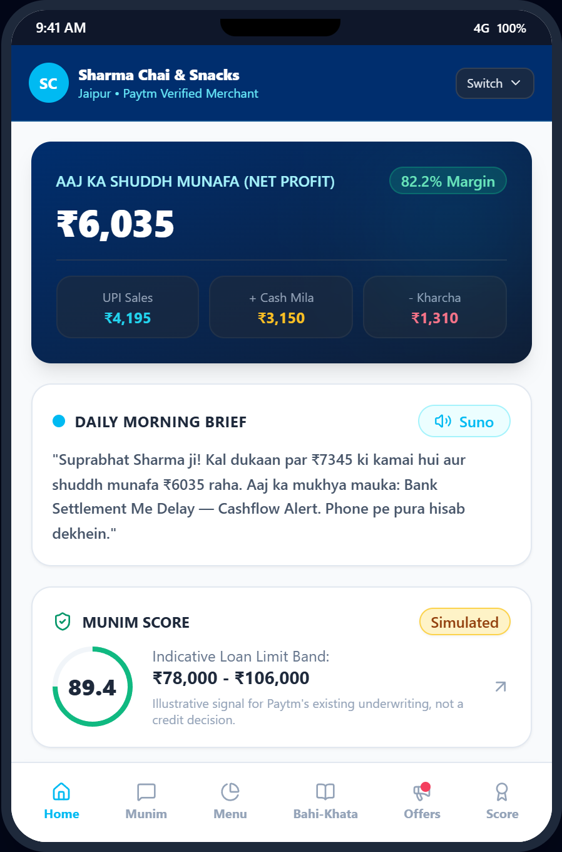






Team Munim
MUNIM (मुनीम)
Paytm AI Hackathon 2026
PROJECT OVERVIEW
Paytm AI Partner Hackathon 2026 Submission
Problem Theme
Build the AI business partner for every Paytm merchant to increase sales, understand business, and execute right actions.
Product Name
Munim (मुनीम) — Voice-first AI copilot for small Indian shopkeepers.
PS Category
Software / AI Copilot (Deterministic Analytics & Decision Engine).
Operating Channel
Output-only Soundbox speaker at counter + merchant smartphone app.
Working prototype, simulated data
Submitting Team
Team Munim — Pair-programmed prototype built strictly for Paytm merchants.
Deterministic Financial Security
LLM never computes math. 0 numeric errors across 50 financial QA benchmarks.
Paytm AI Partner Hackathon 2026 | Munim
1

Slide 2
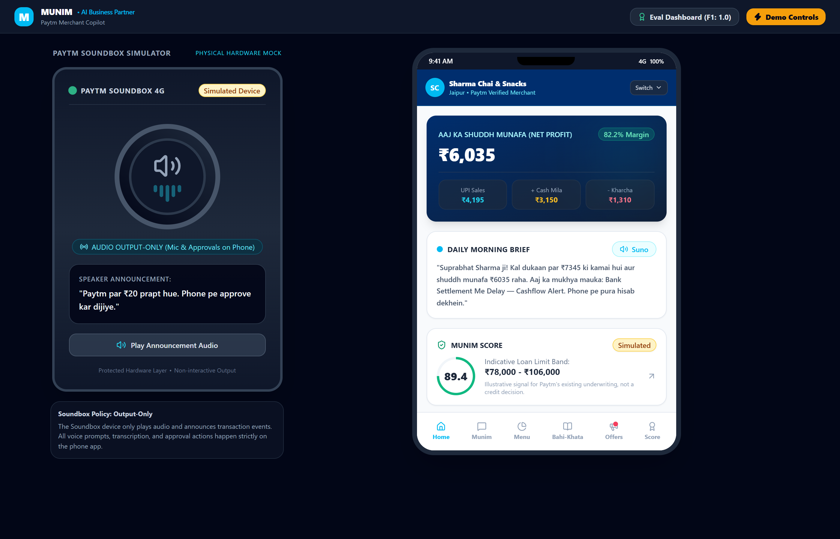








Team Munim
PROPOSAL: Voice-First AI Operating Loop for Paytm Merchants
Paytm AI Hackathon 2026
01 Understand: Continuous Store Signals
Real-time UPI telemetry and evening cash expense recording
UPI Stream
Live incoming digital payment feed.
Item Inference
Clusters amounts to menu items.
Footfall
Z-score rush surge tracking.
02 Recommend: Opportunities & Safety
Identifies demand spikes while actively suppressing unprofitable actions
Rush Alerts
Stock prep alerts 30 min ahead.
Don't Act
Protects margins during lunch peaks.
Munim Score
5-factor credit readiness index.
03 Act & Measure: Ambient Execution
Audio broadcast on counter followed by explicit mobile approval
Integrated Merchant View (Prototype, simulated data)
Soundbox TTS
Hinglish audio voice announcements.
1-Tap Approval
Mandatory mobile approval gate.
Measure Uplift
Simulated campaign revenue vs holdout.
CORE OPERATIONAL PRINCIPLES
Engineered specifically for non-tech-savvy micro-merchants
Soundbox Speaks
Counter speaker is strictly output-only.
Approval Gate
Zero external actions without mobile tap.
Honest Limits
Clearly marks assumptions & simulations.
Paytm AI Partner Hackathon 2026 | Munim
2

Slide 3

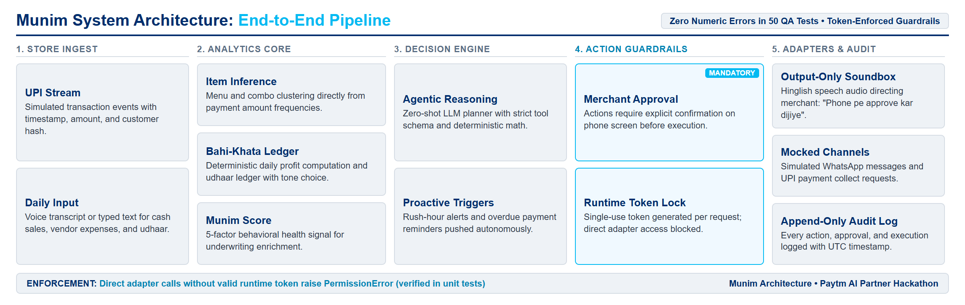

Team Munim
TECHNICAL APPROACH: Deterministic Intelligence & Defense-in-Depth
Paytm AI Hackathon 2026
CORE TECHNOLOGY STACK
Lightweight, auditable, CPU-optimized Python stack
THE PARALLEL DETECTION & ACTION PIPELINE
Defense-in-depth: strict separation between LLM reasoning, math calculation, and execution
Languages
Python 3.12, TypeScript, React 18, FastAPI
01 Ingest & Validate
Streams UPI payments & validates daily cash ledger with schema rules.
Item Inference
GMM clustering + combo solver.
Bahi-Khata Ledger
True net daily cash profit.
03 Guard & Gate
Single-use approval tokens gate external channels.
Analytics & ML
scikit-learn, NumPy, GMM, Combo Solver
Footfall Detector
+2.8σ volume surge analytics.
Munim Score Engine
5-factor credit readiness telemetry.
Speech & Audio
Kokoro Neural TTS, Hinglish Voice Parser
PROTOTYPE vs. PRODUCTION RAILS
Architectural evolution path for Paytm enterprise scale
Compute
Soundbox
Payments
Lending
Database & Audit
SQLite (SQLModel), Append-Only Audit Log
Local FastAPI
WebSocket Sim
Synthetic Stream
Munim Score
Safety & Guards
Token-Locked Mock Adapters, Runtime Verifier
Paytm Cloud Microservices
Paytm 4G Soundbox MQTT
Paytm QR Webhook Engine
Partner Licensed NBFC API
Working prototype architecture
Production integrations labeled above are architectural roadmap assumptions.
Paytm AI Partner Hackathon 2026 | Munim
3

Slide 4
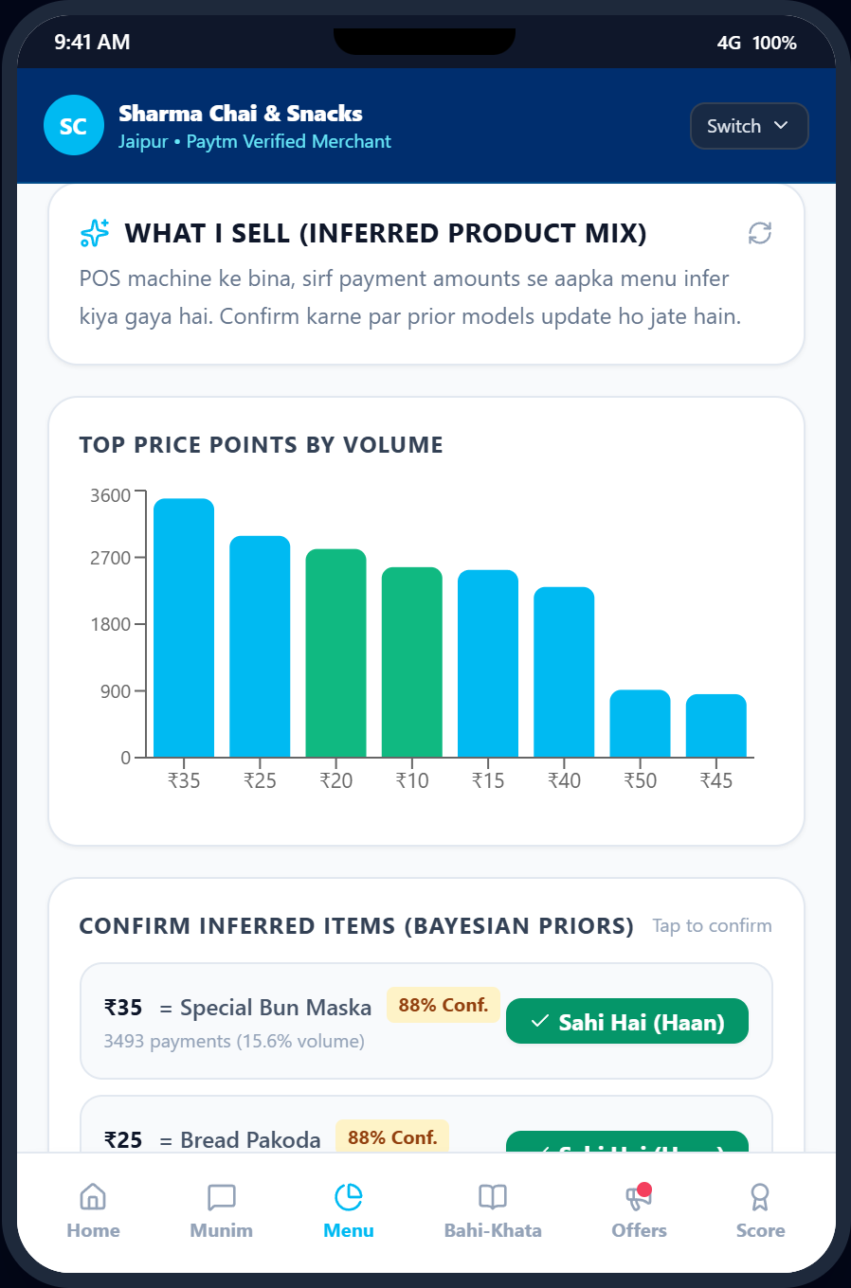
Team Munim
ITEM INFERENCE: Unsupervised Menu Discovery Without POS
Paytm AI Hackathon 2026
UNSUPERVISED DISCOVERY PIPELINE
Transforms raw UPI transaction streams into item-level catalog intelligence
01 Cluster Price Points
Unsupervised Gaussian Mixture Models group transaction amounts into distinct price clusters without manual barcode entry.
02 Explain Combinations
Combinatorial subset solver decomposes multi-item order totals (e.g. ₹50 = ₹20 Chai + ₹30 Bun Maska) into candidate items.
03 1-Tap Merchant Confirmation
Bayesian hypothesis chips appear on mobile; merchant confirms item name once to lock catalog with 100% confidence.
What I Sell view: Inferred menu mix with confirmation chips
EMPIRICAL EVALUATION RESULTS (eval_item_inference.json)
• Clean Synthetic Price Points: F1 Score = 1.000 (Tested on clean synthetic price points)
• Hard-Case Adversarial Stress Test: F1 Score = 0.588 (Real-world noise & price overlap boundary)
Simulated
Paytm AI Partner Hackathon 2026 | Munim
4

Slide 5
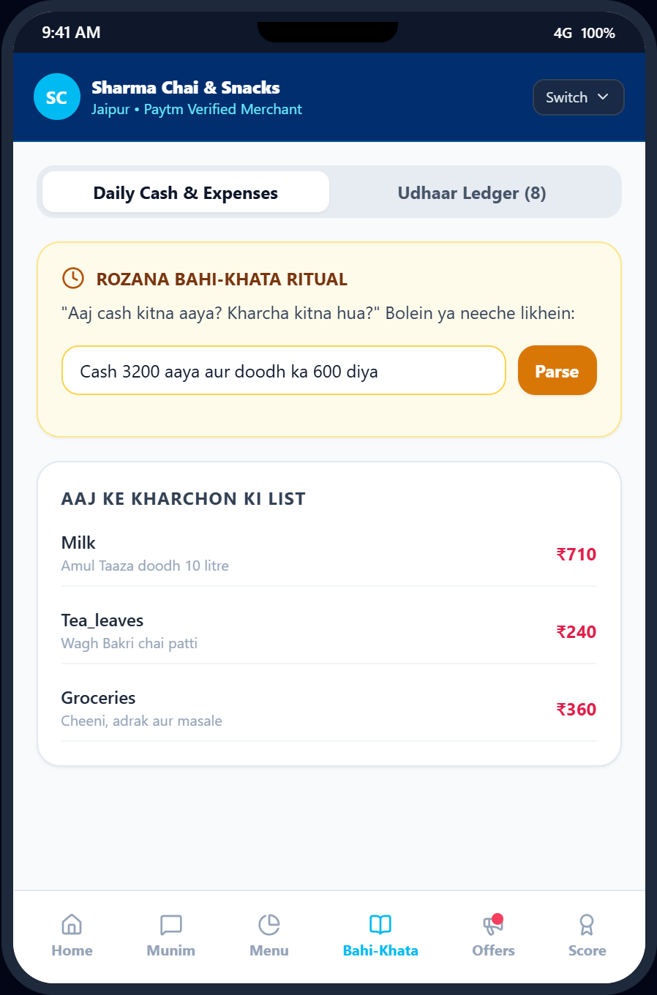


Team Munim
BAHI-KHATA & UDHAAR: Eliminating Invisible Cash Leakage
Paytm AI Hackathon 2026
DAILY RECONCILIATION WORKFLOW
Reconciles unrecorded informal vendor payouts with digital collections
01 30-Second Evening Cash Log
Merchant enters daily vendor cash expenses (milk, gas, vegetables) via typed Hindi text or voice input in 30 seconds.
02 True Daily Net Profit
Deterministic arithmetic calculates True Profit = UPI Digital Sales + Cash Inflow - Cash Outflow. Zero LLM math drift.
03 Tone-Controlled Debt Recovery
Overdue credit is tracked by aging days; merchant chooses Polite, Formal, or Firm tone before tapping Approve to send.
Bahi-Khata Ledger view: Typed daily cash log & overdue credit list
CUSTOMER CONSENT & ETHICAL COLLECTION BOUNDARY
Munim never broadcasts customer names over the counter Soundbox. Udhaar reminder links are generated as private mobile drafts and dispatched via WhatsApp only upon explicit merchant approval.
Paytm AI Partner Hackathon 2026 | Munim
5

Slide 6
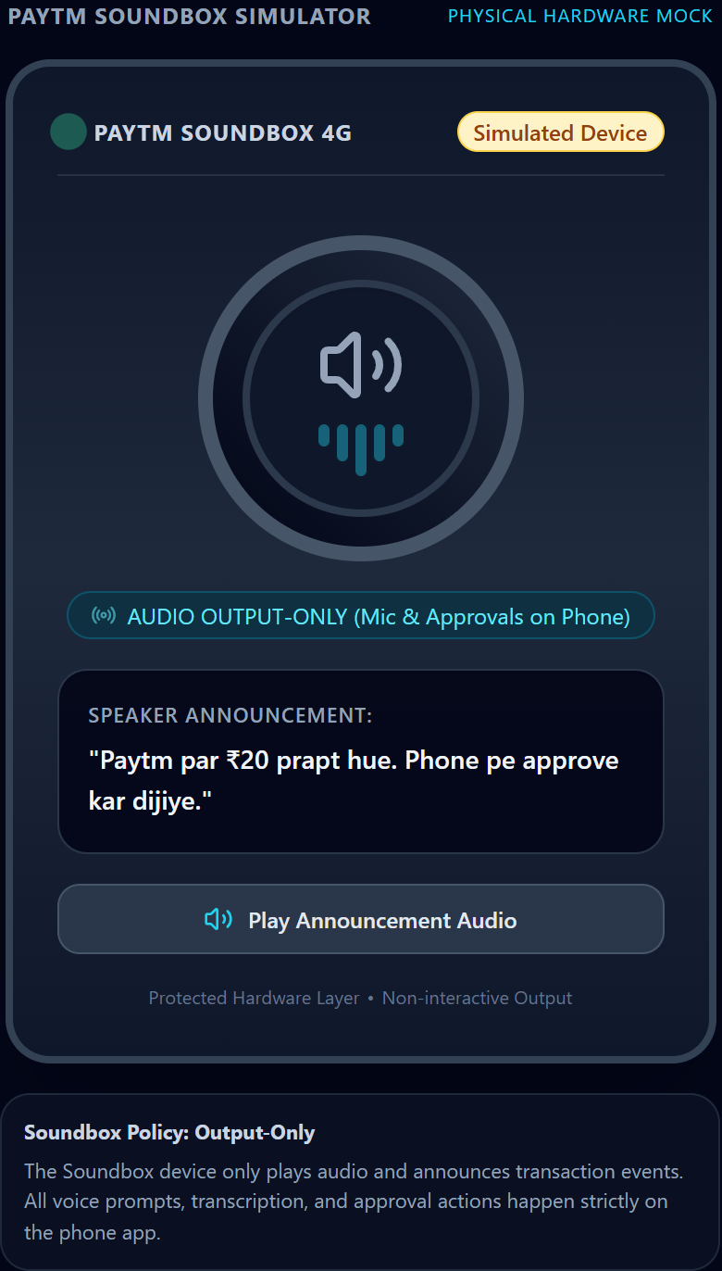



Team Munim
LIVE INTELLIGENCE: Proactive Surges & Honest 'Don't Act' Restraint
Paytm AI Hackathon 2026
OPPORTUNITY: FOOTFALL RUSH
Proactive inventory preparation 30m ahead
MARGIN SAFETY: 'DON'T ACT'
Suppresses discounts during expected lulls
Real-Time Telemetry Burst
UPI transaction rate exceeds historical baseline threshold.
Dip Detection
Payment volume drops 35% below peak morning rush hour.
Statistical Surge Validation
Footfall detector identifies +2.8σ volume acceleration.
Context Explanation
Correlates drop with historical Tuesday afternoon dead lull.
Countertop Voice Broadcast
Announces: 'Chai aur bun maska tayyar rakhein, rush aane wala hai'.
Margin Protection Check
Refuses to trigger discount coupon: discounting would destroy margin.
Automatic Cooldown Window
Suppresses duplicate alerts for 45 minutes to avoid merchant fatigue.
Decision Engine Output
Deliberately recommends: 'Don't Act — Normal lull, preserve pricing'.
Working Soundbox simulator: Audio output only
Paytm AI Partner Hackathon 2026 | Munim
6

Slide 7



Team Munim
TRUST & SAFETY: 3-Tier Risk Hierarchy & Cryptographic Tokens
Paytm AI Hackathon 2026
3-TIER RISK STAIRCASE
Autonomous analysis strictly separated from external action
RUNTIME GUARDRAIL GATEWAY
Tested token architecture prevents unauthorized external adapter execution
ARCHITECTURAL GUARANTEES
Proven through automated unit tests and eval harness
Tier 1: Read & Analyze
Autonomous. Ingests payment feed and calculates profit. Zero external impact.
Agent Tool Call
LLM attempts to trigger external action
Zero Math in LLM
100% of profit, margin, and credit calculations are isolated in deterministic Python arithmetic.
Runtime Guardrail
Intercepts call and validates payload schema
Tier 2: Drafts & Insights
Autonomous preparation. Drafts reminder messages and morning brief internally.
Merchant Approval
Prompts 1-tap confirmation card on phone
Token-Enforced Adapters
Direct adapter calls without a valid single-use token raise PermissionError (verified in unit tests).
Single-Use Token
Generates single-use cryptographically secure token
Tier 3: External & Money Actions
Gated. Customer WhatsApp reminders require explicit mobile tap. Never auto-sent.
Mock Adapter Execution
Dispatches WhatsApp collect or UPI request
Isolated Ground Truth
Item discovery runs strictly unsupervised; seed labels are isolated from the inference engine.
Append-Only Audit Log
Records UTC timestamp, action, and merchant decision
Paytm AI Partner Hackathon 2026 | Munim
7

Slide 8
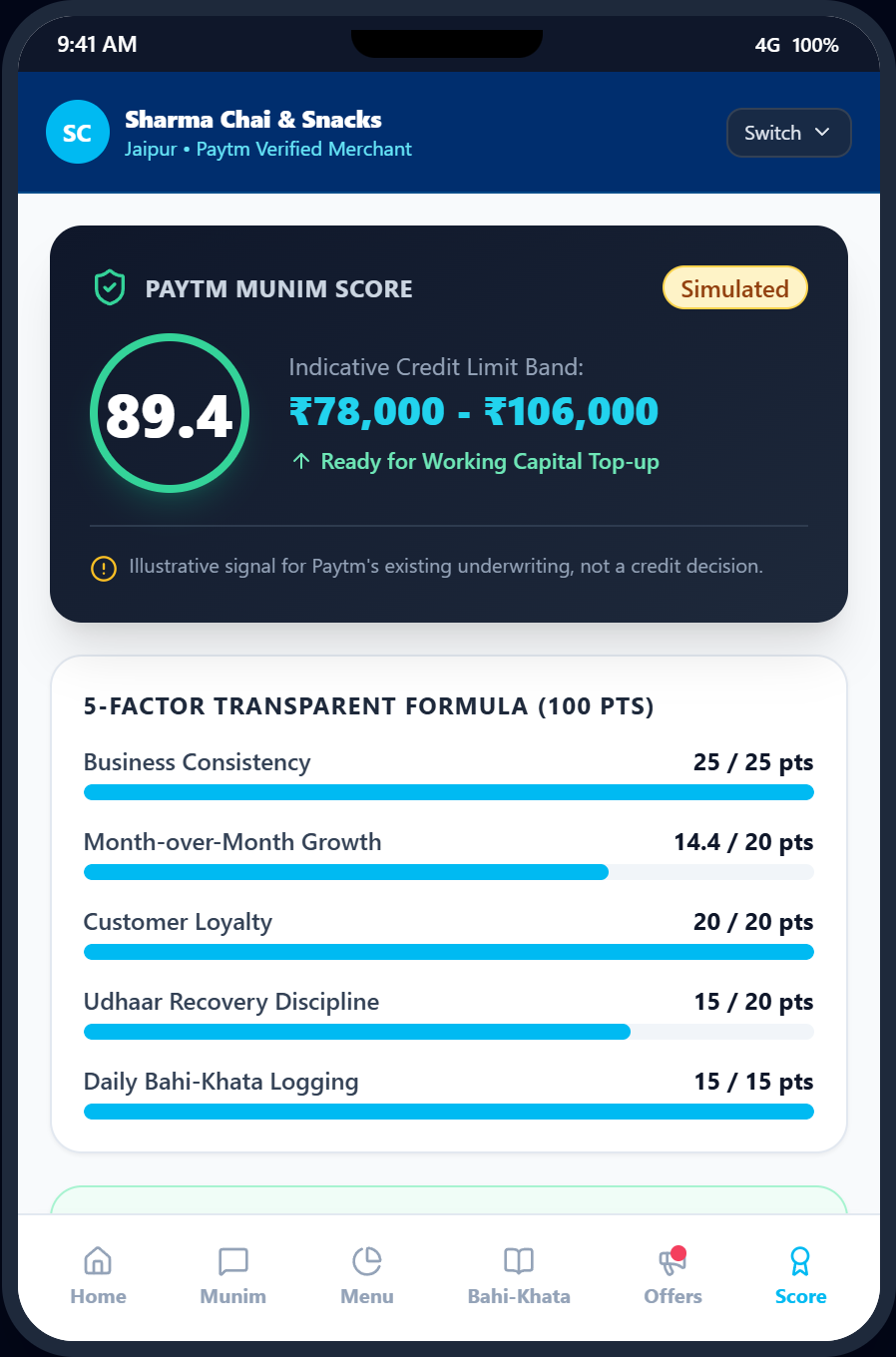
Team Munim
MUNIM SCORE: Behavioral Cashflow Signal for Paytm Underwriting
Paytm AI Hackathon 2026
5-FACTOR BEHAVIORAL SCORING MODEL
Derived purely from daily operating discipline without tax returns or collateral
Volume Consistency (25%)
Measures regular daily customer transactions and business stability.
Expense Discipline (25%)
Regularity of recording evening vendor cash logs in Bahi-Khata.
Revenue Stability (20%)
Week-over-week digital sales trajectory and footfall reliability.
Udhaar Recovery Rate (15%)
Success rate and speed of recovering outstanding customer credit.
Operating Margin Health (15%)
Sustained net profit margin after deducting all operating costs.
Munim Score dashboard: Score tier breakdown and actionable raising tips
REGULATORY & CREDIT COMPLIANCE BOUNDARY (MANDATORY)
Illustrative behavioral signal for Paytm's existing licensed underwriting. Not a credit decision. Munim does not disburse loans, set interest rates, or make licensed credit judgments. It enriches underwriting telemetry for regulated financial institutions.
Paytm AI Partner Hackathon 2026 | Munim
8

Slide 9
Team Munim
DEMONSTRATION SCENARIO: A Day in the Life of Ramesh
Paytm AI Hackathon 2026
ACT 1
08:00 AM
ACT 2
12:30 PM
ACT 3
04:30 PM
ACT 4
06:00 PM
ACT 5
09:00 PM
Simulated
Morning Briefing
Surge Warning
Bahi-Khata Ritual
Udhaar Recovery
Measure Uplift
• Soundbox plays Hinglish neural audio.
• Announces yesterday's net cash profit.
• Reminds milk replenishment target.
• Detects +2.8σ footfall rush surge.
• Alerts counter: 'Bun maska tayyar'.
• Suppresses discounts to save margin.
• Ramesh types: 'Doodh 500, cheeni 200'.
• Parser extracts entries with 90% accuracy.
• Recalculates True Daily Net Profit.
• Flags overdue debtor aging on mobile.
• Merchant picks Polite tone & taps Approve.
• Mock WhatsApp collection link sent.
• Measures combo campaign uplift.
• +21.4% revenue increase recorded.
• Munim Score updates with higher rank.
Paytm AI Partner Hackathon 2026 | Munim
9

Slide 10
Team Munim
FEASIBILITY & VIABILITY: Field Realities and Tested Mitigations
Paytm AI Hackathon 2026
01 FEASIBILITY AT A GLANCE
Evaluating solution readiness from every angle
CHALLENGE vs. TESTED MITIGATION MAPPING
Complex Indian retail field problems paired with proven engineering answers
Data Readiness
UPI stream + 30-sec typed cash log.
Invisible Cash & Expenses
Informal supplier cash payouts remain completely off digital books.
BLINDSPOT
30-Second Bahi-Khata Ritual
Reconciles cash payouts with UPI to compute true daily net profit.
VERIFIED
Hardware Safe
Uses existing Soundbox & merchant phone.
No Ground Truth for Menu
UPI stream gives only rupee amounts, not what items were sold.
CATALOG
Unsupervised GMM Clustering
Groups transactions by price and prompts 1-tap confirmation chips.
VERIFIED
Low Compute
CPU-optimized lightweight Python stack.
Price-Point Collisions
Identical price points (e.g. ₹10 Chai vs ₹10 Biscuit) cause ambiguity.
COLLISION
Subset Solver & Priors
Combinatorial solver ranks item combinations; merchant confirms once.
VERIFIED
Human Control
Mandatory single-use mobile approval gate.
Street Noise & Acoustic Limit
Loud market chatter makes continuous counter mic listening fail.
ACOUSTIC
Output-Only Soundbox
Soundbox is strictly a speaker; user inputs happen in private on phone.
VERIFIED
THE RESULT: HIGH ADOPTION
A low-friction, high-trust copilot engineered specifically for informal micro-merchants.
Customer Debtor Privacy
Aggressive debt reminders harm friendly neighborhood merchant relationships.
PRIVACY
Tone-Controlled Approval
Merchant chooses Polite tone; links dispatched only after mobile approval.
ROADMAP
Paytm AI Partner Hackathon 2026 | Munim
10

Slide 11
Team Munim
IMPACT AND BENEFITS: Ecosystem Paradigm Shift & Verification
Paytm AI Hackathon 2026
AUDIENCE & ECOSYSTEM IMPACT
Multi-sided value creation across the Paytm network
MEASURABLE SOLUTION BENEFITS
Quantified operational gains across key store dimensions
Micro-Merchants
True profit clarity & recovered udhaar.
Paytm Payments
Higher daily merchant app engagement.
Financial Gain
Eliminates ~15% unrecorded cash leakages & accelerates debt recovery.
Operational Ease
Advance footfall rush surge warning enables timely stock prep.
MUNIM
AI ENGINE
Lending Partners
Enriched cashflow behavioral signals.
Soundbox Fleet
Transforms speaker into active advisor.
Margin Protection
Honest 'Don't Act' restraint suppresses discount coupons during peak rush.
Credit Inclusion
Generates alternative cashflow telemetry for unbanked micro-merchants.
CURRENT TOOLS vs. MUNIM AI COPILOT (PARADIGM SHIFT)
Comparing traditional manual bookkeeping against proactive AI copilot loops
Parameter | Current Manual Bookkeeping | → | Proposed Munim AI Copilot | AI Engine / Implementation
Timing | ✗ Post-facto end-of-month review | → | ✓ Real-time streaming & ambient alerts | Continuous transaction listener & TTS
Store Actions | ✗ Purely manual calculation | → | ✓ Proactive drafts with 1-tap mobile approval | Deterministic reasoning & token gate
Offline Cash | ✗ Informal cash invisible to bank | → | ✓ 30-second daily evening Bahi-Khata log | Reconciles cash with digital for True Profit
Item Visibility | ✗ Expensive POS barcode scanners | → | ✓ Unsupervised menu discovery without POS | GMM clustering + combo subset solver
Safety & Math | ✗ LLM math hallucination risk | → | ✓ 0 numeric errors on 50 QA benchmarks | Strict Python arithmetic (LLM math-free)
Empirical Proof
0 numeric errors on 50 QA tests (synthetic data, n=50) | 27/30 voice phrases parsed | Item F1: 1.0 clean / 0.588 stress
Simulated
Paytm AI Partner Hackathon 2026 | Munim
11

