Slide 1
Codos
DFD

Slide 2
Functionalities
Login
Sign Up
Edit profile
Registration in challenges
Compile & Test
Submit solution
Add challenges/problem
View Profile
View Participated Challenges
View Upcoming Challenges
View Live Challenges
View Practice Problem
Create contest

Slide 3
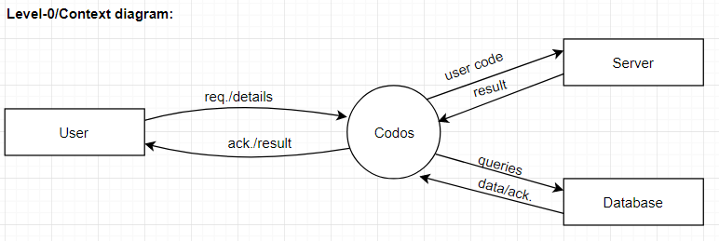
Level-0/Context diagram:

Slide 4
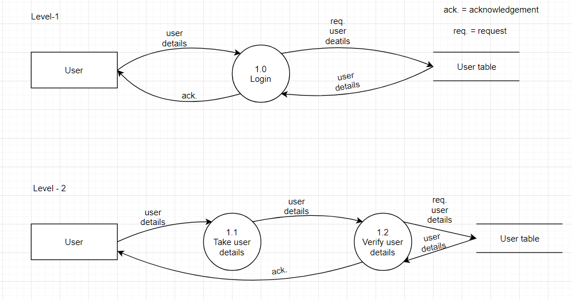
Login:

Slide 5
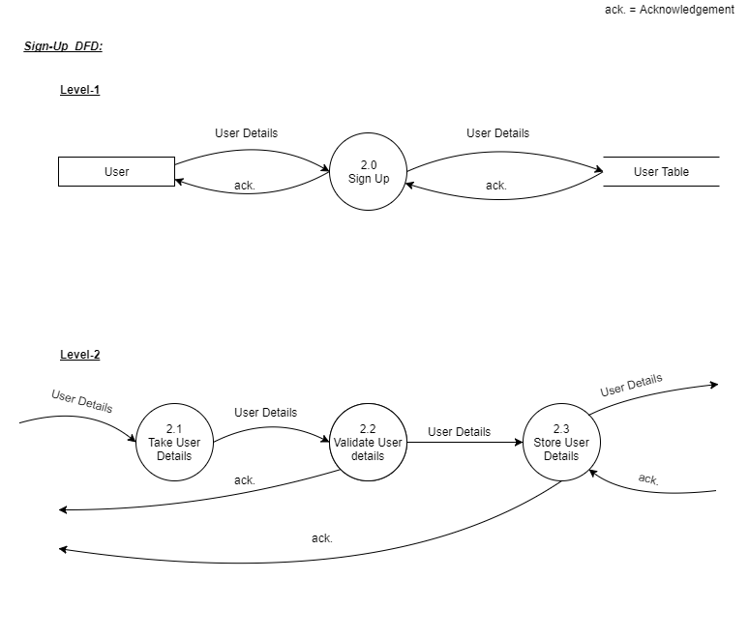
Sign Up:

Slide 6
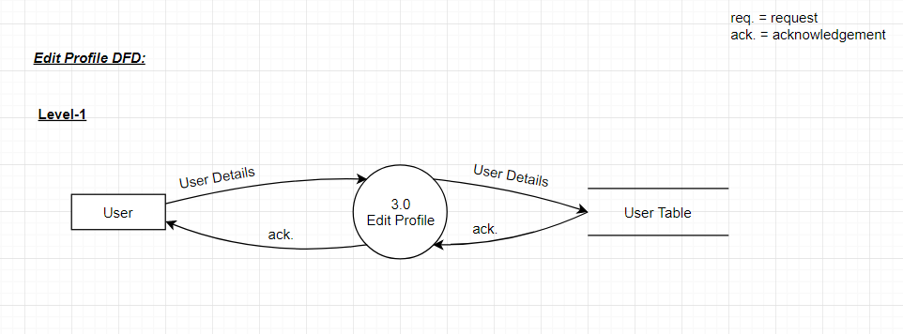
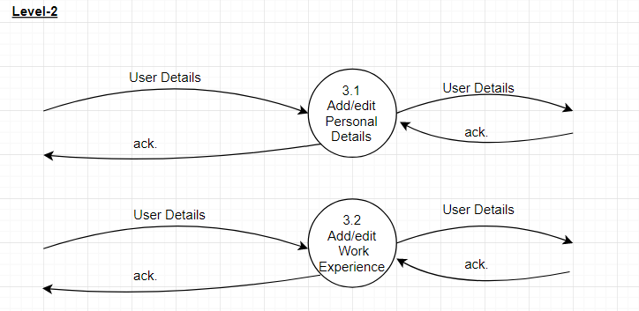
Edit Profile:

Slide 7
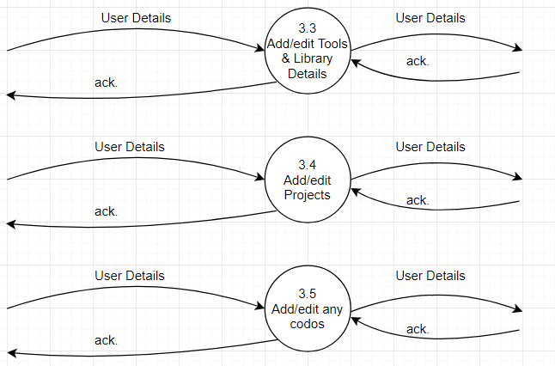

Slide 8
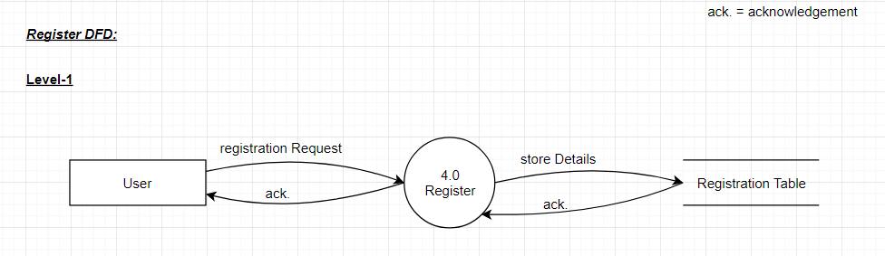
Registration in challenges:

Slide 9
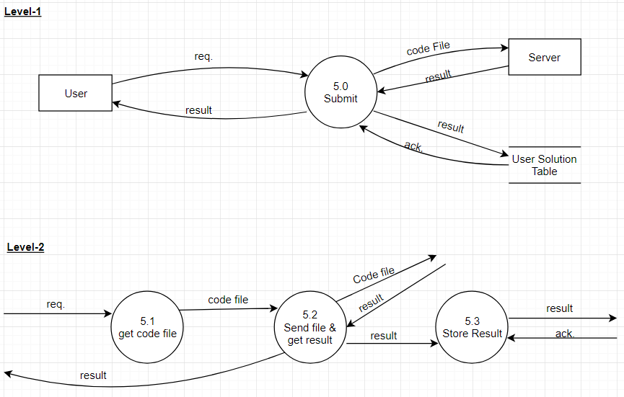
Submit Solution:

Slide 10
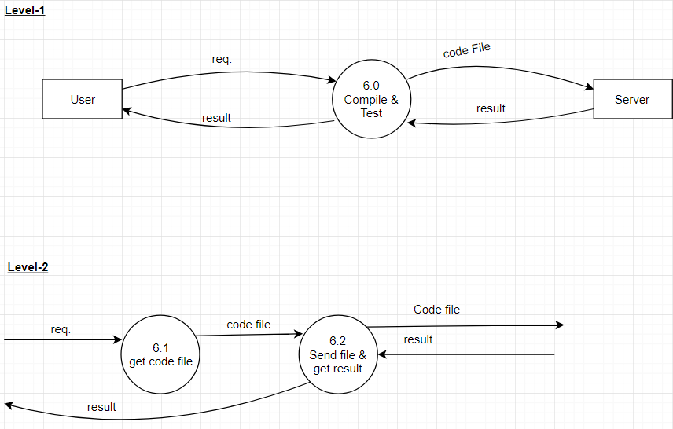
Compile & Test:

Slide 11
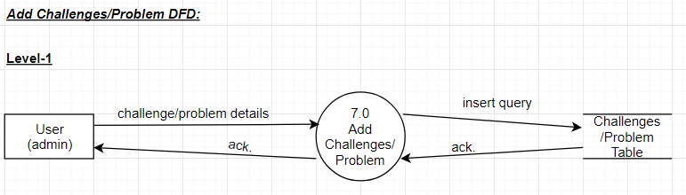
Add Challenges/Problem:

Slide 12
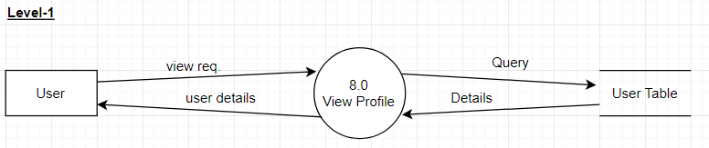
View Profile:

Slide 13
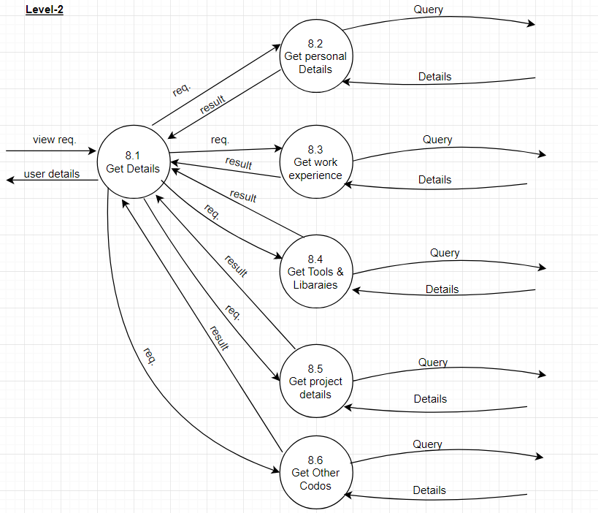

Slide 14
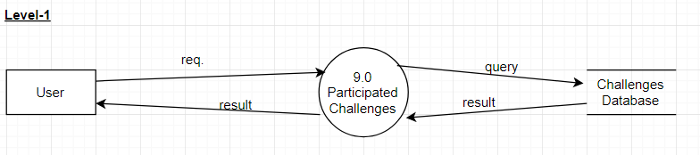
View Participated Challenges:

Slide 15
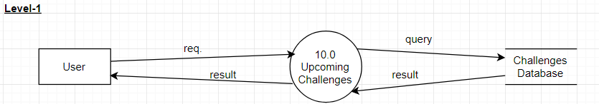
View Upcoming Challenge:

Slide 16
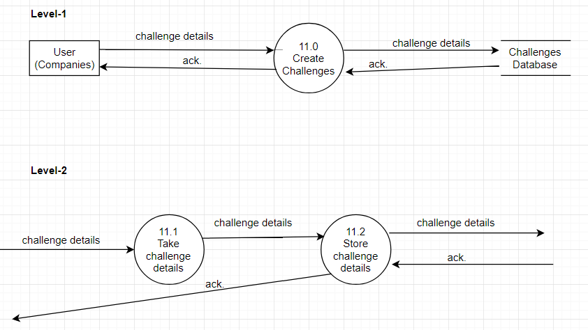
Create Contest:

Slide 17
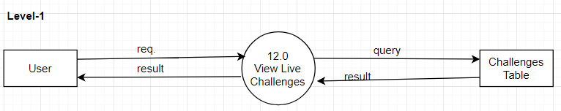
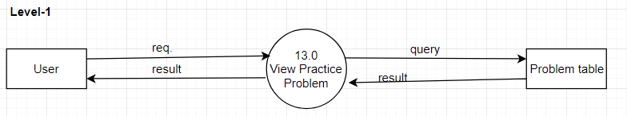
View Live challenges:
View Practice Problem:

Slide 18
The End

