Slide 1
Codos
DFD

Slide 2
Functionalities
Login
Sign Up
Edit profile
Registration in challenges
Compile & Test
Submit solution
Add challenges/problem
View Profile
View Participated Challenges
View Upcoming Challenges
View Live Challenges
View Practice Problem
Create contest

Slide 3
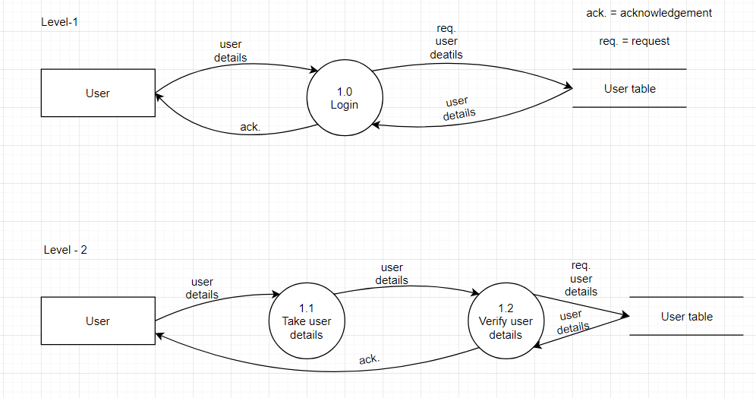
Login:

Slide 4
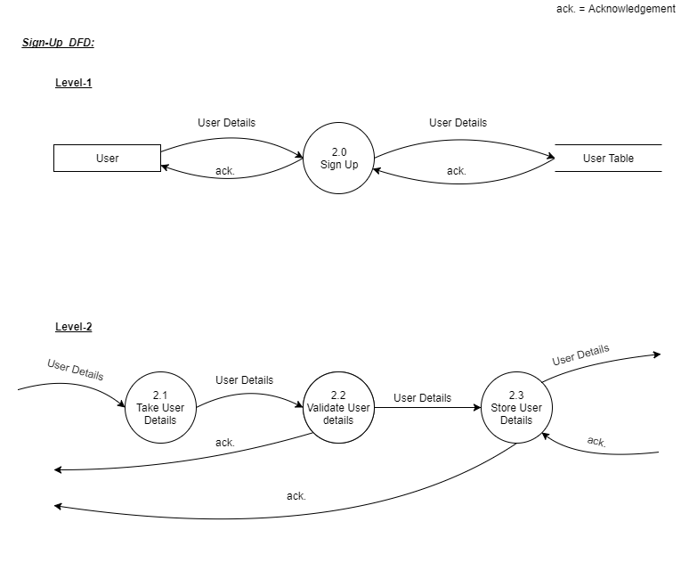
Sign Up:

Slide 5
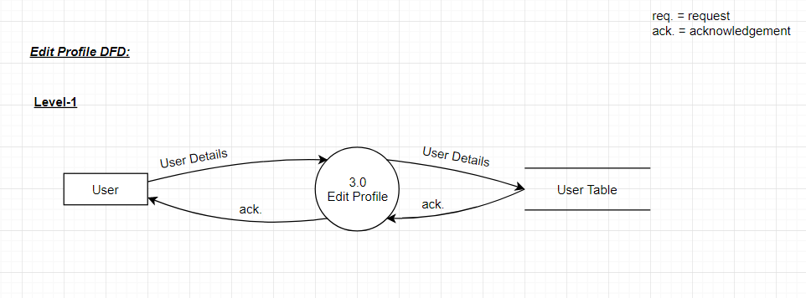
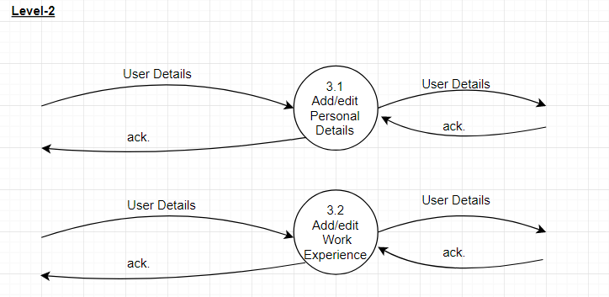
Edit Profile:

Slide 6
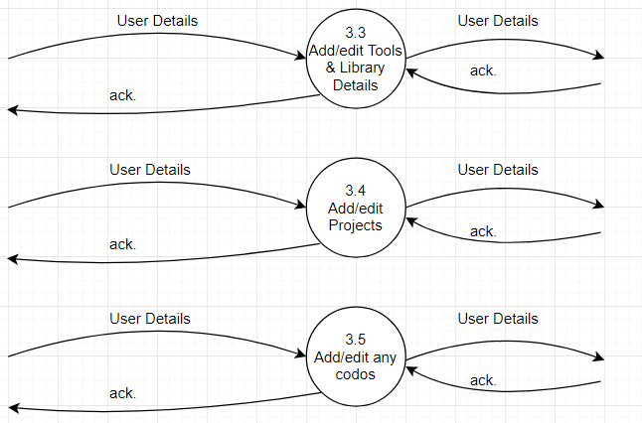

Slide 7
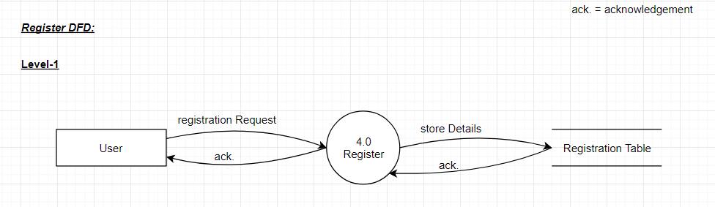
Registration in challenges:

Slide 8
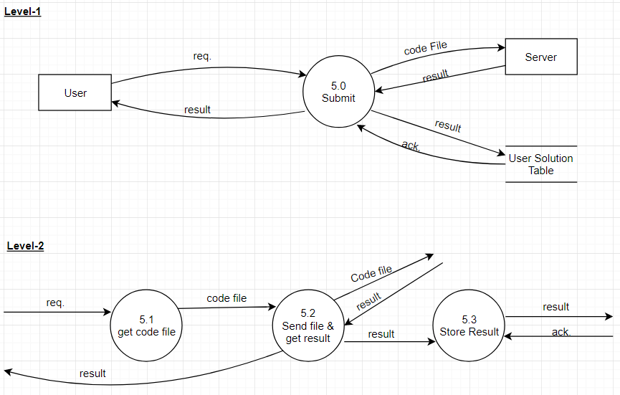
Submit Solution:

Slide 9
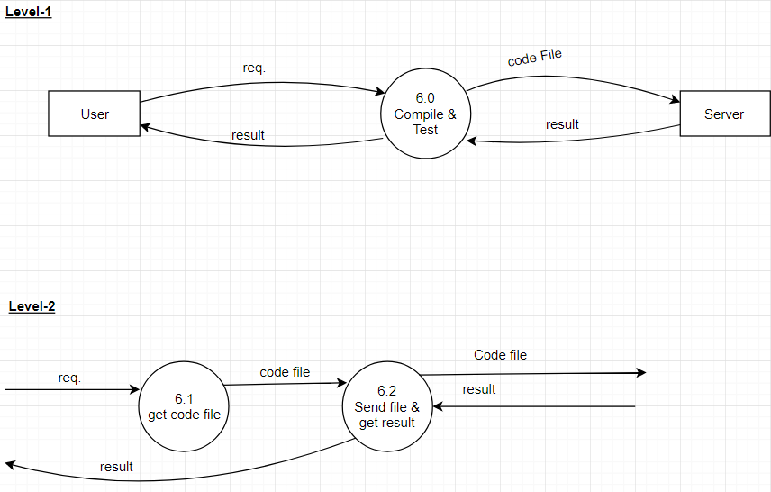
Compile & Test:

Slide 10
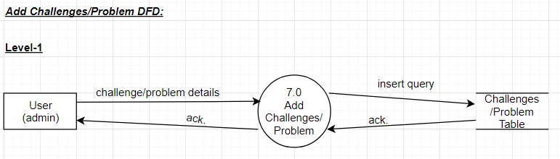
Add Challenges/Problem:

Slide 11
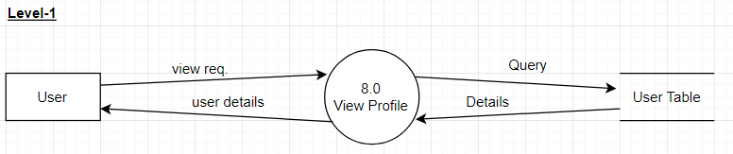
View Profile:

Slide 12
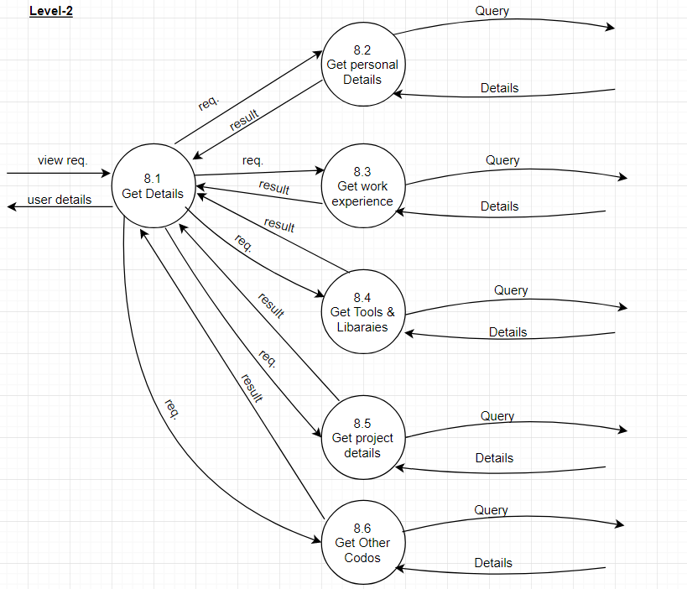

Slide 13
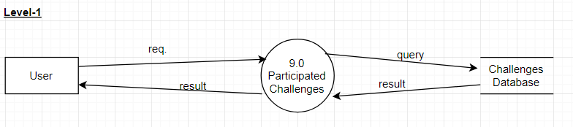
View Participated Challenges:

Slide 14
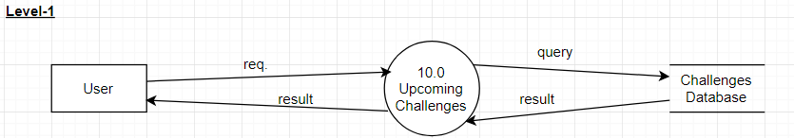
View Upcoming Challenge:

Slide 15
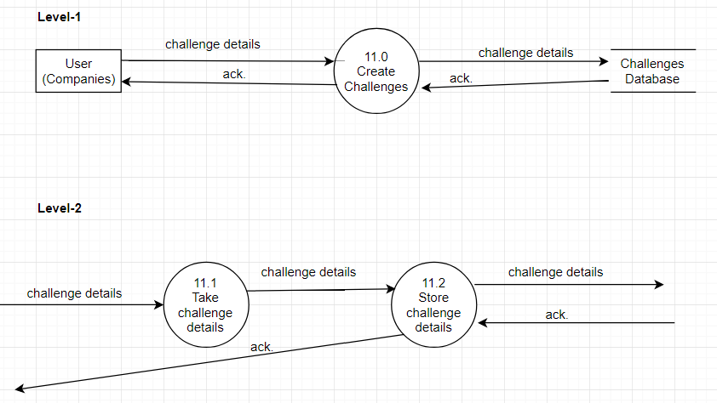
Create Contest:

Slide 16
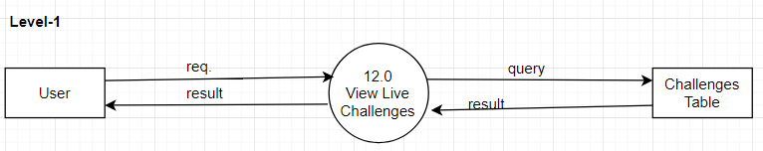
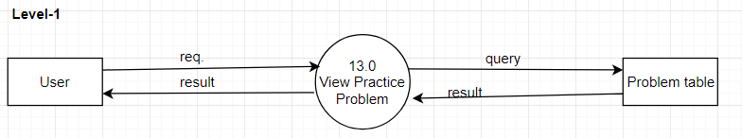
View Live challenges:
View Practice Problem:

Slide 17
The End

