Slide 1
Med‑Track
Your Personal & Family Health Companion

Slide 2
The Challenge of Managing Health Records
Keeping track of symptoms over time is difficult.
Remembering past medications, durations, and doctor instructions is error‑prone.
Managing health records for multiple family members leads to fragmented data.
Communicating accurate medical history to doctors is often rushed and incomplete.

Slide 3
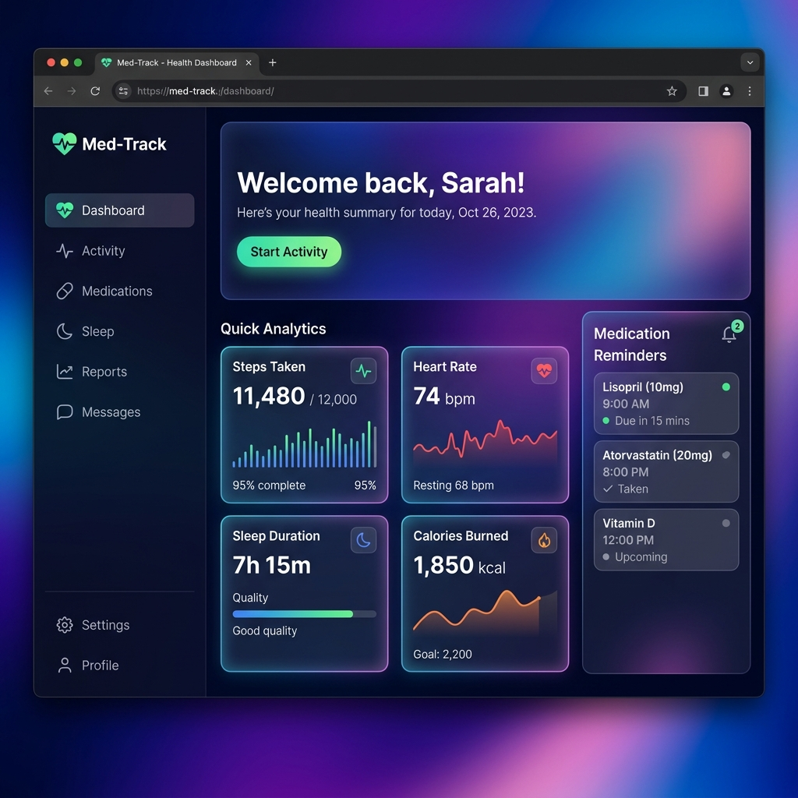
Introducing Med‑Track
A unified, digital health diary.
Log symptoms, medications, and doctor visits in real‑time.
Visual trend analysis for vitals (temperature, SpO2).
Works offline as a PWA with dark mode.

Slide 4
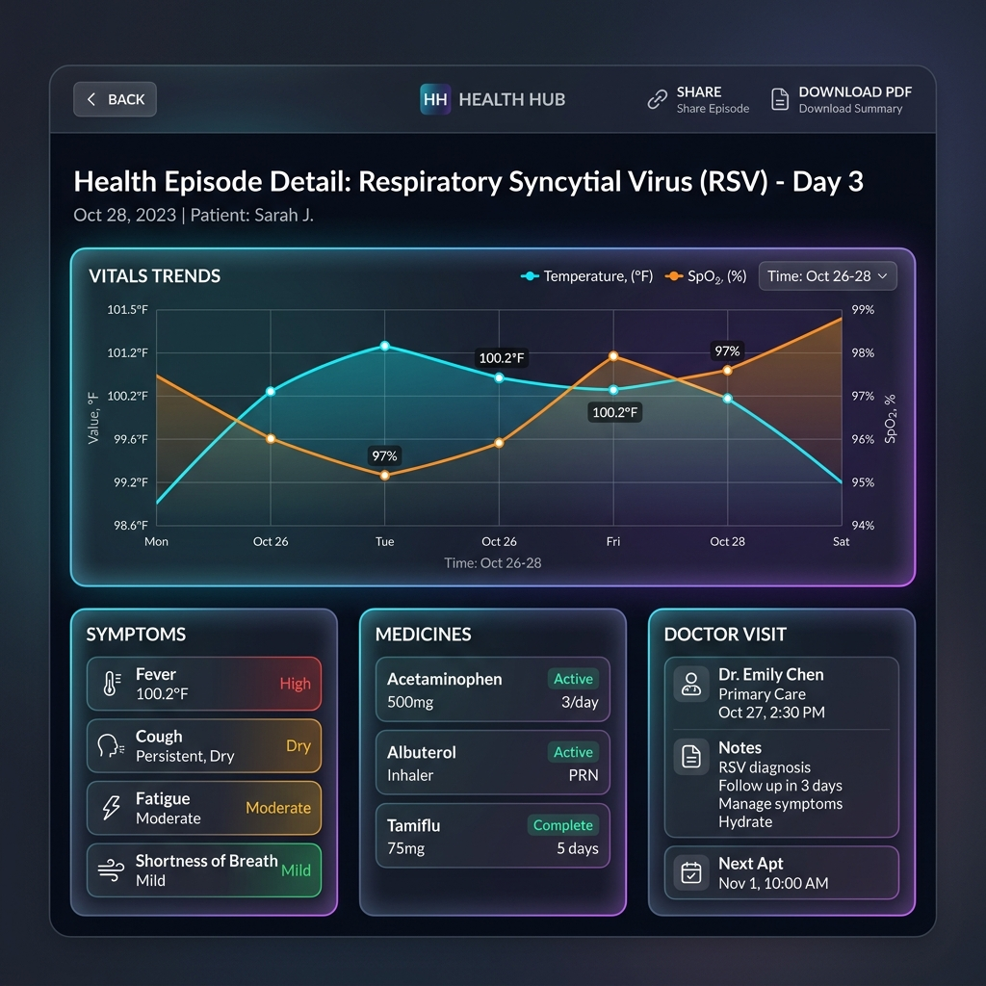
Core Capabilities
Dynamic Health Episodes – continuous updates.
Family Profiles – one account, many users.
Vitals Visualization – interactive charts.

Slide 5
Sharing & Accessibility
Shareable Doctor Links – secure read‑only URLs.
PDF Export – one‑click medical report.
Progressive Web App – install on phone, offline use.
Dark Mode – eye‑friendly for night logging.

Slide 6
Built for Speed & Reliability
Frontend: React + Vite – lightning fast.
Styling: Tailwind CSS + glassmorphism – vibrant UI.
Backend: Firebase Auth & Firestore – real‑time syncing.
Charts: Recharts – responsive, interactive.

Slide 7
What’s Next?
Smart Medication Reminders – push notifications.
AI Health Insights – detect recurring patterns.
Wearable Integration – Apple Health, Fitbit.

Slide 8
Live Demo – UI Walkthrough

Slide 9
Questions?
Thank you for your time.

