Slide 1
Hiring Process Analytics Statistics
Project Description ->Data Analytics Tasks:
After downloading the dataset, use Excel to answer the below questions:
A. Hiring Analysis: The hiring process involves bringing new individuals into the organization for various roles.
Your Task: Determine the gender distribution of hires. How many males and females have been hired by the company?
B. Salary Analysis: The average salary is calculated by adding up the salaries of a group of employees and then dividing the total by the number of employees.
Your Task: What is the average salary offered by this company? Use Excel functions to calculate this.
C. Salary Distribution: Class intervals represent ranges of values, in this case, salary ranges. The class interval is the difference between the upper and lower limits of a class.
Your Task: Create class intervals for the salaries in the company. This will help you understand the salary distribution.
D. Departmental Analysis: Visualizing data through charts and plots is a crucial part of data analysis.
Your Task: Use a pie chart, bar graph, or any other suitable visualization to show the proportion of people working in different departments.
E. Position Tier Analysis: Different positions within a company often have different tiers or levels.
Your Task: Use a chart or graph to represent the different position tiers within the company. This will help you understand the distribution of positions across different tiers

Slide 2
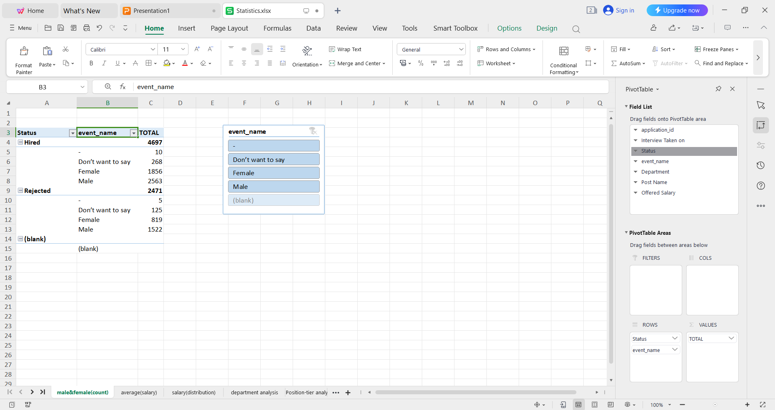
Tech-Stack Used :
APP-WPS OFFICE, Product Version-12.2.0.13085 ,Publisher-Kingsoft corp.
A. Hiring Analysis: The hiring process involves bringing new individuals into the organization for various roles.
Your Task: Determine the gender distribution of hires. How many males and females have been hired by the company?
Approach:
First create a pivot table with the given table in a new sheet .
then add status to row lable, event_name in row lable and application_id in value lable and change it’s field setting to count.
then the gender distribution of hires can be seen on the table.
Output:

Slide 3
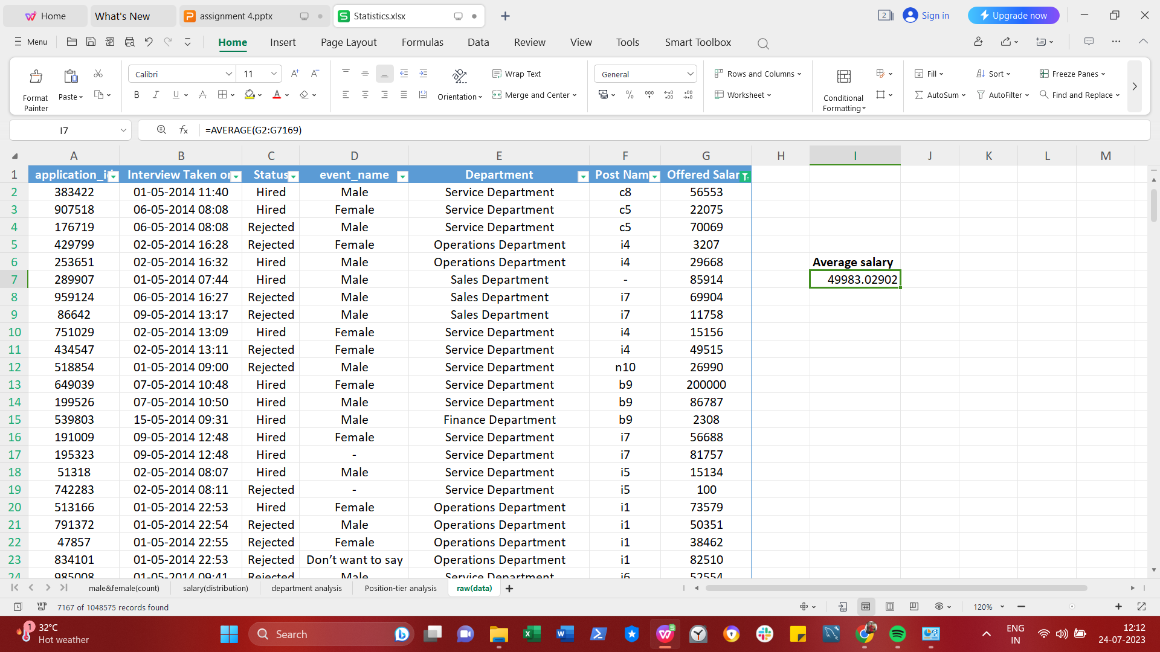
B. Salary Analysis: The average salary is calculated by adding up the salaries of a group of employees and then dividing the total by the number of employees.
Your Task: What is the average salary offered by this company? Use Excel functions to calculate this.
Approach:
Select the cell where i want to show the average.
Then filter the offered_salary to remove blank data to avoid calculation error.
Then go to the home tab and click on autosum drop down buttom and click on average.
After clicking on average it will ask for range for which the calculation has to be perform.
After clicking enter we will get the average salary given by the company.
Output:

Slide 4
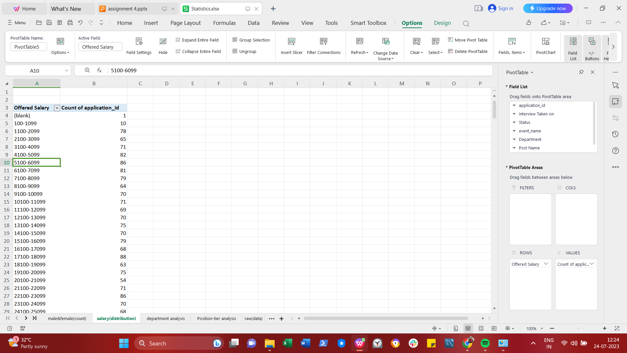
C. Salary Distribution: Class intervals represent ranges of values, in this case, salary ranges. The class interval is the difference between the upper and lower limits of a class.
Your Task: Create class intervals for the salaries in the company. This will help you understand the salary distribution.
Approach:
First create a pivot table in new sheet then add offered salary to row lable and add application id to value lable to count the application id.
then select all the entry in offered salary to put class interval between them.
after selecting ,go to option tab and select group selection.
Then a popup dialog box will appear in which i set the starting & ending point and the interval between them,I choose 1000 as an interval.
then you can see the class interval of salaries and no of employee getting the salary between that range.
Output:

Slide 5
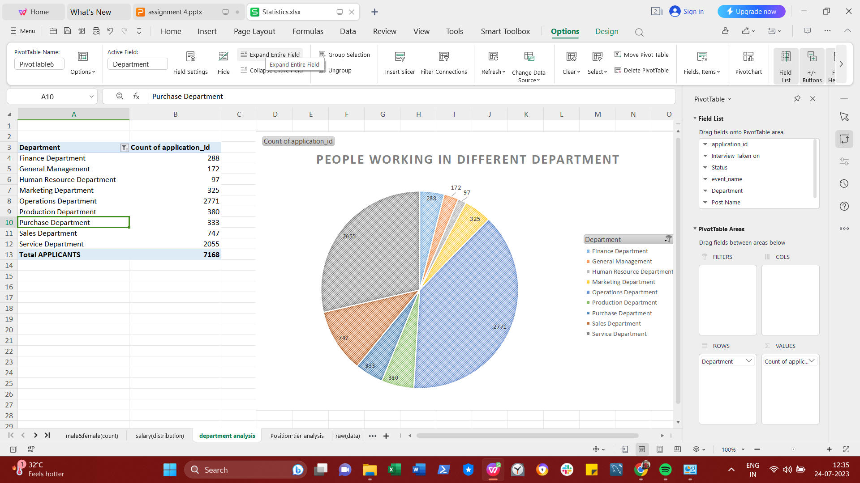
D. Departmental Analysis: Visualizing data through charts and plots is a crucial part of data analysis.
Your Task: Use a pie chart, bar graph, or any other suitable visualization to show the proportion of people working in different departments.
Approach:
first created a pivot table in new worksheet.
Then add department in row lable and application id in values to count no of applicant.
then we will get the table of all the department and no of applicant in that department.
To show that data in graphical format ,we need to select option tab and select pivot chart.
An insert chart dialog box appear from which we need to choose the suitable visualization according to the data,then double click on that chart to dispaly it on the sheet.
Output:

Slide 6
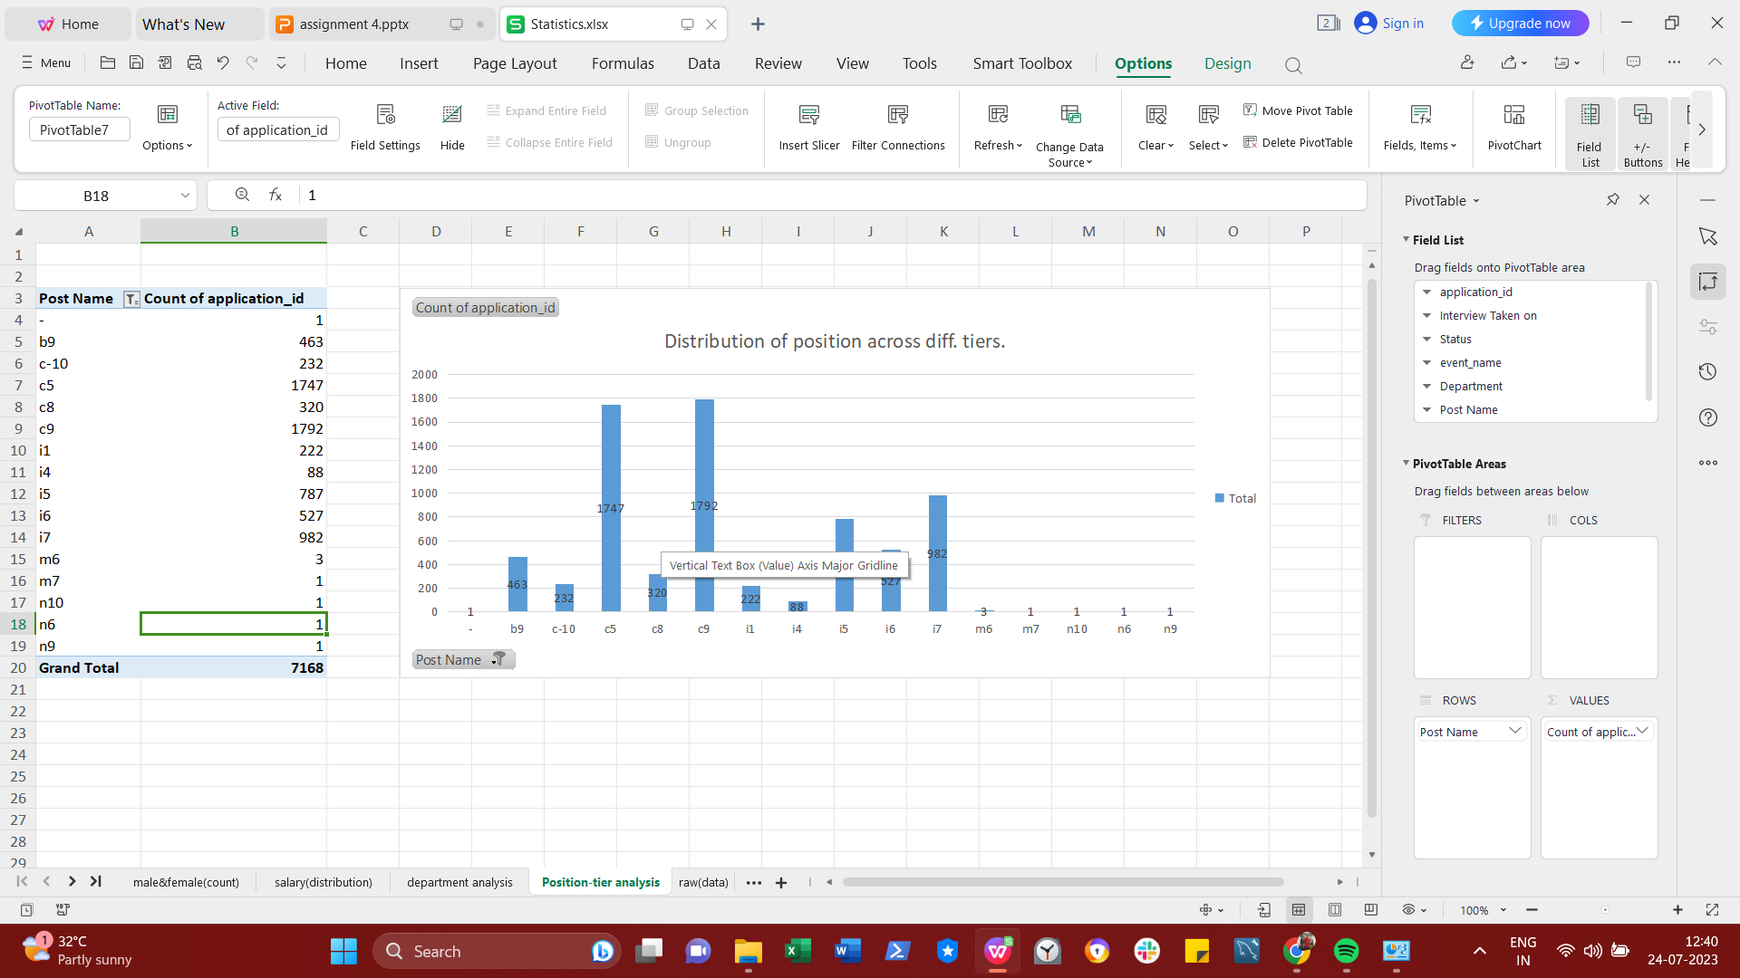
E. Position Tier Analysis: Different positions within a company often have different tiers or levels.
Your Task: Use a chart or graph to represent the different position tiers within the company. This will help you understand the distribution of positions across different tiers.
Approach:
first created a pivot table in new worksheet.
Then add postname in row lable and application id in values to count no of applicant.
then we will get the table of all the postname and no of applicant in that post.
To show that data in graphical format ,we need to select option tab and select pivot chart.
An insert chart dialog box appear from which we need to choose the suitable visualization according to the data,then double click on that chart to dispaly it on the sheet.
Output:

Slide 7
Hyperlink the Excel Sheet file:-
Link:
https://docs.google.com/spreadsheets/d/1E1UqvUt9LwCYcCUNAdc1McixrYjLSv7C/edit?usp=drivesdk&ouid=111398243446314990339&rtpof=true&sd=true

