Slide 1
IMDB Movie Analysis
Final Project-1
Tech-Stack Used :
APP-WPS OFFICE, Product Version-12.2.0.13085 ,Publisher-Kingsoft corp.
Project Description :
A. Movie Genre Analysis: Analyze the distribution of movie genres and their impact on the IMDB score.
Task: Determine the most common genres of movies in the dataset. Then, for each genre, calculate descriptive statistics (mean, median, mode, range, variance, standard deviation) of the IMDB scores.
Approach:
First i created a pivot table with the given data.
then add genre to row lable and again genre to value lable to count , because by counting the genre we can get the genre distribution like we can known how many movie of that genre are present.
then i created another pivot table ,because so,if i manipulate the data it does not affect the whole data that i have extracted.
then i added the genre to row lable and genre to value lable to count and filtered the genre to get the common genre of movies,so that the movie with multiple genre does not be counted more than once.
then i added the imdb score to row lable to get the imdb score of my filtered genre and calculated the descriptive statistic like mean,max,min,variance and standard deviation as this function was present in the value lable.
then to find the median and mode i had to manually entered the formula for the imdb score.

Slide 2
To calculate the median the function i used was syntax: =MEDIAN(SELECT THE RANGE OF WHICH WE WANT TO FIND THE MEDIAN) AND PRESS ENTER.
tO FIND the mode from pivot table is little complicate because we cannot use mode function because mode calculates the higest repeated value and when we add the imdb score value to row lable it merges all the repeated value automatically.
So to get the mode i used INDEX,MATCH,IF & MAX function to get the desire result ,so to get the mode i first created another pivot chart having genre ,imdb score and count of imdb score and perform my calculation to get the mode.
so to get the mode i used this function
Syntax: =INDEX(RANGE OF IMDB SCORE,MATCH(IF(MAX(RANGE OF IMDB COUNT)>1,MAX(RANGE OF IMDB COUNT),FALSE),RANGE OF IMDB COUNT,0))
This function will show the imdb score of higest no of occuring,which is called mode of imdb score.
Insight:
from the statistic i get to know that drama genre got the average higest imdb score as compare to other genre.

Slide 3
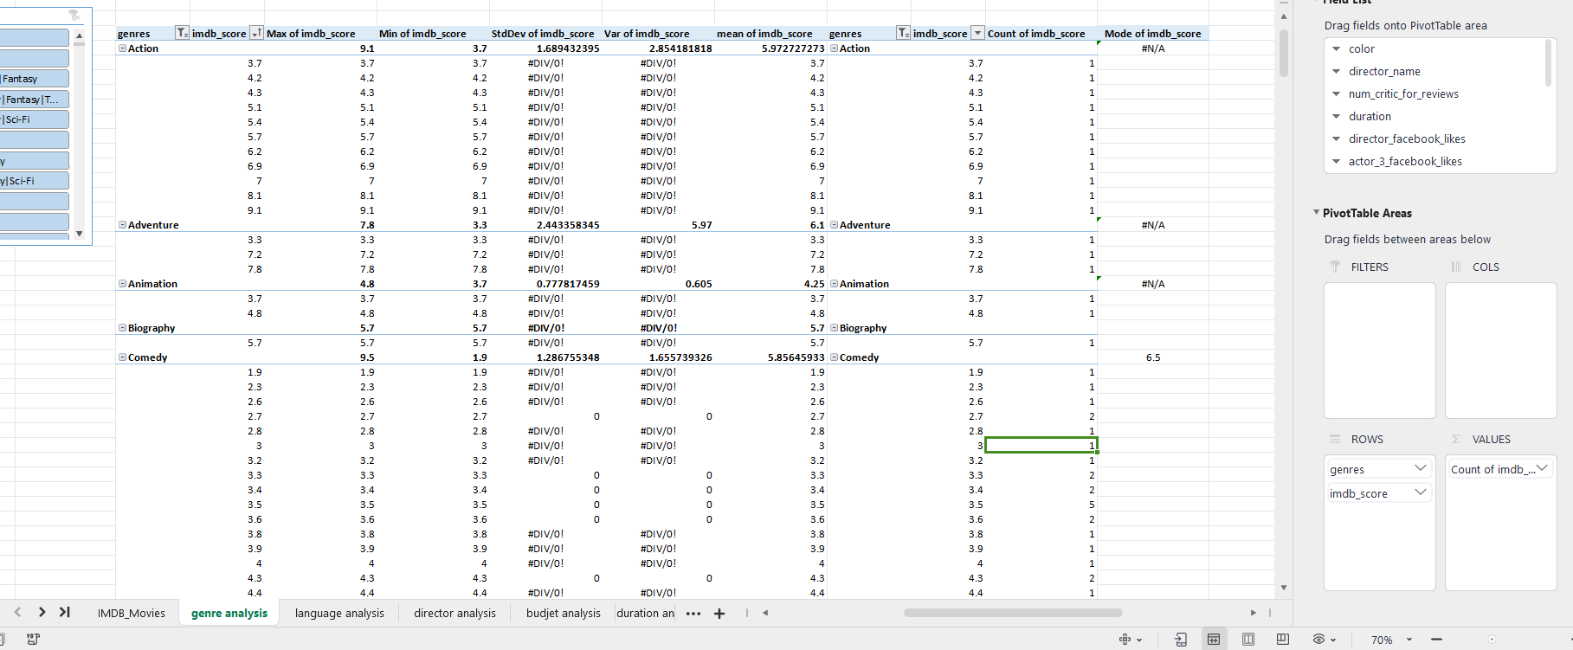

Slide 4
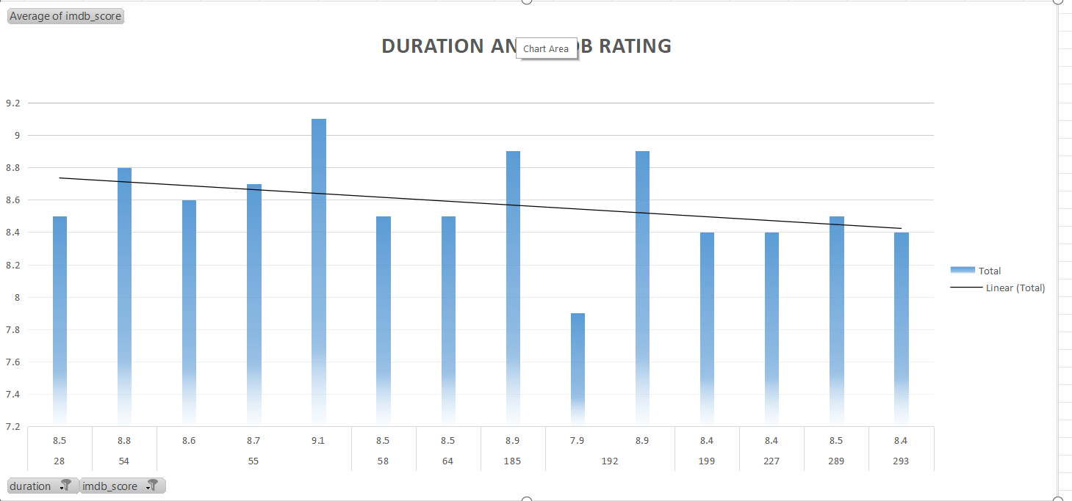
B. Movie Duration Analysis: Analyze the distribution of movie durations and its impact on the IMDB score.
Task: Analyze the distribution of movie durations and identify the relationship between movie duration and IMDB score.
Approach:
First i created 2 pivot table.
in first pivot table i added duration and the imdb score and filtered the blank data.
and then calculated the mean median and standard deviation on the imdb score of different duration .
and then on another pivot table i added duration and imdb score and calculate the average imdb score of duration.
And then i added the pivot chart with trendline to the second pivot table to known the relation between duration and imdb score.
Insight:
Here after seeing the chart i got to know that ,it doest not mean if the duration is high then the movie will get higher imdb score .

Slide 5
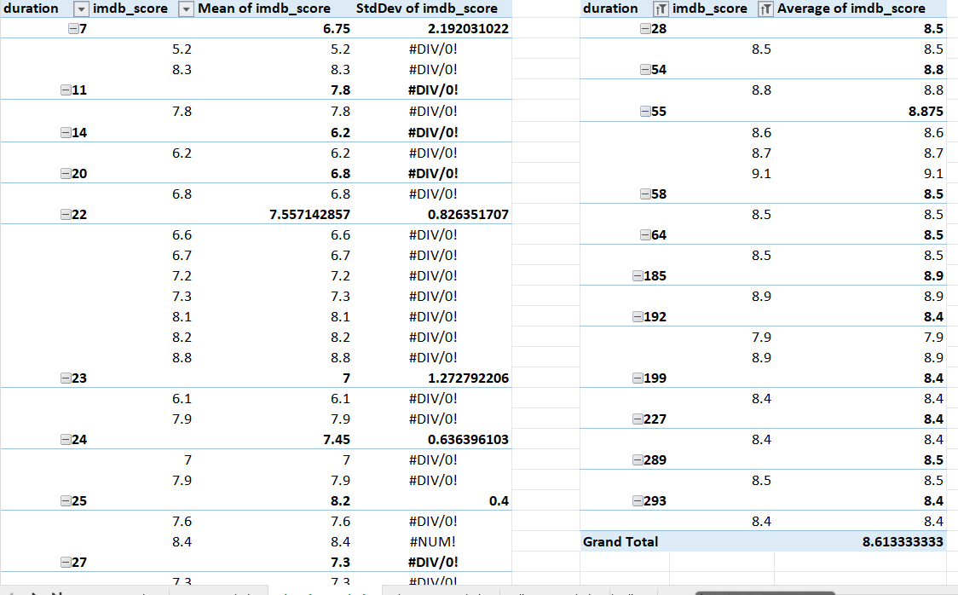

Slide 6
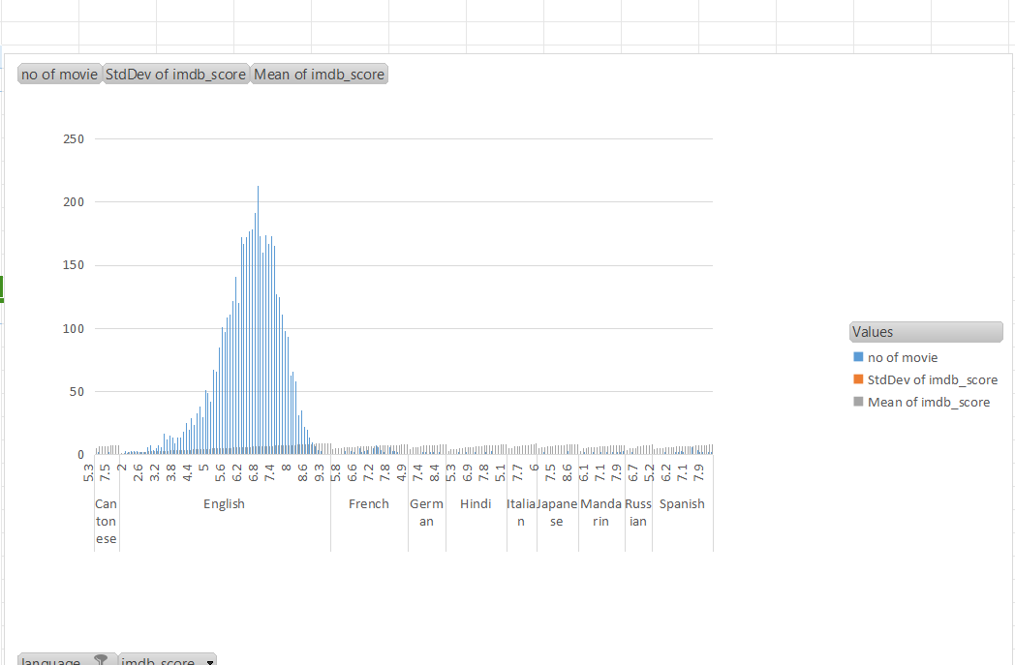
C. Language Analysis: Situation: Examine the distribution of movies based on their language.
Task: Determine the most common languages used in movies and analyze their impact on the IMDB score using descriptive statistics.
Approach:
First i created a pivot table .
And then added language ,imdb score ,and count of language to get the no of movie of that language.
And calculated the mean median & standard deviation on the imdb score i got.
And added pivot chart to the pivot table to understand the statistic i got after calculating.
Insight:
After looking at the chart i got to know that english language movie got the higest no of rating as compair to other languages.

Slide 7
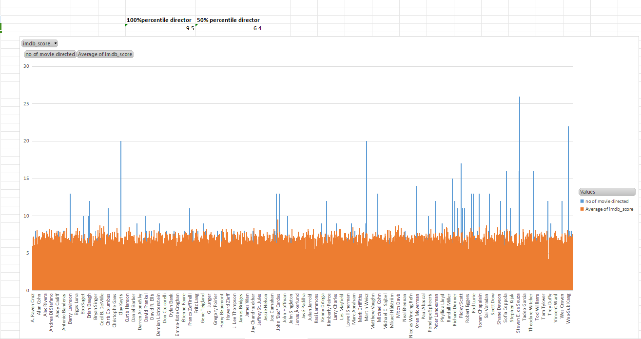
D. Director Analysis: Influence of directors on movie ratings.
Task: Identify the top directors based on their average IMDB score and analyze their contribution to the success of movies using percentile calculations.
Approach:
First i created a pivot table in new worksheet.
then added director list ,and the count of movie directed by them and the average rating they got for their movie.
Then i use 100-percentile on their average imdb score to get the higest imdb score director.
And then i added a pivot chart to it to get a visulization of their rating.
Insight:
I got to know that John Blanchard got the higest rating for his movie .

Slide 8
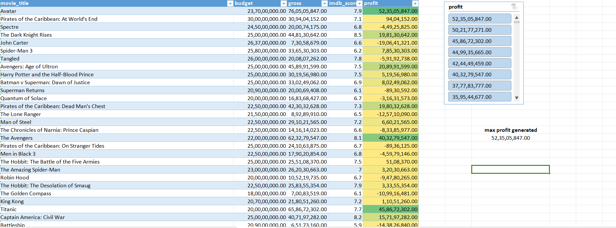
E. Budget Analysis: Explore the relationship between movie budgets and their financial success.
Task: Analyze the correlation between movie budgets and gross earnings, and identify the movies with the highest profit margin.
Approach:
first i created another table in new worksheet .
i included movie title ,budget,gross,imdb score & profit column.
I imported the desire data and fitered the blank values,& calculated the profit earned .
To calculate the profit i minused budget from gross earned.
Insight:
after calculating i got to know that the gross earned is not depended on the movie budget,it depends on the genre of the movie and the director and the language.

Slide 9
Hyperlink the Excel Sheet file:-
https://docs.google.com/spreadsheets/d/1I2NxHaF2NpLdkRkEIlSW9Ylu2JtYELdA/edit?usp=drivesdk&ouid=111398243446314990339&rtpof=true&sd=true

