Slide 1


Bapuji Educational Association®
Bapuji Institute of Engineering and Technology
Davangere-577 004
Department of Electronics & Communication Engineering
A Progress Presentation on Mini Project
Ballot Tabulator Using Verilog
Project Associates
GURUKIRAN P M 4BD21EC033
H S SUSHANTH 4BD21EC035
HARSHITHA B 4BD21EC037
JEETENDRA M 4BD21EC041
Mrs. SUMA K. G. Dr.G S SUNITHA
M.Tech. M.Tech.,(DEAC),Ph.D.,MISTE., FIETE.,FIE Mini Project Guide Program Coordinator

Slide 2
BAPUJI INSTITUTE OF ENGINEERING AND TECHNOLOGY, DAVANGERE-577004
Institute Vision
To be a centre of excellence recognized nationally and internationally, in distinctive areas of engineering education and research, based on a culture of innovation and invention.
Institute Mission
BIET contributes to the growth and development of its students by imparting a broad based engineering education and empowering them to be successful in their chosen field by inculcating in them positive approach, leadership qualities and ethical values.

Slide 3
Department of Electronics and Communication Engineering
Department Vision
To be in the forefront in providing quality technical education and research in Electronics & Communication Engineering to produce skilled professionals to cater to the challenges of the society.
Department Mission
To facilitate the students with profound technical knowledge through effective teaching learning process for a successful career.
To impart quality education to strengthen students to meet the industry standards and face confidently the challenges in the programme.
To develop the essence of innovation and research among students and faculty by providing infrastructure and a conducive environment.
To inculcate the student community with ethical values, communication skills, leadership qualities, entrepreneurial skills and lifelong learning to meet the societal needs.

Slide 4
Table of Contents
Introduction
Literature Review
Problem Statement
Block Diagram for ballot system using verilog
Methodology
Working
Design and Implementation
Generated Reports
Application
Advantages & limitations
Future Scope
Conclusion
References

Slide 5
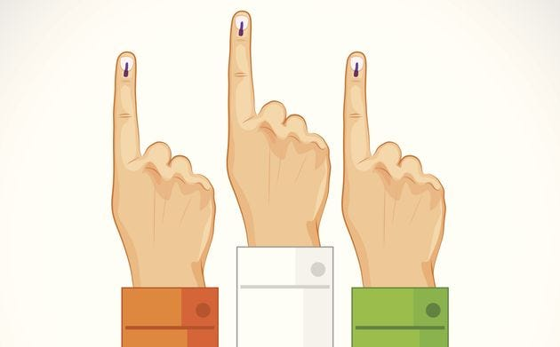
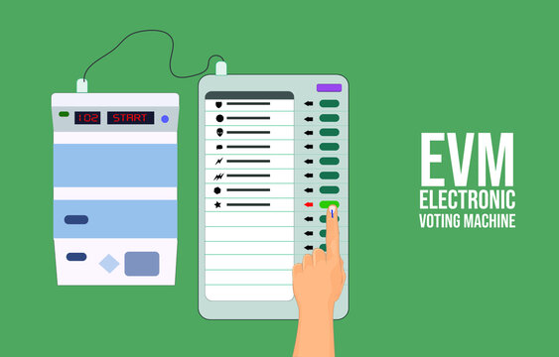

1.Introduction
Project Overview
Objective
*Related images

Slide 6
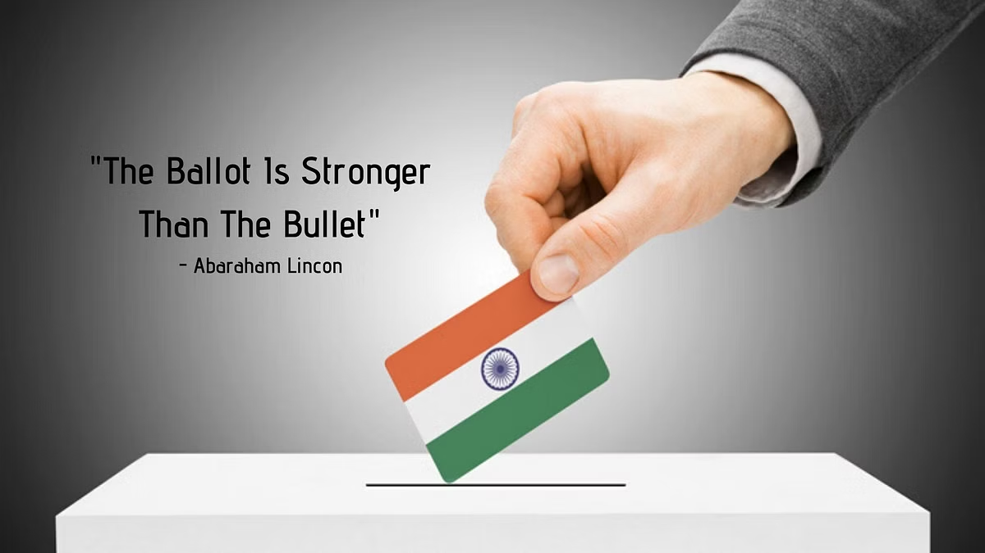

Slide 7
Project Overview : Ballot Tabulator Using Verilog
Purpose and Scope of the Project: Ballot Tabulator Using Verilog
Purpose:The purpose of designing a ballot tabulator using Verilog, a hardware description language (HDL) typically used for digital circuit design, revolves around creating a specialized electronic device capable of accurately and efficiently counting votes in elections. Here are the key purposes and advantages:
Digital Circuit Implementation: Verilog allows engineers to describe the behavior of digital circuits at various levels of abstraction, from high-level functionality down to low-level hardware details.

Slide 8
Scope:
Designing a ballot tabulator using Verilog involves focusing on several key areas to ensure the system is efficient, reliable, secure, and compliant with electoral standards.
Digital Logic Design: Utilizing Verilog to design the digital logic circuits that implement the core functionalities of the ballot tabulator. This includes designing circuits for reading ballots, counting votes, handling errors, and generating output results.
Vote Counting Algorithms: Developing algorithms within Verilog to accurately count and tabulate votes according to electoral rules and regulations. This involves implementing logic for handling different voting systems (e.g., first-past-the-post, proportional representation) and managing ballot preferences.
User Interface Design: Developing user interfaces using Verilog that provide intuitive interaction for both voters and election officials.

Slide 9
Objective:
The primary objective of this project is to design and implement a Voting Machine using Verilog, which ensures a systematic and error-free vote counting process by managing votes for three candidates through a state machine architecture.
This architecture facilitates transitions through various states—idle, vote, hold, and finish—based on input signals, addressing challenges associated with traditional voting methods such as manual counting errors, time consumption, and logistical complexities

Slide 10
2.Literature review
TITLE | AUTHOR | YEAR | METHODOLOGY | LIMITATIONS
Introduction to the Theory of Finite-state Machines | Michael Gill | 2001 | Explanation of finite-state machine theory | Theoretical in nature.
A Better Ballot Box? | Rebecca Mercuri | 2002 | Analysis of traditional voting systems vs. EVMs in terms of speed and error reduction | Concerns over the security and integrity of electronic systems
Secret-Ballot Receipts: True Voter-Verifiable Elections | David Chaum | 2004 | Cryptographic techniques | Implementation complexity and trust in the system.
Security Analysis of the Diebold AccuVote-TS Voting Machine | Ariel J. Feldman et al. | 2006 | Empirical analysis of the security vulnerabilities | Specific to one model; may not generalize

Slide 11
3. Problem Statement
In modern democratic societies, the accuracy and reliability of vote counting are crucial for maintaining the integrity of the electoral process.
Traditional voting methods often encounter issues such as manual counting errors, time consumption, and logistical complexities, which can compromise the efficiency and trustworthiness of elections.
To address these challenges, this project aims to design and implement an electronic Voting Machine using Verilog.
The machine will manage votes for three candidates using a state machine architecture, which will facilitate smooth transitions through various operational states (idle, vote, hold, and finish) based on input signals, thereby ensuring a systematic and error-free vote counting process.

Slide 12
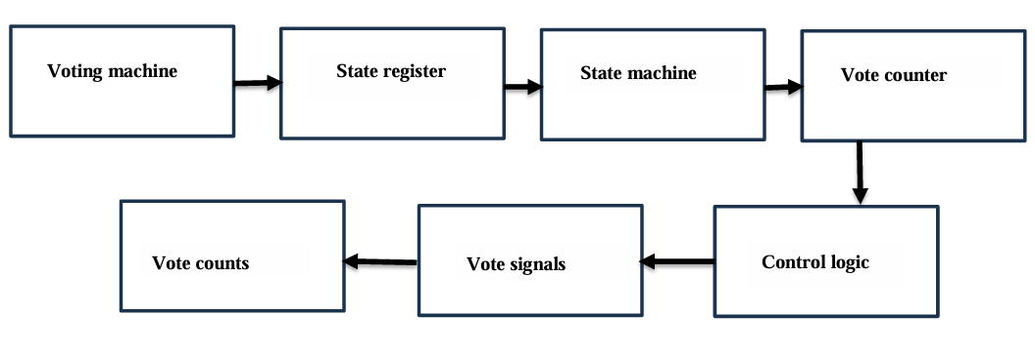
4.Block Diagram for ballot system using verilog

Slide 13
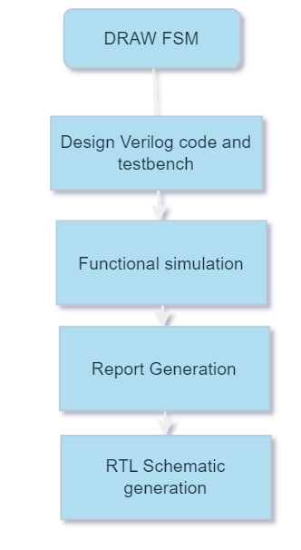
5. Methodology
Tools and Technologies:
Online EDA playground- Aldec Riviera Pro 2023.04
Free tool-icarus verilog 12..00
Cadence tool
For functional simulation: Incisive simulator
For synthesis : Genus
Work Flow:

Slide 14
6.Working:
The project involved designing a voting machine
1.Basic components
Inputs: Buttons for each candidate.
Outputs: Display for the vote count.
Registers: Storage for the vote counts.
2. Basic Flow
Initialization: Set the vote counts to zero.
Vote Casting: When a button is pressed, increment the corresponding candidate's vote count.
Display: Show the current vote counts.
3.By Using a Verilog code.

Slide 15
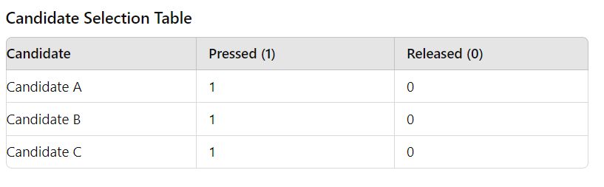
7. Design and Implementation:
To operate the voting machine
States:
Idle: The machine is waiting for a voter to start the voting process.
Vote: The voter is actively selecting a candidate.
Hold: The voting process is temporarily paused.
Finish: The voting process is complete, and results are ready for processing.
When a voter interacts with the voting machine's touchscreen or button interface, they can select candidates. This interaction can be represented with binary states: 1 for pressed and 0 for released.

Slide 16
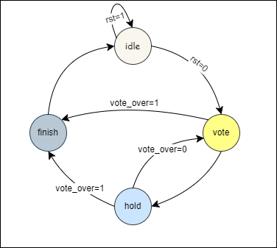
Finite State Machine Diagram

Slide 17
Voting Process
System Components:
User Interface (UI): Touchscreen or button interface for voter interaction.
Control Unit: Manages the states and processes voter input.
Memory Unit: Stores votes and state information.
Implementation:
Initialization:
The system starts in the Idle state.
The display shows a welcome message and instructions for starting the voting process.
State Transitions:
Idle to Vote: Triggered when a voter initiates the voting process (e.g., pressing a start button).
Vote to Hold: Triggered by an administrator to pause voting (e.g., for a break or technical issue).
Hold to Vote: Triggered by an administrator to resume voting.
Vote to Finish: Triggered when the voter confirms their vote.

Slide 18
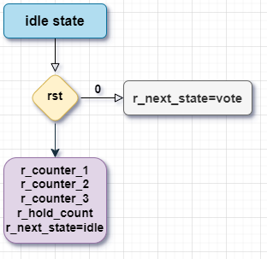
State explaination
Idle state:

Slide 19
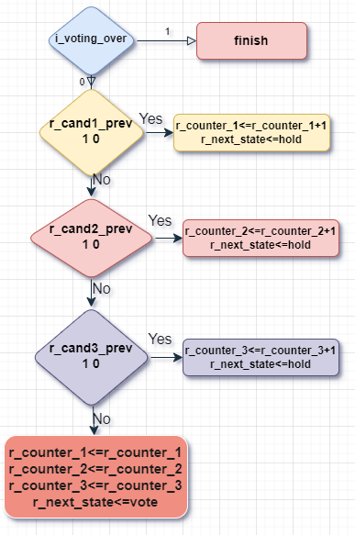
Vote state:

Slide 20
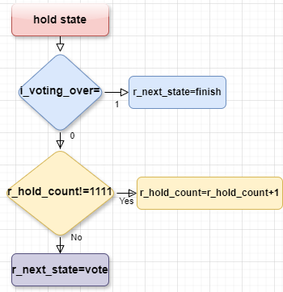
Hold state:

Slide 21
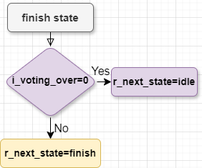
Finish state:

Slide 22
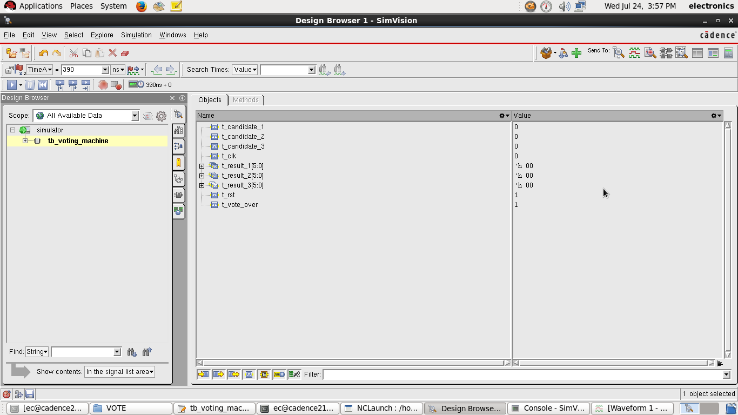
Verilog Design and Testbench Code
To watch the Verilog design code, [click here]
To watch the Verilog Testbench code, [click here]
Verilog Simulation Process

Slide 23
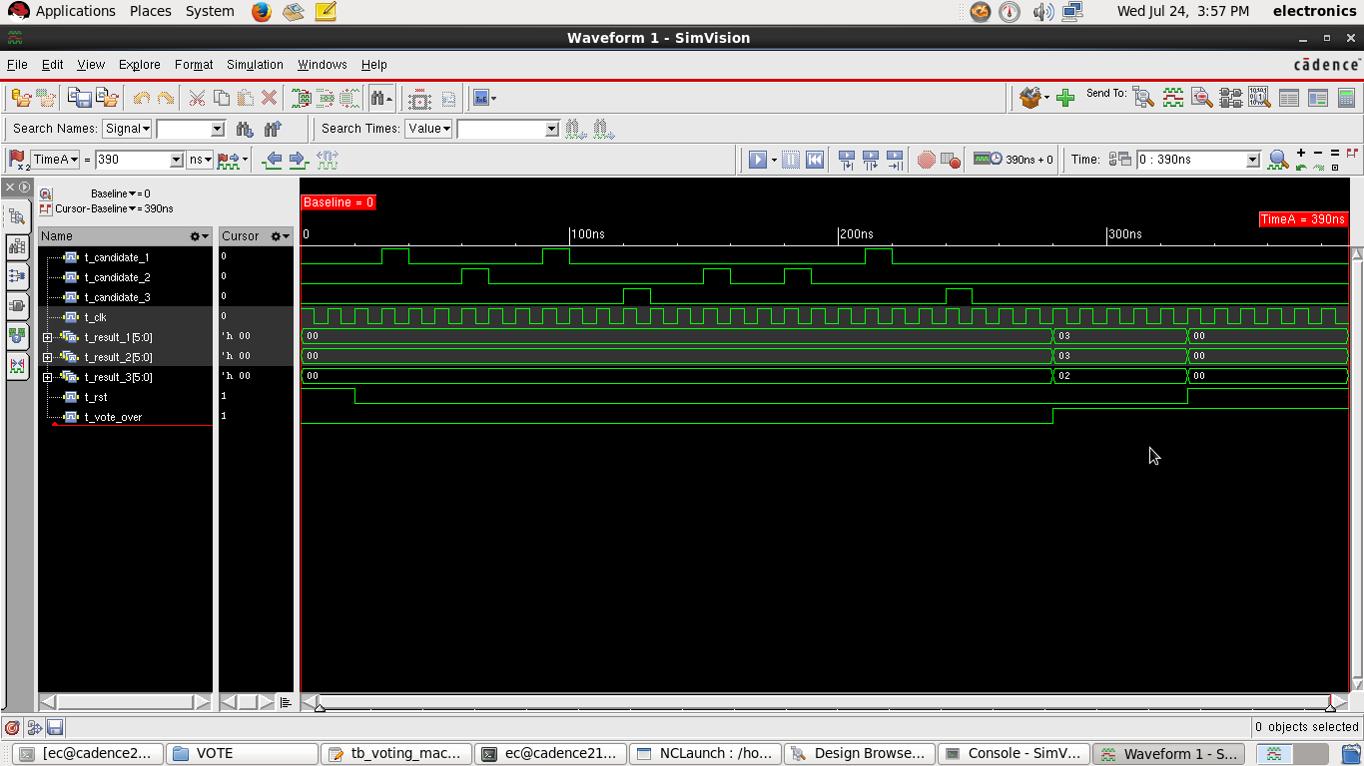
Verilog Simulation Output

Slide 24
Synopsys Design Constraint (.sdc) file
To view the constraint file, [click here]
Output files
To view the netlist file, [click here]
To view the sdc output file, [click here]

Slide 25
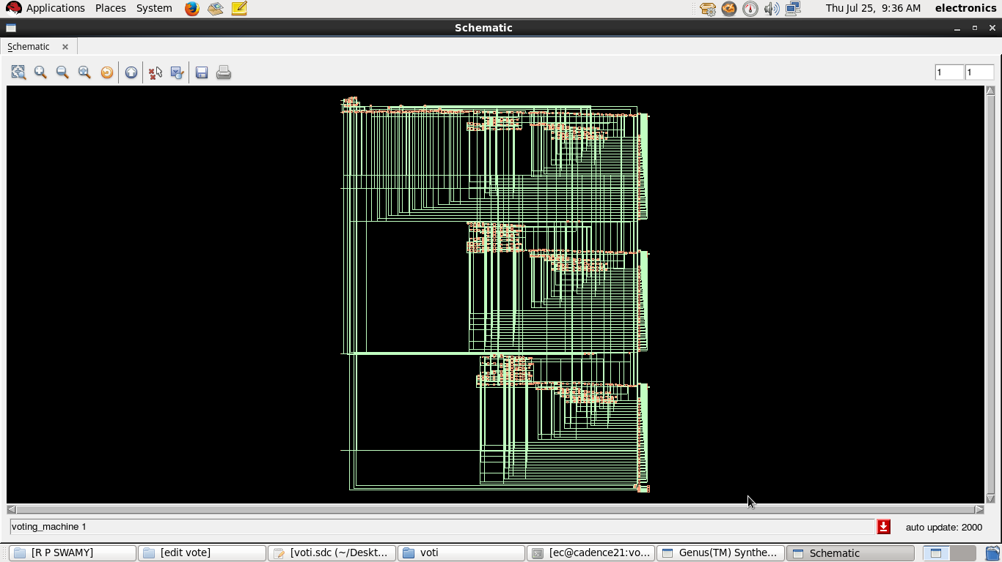
Schematic Synthesis

Slide 26
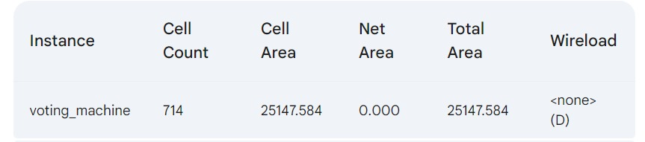
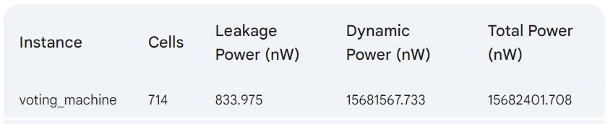
8.Generated Reports
Report on Area
To view the Area rpt. file, [click here]
To view the Power rpt. file, [click here]

Slide 27
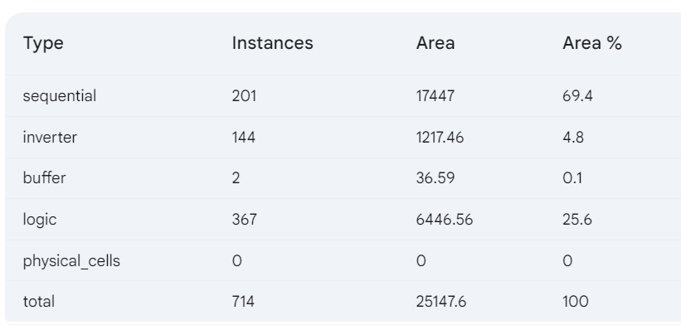
Report on Gate
To view the Gate rpt. file, [click here]

Slide 28
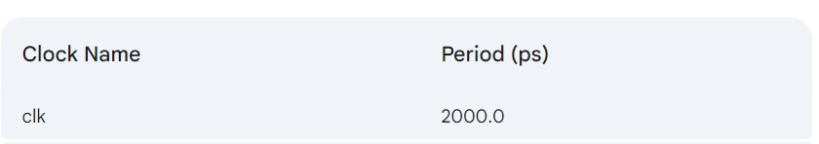
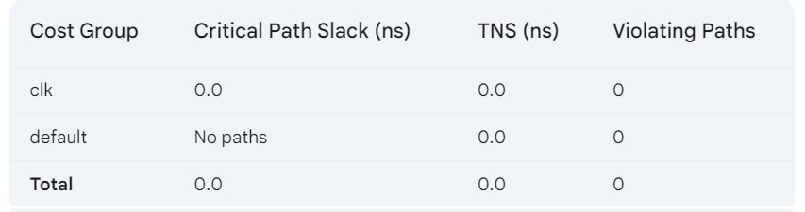
Report on Quality of Result (QoR)
Timing information
Timing Analysis Summary Table

Slide 29
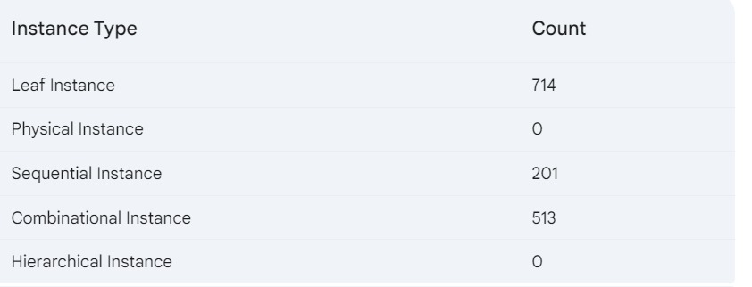
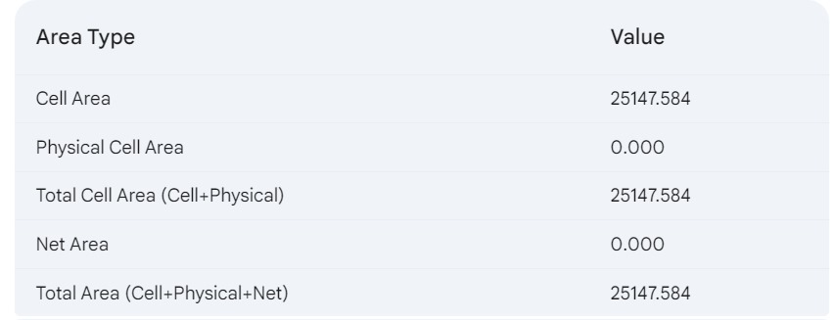
Instance Count Summary
Area Summary

Slide 30
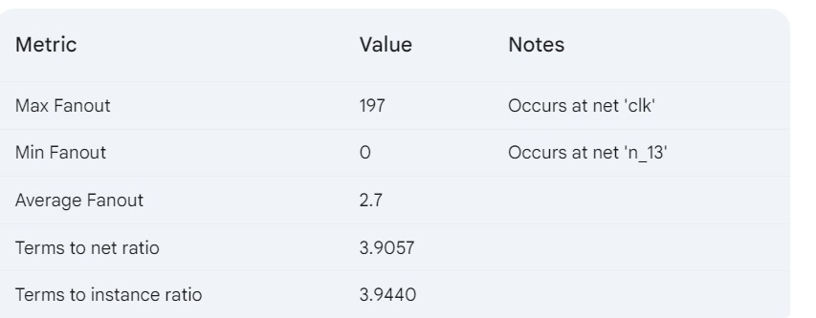
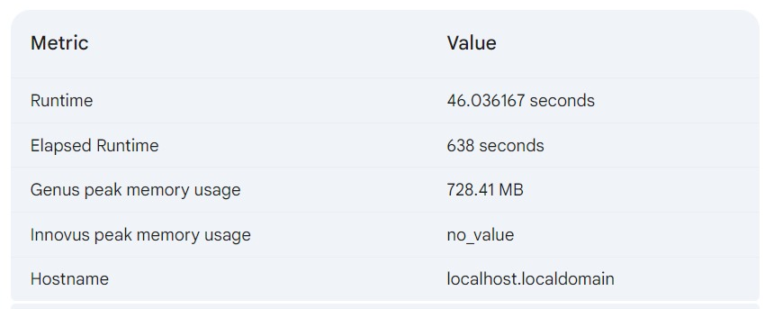
Fanout and Ratio Metrics
Runtime and Resource Utilization
To view the QoR rpt. File, [click here]

Slide 31
7.Applications
1. Elections:
Government Elections: Used in local, state, or national elections for accurate and efficient vote counting.
2. Surveys and Polls:
Public Opinion Polls:Conduct surveys where participants vote on various options.
3. Meetings and Conferences:
Conferences: Enable attendees to vote on topics or speakers.
4. Educational Institutions:
Student Council Elections:Used in schools and universities for electing student representatives.
Classroom Polls:Engage students in discussions and decisions through quick polling and voting.

Slide 32
8.Advantages & Limitations:
Advantages
Accuracy and Reliability:Ensures accurate vote counting with reliable state transitions and debouncing, minimizing errors.
Efficiency:Automates vote counting, reducing time and effort compared to manual counting.
Scalability:Easily scalable to accommodate more candidates or options by extending the state machine and adding counters and inputs.
Real-Time Processing:Provides real-time updates on vote counts for immediate feedback and results.

Slide 33
Limitations
1. Initial Cost and Complexity:
Higher initial setup cost and complexity compared to manual voting systems, especially for smaller organizations or events.
2. Dependence on Technology:
Relies on electronic components, which can be prone to technical issues or failures.
3.Limited by State Machine Complexity:Adding candidates or features increases state machine complexity, requiring careful design and testing for reliability.

Slide 34
9. Future Scope
The future scope of voting machines includes several promising developments:
Increased Security: Enhanced encryption and secure hardware to prevent tampering and ensure the integrity of the voting process.
Biometric Authentication: Using fingerprint or facial recognition to verify voter identity and prevent fraud..
Improved Usability: Designing more user-friendly interfaces to accommodate all voters, including those with disabilities.
Auditability: Enhanced auditing mechanisms to ensure votes are correctly counted and verifiable.

Slide 35
10. Conclusion
Here are the key takeaways from the project :
Functional Implementation: The voting machine was effectively designed and simulated in Verilog, demonstrating the feasibility of using hardware description languages for complex digital systems.
Synthesis Success: The design was synthesized onto a target FPGA, validating the correctness and efficiency of the Verilog code.
Verification: Comprehensive simulation ensured the reliability and accuracy of the voting machine under various scenarios.
Comprehensive Analysis: Synthesized design with detailed reports on area, gate count, QoR, timing, and power to ensure optimal performance and efficiency.

Slide 36
11. References
"VLSI Based on Voting machine”M. Raja Kumar(1), B. Anitha(2), R. Pravallika(3), D. K. Kavitha(4), S. Joseph(5), N. Rambabu(6), and R. GopiNailk(7)
“Digital Design and Computer Architecture" by David Harris and Sarah Harris, 2nd Edition
https://github.com/pratikbhuran/Voting_Machine.git
Voting Machine in Verilog | Verilog project | XILINX | EDA Playground

Slide 37
Course Outcomes
On completion of this course, students are able to
Solve the identified problems.
Analyze the available resources and their utilization.
Present the work carried out and prepare the report.
Work in a team to find the solutions for societal and technical problems.

Slide 38
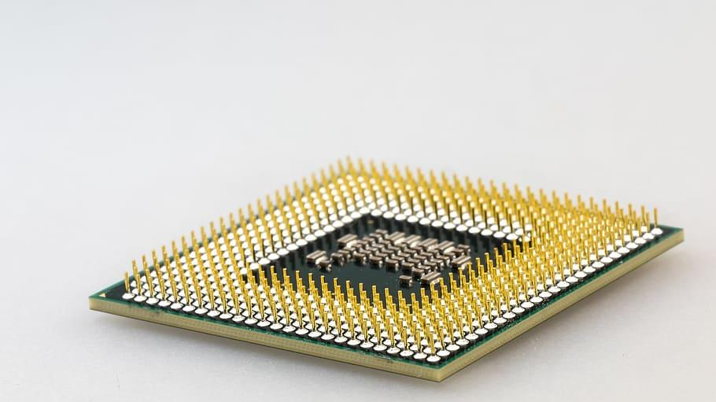
Thank you

