Slide 1
Quantum28 Pipeline — 1 of 3: Inputs → Risk Manager
Agents never talk to each other; each writes a structured JSON file to a shared folder.
Trigger
orchestrator.py run --ticker NVDA (cron / on-demand)
Auth gate
authenticate caller + authorize ticker (restricted list)
VOTERS — weighted vote on DIRECTION
Fundamental · Technical · Insider (Form 4 + Congress)
Quant/Factor · Options (IV + GEX via gex_algo) · Earnings-Quality (veto)
Catalyst (events, IPO lock-ups) · Alt-Data · News
each → its *_view.json
SHARED FEED (datafeed.py)
Tastytrade / IB / demo (auto-fallback)
→ one normalized options_block
powers Options: IV / term / gamma
compute_gex() = your gex_algo.py hook
OVERLAYS — trim / veto (no direction)
Sentiment · Macro (FRED, Bull&Bear, net-liquidity)
Credit · Liquidity · FX-Macro
DIRECTIONAL stress: veto longs, KEEP shorts;
systemic seizure → flatten both sides
OUTPUT GUARDRAIL
validate every view: schema + freshness (as_of) + injection scan → reject stale/malformed
RISK MANAGER
weighted vote: Σ(weight × conviction × direction) → net
CONVICTION FLOOR: |net| < MIN_CONVICTION → no directional trade
DIRECTIONAL STRESS overlay: veto longs / keep shorts; systemic → flat
RANGE / NEUTRAL regime: flat vote + IV/gamma edge → non-directional trade
→ writes risk_decision.json (continues on slide 2)

Slide 2
Quantum28 Pipeline — 2 of 3: Decision → Book
The approved view becomes a structure, a sign-off, a sized book — and eventually a managed exit.
RISK MANAGER (from slide 1)
risk_decision.json — one decision from all views
tradeable?
No
log only (shadow book)
SUSPEND (human-in-the-loop)
persist → pending_approvals/ (survives restart)
Telegram OR Dashboard → resume()
APPROVE / DISAPPROVE → server.py /api/resume (same durable resume)
Order ticket → orders/
desk executes — the agent never trades / moves money
CIO / PORTFOLIO
sizes the whole BOOK; caps: per-name, sector,
correlation-cluster, gross/net, risk budget
CAPACITY COMPETITION when full: rank by
conviction → rotate out weakest held; WAITLIST
OPTIONS STRATEGIST (constructor)
direction → structure: vertical / diagonal /
calendar / butterfly / condor / RATIO SPREAD /
reverse fly (long vs short gamma)
placement is CALIBRATED
POSITION MANAGER (closer) — same HITL
reviews OPEN book: RISK → VIEW → PROFIT → TIME → HOLD
CLOSE / ROLL / TRIM (CIO rotations route here)
FEEDBACK LOOPS (from outcomes + logs)
BENCHMARK → analyst_weights.json (net Sortino × capacity − tail CVaR): tunes WHICH analysts to believe
CALIBRATION → calibration.json: put-write buffer / IV floor, vertical pivot, butterfly / diagonal / calendar
placement, per-name suitability — tunes HOW rules act (self-improvement)
both feed the next run; model weights are frozen — the FRAMEWORK learns

Slide 3
Quantum28 Pipeline — 3 of 3: Parallel books + reporting
0DTE gamma, SSF basis, and the levered-ETF sleeve — all reading the shared feed, all through the SAME HITL.
◆ SHARED MARKET-DATA FEED — datafeed.py
one normalized options_block · Tastytrade / IB / demo (auto-fallback) · feeds every book below
0DTE INDEX GAMMA (SPX/NDX)
Options Analyst gamma read (fresh)
POSITIVE → BWB on the pin (midday;
deferred pre-11:30 as wall forms)
NEGATIVE → BREAKOUT: backspread /
reverse fly (long gamma), early
stale / no-regime → stand aside
BASIS TRADER — SSF (mkt-neutral)
scan SSF vs spot; fair S·(1+(r−q)T)
implied repo vs funding, net cost
RICH/contango → CASH-AND-CARRY
CHEAP/backwardation → REVERSE
crash: front basis gaps, long-dated lags
edge must clear costs
LEVERED-ETF DECAY SLEEVE — own book
Structural-Decay Analyst (The Decay Edge):
3-level signal → composite → short
BOIL / UVXY / TQQQ … vol drag + contango
OWN budget: 10 pos · 4% gross
DEFINED-RISK only · no naked short vol
systemic veto still flattens the tail
SAME HITL — Telegram or Dashboard
suspend → pending_approvals/ · buttons → server.py /api/resume → resume()
Order tickets → orders/
paired spot+future / options legs — desk executes; agent never trades
PERFORMANCE ANALYST (reporter — read-only)
reads decision_log + outcomes + signal_log (live vs shadow book)
publishes PnL, EQUITY CURVE, Sortino & Sharpe, drawdown, hit rate, attribution
does NOT steer weights or trade — scorer kept apart from the optimizer
→ performance_report.json + equity_curve.svg (feeds the morning brief)
DAILY AUTOMATIONS (cron, US/Eastern)
07:00 brief · 09:35 0DTE breakouts · 10:00 & 14:00 basis · 12:30 0DTE flies · 16:30 performance
Fri 18:00 re-weight (benchmark) · Fri 18:30 re-calibrate (entry params)
auto-restart on reboot; every proposal waits for your tap

Slide 4
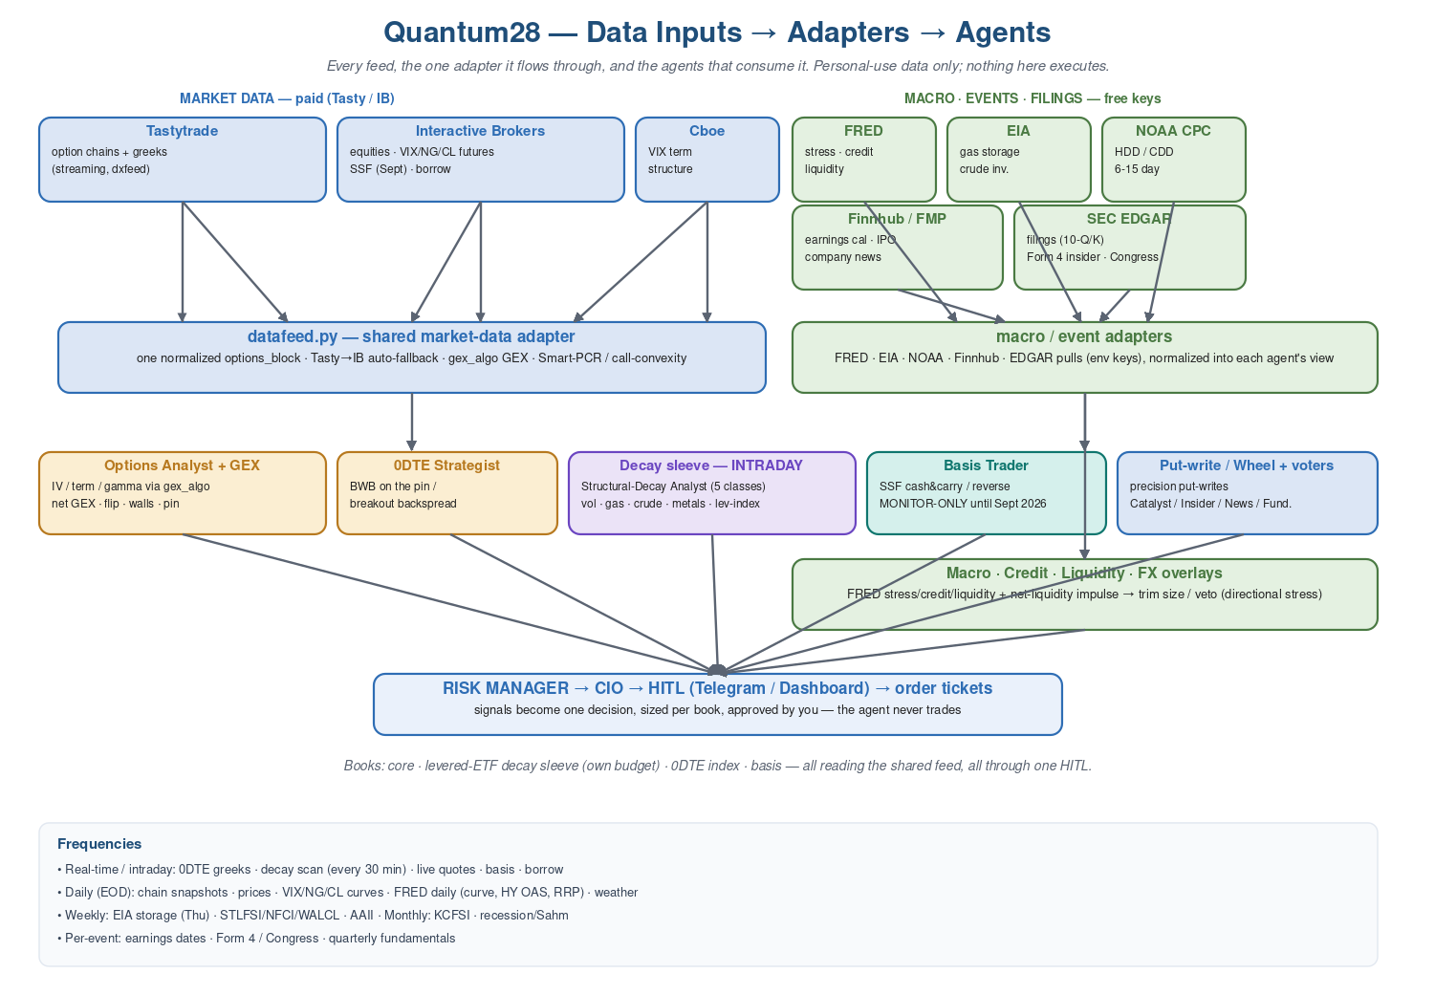
Data Inputs → Adapters → Agents
Every feed, the adapter it flows through, and the agent that consumes it.

