Slide 1


Navyug Vidyabhavan Trust
C. K. Pithawala College of Engg. & Tech.
Computer Engineering Department
IPL Analytics & Performance Dashboard
Summer Internship Presentation
Internship
(3170001)
BE IV, Sem VII
Presented By
Patel Jeet
(230090107137)
Faculty Guide
Stephanie Tamakuwala
(Assistant Professor )

Slide 2
Outline
Company Brief
Domain and Technology Stack
  Sports Data Analytics using Business Intelligence
  Power BI, Power Query, DAX, Kaggle IPL Dataset
Work Profile
  IPL Analytics & Performance Intelligence Dashboard
  Work Flow
Type of Engagement
  Internship schedule, working hours and project engagement
Weekly Diary
  Snapshots of Weekly Diary maintained since the beginning of internship till date
Documents
  Project report, dashboard and internship documentation

Slide 3
Company Brief
Karon Infotech
A Surat-based technology and digital solutions company providing web design, development, mobile applications, SEO, digital marketing, creative design and IT consultation.
Karon Infotech – Technology & Digital Solutions
The internship environment provided practical exposure to project development, data analytics and Business Intelligence through the IPL Analytics dashboard.
Karon Infotech Internship
Founded in March 2013 by Satish Patel.
Provides elite cloud training, consulting, and global certification programs.
Covers major cloud ecosystems including Karon Infotech – Technology & Digital Solutions, AWS, and Google Cloud.

Slide 4
Internship & Reporting Details
Training Organization
Karon Infotech, Surat
Technology Partner
Program
Offline Data Analytics Internship
Mentor
Ms. Ritika M. Tilashi
Faculty Guide
Ms. Stephanie Tamakuwala
Institution
C. K. Pithawala College of Engineering & Technology, Surat

Slide 5
Domain
Sports Data Analytics
The internship project was developed in the domain of sports analytics, focusing on historical IPL match, team, venue and player data to generate meaningful performance insights through Power BI.
What is Sports Data Analytics?
The process of collecting, processing and visualizing sports data to understand match outcomes, team performance, venue patterns and player statistics.
Project Focus
Analyze historical IPL matches
Compare team wins and losses
Analyze batting-first vs chasing outcomes
Analyze venue-wise scoring and match patterns
Visualize player performance through interactive dashboards

Slide 6

Technology Stack
Internship Technologies
The project was developed using Business Intelligence and data analytics technologies. Each technology contributed to a specific stage of the IPL Analytics Dashboard.
Power Query
Interactive dashboards, KPIs, charts, tables, maps and report navigation.
SQL AND Python
Data cleaning, transformation, type correction and preparation.
Development Tools
Kaggle IPL datasets were used as the primary data source, while Power Query and Power Query were used for cleaning, modeling and dashboard development.
DAX
Analytical measures for runs, wickets, averages, strike rate, wins and other KPIs.
Kaggle IPL Dataset
Historical IPL match and delivery data used for analytical reporting.

Slide 7
Work Profile
Internship Work Assigned
The internship involved project-based development of an IPL Analytics and Performance Intelligence Dashboard using historical IPL data, Power Query, Power BI and DAX.
Major Tasks Performed
Studied and prepared the Kaggle IPL dataset.
Cleaned and transformed data using Power Query.
Data cleaning, transformation, type correction using Python & SQL
Built the Power BI data model and analytical fields.
Created DAX measures for cricket KPIs.
Designed five interactive dashboard pages.
Tested filters, calculations and visual interactions.
Project Deliverable
IPL Analytics & Performance Intelligence Dashboard
A Business Intelligence dashboard capable of analyzing IPL matches, team performance, venue patterns, match outcomes and player statistics.

Slide 8
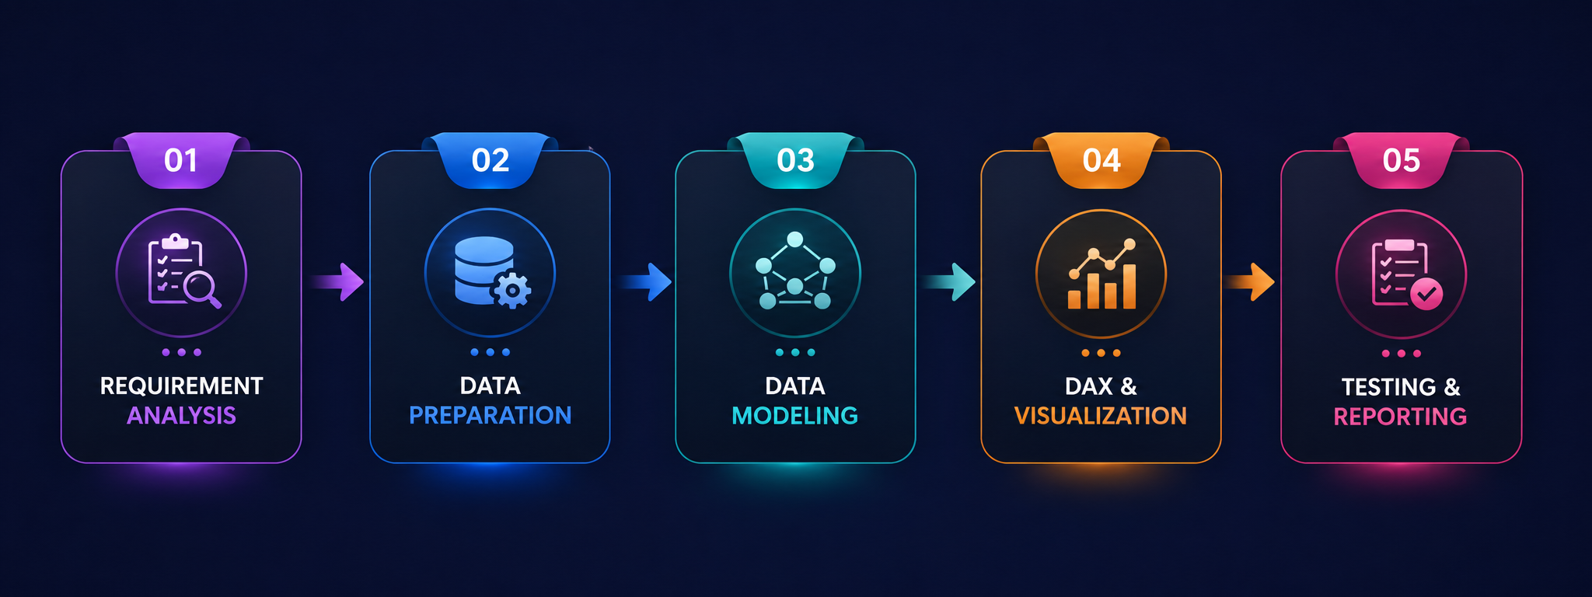
Work Profile

Slide 9
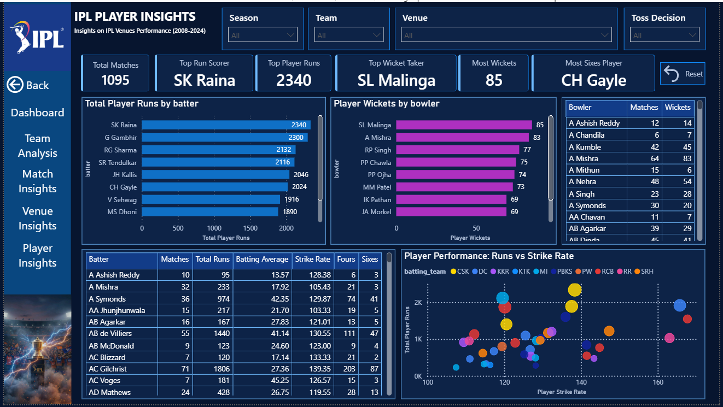
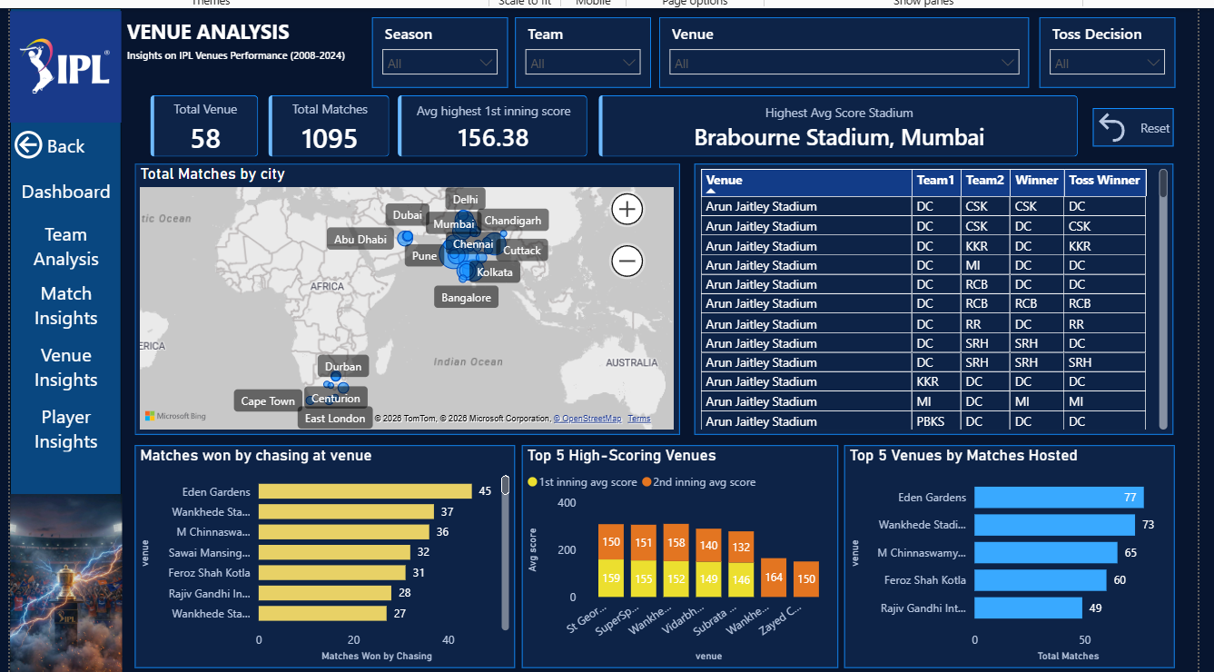
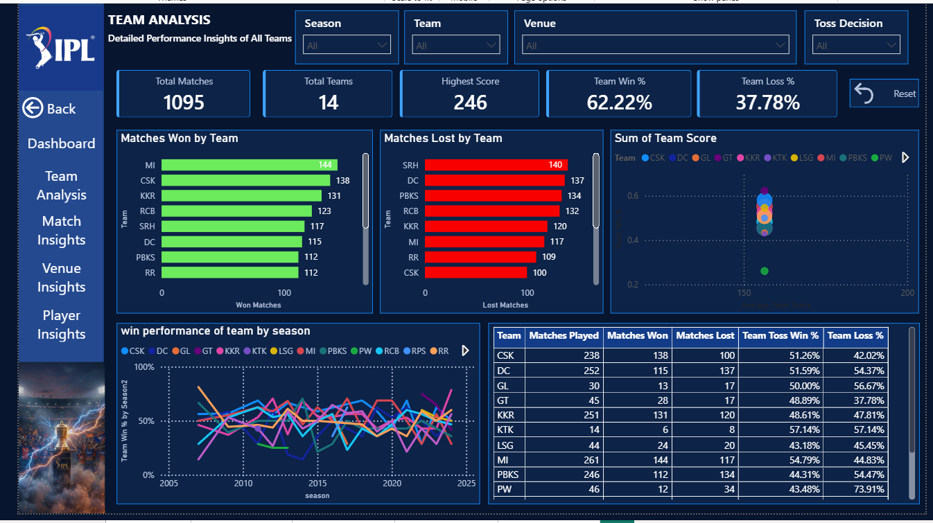
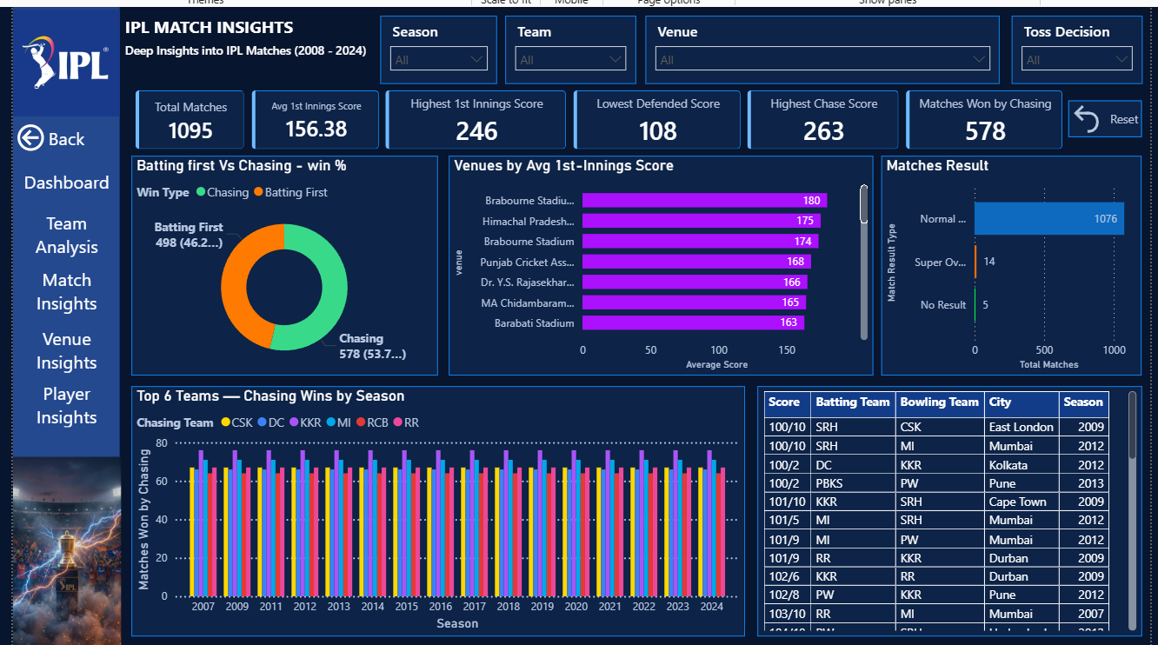
Work Profile
Power BI: IPL Analytics Dashboard
Power BI: Team Analysis Dashboard
Power BI: Match Insights Dashboard
Power BI: Venue Analysis Dashboard

Slide 10
Type of Engagement
Internship Engagement Details
The internship was conducted as a project-based technology engagement focused on Business Intelligence and sports data analytics. The work combined data preparation, Power BI development, DAX analysis, dashboard design, testing and documentation.
Working Schedule
Duration
15 Days
06 July – 22 July 2026
Daily Timing
5 Hours
11:00AM To 4:00PM
Nature of Engagement
Project-based analytics development
Power Query data preparation
DAX and Power BI dashboard development
Independent development of IPL Analytics Dashboard
Mentor guidance, testing and documentation
Project Work
Data Analytics & Dashboard Development
75 Hours
Testing & Documentation
12 Hours

Slide 11
Weekly Diary
Phase 1
Requirement understanding, IPL dataset study & project planning
Phase 4
Power BI data model and analytical structure
Phase 7
Dashboard testing, filter validation and calculation checking
Phase 2
Kaggle data import, inspection and field understanding
Phase 5
DAX measures for match, team, venue and player KPIs
Phase 8
Final dashboard refinement and insight analysis
Phase 3
Power Query cleaning, transformation and data-type correction
Phase 6
Dashboard page development and visual design
Phase 9
Final documentation, presentation preparation and project submission

Slide 12
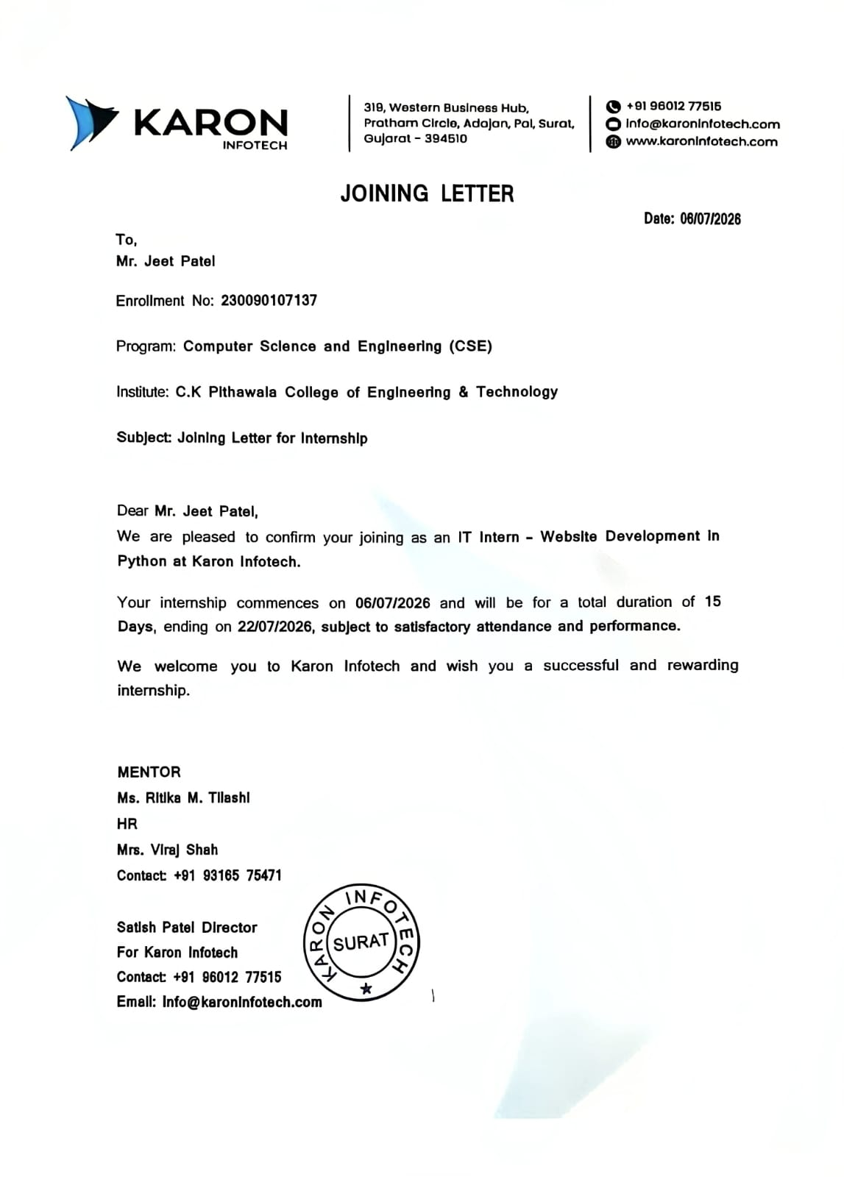
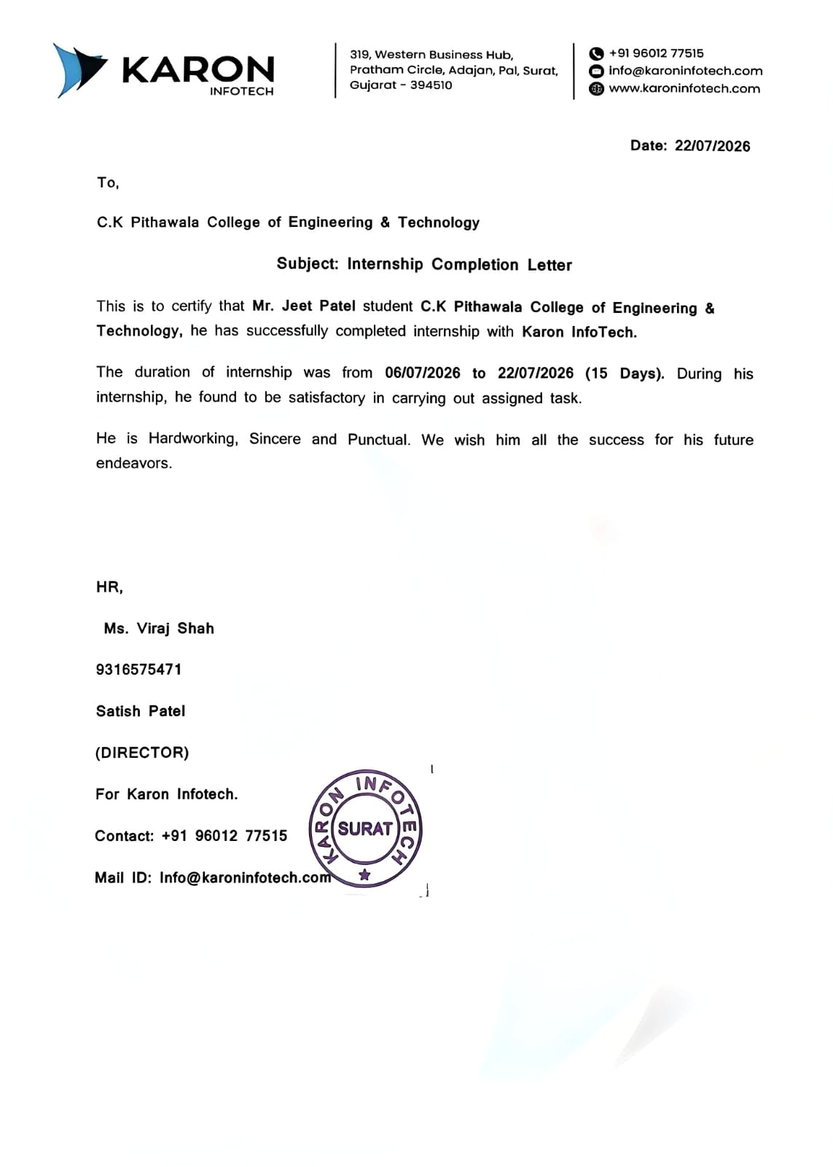
Documents
Joining Letter
Completion Letter

Slide 13

Documents
Completion Certificate
Final project documentation prepared for the IPL Analytics internship, including dashboard results, testing and analytical findings.
Prepared By:
Patel Jeet Hasmukhbhai
Project & Institution:
IPL Analytics Internship, Gujarat Technology University
Details:
Date: 2026-07-22
Credential Preview

