Slide 1
Customers like you
Better product suggestions and customer groups for GiftLane
Jeevan Mandala and Manavkrishna Manoj
Mini-project 1 | October 2026
Notes:
Hi, we're Jeevan and Manavkrishna. Manavkrishna built the data side and Jeevan did the model. We got an email from Sarah, the head of e-commerce, with two requests, and we'll show what we did about them in about five minutes.

Slide 2
What Sarah asked for
A "customers who bought this also bought" box on every product page. It has to run overnight, be small enough to keep, and do better than just showing the best sellers.
One simple picture of our main customer groups, so marketing can plan a different campaign for each.
22×
0.88 s
smaller than the full table, 154 MB down to 7 MB
for the whole nightly job on a laptop
38% vs 27%
3 groups
of customers got a product they later bought in their top 10, against the best sellers
that marketing can name, from what customers buy
Presenter: Manavkrishna Manoj
Notes:
Sarah wanted two things. First, a box on every product page saying customers who bought this also bought, which has to run overnight, be small enough to keep, and beat simply showing the best sellers. Second, one picture of our customer groups for marketing. On the right is how it turned out: the compressed table is 22 times smaller, the nightly job takes under a second, our suggestions reach 38% of customers against 27% for best sellers, and we found three groups. We'll go through how we got there.

Slide 3
From raw lines to a matrix
Cleaning rule | Lines removed
Cancelled invoices | 19,494
Quantity of 0 or less | 3,457
Price of 0 or less | 2,750
Postage, fees, vouchers | 4,668
No customer ID | 234,370
Exact duplicates | 26,055
Left of 1,067,371 | 776,577
Split by time
The model learns from everything before 9 October 2011. The last two months are the test.
The matrix
5,471 customers by 3,686 products, 98% empty. A product needs at least 10 buyers to get in.
No peeking
The matrix only uses training rows, so nothing from the test period leaks in.
Presenter: Manavkrishna Manoj
Notes:
This is the data side. It's a real UK gift-ware retailer, just over a million invoice lines. We threw out cancelled invoices, zero or negative quantities and prices, service lines like postage, fees and vouchers, lines with no customer ID, and exact duplicates. The big one is missing customer IDs, nearly a quarter of the raw lines, which leaves 776,577 lines. We split by time. The model sees everything before 9 October 2011 and the last two months are the test. The matrix has 5,471 customers and 3,686 products and it's 98% empty, and it's built from training rows only.

Slide 4
SVD or PCA?
Both squeeze the table into a few dimensions. SVD works on the table as it is. PCA subtracts the average customer first.
We picked SVD before fitting anything, because the table is mostly zeros and SVD doesn't need that centring step.
Then we ran PCA with the same k = 100 and compared.
Measure | PCA | SVD
Fit time | 0.40 s | 0.28 s
Peak memory | 14.7 MB | 17.0 MB
Stored factors | 7.01 MB | 6.99 MB
Detail kept* | 44.9% | 47.1%
Hit rate at 10 | 38.5% | 38.3%
Component 1 | Overall volume | Overall volume
*variance explained (PCA) and matrix energy kept (SVD)
Same quality either way, so we kept SVD: simpler, with no centring step.
Presenter: Jeevan Mandala
Notes:
SVD and PCA are close relatives. PCA first subtracts the average customer, SVD doesn't. We chose SVD before fitting anything, because our table is mostly zeros and SVD doesn't need that centring. Then we ran PCA with the same number of dimensions to see if it mattered. It didn't. The hit rates are 38.5% for PCA and 38.3% for SVD, which is a tie, and the size and speed are about the same too. In both, the first dimension is basically how much and how widely a customer buys. So SVD stays: same quality, simpler.

Slide 5
Picking the number of dimensions
The error curve has no clear elbow. It just keeps falling slowly, from 0.88 at k = 10 to 0.64 at k = 200.
So we used a validation period cut from the end of the training data. The hit rate stops improving after k = 100.
Rule: the smallest k within one point of the best. That gives k = 100, with factors of 7 MB (the sparse table is 4.8 MB).
Presenter: Jeevan Mandala
Notes:
How many dimensions? The reconstruction error doesn't show a clear elbow. It just keeps falling slowly, so we couldn't pick from that. So we cut a validation period from the end of the training data and measured the hit rate there. With our final scoring it climbs up to k = 100 and then stops improving. Our rule was to take the smallest k within one point of the best, which gives 100. That makes the factors 7 MB, 22 times smaller than the full table but a bit bigger than the sparse table at 4.8 MB, and we say that honestly in the memo. The test set wasn't touched for this.

Slide 6
Do we beat the best sellers?
+11.3 points
over the best sellers, and the 95% range (8.6 to 14.0) doesn't include zero.
452 customers were hit only by our model and 236 only by the best sellers.
Our first scoring lost because it scales every product to the same length, which hides how popular it is. Customers here keep buying popular lines, so the final scoring keeps popularity as well as their own history.
Presenter: Jeevan Mandala
Notes:
This is the main result. We hid the last two months of orders, the pre-Christmas period, and asked whether a product a customer bought for the first time was in our top 10 for them. Best sellers get 27%. Our first version, the cosine scoring the brief describes, got 22.5% and lost. The reason is that it scales every product to the same length, so it throws away how popular a product is. The final scoring rebuilds each customer's row from the compressed table, which keeps popularity and their own history, and it gets 38.3%. That's 11 points better, and the range of 8.6 to 14 doesn't include zero. We tuned all of this on the validation period and used the test period once.

Slide 7
What the suggestions look like
If you're looking at
If you're looking at
If you're looking at
Regency cakestand 3 tier
White hanging heart T-light holder
Pack of 72 retro spot cake cases
Roses Regency Teacup and Saucer
Green Regency Teacup and Saucer
Regency Teapot Roses
Set of 3 Regency Cake Tins
Regency Milk Jug Pink
Red Hanging Heart T-Light Holder
Candleholder Pink Hanging Heart
Red Hanging Metal Star T-Light Holder
Colour Glass Star T-Light Holder
Glass Star Frosted T-Light Holder
Set of 72 Retro Spot Paper Doilies
Pack of 72 Skull Cake Cases
Pack of 60 Pink Paisley Cake Cases
60 Teatime Fairy Cake Cases
Pack of 60 Dinosaur Cake Cases
Further down the lists the matches get weaker (a wall cabinet turned up next to a T-light holder), so we'd test the box live before rolling it out.
Presenter: Jeevan Mandala
Notes:
This is what the product page box would show. Here are three of our best sellers and their closest neighbours from the model. The Regency cakestand sits next to the Regency teacups, teapot and cake tins. The hanging heart holder sits next to other hanging heart and star holders. The retro spot cake cases sit next to other cake cases and doilies. These make sense without us telling the model anything about the products. It only saw who bought what. It's not perfect, and a wall cabinet shows up further down one list, so we'd want a live test.

Slide 8
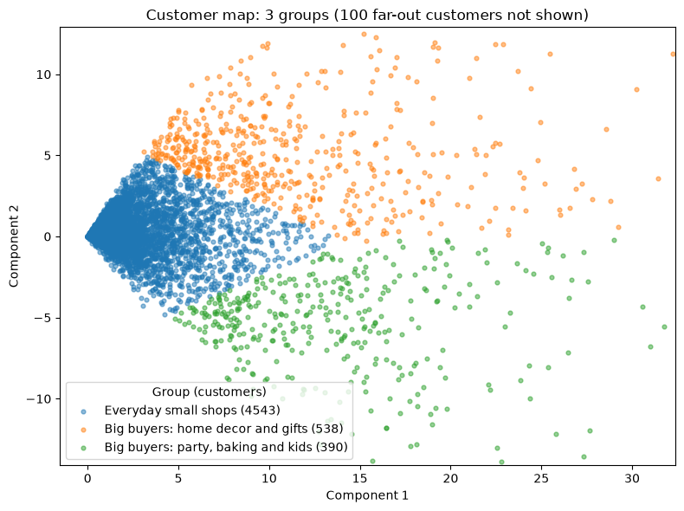
Our customer groups
Everyday small shops
83% of customers (4,543). About 47 different products each, 92% in the UK.
Big buyers: home decor and gifts
10% (538). About 230 products each: hearts, T-light holders, wicker, French signs. 98% UK.
Big buyers: party, baking and kids
7% (390). About 200 products each: lunch bags, cake cases, backpacks. 29% outside the UK.
The first axis is basically how much customers buy, so the picture mostly separates small from big buyers. The edges are soft.
Presenter: Jeevan Mandala
Notes:
For marketing we put each customer on the first two dimensions of the model and grouped them with k-means. The first dimension is basically how much a customer buys, so the picture mostly separates small from big buyers. We got three groups. Everyday small shops are 83% of customers. There are two big buyer groups, together about 17% of customers, who buy four to five times as many different products. One leans towards home decor and gifts, the other towards party, baking and kids' items, and that one has the most customers outside the UK. The edges are soft, and the small shops group is big enough that we'd split it by theme next.

Slide 9
What could go wrong, and what next
What could go wrong
What we'd do next
One test period, and it was the run up to Christmas
23% of order lines have no customer ID, so guest buyers are invisible
New customers and products with fewer than 10 buyers get no suggestions (about 3 in 10 of the new purchases we tested)
We measured personal top-10 lists, not the product page box itself
A/B test the box against best sellers for 2 to 4 weeks
Try a bought or not bought input: it was 2.8 points better on validation (interval 0.5 to 5.1)
Refresh the model every night and check the hit rate monthly
Split the small shops group by theme
Presenter: Manavkrishna Manoj (risks) and Jeevan Mandala (next steps)
Notes:
To finish. Manavkrishna on what could go wrong: we tested one period and it was the run up to Christmas, nearly a quarter of the raw order lines have no customer ID so guest buyers are invisible, new customers and rare products can't get suggestions, and we measured personal top-10 lists rather than the product page box itself. Jeevan on next steps: run an A/B test of the box against best sellers, try a simple bought or not bought input, which scored about three points better on validation, refresh nightly and check monthly, and split the small shops group by theme. Thanks, we're happy to take questions.

