Slide 1
RecycleSense AI ♻️
Intelligent Recycling Assistant Using Artificial Intelligence
Internship Project - 1M1B AI for Sustainability Virtual Internship
Prepared By: Jeeva A
B.E. Computer Science and Engineering
Easwari Engineering College
Technology Stack: Python, Streamlit, TensorFlow, MobileNetV2, Pandas
Sustainable Development Goals: SDG 11 • SDG 12 • SDG 13
June 2026

Slide 2
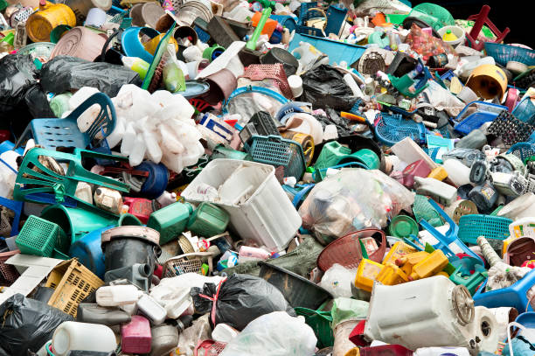
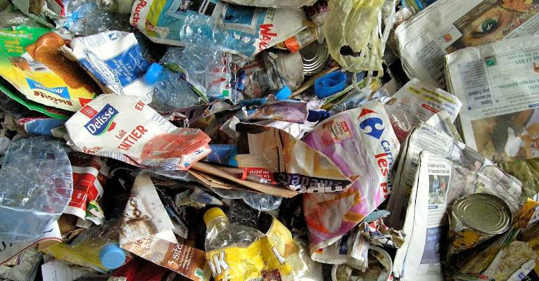
PROBLEM STATEMENT
Current waste segregation methods are inefficient and heavily dependent on manual effort.
Many recyclable materials are disposed of incorrectly due to a lack of awareness and proper guidance.
Manual waste classification is time-consuming, inconsistent, and difficult to scale.
Improper disposal of plastic, organic, and electronic waste contributes to environmental pollution and resource loss.
There is a growing need for an intelligent system that can automatically identify waste and provide accurate recycling recommendations.

Slide 3
PROPOSED SOLUTION – RECYCLESENSE AI
User Uploads Waste Image
↓
AI Object Detection
(MobileNetV2)
↓
Waste Category Mapping
↓
Environmental Impact Analysis
↓
Recycling Guidance
↓
Analytics Dashboard &
Sustainability Report
RecycleSense AI is an intelligent waste management platform that uses Artificial Intelligence to identify waste materials from images.
The system automatically classifies waste into categories such as Plastic, Organic, and E-Waste.
Users receive disposal recommendations, recycling tips, environmental impact information, and sustainability insights.
The platform also maintains historical records and generates sustainability reports for analysis.

Slide 4
TECHNOLOGY STACK
Component | Technology Used
Programming Language | Python
Frontend | Streamlit
AI Model | MobileNetV2
Machine Learning Library | TensorFlow
Data Processing | Pandas
Visualization | Matplotlib
Data Storage | CSV
Version Control | Git & GitHub

Slide 5
SYSTEM WORKFLOW
User Uploads Image
↓
Image Preprocessing
↓
MobileNetV2 AI Model
↓
Waste Object Detection
↓
Waste Category Mapping
↓
Environmental Impact Analysis
↓
Recycling Recommendation
↓
Analytics Dashboard
↓
Sustainability Report Generation

Slide 6
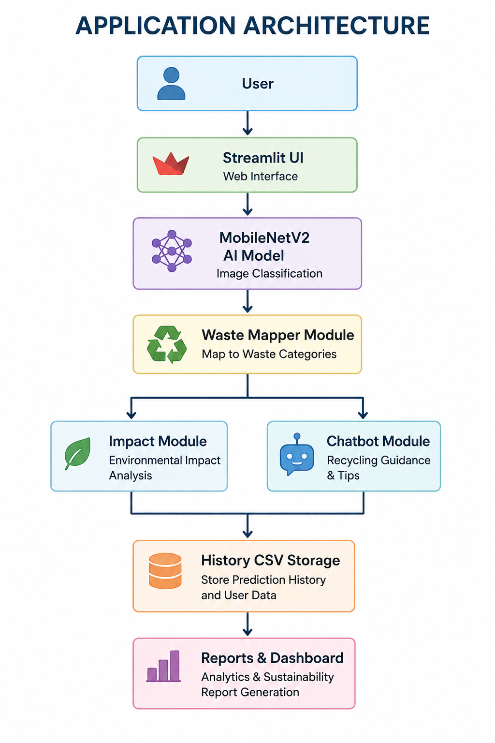
APPLICATION ARCHITECTURE

Slide 7
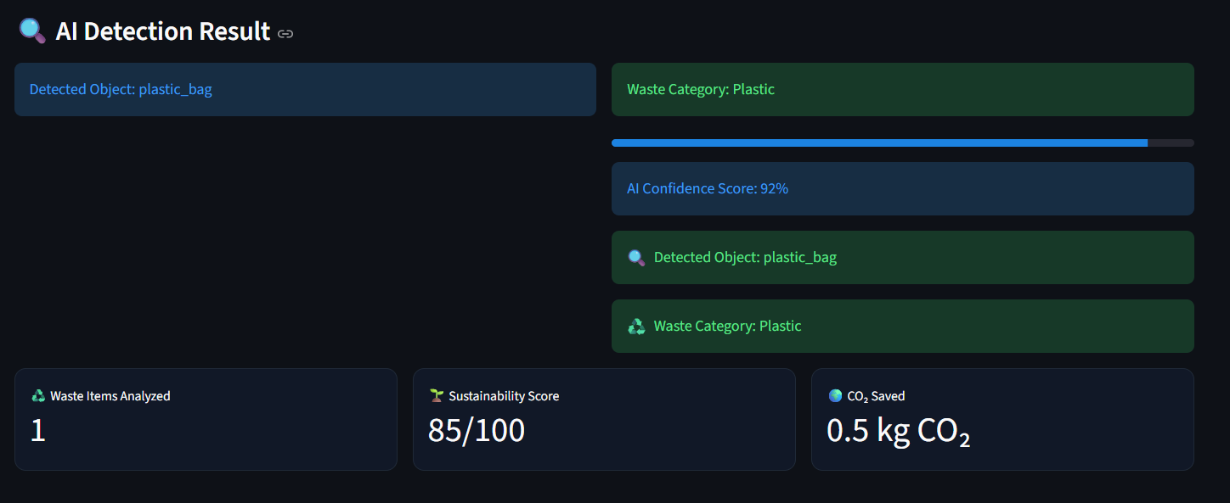
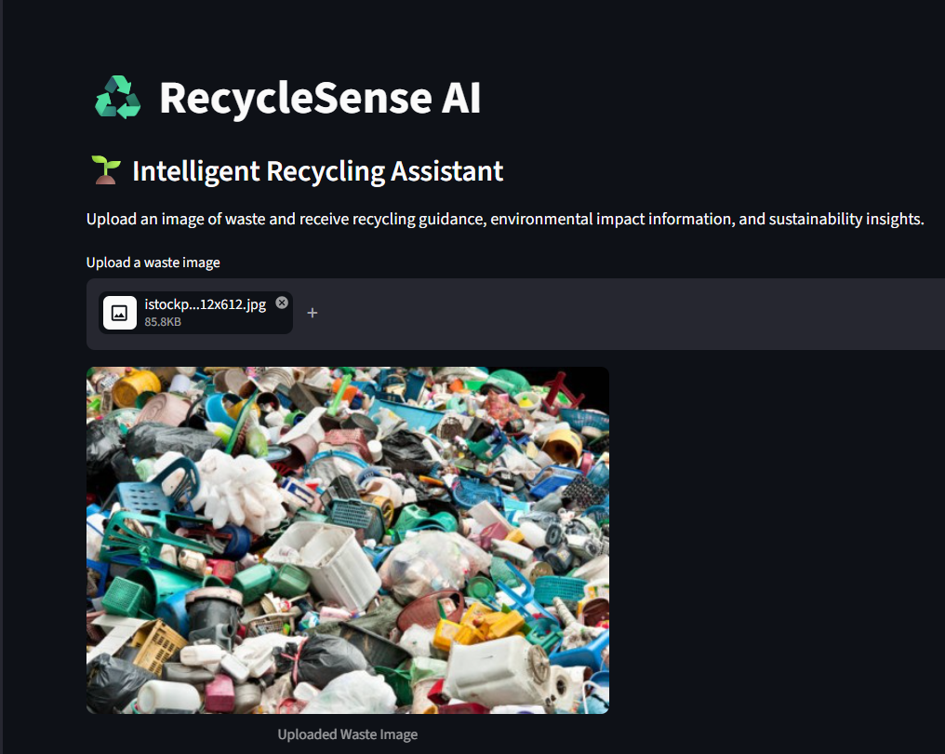
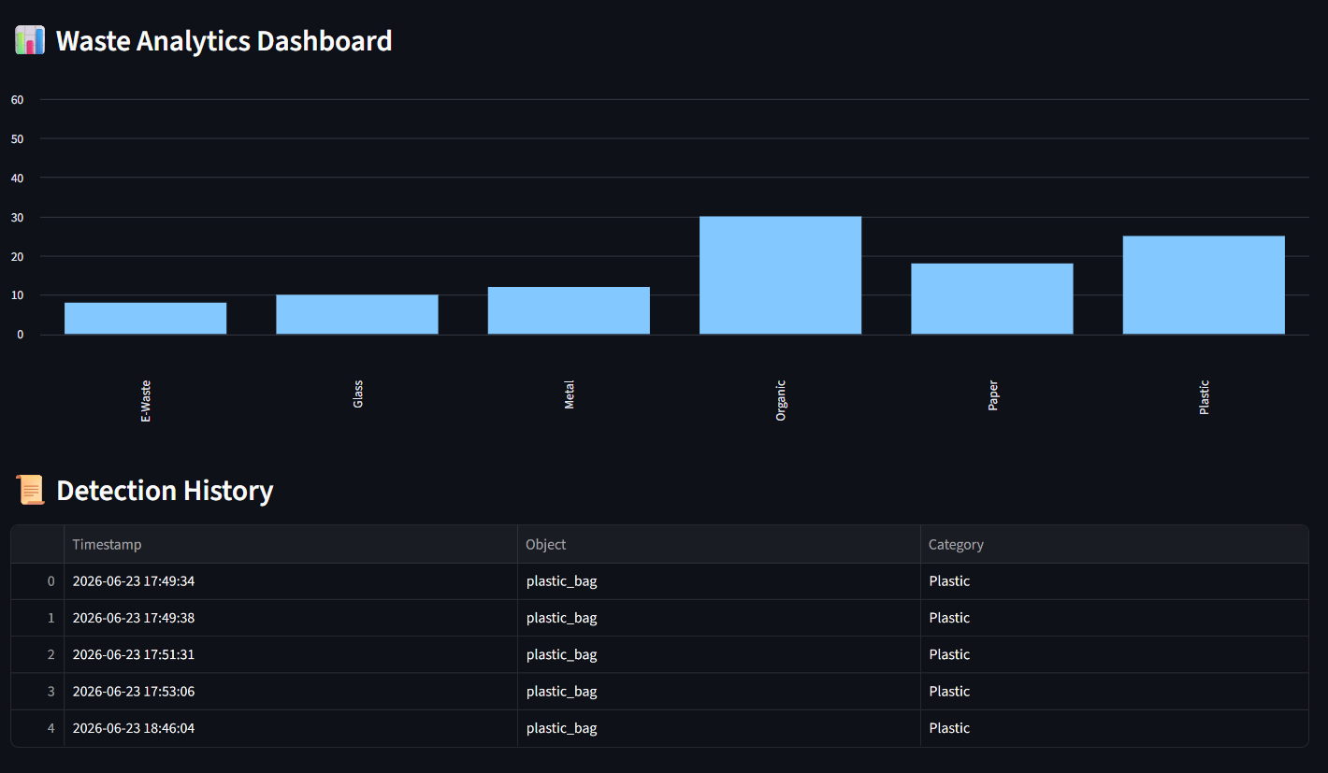
APPLICATION DEMONSTRATION
AI Waste Detection & Classification
Waste Image Upload Interface
Analytics Dashboard & Detection History

Slide 8
KEY FEATURES
♻️ AI Waste Classification
Uses MobileNetV2 deep learning model
Identifies waste objects from uploaded images
Provides fast and accurate predictions
💡 Recycling Recommendations
Provides disposal instructions
Suggests recycling best practices
Encourages responsible waste management
🗂 Waste Category Mapping
Maps detected objects into waste categories
Categories include:
Plastic
Organic
E-Waste
📊 Analytics Dashboard
Tracks waste detection history
Visualizes trends using charts
Supports sustainability monitoring
🌍 Environmental Impact Analysis
Calculates environmental benefits
Displays CO₂ reduction information
Promotes sustainability awareness
📄 Sustainability Reports
Generates automated sustainability summaries
Highlights waste classification statistics
Useful for reporting and analysis

Slide 9
RESULTS & OUTPUT
✅ Waste classification using MobileNetV2
✅ Automatic waste category mapping
✅ Environmental impact calculation
✅ Recycling recommendation generation
✅ Detection history tracking
✅ Sustainability report generation
METRIC | RESULT
AI Model | MobileNetV2
Waste Categories | Plastic, Organic, E-Waste
Prediction Confidence | ~92% Confidence
Sustainability Score | 85/100
Sample CO₂ Reduction | 0.5 kg
Data Storage | CSV History

Slide 10
RESPONSIBLE AI CONSIDERATIONS
Fairness: Model is designed to classify waste categories without bias.
Transparency: Users can see detected objects and waste category predictions.
Ethics: Recommendations promote environmentally responsible disposal practices.
Privacy: Uploaded images are used only for classification and are not linked to personal data.

Slide 11
FUTURE ENHANCEMENTS
📱 Mobile Application
Develop Android/iOS version for wider accessibility.
☁️ Cloud Database Integration
Replace CSV storage with cloud-based databases.
🤖 Advanced AI Models
Improve classification accuracy using larger datasets.
📷 Real-Time Camera Detection
Enable live waste recognition through device cameras.
🗺 Smart Recycling Center Locator
Show nearby recycling and disposal centers.
📄 PDF Report Generation
Generate downloadable sustainability reports.

Slide 12
CONCLUSION
Developed an AI-powered waste classification system using MobileNetV2.
Automated waste category mapping and recycling recommendations.
Provided environmental impact analysis and sustainability insights.
Implemented analytics dashboard and detection history tracking.
Generated sustainability reports for monitoring waste management activities.
Contributes to Sustainable Development Goals (SDG 11, SDG 12, and SDG 13).

Slide 13
THANK YOU ♻️
Prepared By: Jeeva A github.com/Jeeva-0805/RecycleSense-AI B.E. Computer Science And Engineering Easwari Engineering College
June 2026

