Slide 1
CLEANOBOT
TEAM - 8
TEAM GUIDE : SATHISH.A, LECTURER
TEAM MEMBERS : LINKESHWARA.N.S
VIJAYABASKAR.R
SRIGOKULAKANNAN.S
JEEVA.L
SANJEEV KUMAR.V

Slide 2
CLEANOBOT
ABSTRACT
In the current busy schedule, cleaning surrounding environment is more difficult. An efficient method to clean the desired area has been implemented through this project. By using this robot vacuum cleaner, difficult places can be cleaned which there by reduce risks to mankind.

Slide 3
CLEANOBOT
METHODOLOGY
Cleanobot can be work under any place. It has a disk shape, sucks the dirt particle and stores in the dustbin. Easy to use, low noise and independent cleaning is main advantage.
Here, RC car which is embedded with a vacuum cleaner is used. This system has an ultrasonic sensor attached to it that helps in avoiding large obstacles such as tables, chairs, walls etc.
By measuring the distance with this sensor, the car takes the direction where the distance between obstacle and car is more, hence avoiding the collision with the obstacles.

Slide 4
CLEANOBOT
HARDWARE REQUIRED
Arduino Pro Mini – 1
7.4V Lithium-Ion Battery – 1
L293D Motor Driver – 1
N20 Motor Wheels – 2
HC-SR04 Ultrasonic Module – 3
LM7805 Voltage
5Volt N20 Motors and Mounting Brackets – 2
IPerfboard – 1
R Module – 1
Switch – 1
Regulator – 1
Castor Wheel -1
MDF

Slide 5
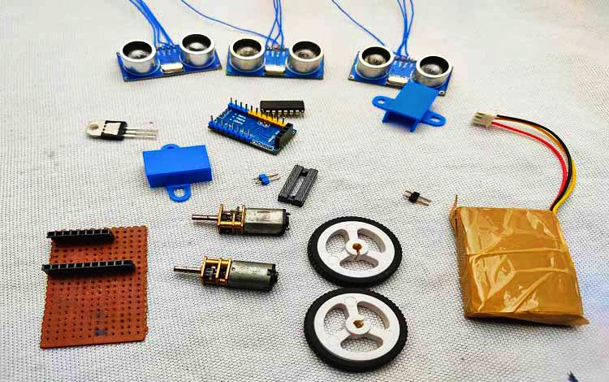
CLEANOBOT
SOFTWARE REQUIRED
C Language is required

Slide 6
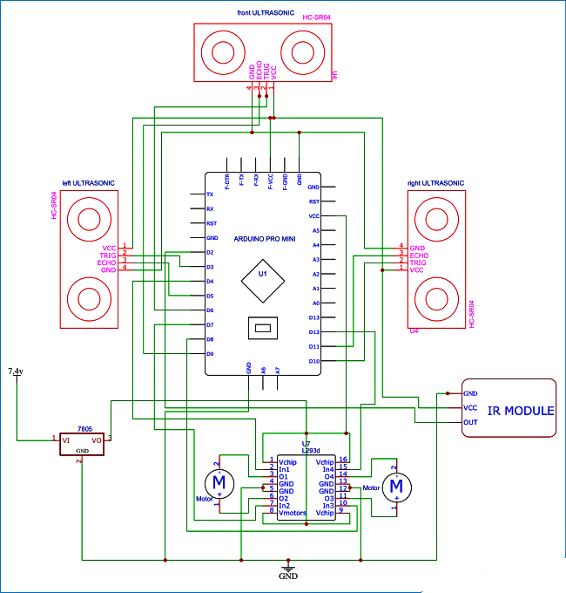
ARCHITECHTURE

Slide 7
CLEANOBOT
EXPECTED RESULT
A vacuum cleaner robot has been designed, fabricated and tested. It has a disk-shape, sucks dirt with a retractable dustbin on top of which a fan is mounted.
The suction fan helps create air pressure that attracts dirt to the dustbin.
The robot navigates with a front caster wheel and two rear wheels, and detects obstacles using the ultrasonic sensors.

Slide 8
CLEANOBOT
THANK YOU
BY,
TEAM - 8

