Slide 1
EnergyGrid-RL-vs-Search
Jeeva J
Javagar Prasath
Monish Prasanna

Slide 2
Introduction
Problem Overview:
Develop an intelligent agent navigating an 8×8 energy-constrained grid.
Goal: reach a target cell while avoiding random obstacles.
Challenge: limited energy, obstacles vary each episode.
Algorithms Explored:
Classical Search: DFS, BFS, A* (heuristic)
Reinforcement Learning: Q-Learning (tabular), PPO (policy-gradient)

Slide 3
Environment Details
State Space: Flattened 64 cells + normalized energy (65-dim vector)
Action Space: 4 discrete actions – Up, Down, Left, Right
Reward Structure:
Step penalty: −0.5 (discourage wandering)
Progress reward: +1 (closer to goal)
Collision penalty: −2
Goal reward: +50
Energy depletion: −10
Termination: Goal reached, energy 0, or max steps (32)
Visualization Concept:
Agent (blue), Goal (green), Obstacles (grey), Empty cells (white)
Step-wise movement shows agent navigating dynamically

Slide 4
Demo GIF

Slide 5
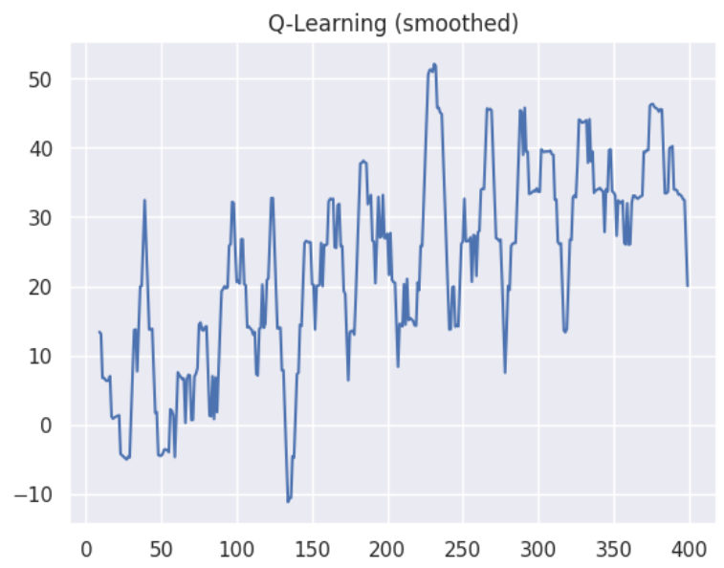
Q Learning Result

