Slide 1







BotTrainer – LLM-Based
NLU Model Trainer &
Evaluator for Chatbots
Presented By
Jeeva M
Nishtha Mishra
Swayam Bora
Riya
Under the guidance: Mr. Thangarasu
Team B
Siri Reddy
Srinivas
Utkarsh Gupta

Slide 2
Introduction
BotTrainer is an LLM-powered Natural Language Understanding (NLU) system designed for chatbot applications.
It performs intent classification and schema-constrained entity extraction using prompt engineering instead of traditional machine learning training pipelines.
The system uses a JSON-first dataset structure to define intents, example utterances, and allowed entity schemas.
It supports multiple LLM backends, including a local Gemma-3 model (via Ollama) and Qwen-2.5, producing structured JSON outputs for intent and entity prediction.
The project includes an evaluation module to analyze intent classification performance using standard metrics such as accuracy.
An interactive Streamlit interface is planned to enable real-time testing and analysis.

Slide 3

Problem Statement
Traditional chatbot NLU systems depend on feature engineering and supervised classifiers, which require large labeled datasets, frequent retraining, and are hard to scale while offering limited explainability. With the advent of Large Language Models (LLMs), NLU pipelines can be redesigned using prompt-based reasoning to achieve scalable, reliable, and structured intent understanding without heavy retraining.

Slide 4


LLM-BASED INTENT CLASSIFICATION
Use large language models to classify user intents without training traditional machine learning models.
Project Objectives
SCHEMA-CONSTRAINED ENTITY EXTRACTION
Extract relevant entities in a structured JSON format using prompt engineering and predefined entity schemas.
JSON-Driven NLU Pipeline Design
Design an end-to-end NLU pipeline based on a JSON-first dataset defining intents, examples, and entities.
MULTI-MODEL LLM EVALUATION
Integrate and evaluate multiple LLM backend, including Gemma-3 and Ollama, for intent prediction performance.

Slide 5
Tools & Technology Stack
PROGRAMMING & FRAMEWORKS
LLM & INFERENCE
  Ollama (LLM runtime)
  Gemma-3 (Local LLM)
  Qwen-2.5 (Local LLM)
  Python
  React (UI & visualization)
DATA HANDLING & EVALUATION
  JSON (intent schema)
  Pandas (data processing)
  Scikit-learn (evaluation metrics)

Slide 6
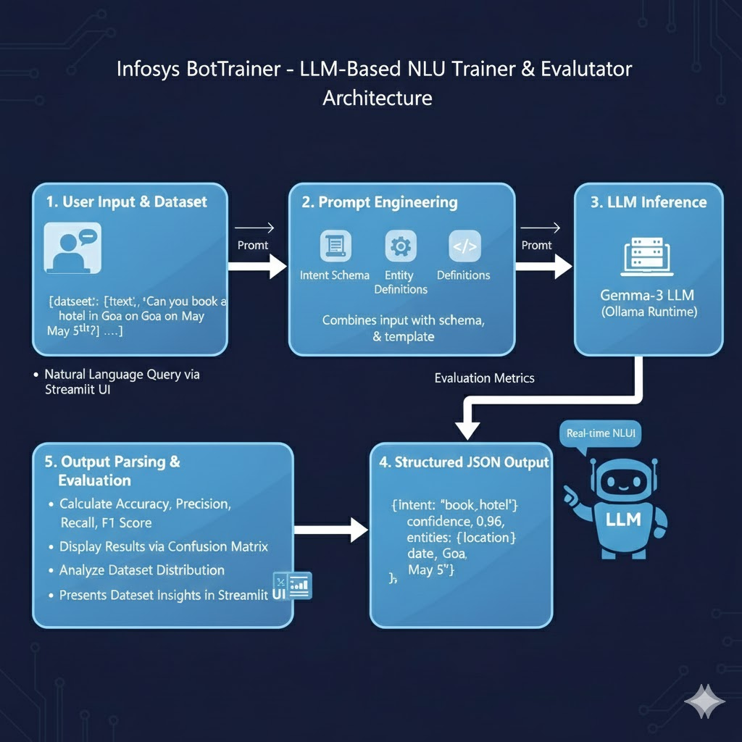
Project Workflow & Architecture
USER INPUT COLLECTION
PROMPT CONSTRUCTION
The user enters a natural language query through the Streamlit interface to initiate the NLU process.
The input is combined with the intent schema, entity definitions, and a predefined prompt template to guide the LLM.
STRUCTURED JSON GENERATION
LLM INFERENCE (GEMMA-3 / Qwen2.5 )
The LLM generates a structured JSON response containing the predicted intent, confidence score, and entities.
The constructed prompt is sent to the local Gemma-3 model via Ollama for reasoning and prediction.
OUTPUT PARSING & VALIDATION
EVALUATION AND MODEL PERFORMANCE COMPARISON
The JSON output is parsed, validated, and extracted to ensure correctness and reliability.
Predicted intents are evaluated using standard classification metrics, and performance is compared across different LLMs.

Slide 7
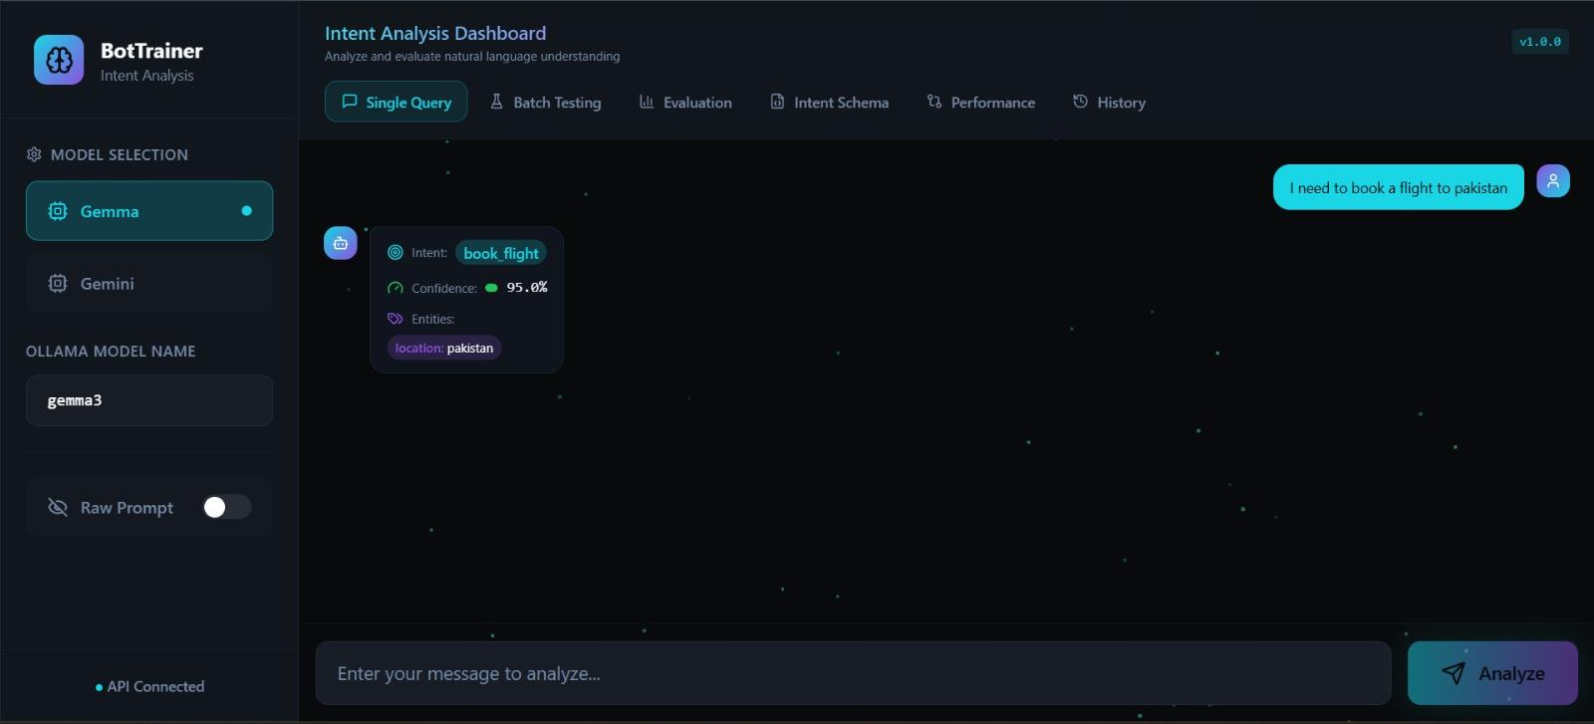
Results – NLU Tester
The system allows users to enter natural language queries and instantly predicts the intent, confidence score, and extracted entities. Results are displayed in a structured UI, demonstrating real-time LLM inference and explainability through confidence and entity extraction.

Slide 8
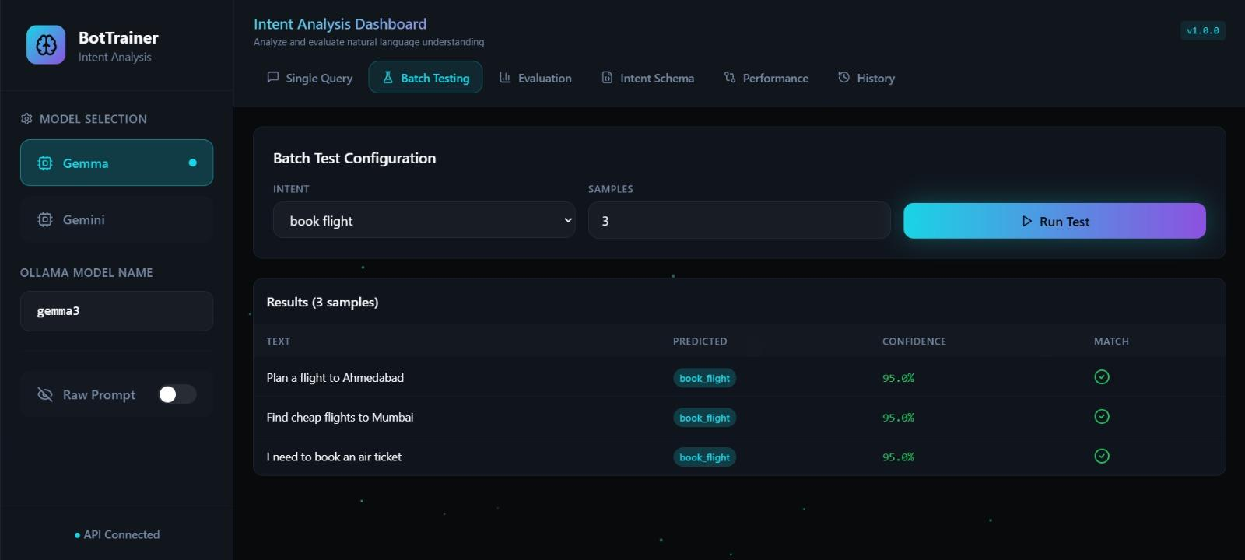
Results
“Batch Testing is used to test multiple user sentences together for the same intent.
We select an intent and run several example sentences at once.
This helps us check consistency, accuracy, and entity extraction across different ways users phrase the same request.”

Slide 9
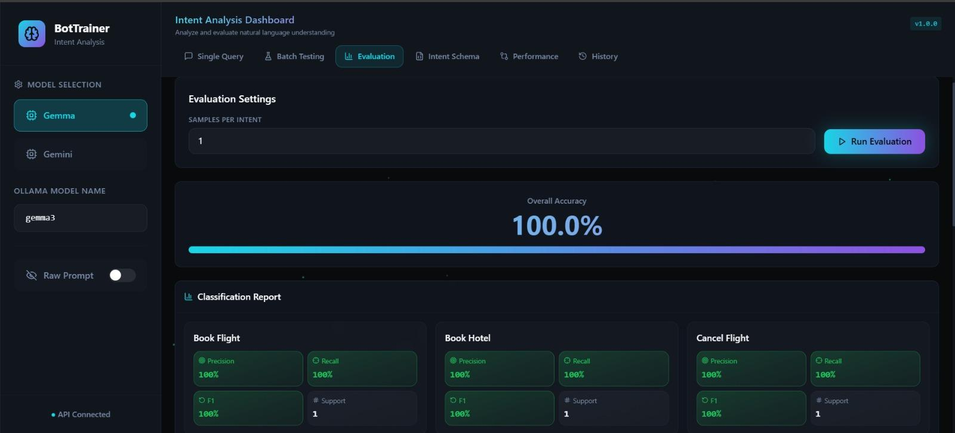
Results – Model Evaluation
The evaluation dashboard measures model performance using one sample per intent and displays Accuracy, Precision, Recall, F1-score, and a confusion matrix. This validates the reliability and correctness of intent predictions across all supported intents.

Slide 10
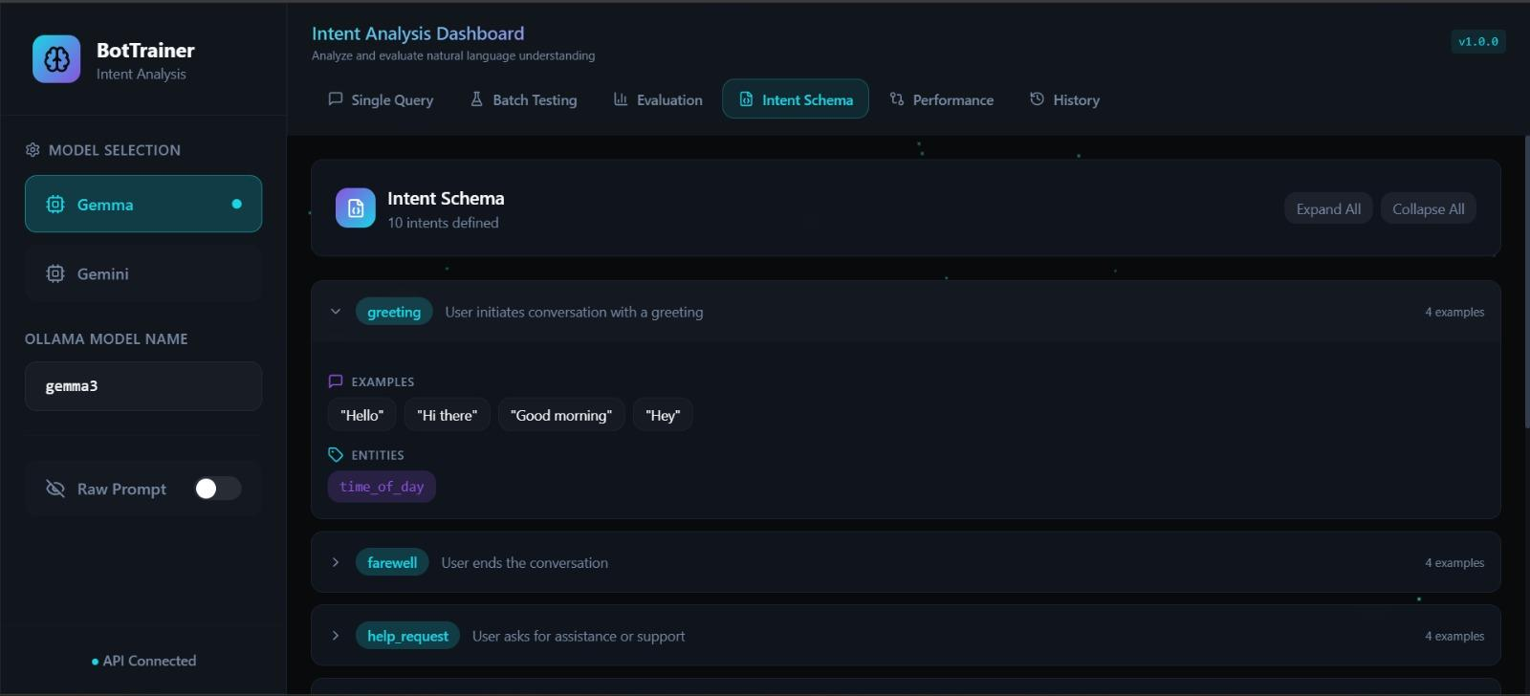
Results – intent schema
The Intent Schema defines what actions the system understands and what information to extract for each action.

Slide 11
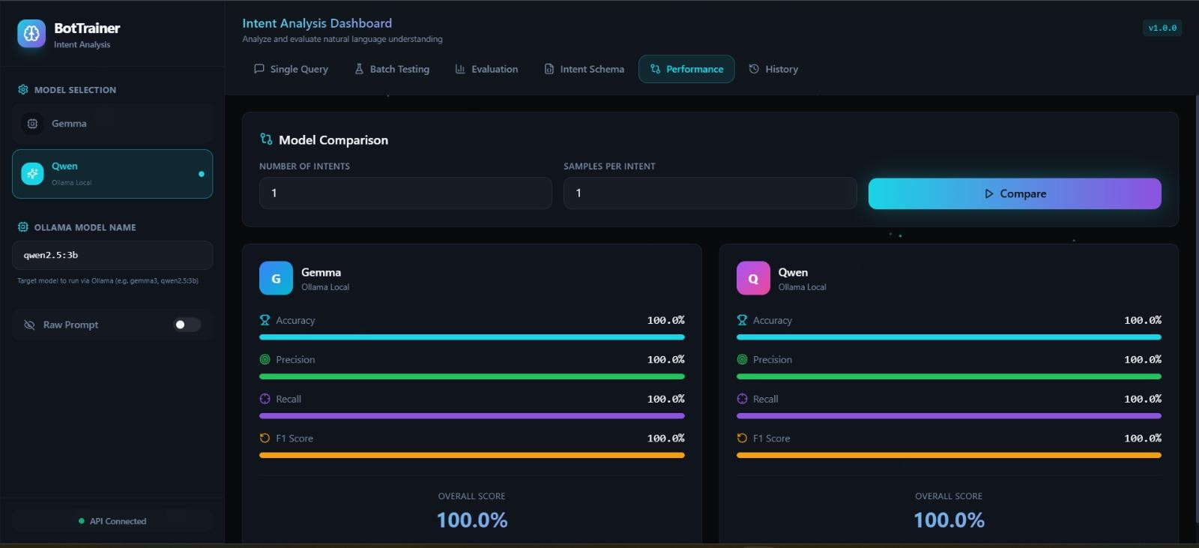
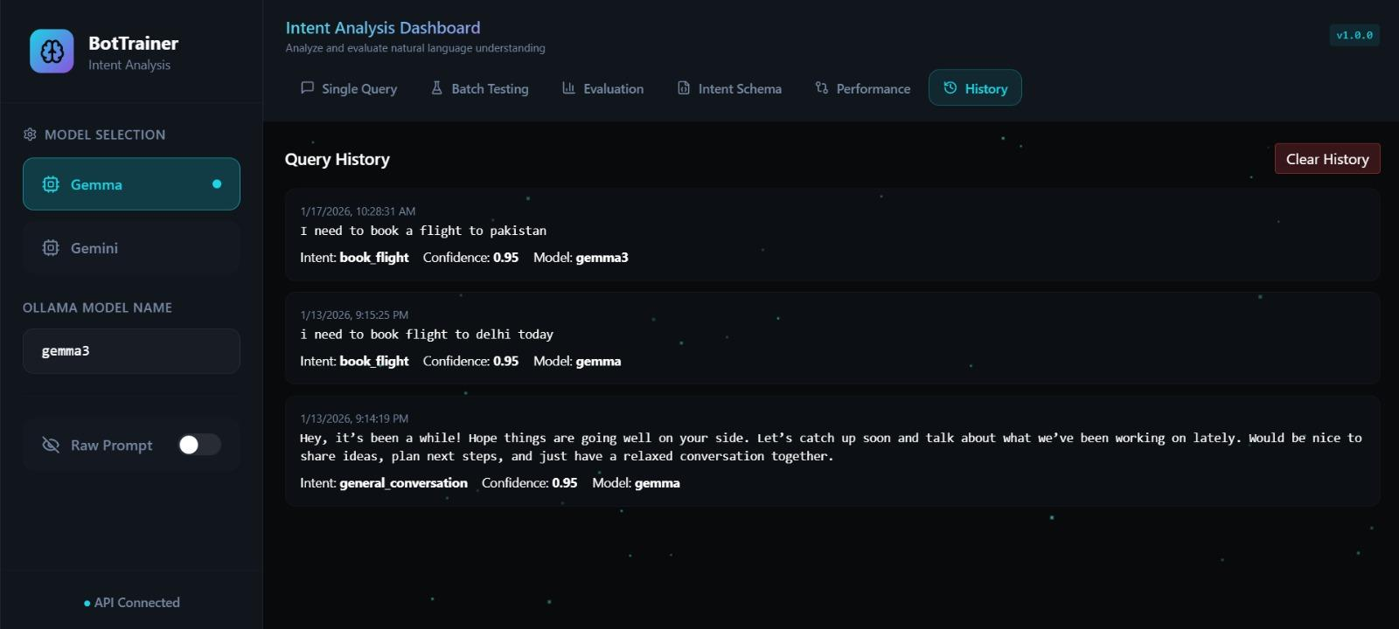
Results – Model
This section compares two different LLMs — Gemma (local via Ollama) and Qwen (local via Ollama) — on the same set of intents and test samples, using standard classification metrics

Slide 12
Overall Performance Summary
  High Intent Classification Accuracy
The model achieved correct intent predictions across all evaluated intents without misclassification.
  Consistent LLM Performance
The LLM delivered stable results without requiring retraining or parameter updates.
  Reliable Structured Output
Enforced JSON responses ensured error-free parsing and downstream processing.
  Effective Evaluation Coverage
Each intent was validated at least once, confirming reliable intent separation.
  Key Outcome
Prompt-engineered LLMs can successfully replace classical NLU pipelines when combined with structured evaluation.

Slide 13
Challenges Faced
  Structured Output Enforcement
Ensuring the LLM consistently returns valid JSON required careful prompt design and robust parsing logic.
  Inference Latency
Running a local LLM (Gemma-3) introduces response time delays compared to traditional classifiers.
  Evaluation Consistency
Designing a fair evaluation strategy for LLM outputs without retraining posed challenges in comparison.
  Prompt Sensitivity
Small changes in prompt wording can impact intent prediction accuracy, requiring iterative prompt tuning.

Slide 14


Future Potential
  Entity-Level Evaluation & Explainability
Extend evaluation to measure entity extraction accuracy and provide deeper interpretability.
  Multi-Language & Multi-Domain Support
Adapt the system for multilingual inputs and scale it across different business domains.
  Voice-Enabled NLU Pipeline
Integrate a speech-to-text module to allow voice inputs, enabling hands-free interaction while reusing the same LLM-based NLU pipeline.
  Production Deployment & Conversational Expansion
Deploy using Docker or cloud platforms and extend the system to support voice input and multi-turn conversations.

Slide 15

Conclusion
BotTrainer successfully demonstrates how Large Language Models can be used to build a modern, scalable, and explainable NLU system using prompt engineering and structured outputs, eliminating the need for traditional intent classifiers while maintaining evaluation rigor.

