Slide 1
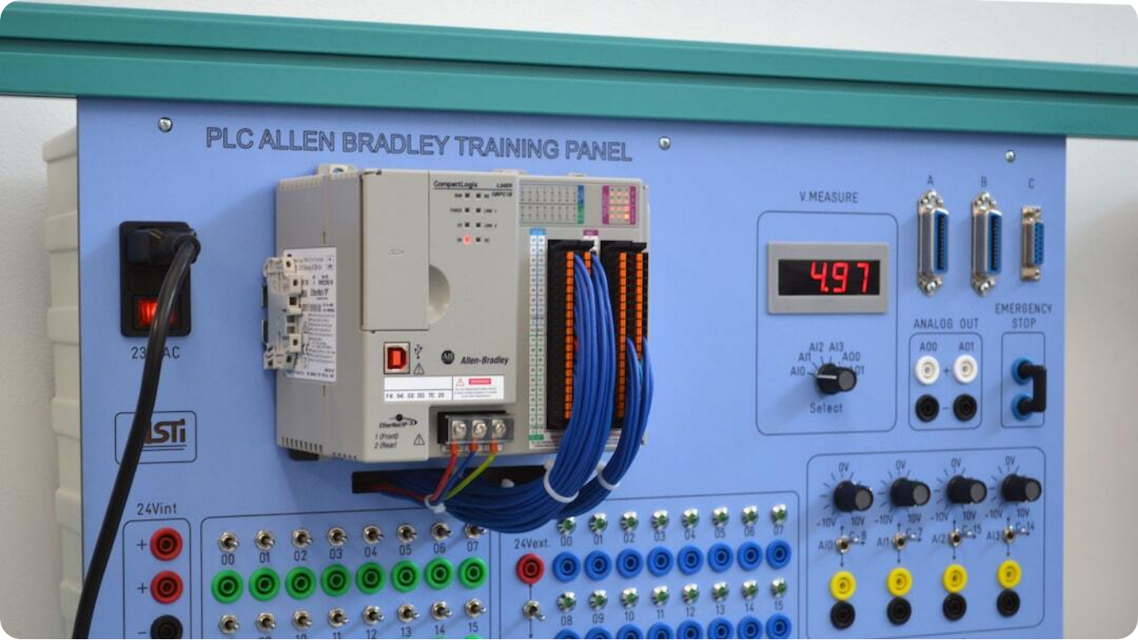
Smart Energy Meter
Real-time Monitoring with GSM Communication
Innovative Power Monitoring: A smart energy meter designed to track electricity usage and send real-time updates to users via GSM technology.
Seamless GSM Integration: Enables transmission of meter readings over mobile networks, eliminating the need for manual readings.
User-Centric Design: Provides consumers with instant access to consumption data, improving awareness and enabling cost-saving decisions.
Photo by Douglas de Aguiar Mendes on Unsplash
Notes:
Welcome to our final year engineering project: Smart Energy Meter with GSM Module. The rising demand for accurate, remote power monitoring has led us to develop this innovative solution. This smart meter continuously measures electrical consumption and transmits the data directly to the user using a GSM module, making real-time monitoring a reality.
Unlike traditional meters, this system offers automation and removes the reliance on physical meter reading. It empowers the user with timely insights, thereby enabling better consumption management. Our focus was to ensure this system is affordable, scalable, and user-friendly.
We aim to showcase not just the functional design of this system, but also its implications for modern energy management. Let’s dive deeper into how it works and what makes it a robust solution for the future.

Slide 2
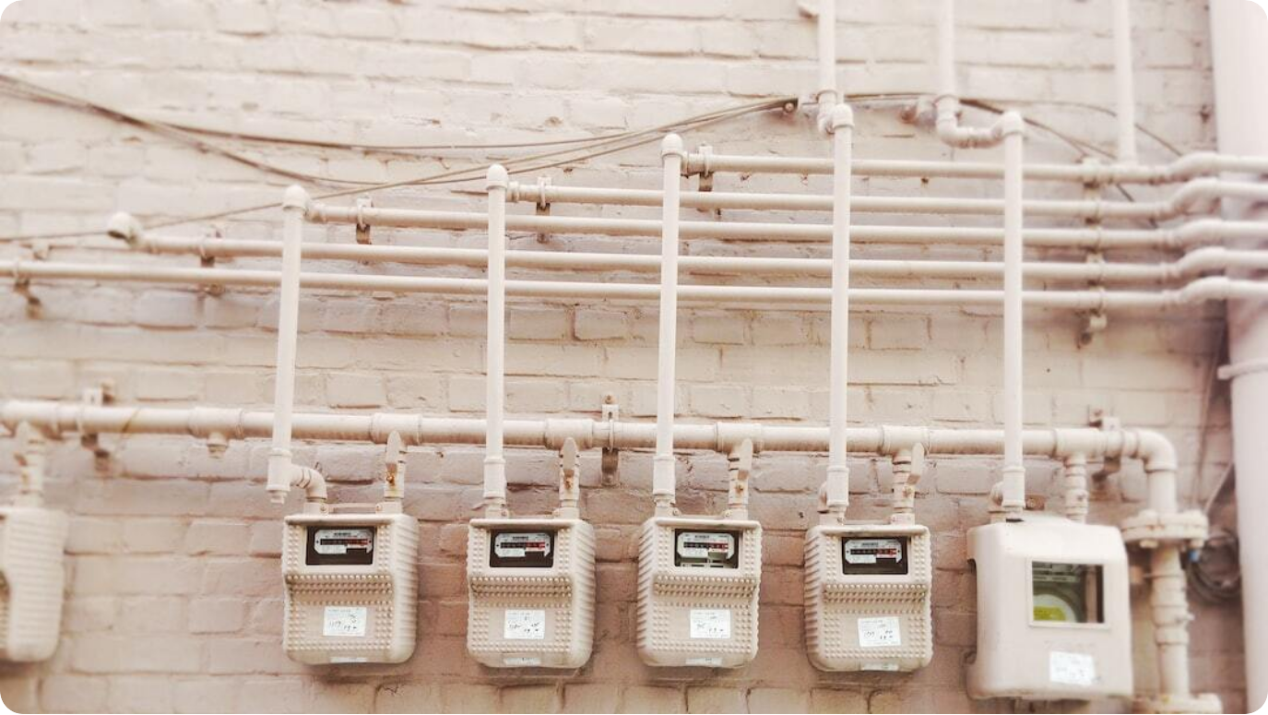
Introduction
The Evolution of Energy Monitoring
Conventional Metering Limitations: Traditional meters lack real-time data capability and require manual readings.
Need for Automation: Growing energy demands necessitate intelligent, automated monitoring systems.
GSM-Based Smart Meters: Integrates mobile communication to enable remote tracking of electricity consumption.
Photo by Linh Ha on Unsplash
Notes:
In today's energy-conscious world, traditional metering systems fall short in meeting the demands for real-time insights and efficient management. They require manual intervention for reading and billing, often leading to human errors and delays in data processing.
This limitation has catalyzed the shift toward smart energy meters, which not only digitize the measurement process but also allow for automated data handling. The use of mobile communication technologies like GSM further extends this capability, enabling real-time, remote access to energy usage data.
The integration of GSM modules into energy meters represents a step toward smarter infrastructure, aligning with global trends in smart cities, digital utilities, and sustainable energy use.

Slide 3
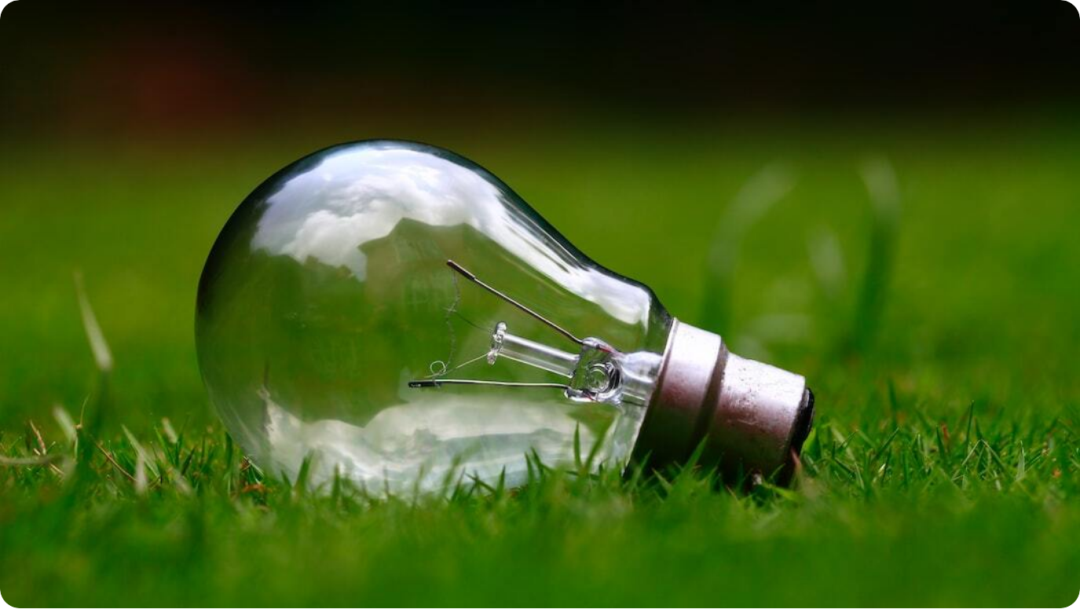
Project Objectives
Aims of the Smart Energy Meter System
Accurate Energy Tracking: Measure electricity usage in real-time with minimal error.
Remote Data Access: Enable users to access consumption information from any location via GSM.
Automated Billing Support: Support integration with billing systems to reduce human dependency.
Photo by Ashes Sitoula on Unsplash
Notes:
Our project was built around three major objectives. First, we aimed to provide **accurate real-time measurement** of electricity consumption. This helps eliminate estimation errors and gives users exact data for better control over usage.
Second, we wanted to ensure **remote accessibility** using a GSM module. With this feature, users can receive energy data updates on their mobile phones without needing physical access to the meter. This is especially useful for utility providers and consumers managing multiple properties.
Finally, we targeted **automated billing compatibility**. By integrating with backend systems, our smart meter can streamline the billing process, reducing operational overheads and improving transparency for both utilities and users.

Slide 4
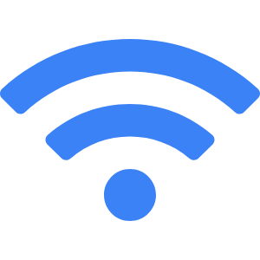


Literature Survey
Research Background on Smart Energy Meters
Existing Technologies
Many systems use ZigBee, Wi-Fi, or PLC, but face challenges in cost, range, and infrastructure.
GSM-Based Innovations
GSM-based energy meters offer wider coverage and simplicity for mobile-enabled data transfer.
Identified Gaps
Lack of real-time user interaction and dependency on utility-side solutions in older models.
Notes:
The development of our Smart Energy Meter was informed by extensive literature review. Existing smart meter technologies often rely on communication modes like ZigBee, Wi-Fi, or PLC. While effective in certain scenarios, these systems struggle with scalability, signal range, and integration into widespread infrastructure.
We found GSM to be a more robust alternative for mobile communication. Several studies highlight its simplicity and nationwide coverage, which make it ideal for real-time data transmission in energy monitoring applications.
However, many current implementations still lack direct user interaction or are too reliant on utility providers' backend systems. Our approach bridges these gaps by offering user-level accessibility with minimal deployment complexity.

