Slide 1
Employee Data Analysis using Excel
STUDENT NAME: R.JEEVAPRIYA
REGISTER NO: 312204803
DEPARTMENT: COMMERCE
COLLEGE: THIRUMURUGAN ARTS AND SCIENCE COLLEGE FOR WOMEN.

Slide 2
PROJECT TITLE
Employee Performance Analysis using Excel

Slide 3


AGENDA
Problem Statement
Project Overview
End Users
Our Solution and Proposition
Dataset Description
Modelling Approach
Results and Discussion
Conclusion
3/21/2024 Annual Review

Slide 4

PROBLEM STATEMENT
Employee performance analysis using excel contains
information about employees, including their job
function, the business units they belong to, and their
respective pay zones. The goal is to perform an
in-depth analysis to evaluate how job salary are
allocated across various business units and pay
zones.
This data is then analysed using excels function and
tools, such as pivot tables, charts, and conditional
formatting, to identify patterns, strength and areas
for improvement.
Notes:
Develop a predictive model

Slide 5

PROJECT OVERVIEW
Project Title: Analysis of Job Function and Salary Distribution Across Business Units and Pay Zones.
Objective: To analyse and visualisation the distribution of job functions within various business units and Pay Zones to identify trends, patterns, and potential discrepancies
in the organisational structure and compensation alignment.

Slide 6

WHO ARE THE END USERS?
☆ HR Professionals.
☆ Data Analyst and Data Scientist.
☆ Business Executives and Managers.
☆ Researchers and Academics.
☆ Employees and Job Seekers.
☆ Policy Makers.

Slide 7

OUR SOLUTION AND ITS VALUE PROPOSITION
Comprehensive Distribution Analysis: Analysis the
Dataset to determine how job functions are distributed across different business units and pay zones.
Visualisation and Reporting: Create detailed visualisation (e.g., Bar charts, Pie charts, Heat maps) and a comprehensive report summarising key
Findings.
Enhanced Workforce Planning: Use insights from the analysis to inform workforce planning and
development strategies.

Slide 8
Dataset Description
Description for each of the columns in the dataset:-
1.Job Function: A brief description of the employee primary job function or role.
2.Business Unit: The specific business unit or department to which the
Employees belongs.
3.Gender: A code representing the gender of the employees
(e.g., Male, Female)
4.Pay Zones: A Salary indicating the employee pay zones.
(e.g., Pay Zone A[Full Time], Pay Zone B[Part Time], Pay Zone C)
5.Grand Total: The Grand total of the employees overall performance.

Slide 9

THE "WOW" IN OUR SOLUTION
Dynamic Visualisation and Interactive Dashboards: Instead of static charts, we offer dynamic, interactive Dashboards that allow users to explore the data in real-time. Users can drill down into specific business units, job functions, or pay zones to uncover deeper insights and trends.
Advanced Anomaly Detection and Predictive Insights:
Employ advanced analytics techniques to not only identify
current anomalies but also predict potential future trends
or imbalances based on historical data.
3/21/2024 Annual Review
9

Slide 10
MODELLING
Data Filtering:-
1.To sort and refine the data to focus on specific criteria, such as
department, data range, or individual employee performance.
2.For Examples: filtering by job functions or by grand total.
Pivot Tables:-
1. To summarise and analyse large datasets by grouping and aggregating
data based on different performance metrics.
2. Pivot tables will be used to dynamically calculating the pay zones, Grand
Grand total.
10

Slide 11
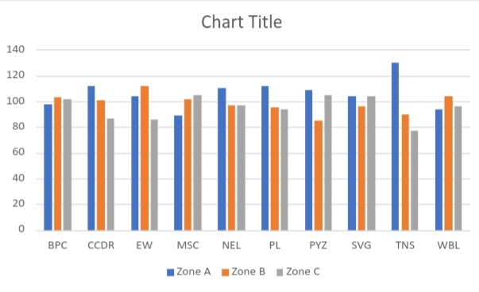
RESULTS
11

Slide 12
conclusion
The analysis of the employment dataset reveals crucial insights into the
distribution of job functions across business units and pay zones. By
Aggregating and Visualising this data, we can clearly see how job functions and Salary are allocated and identify any imbalances or trends that might impact Organisational efficiency and employee satisfaction.

