Slide 1
OT Communications Cloud Native
Product Architecture and Installation Overview
2026
|
Kamalraj Ramalingam

Slide 2
OTDS Cloud-Native 25.4 - Architecture
Database services
OTDS
database
OTDS Docker images
otdsws
Pre-req images and software
Kubernetes (pod orchestration)
NGINX Ingress Controller (pod) – NA for OpenShift
IdP
otdsws
NGINX Ingress / HA Proxy
Applications
(ECM, Exstream Runtime and Desktop Apps)
HELM Charts
OTDS (otds-25.4.x.tgz)
Images Tags
Refer the latest chart values yaml or install planning guide
External Systems/Applications
Kubernetes / OpenShift Environment
Bastion Host (k8s / oc, helm CLI)

Slide 3
Communications Cloud-Native 25.4 – Architecture
Database services
Exstream Docker images
Document Generation (Production Engine)
Design (DAS)
Orchestration
Empower (optional)
Design Database
DAS
database
Orchestration
database
Empower
database
OTDS
Pre-req images and software
Kubernetes / OpenShift (pod orchestration)
OTDS (pod or standard install)
NFS provisioner / CSI Driver (pod)
RabbitMQ (pod)
NGINX Ingress controller (pod) – NA for OpenShift
Design (DAS)
Orchestration
Empower
Exstream Web Client
Empower Editor
Web Browser
Communications Designer
Rabbit MQ
Empower Server Console
Databases
Oracle
MS SQL Server
PostgreSQL
Design and Production
NGINX Ingress Controller / HA Proxy
Design Engine
Designer
Communications Orchestrator
Document Generation
(Production Engine)
Batch processing
Content Author
On-demand processing
HELM Charts
RabbitMQ / OTDS (opentext-experience-cloud)
Exstream (exstream)
Design Manager
Desktop environment
Images Tags
Refer the latest chart values yaml or install planning guide
NFS Provisioner / CSI Driver
Kubernetes / OpenShift Environment
Bastion Host (k8s or oc, helm CLI)
Storage

Slide 4
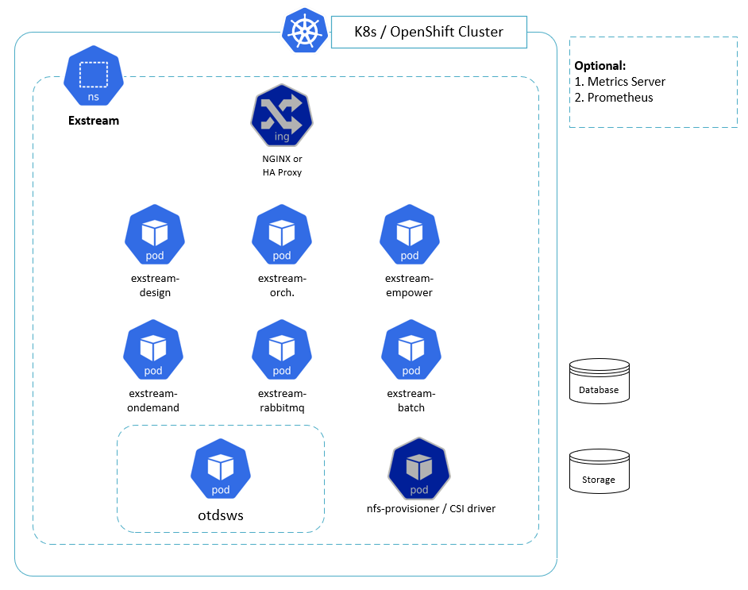
Communications v25.4 – K8s / OpenShift Cluster

Slide 5
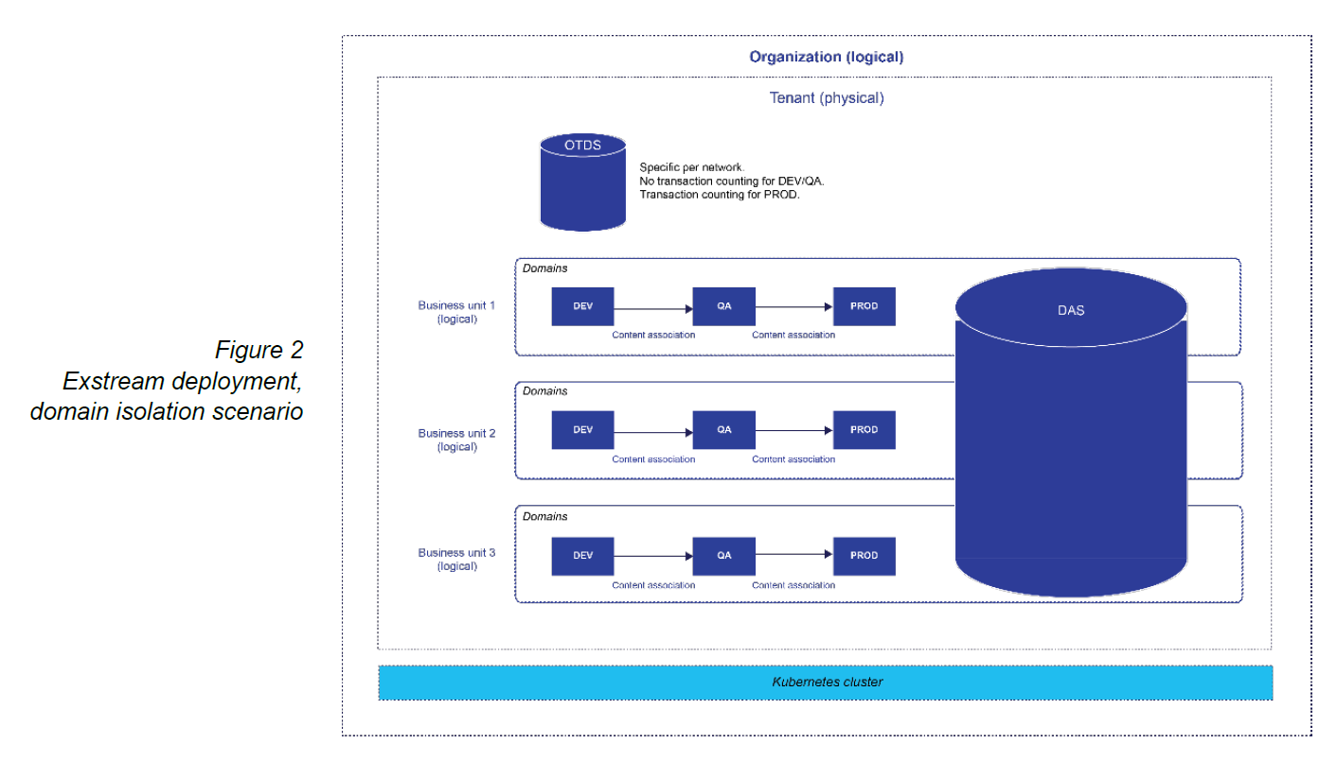
Tenant and Domains

Slide 6
Q&A

