Slide 1
Employee Data Analysis using Excel
STUDENT NAME: JEEVAJOTHI S
REGISTER NO: 122203989
DEPARTMENT: B.com [ corporate secretaryship ]
COLLEGE: SHRI KRISHNASWAMY COLLEGE FOR WOMEN

Slide 2
PROJECT TITLE
Employee Gender Analysis using Excel

Slide 3


AGENDA
Problem Statement
Project Overview
End Users
Our Solution and Proposition
Dataset Description
Modelling Approach
Results and Discussion
Conclusion
3/21/2024 Annual Review

Slide 4

PROBLEM STATEMENT
Excel will be used in this analysis to look at the dynamics and gender distribution inside a company. Through the examination of employee demographics, pay, performance, and retention data, we will be able to pinpoint any possible gender-based discrepancies and offer suggestions for optimizing workplace equity.

Slide 5

PROJECT OVERVIEW
.
The purpose of this analysis is to use Excel to look at the dynamics and gender distribution inside a company. We will find any possible gender-based differences in the workforce by examining employee data, and we'll also offer suggestions for enhancing workplace equity. Data quality, diversity, bias, and statistical significance are important factors to take into account.

Slide 6

WHO ARE THE END USERS?
Stakeholders in a business, such as HR specialists, CEOs, D&I committees, legal teams, researchers, and external stakeholders, are the ultimate users of employee gender analysis conducted using Excel. They evaluate workplace fairness, pinpoint gender-based discrepancies, and use this data to guide decisions.

Slide 7

OUR SOLUTION AND ITS VALUE PROPOSITION
We provide a complete Excel-based solution for gender analysis of employees. Our resolution consists of: Data Templates: Pre-made templates that make gathering and organizing data easier. Analysis Tools: Inbuilt algorithms and formulas for computing important metrics, like wage disparities, representation in leadership, and gender ratios. Charts and graphs are visualization tools that help show data and spot trends. Best Practices: Advice on methods for cleaning data, analyzing it, and interpreting the findings. Value Proposition: Our solution offers businesses the following advantages: Data-Driven Insights: By using our products, employers can obtain important knowledge about the gender dynamics and makeup of their workforce. Increased Equity: Organizations can establish a more equitable workplace by recognizing and resolving gender-based inequities. Enhanced Reputation: An organization can attract top personnel and gain a better reputation by showcasing a commitment to gender equality.

Slide 8
Dataset Description
Essential elements such as employee ID, name, gender, department, job level, tenure, salary, performance ratings, and reason for leaving the company should be included in the dataset for an Excel-based employee gender analysis. Education, experience, work title, location, manager ID, and survey results are examples of additional fields. For analysis to be effective, the data must be precise, comprehensive, and consistent.

Slide 9

THE "WOW" IN OUR SOLUTION
The "WOW" in employee gender analysis using Excel lies in its ability to uncover hidden insights, quantify disparities, develop targeted strategies, and track progress. This empowers organizations to create a more equitable workplace and achieve positive outcomes.
3/21/2024 Annual Review
9

Slide 10
MODELLING
In order to comprehend the interactions between variables, modeling in employee gender analysis entails developing mathematical representations. Regression, correlation, hypothesis testing, decision trees, and machine learning are examples of common techniques. Models help with decision-making, relationship analysis, and outcome prediction.
10

Slide 11
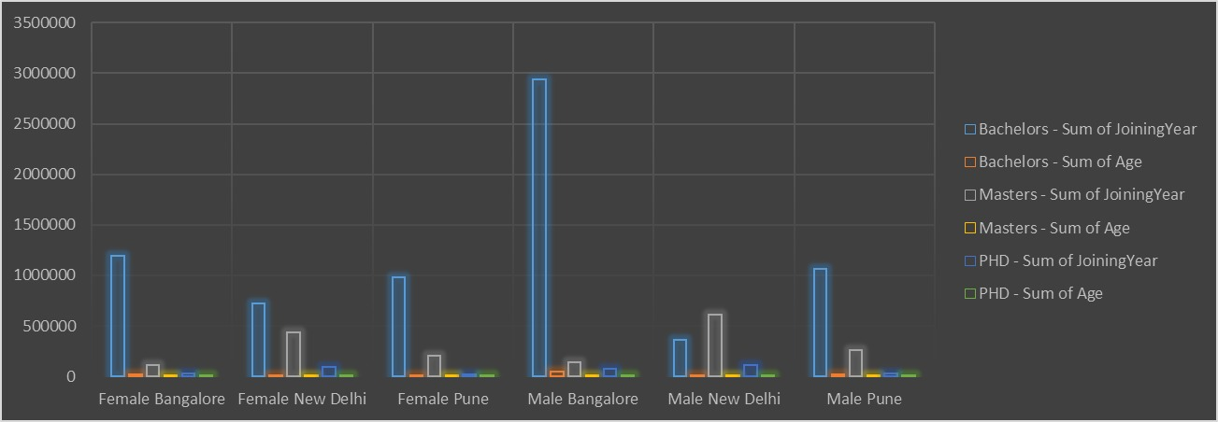
RESULTS
11

Slide 12
conclusion
Excel is a strong tool for discovering inequalities, measuring their impact, formulating remedies, and monitoring progress in employee gender analysis. With data-driven decision-making, inclusion, continuous monitoring, and efficient modeling, it assists enterprises in establishing a more equal and welcoming workplace.

