Slide 1

ethna attributes soft technologies private Ltd.
Research and Innovation, Matters

Slide 2
PATENT – STAGE I
- TITLE OF THE PATENT: “Smart Mirror ”
- APPLICANTS/ INVENTORS NAME(s): 1. Dr.Mohanaprasad K
2. Jeevak Raj S
3. Aswath M
4.Nikshith Narayan Ramesh
- DOMAIN OF IDEA: DeepLearning, Embedded Systems, Image Processing

Slide 3
PATENT – STAGE I
II. ABSTRACT OF THE IDEA:
“The first thing we do after we wake up in the morning is look into the mirror, even often throughout the day. As with the evolution of technology, everything does keep up with the current trend. We planned on doing the same for mirrors, such as being more interactive, informative and entertaining. What if mirrors are your assistant, they could give you beauty tips, guide you in the makeup process, suggest you attractive spectacles and hairstyles, they could deliver personalized news feeds. The interactive voice assistant greets you and performs basic conversations, even play you themed songs based on the ambiance. The camera mounted on the mirror takes a live feed of the person, performs face recognition for personalization and detects facial landmarks to try-out spectacles and makeup tips, this is done with Haar cascades, HOG and Linear SVM algorithms. As people’s preferences are stored in the cloud and deep learning is performed on these data, the trained model is then retrieved by the mirror to give better suggestions.”

Slide 4
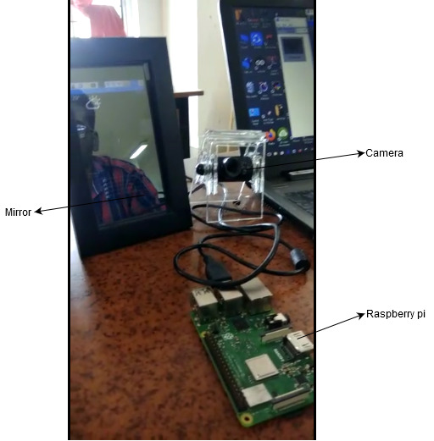
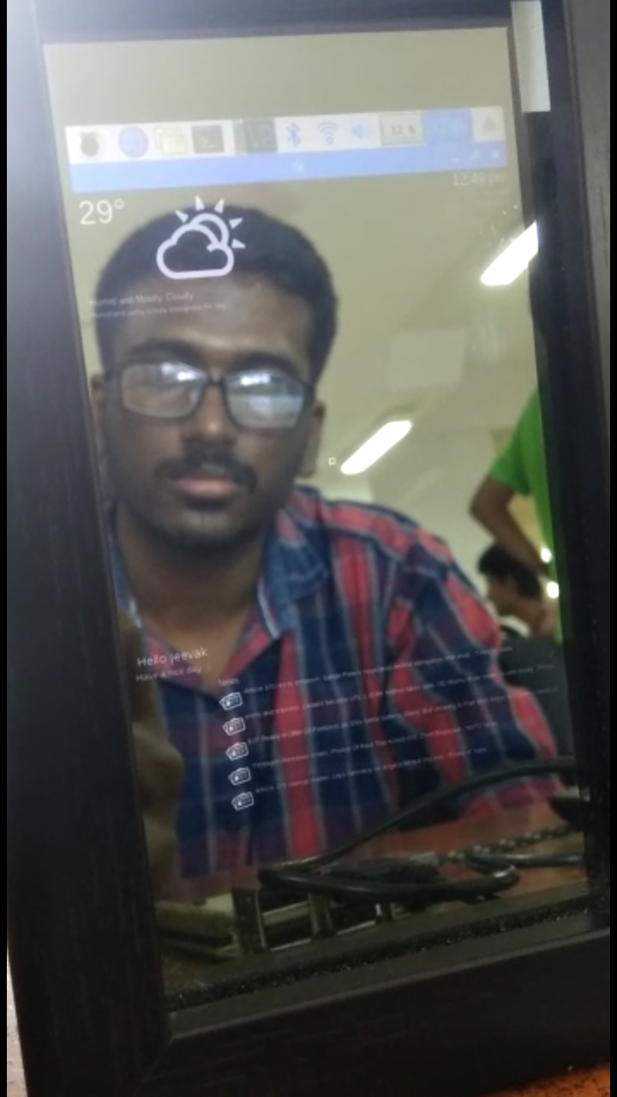
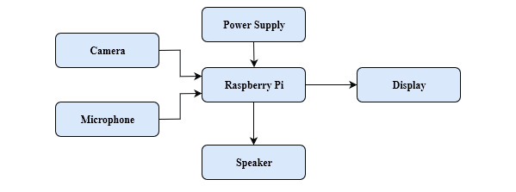
PATENT – STAGE I
Figure 1. Hardware Circuit Setup
Figure 2. Schematic diagram for smart mirror

Slide 5
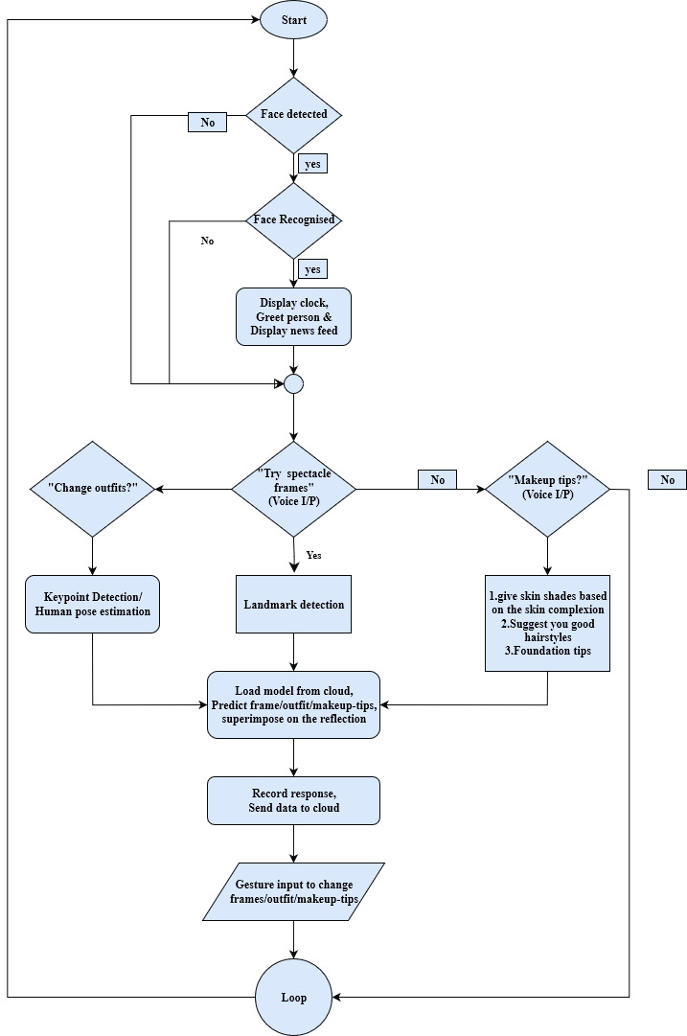
Link to the FlowChart:
https://drive.google.com/open?id=16txh2GwUW_mubvA1Z0Jw2hEMFDYmAk2q
Figure 3. Flowchart of the process

Slide 6
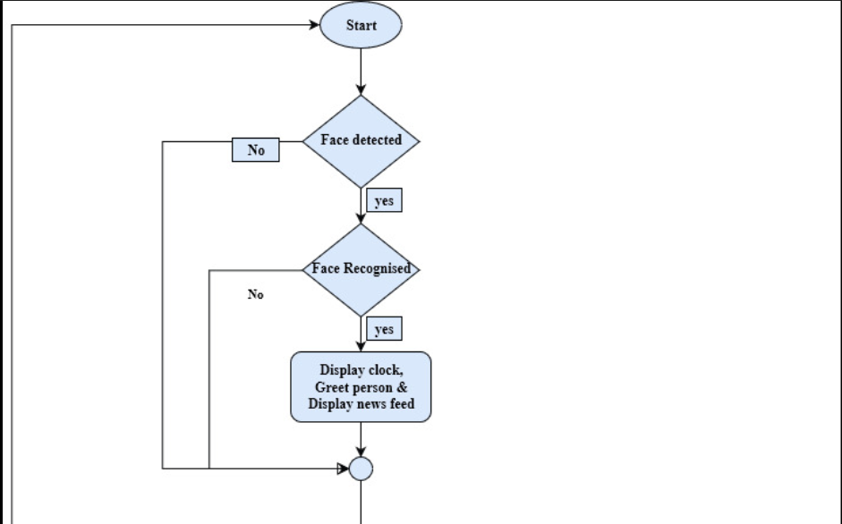
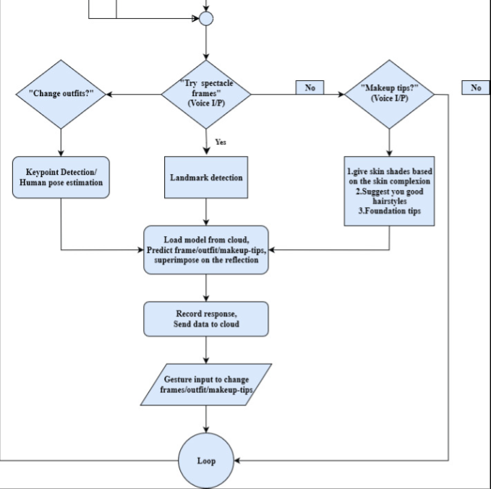
Figure 3. Flowchart of the process

Slide 7
Thank You

