Slide 1
Debugging

Slide 2
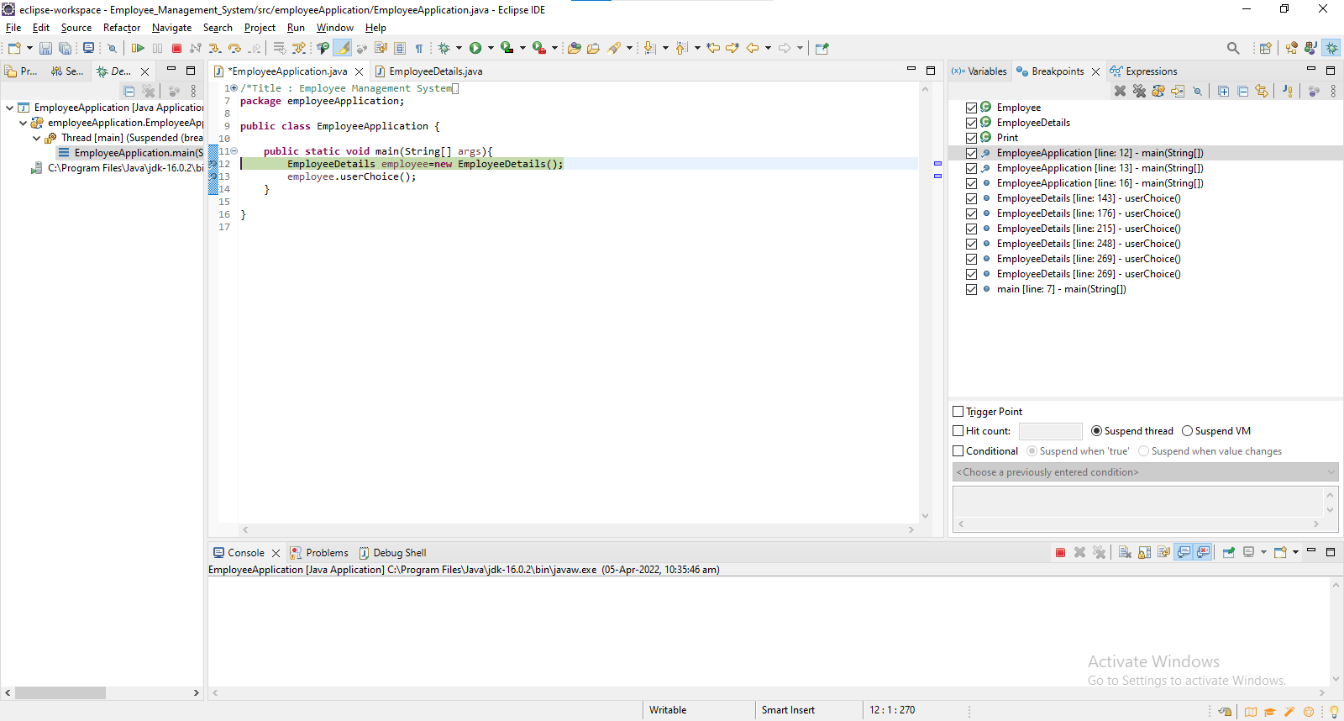
Debugging
Debugging is the process of identifying and fixing any issues in the source code of a program.

Slide 3

Stepping commands
Continue – An action to take in the debugger that will continue execution until the next breakpoint is reached or the program exits.
Step over – An action to take in the debugger that will step over a given line. If the line contains a function the function will be executed and the result returned without debugging each line.
Step into – An action to take in the debugger. If the line does not contain a function it behaves the same as “step over” but if it does the debugger will enter the called function and continue line-by-line debugging there.
Step out – An action to take in the debugger that returns to the line where the current function was called.

Slide 4
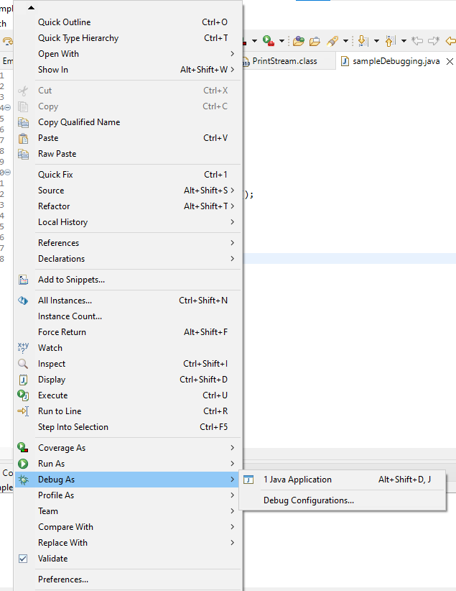
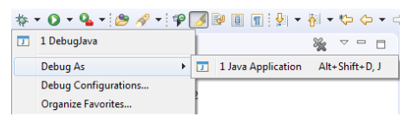
Launching and Debugging a Java program
A Java program can be debugged simply by right clicking on the Java editor class file from Package explorer. Select Debug As → Java Application or use the shortcut Alt + Shift + D, J instead.

Slide 5
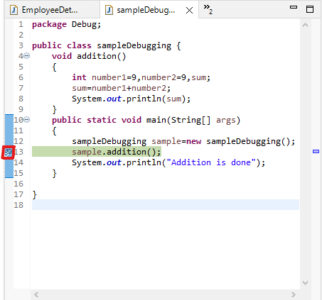
Breakpoints
A breakpoint is a signal that tells the debugger to temporarily suspend execution of your program at a certain point in the code.
To define a breakpoint in your source code, right-click in the left margin in the Java editor and select Toggle Breakpoint. Alternatively, you can double-click on this position.

Slide 6
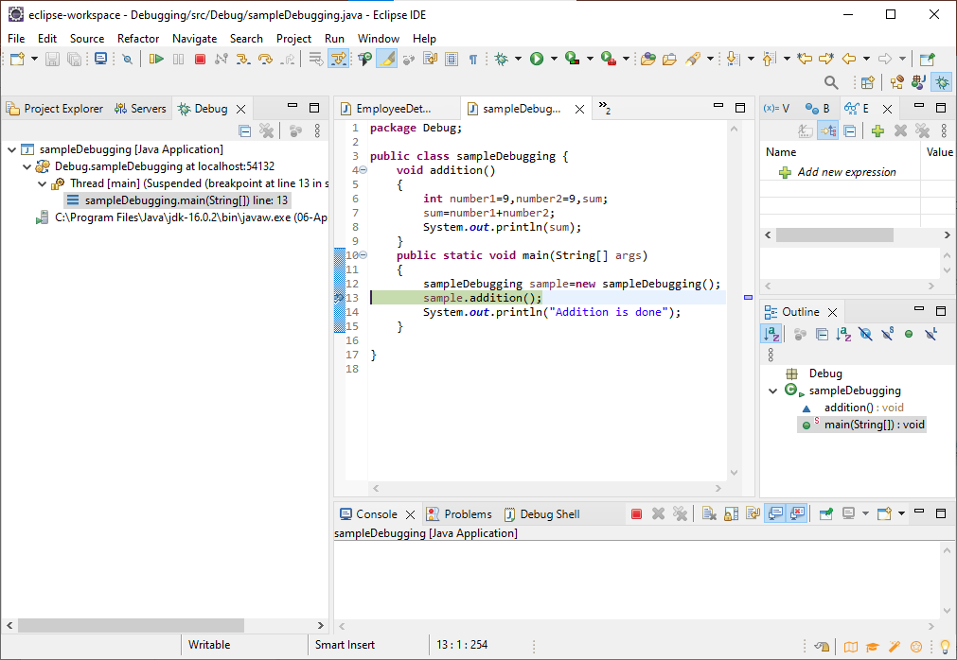
Debug Perspective
The debug perspective offers additional views that can be used to troubleshoot an application like Breakpoints, Variables, Debug and Console etc. When a Java program is started in the debug mode, users are prompted to switch to the debug perspective.
Debug view – Visualizes call stack and provides operations on that.
Breakpoints view – Shows all the breakpoints.
Variables/Expression view – Shows the declared variables and their values. Press Ctrl+Shift+d or Ctrl+Shift+i on a selected variable or expression to show its value. You can also add a permanent watch on an expression/variable that will then be shown in the Expressions view when debugging is on.
Display view – Allows to inspect the value of a variable, expression or selected text during debugging.
Console view – Program output is shown here.

Slide 7
Example
import java.util.Scanner;
public class sampleDebugging {
void addition()
{
Scanner scanner= new Scanner(System.in);
int number1,sum=0;
System.out.println("Enter a number ");
number1=scanner.nextInt();
while(number1<0)
{
sum+=number1;
number1--;
}
System.out.println(sum);
}
public static void main(String[] args)
{
sampleDebugging sample=new sampleDebugging();
sample.addition();
System.out.println("Addition is done");
}
}

Slide 8
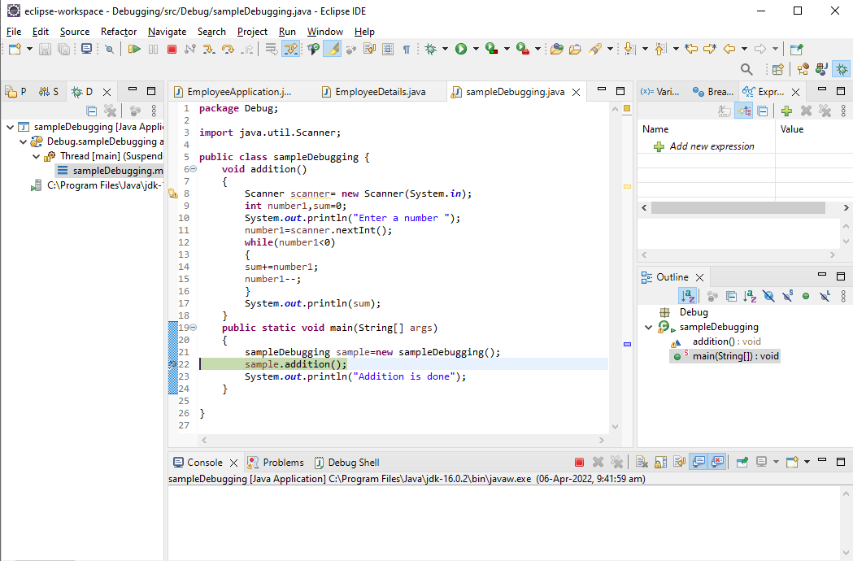

Slide 9
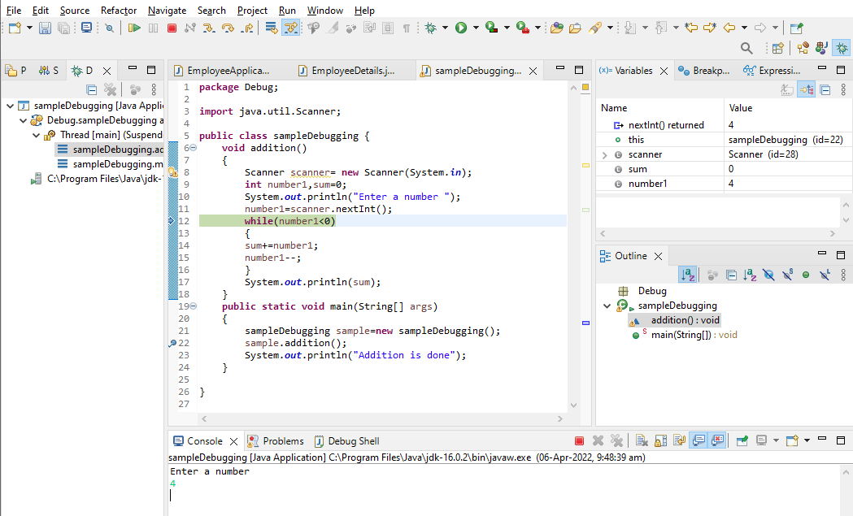

Slide 10
