Slide 2
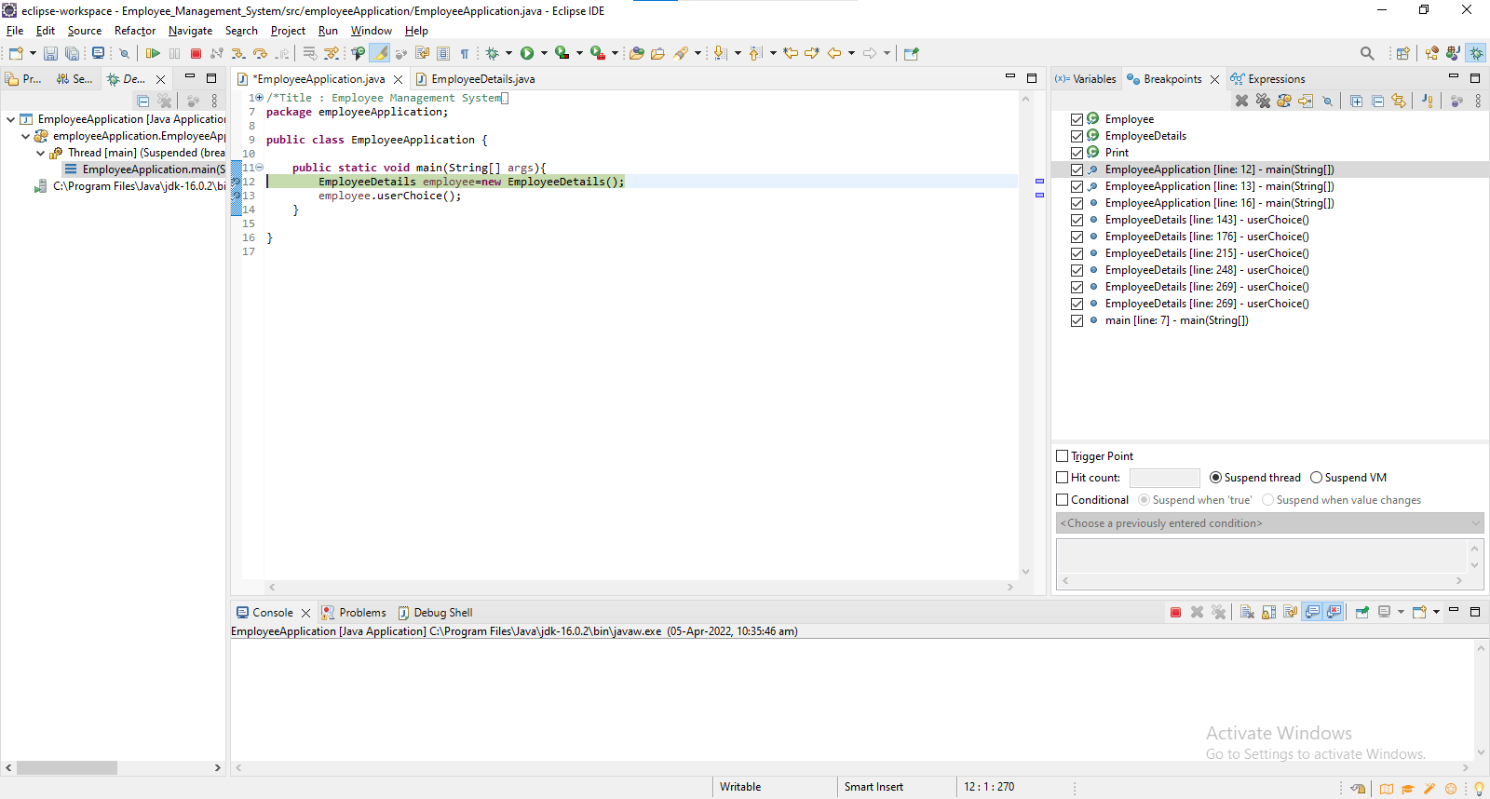
Debugging
Debugging is the process of identifying and fixing any issues in the source code of a program.

Slide 3

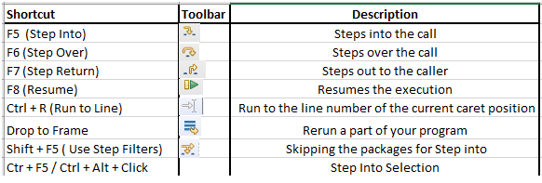
Stepping commands

Slide 4
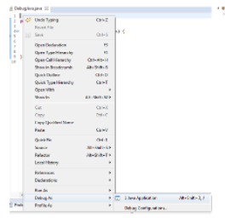
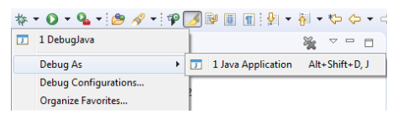
Launching and Debugging a Java program
A Java program can be debugged simply by right clicking on the Java editor class file from Package explorer. Select Debug As → Java Application or use the shortcut Alt + Shift + D, J instead.

Slide 5
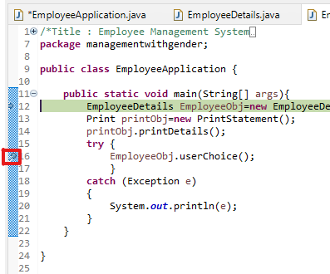
Breakpoints
A breakpoint is a signal that tells the debugger to temporarily suspend execution of your program at a certain point in the code.
To define a breakpoint in your source code, right-click in the left margin in the Java editor and select Toggle Breakpoint. Alternatively, you can double-click on this position.

Slide 6
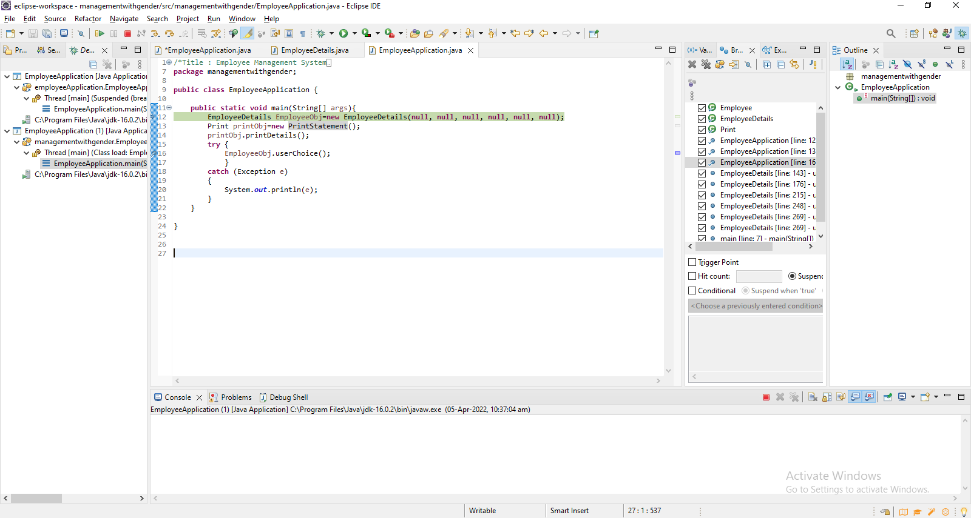
Debug Perspective
The debug perspective offers additional views that can be used to troubleshoot an application like Breakpoints, Variables, Debug and Console etc. When a Java program is started in the debug mode, users are prompted to switch to the debug perspective.
Debug view – Visualizes call stack and provides operations on that.
Breakpoints view – Shows all the breakpoints.
Variables/Expression view – Shows the declared variables and their values. Press Ctrl+Shift+d or Ctrl+Shift+i on a selected variable or expression to show its value. You can also add a permanent watch on an expression/variable that will then be shown in the Expressions view when debugging is on.
Display view – Allows to inspect the value of a variable, expression or selected text during debugging.
Console view – Program output is shown here.

