Slide 1
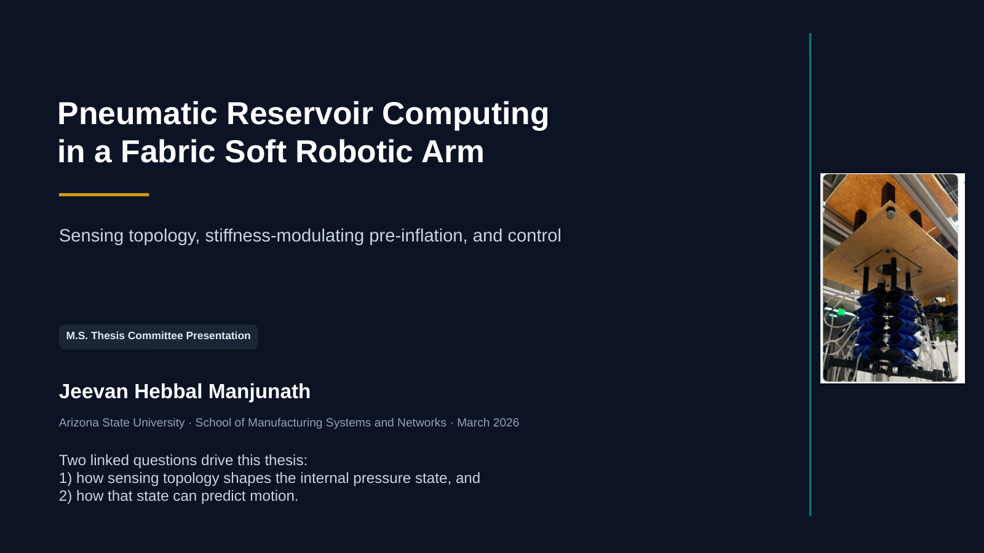
Notes:
[Sources] - Rasterized from the previously delivered committee_presentation_soft_robot_prc_rev3.pptx deck, itself based on the user-provided thesis materials.

Slide 2
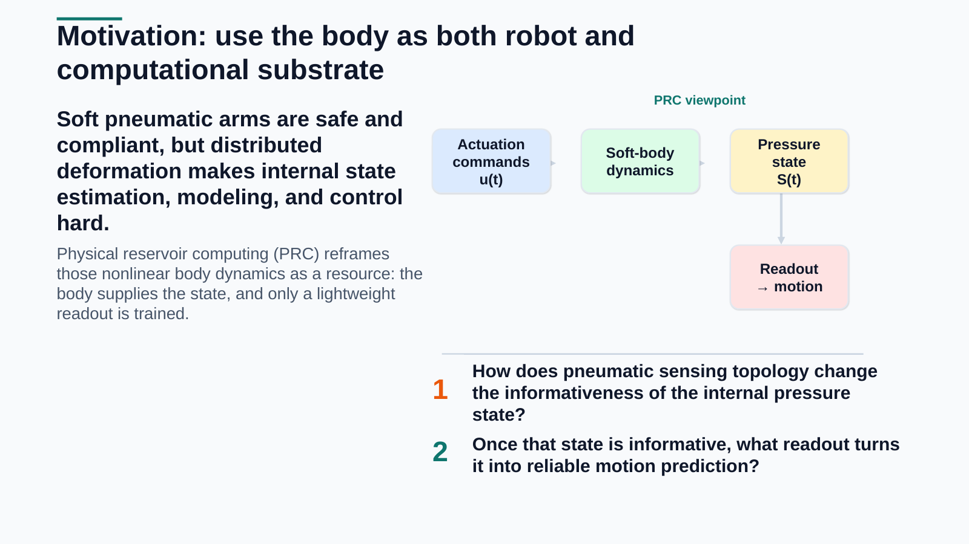
Notes:
[Sources] - Rasterized from the previously delivered committee_presentation_soft_robot_prc_rev3.pptx deck, itself based on the user-provided thesis materials.

Slide 3
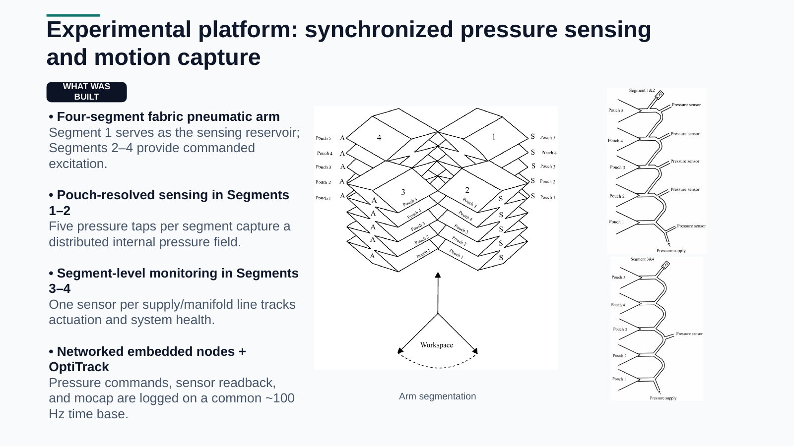
Notes:
[Sources] - Rasterized from the previously delivered committee_presentation_soft_robot_prc_rev3.pptx deck, itself based on the user-provided thesis materials.

Slide 4
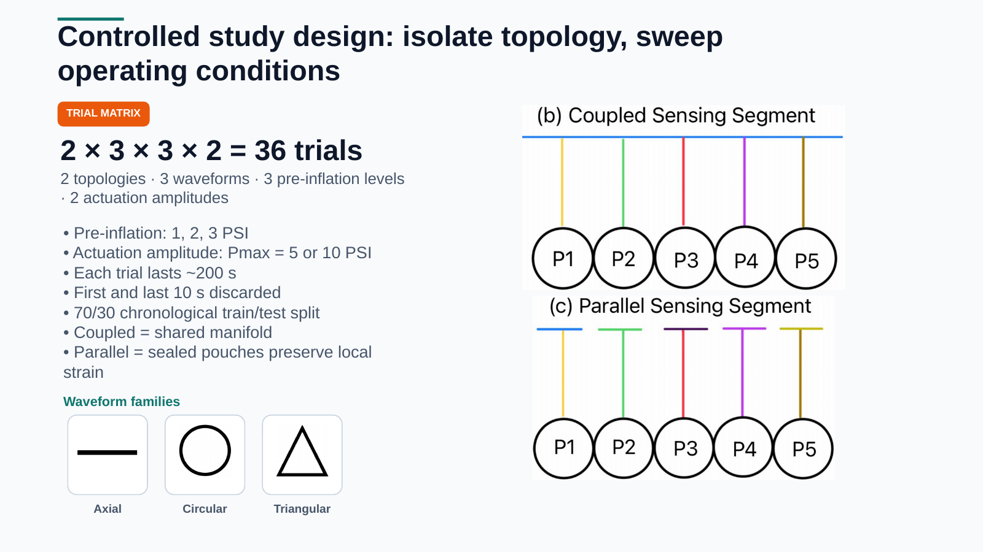
Notes:
[Sources] - Rasterized from the previously delivered committee_presentation_soft_robot_prc_rev3.pptx deck, itself based on the user-provided thesis materials.

Slide 5
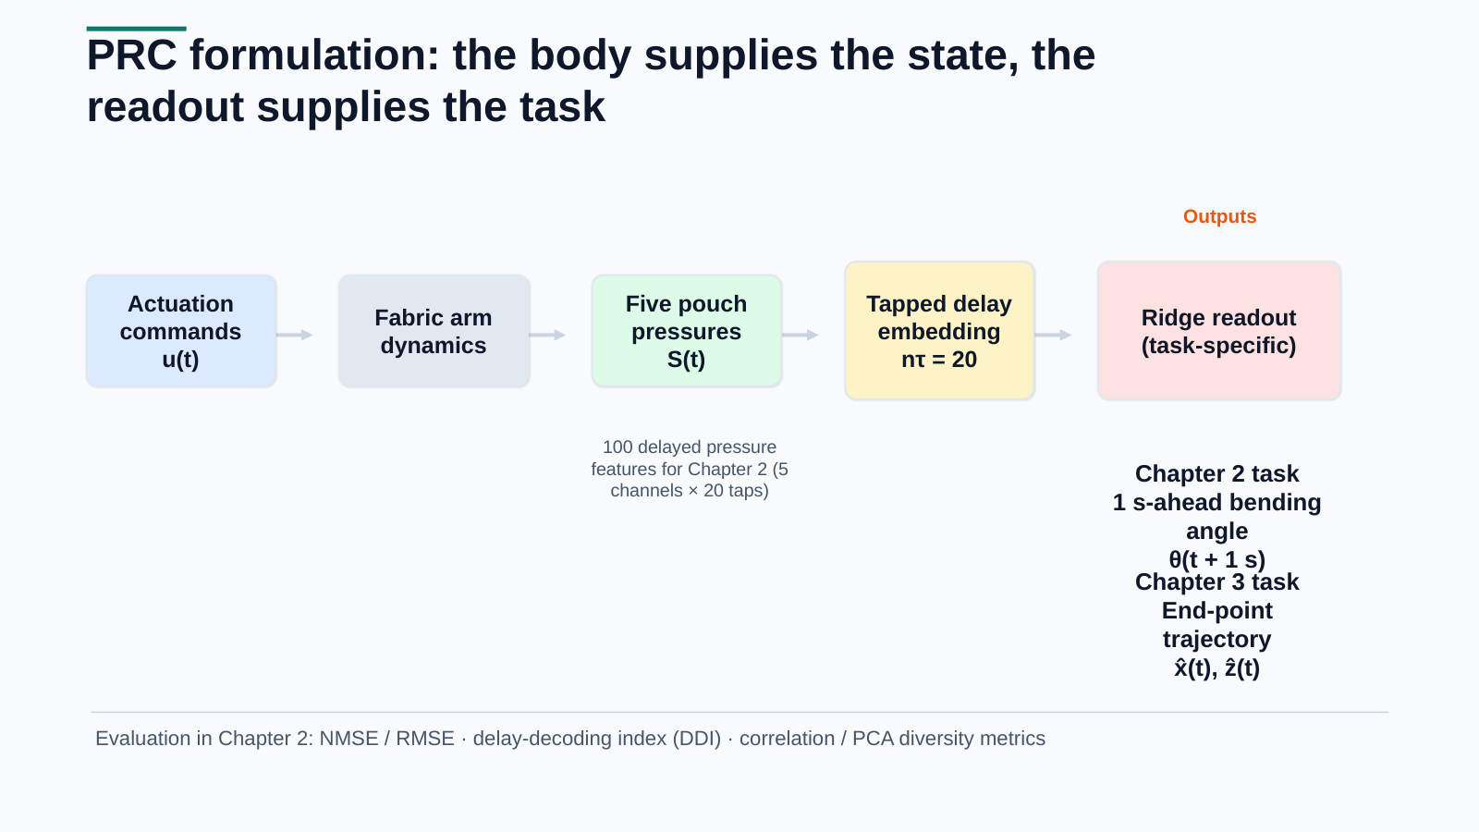
Notes:
[Sources] - Rasterized from the previously delivered committee_presentation_soft_robot_prc_rev3.pptx deck, itself based on the user-provided thesis materials.

Slide 6
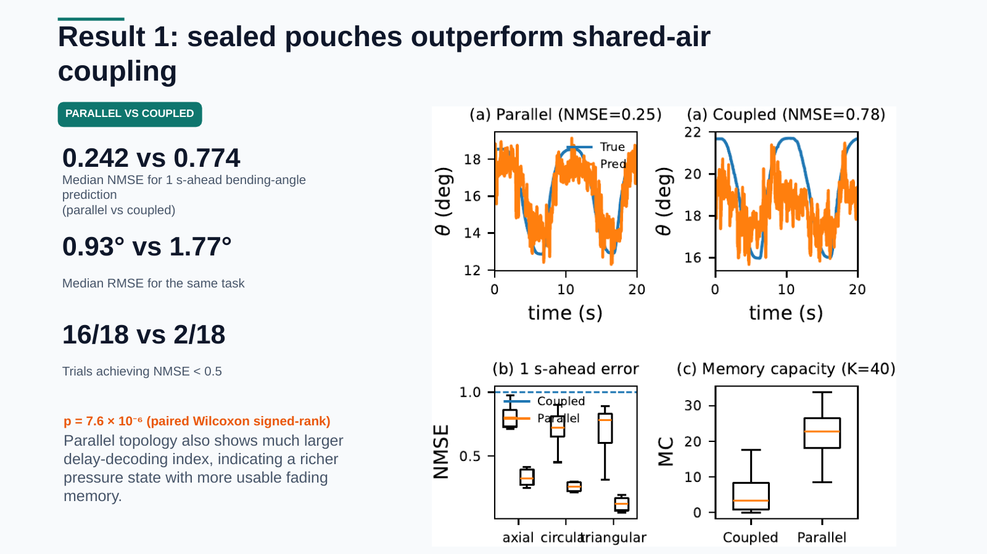
Notes:
[Sources] - Rasterized from the previously delivered committee_presentation_soft_robot_prc_rev3.pptx deck, itself based on the user-provided thesis materials.

Slide 7
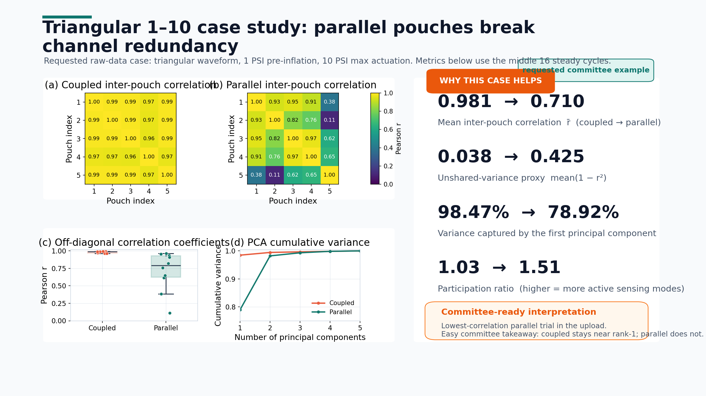
Notes:
[Sources] - User-provided Data.zip: parallel/triangle_1-10_parallel.csv and coupled/triangular_1-10_coupled.csv. - Metrics computed on the middle 16 steady peak-to-peak cycles detected from Desired_pressure_segment_2. - Pearson correlation uses Measured_pressure_Segment_1_pouch_1..5. PCA uses z-scored pouch pressures.

Slide 8
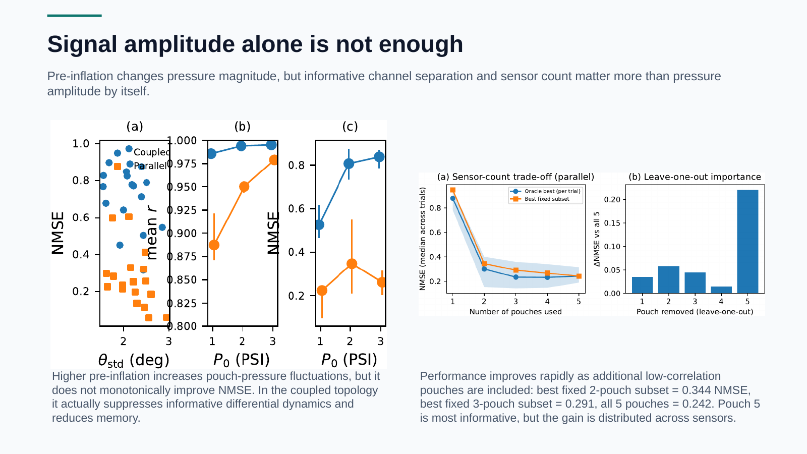
Notes:
[Sources] - Rasterized from the previously delivered committee_presentation_soft_robot_prc_rev3.pptx deck, itself based on the user-provided thesis materials.

Slide 9
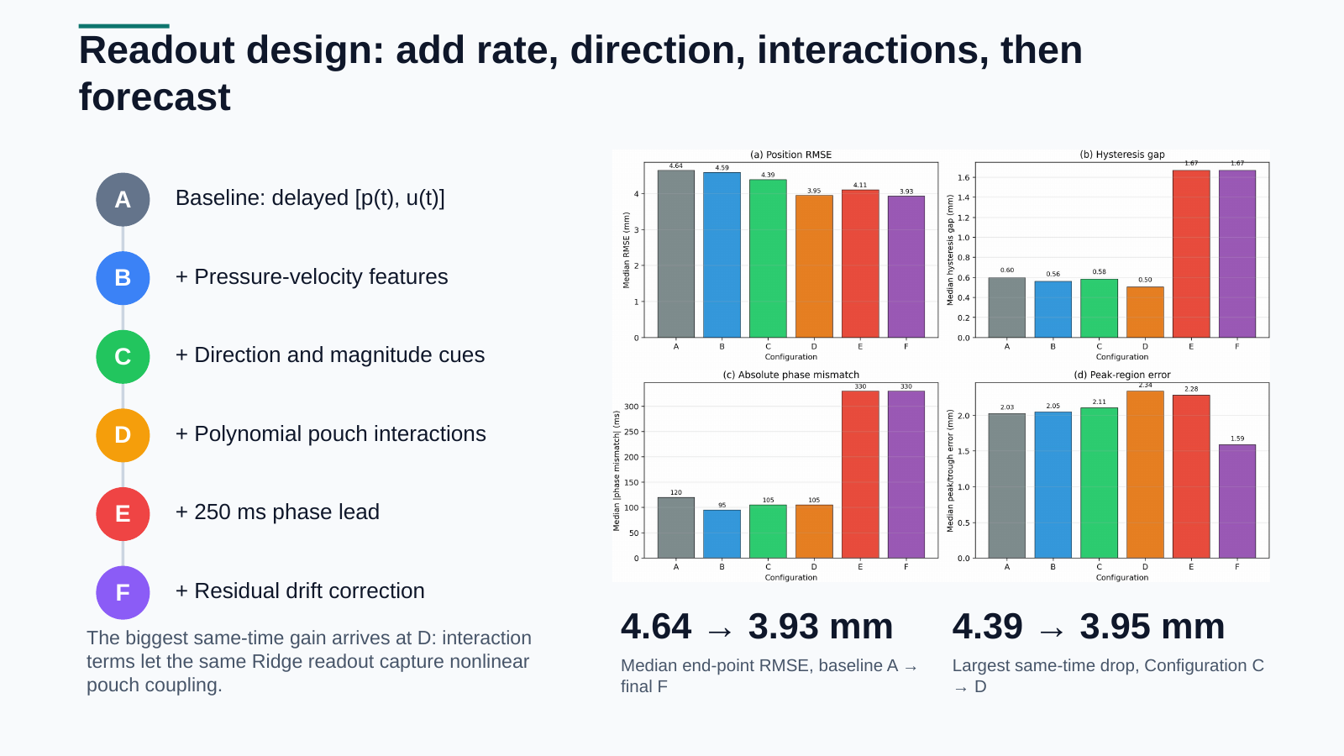
Notes:
[Sources] - Rasterized from the previously delivered committee_presentation_soft_robot_prc_rev3.pptx deck, itself based on the user-provided thesis materials.

Slide 10
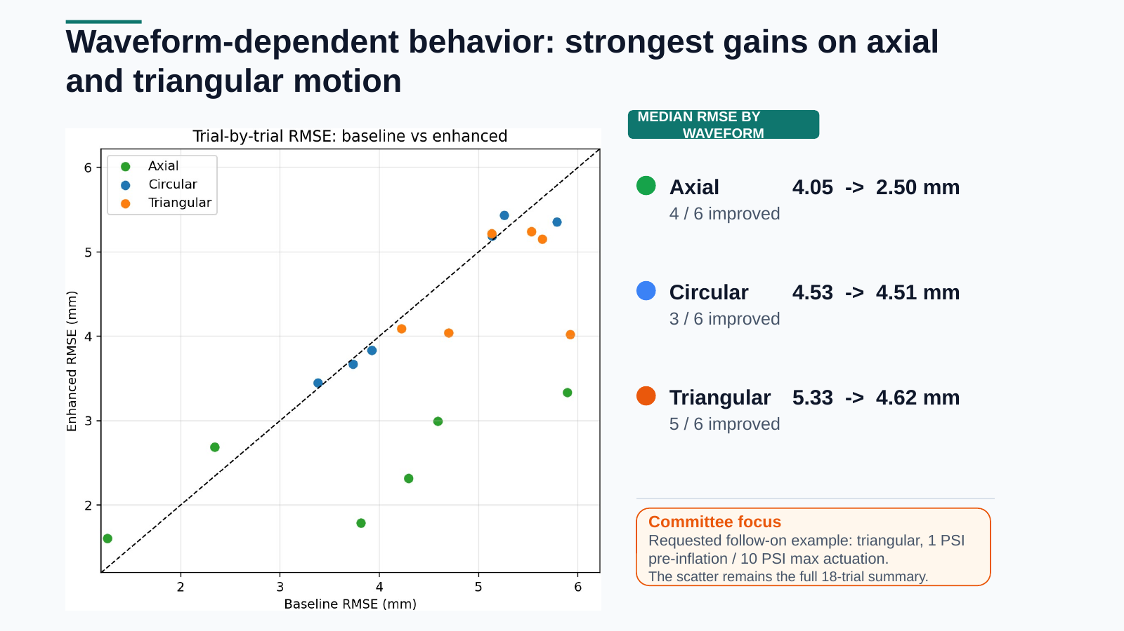
Notes:
[Sources] - Rasterized from the previously delivered committee_presentation_soft_robot_prc_rev3.pptx deck, itself based on the user-provided thesis materials.

Slide 11
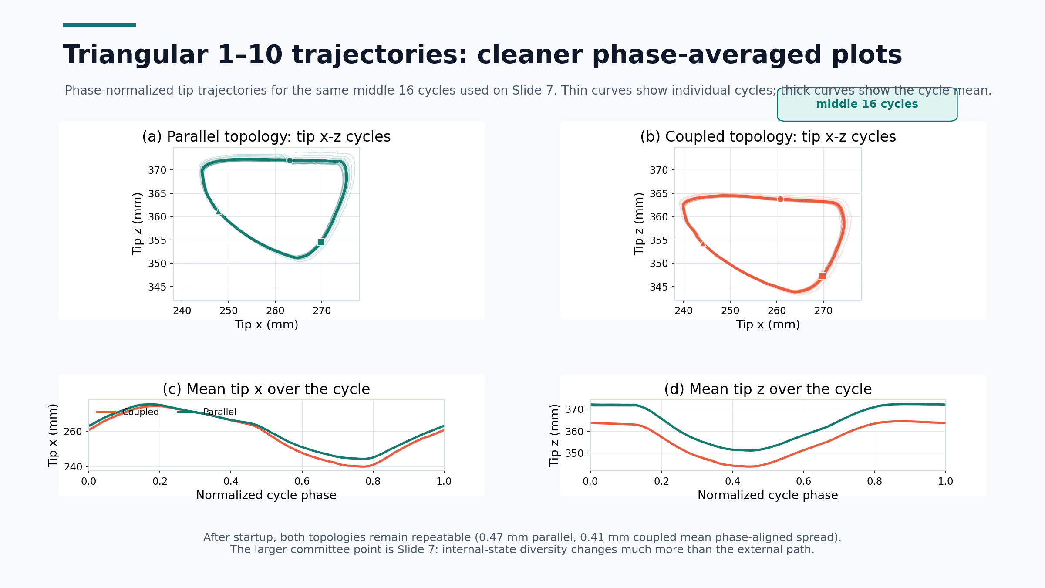
Notes:
[Sources] - User-provided Data.zip: parallel/triangle_1-10_parallel.csv and coupled/triangular_1-10_coupled.csv. - Trajectories use Rigid_body_3_x and Rigid_body_3_z from the same middle 16 steady cycles as Slide 7. - Each cycle is phase-normalized to 200 samples before averaging.

Slide 12
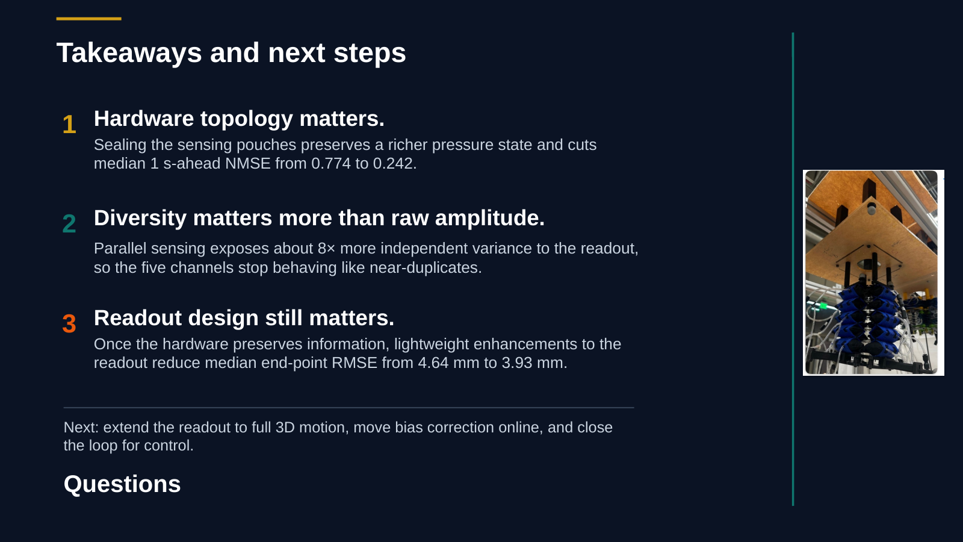
Notes:
[Sources] - Rasterized from the previously delivered committee_presentation_soft_robot_prc_rev3.pptx deck, itself based on the user-provided thesis materials.

