Slide 1
N
Compass
Never get lost on your own computer again.
100% Local On-Device AI Copilot & Scam Shield
Snapdragon X Elite | Qualcomm Hexagon NPU (45 TOPS) | HP OmniBook X
Zero Cloud
Sub-100ms Latency
100% Private
All-Day Battery

Slide 2
The Problem: A Hidden Digital Divide
1.2 billion users aged 40+ struggle with technology that changes faster than they can learn it.
1
2
3
The Fear of
"Breaking Something"
$3.4 Billion
Lost to Scams Yearly
The Embarrassment
of Asking for Help
Non-digital natives hesitate to explore software. Error messages are cryptic. Interfaces change without warning.
Tech support scams, phishing pop-ups, OTP theft — adults over 40 are the #1 target of online fraud.
40+ users suffer in silence, watching outdated YouTube tutorials rather than asking family for help again.

Slide 3
The Solution: Compass
An on-demand, private AI layer that inspects your screen only when you ask.
Guide Mode
Patient AI Tutor
Guardian Mode
Real-Time Scam Shield
Step-by-step visual walkthroughs
Detects 5 categories of scams
Highlights exactly where to click
Tech support, phishing, OTP theft
Copyable keyboard shortcuts
Calm, non-alarmist explanations
Works in Google Docs, Word, Excel,
PowerPoint, GitHub, & more
Clear safe actions for every threat
Quest-style progress tracking
38ms NPU-powered screen analysis

Slide 4
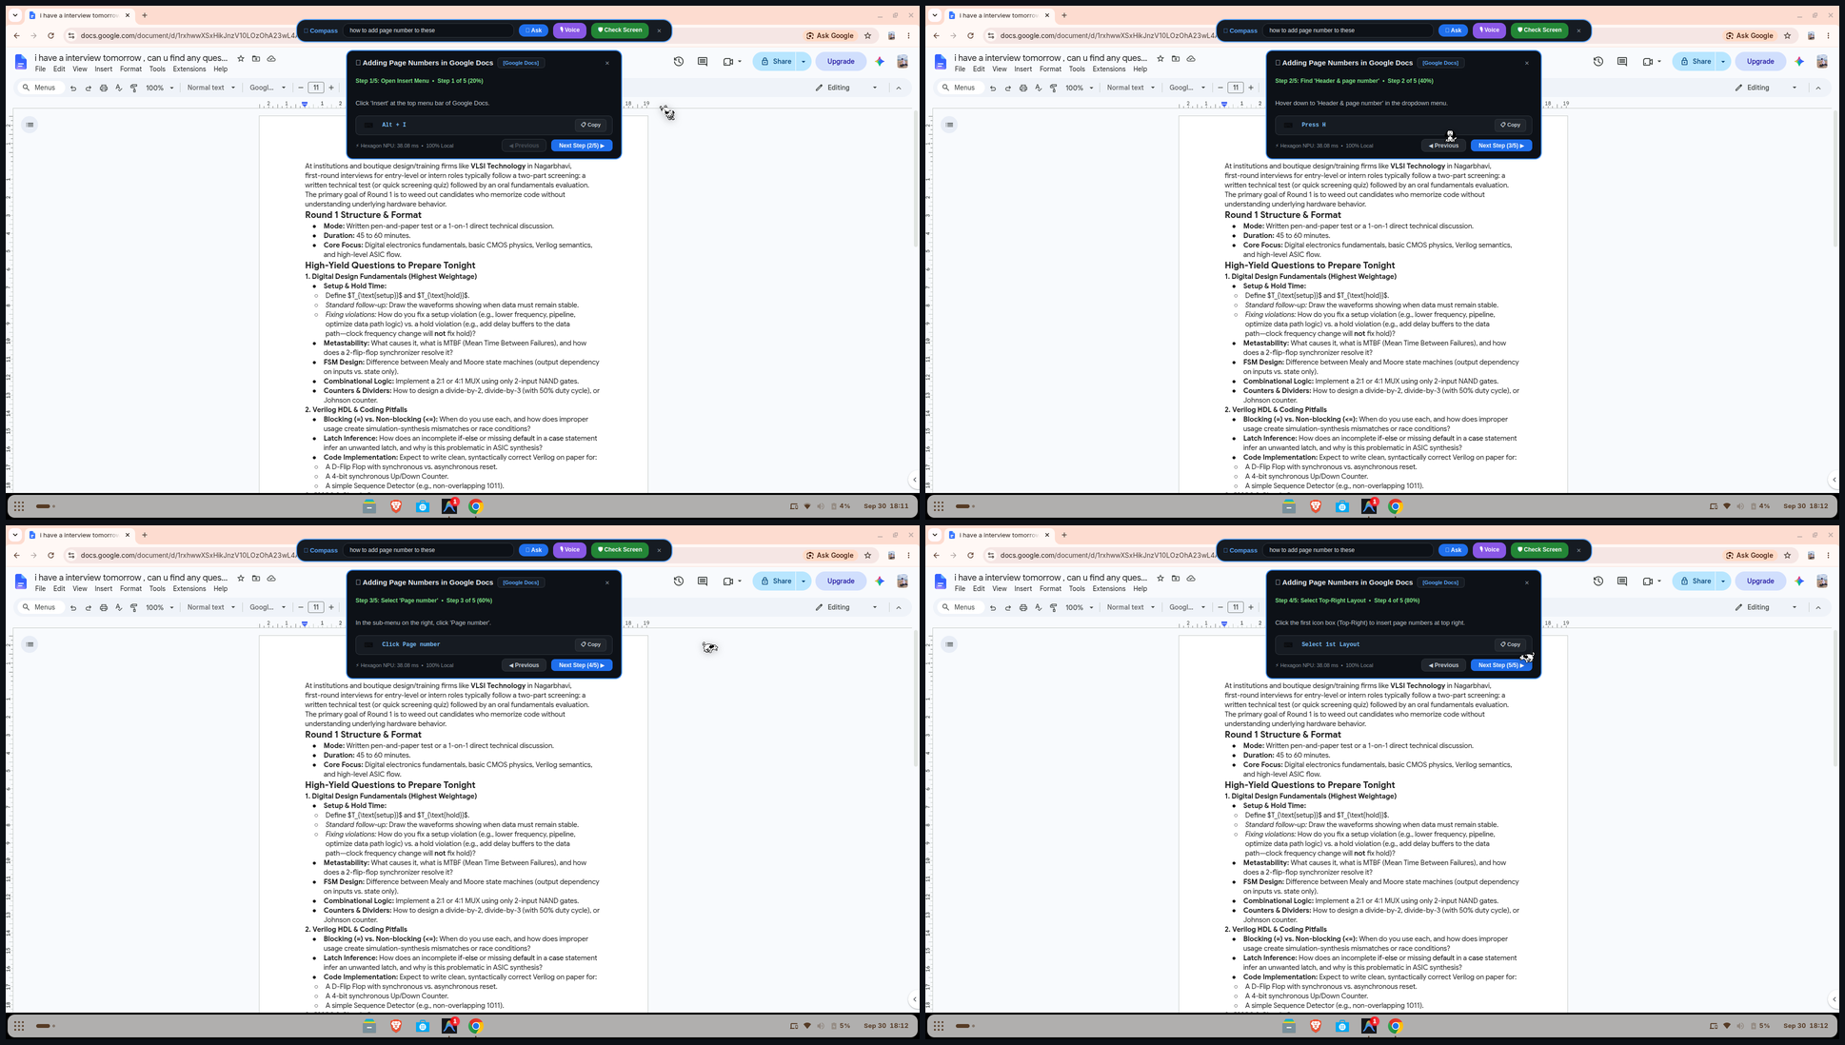
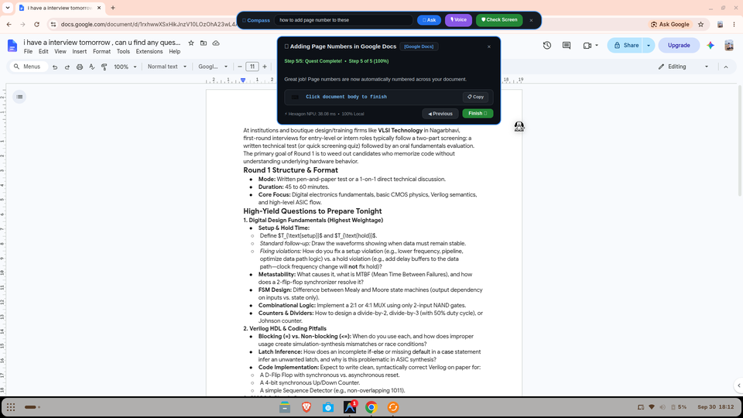
Guide Mode in Action
User asks: "How to add page numbers?" — Compass generates a 5-step visual walkthrough instantly.
Step 1
Step 2
Step 3
Step 4
Step 5
Open Insert Menu
Find Header & Page Number
Select Page Number
Select Top-Right Layout
Quest Complete!
Alt + I
Press H
Click Page number
Select 1st Layout
Click document body

Slide 5
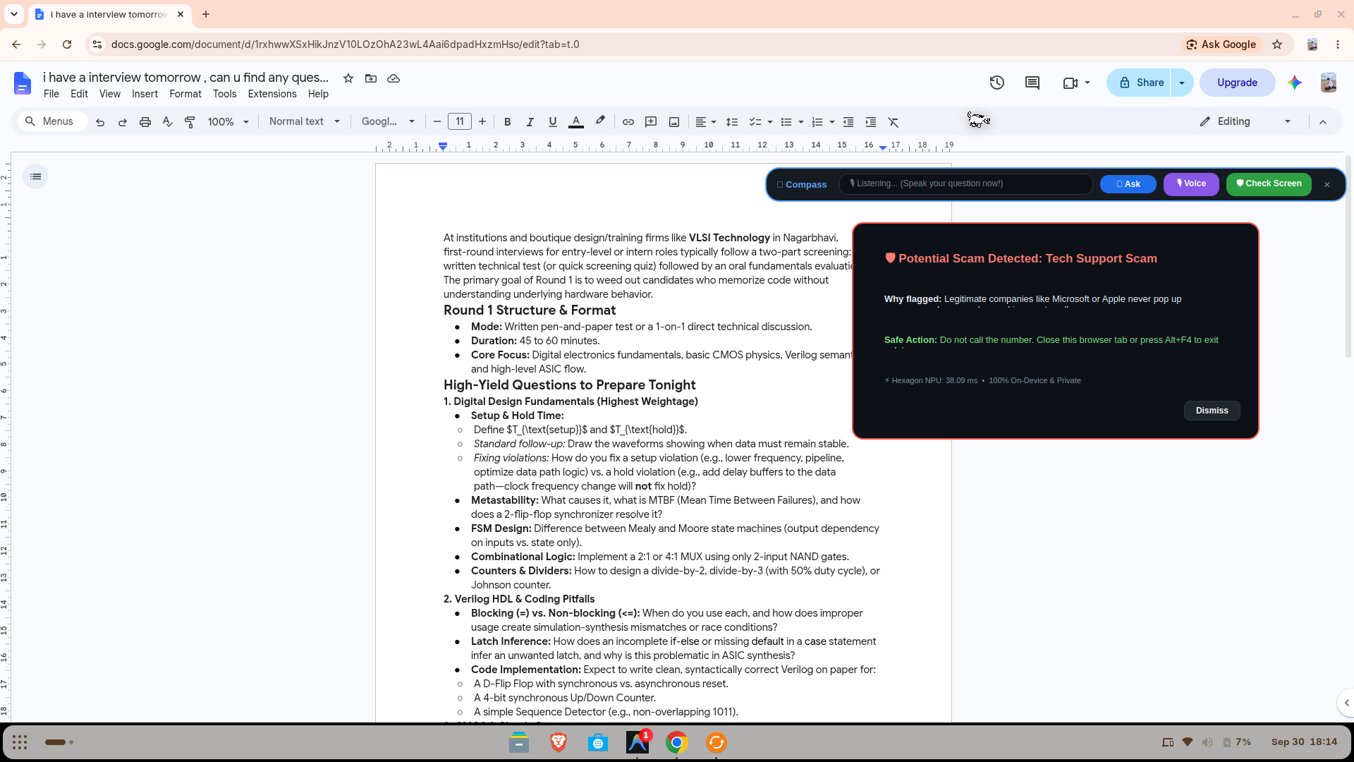
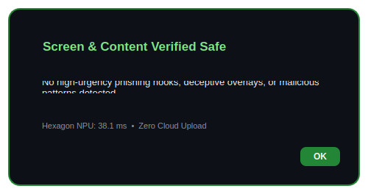
Guardian Mode: Real-Time Scam Shield
Detects Tech Support Scams, Phishing, OTP Theft, and Fake Downloads — all in <40ms on NPU.
5 Threat Categories Detected
Tech Support Scams
"Your PC is infected! Call now!"
Banking & OTP Theft
"Share your OTP to verify."
Phishing & Fake Sites
"Claim your tax refund!"
Celebrity Impersonation
"I'm in trouble, send money"
Deceptive Downloads
"Update Flash Player now!"
Design Rules for Protective Alerts
Calm, not alarmist | Always explain why | Suggest safe actions | Never auto-block | Large text, simple words
"This might be a scam. Let's check together." — Compass speaks with reassurance, not fear.

Slide 6
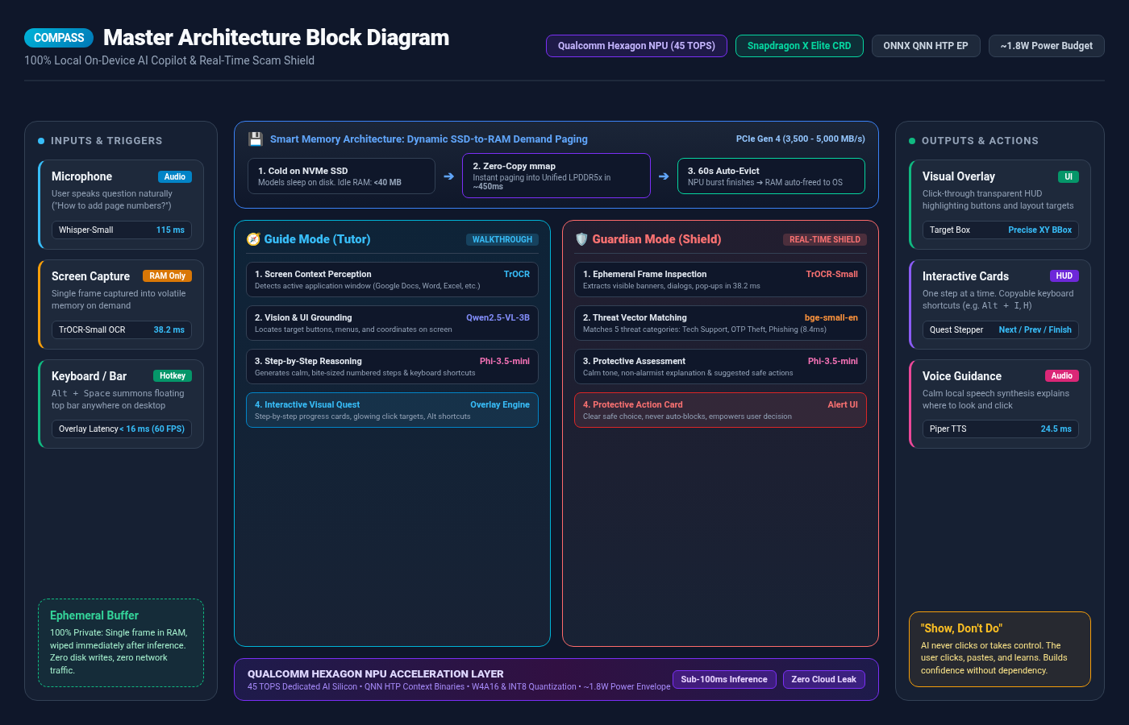

Slide 7
AI Models & NPU Benchmarks
All models verified on physical Snapdragon X Elite CRD via Qualcomm AI Hub
TrOCR-Small
Qwen2.5-VL-3B
Phi-3.5-mini
Screen OCR
Vision + UI Understanding
Reasoning & Explanation
Latency
38.2 ms
Latency
42 ms/tok
Latency
17.5 ms/tok
Peak RAM
84.5 MB
Peak RAM
1.85 GB
Peak RAM
2.15 GB
NPU Offload
100%
NPU Offload
100%
NPU Offload
100%
Whisper-Small
bge-small-en
Piper TTS
Voice Transcription
Scam Pattern Matching
Voice Output
Latency
115 ms
Latency
8.4 ms
Latency
24.5 ms
Peak RAM
260 MB
Peak RAM
42 MB
Peak RAM
34 MB
NPU Offload
98.4%
NPU Offload
100%
NPU Offload
100%

Slide 8
Why Snapdragon NPU — Performance & Smart Memory
100% Private On-Device Execution paired with Dynamic SSD-to-RAM Demand Paging
Cloud AI vs Snapdragon Hexagon NPU
Smart Memory: Dynamic SSD-to-RAM Demand Paging
✕ Cloud AI Services
1. Resting State: Stored Cold on PCIe Gen 4 NVMe SSD
• Heavy models (Phi-3.5 2.1GB, Qwen-VL 1.8GB) sleep dormant on disk
• Compass Idle RAM Footprint: <40 MB — leaves 95%+ RAM free for your apps
• Privacy Risk: Screens & audio uploaded to remote servers
• High Latency: 500ms–2.0s roundtrip; completely dead offline
• Battery & Cost: Ongoing API token bills; CPU/GPU fans spin up
User clicks 'Ask' / Speaks
2. Instant Demand Paging: Zero-Copy mmap (~450ms)
• Ultra-fast PCIe Gen 4 SSD read speed: 3,500 – 5,000 MB/s
• Memory-Mapped Files (mmap): Weights mapped directly into Unified LPDDR5x RAM
✓ Snapdragon Hexagon NPU (45 TOPS)
• 100% Private: Ephemeral volatile buffer in RAM — zero telemetry
• Instant & Offline: Sub-100ms local inference; works anywhere
• ~1.8W Power Envelope: Whisper-silent cooling & all-day battery
• Zero Marginal Cost: $0 server infrastructure; runs 100% free forever
Steps rendered on screen
3. Active Hexagon Burst & 60s Auto-Eviction
• Hexagon NPU processes task in <100ms at ~1.8W power envelope
• Auto-Evict TTL (60s): Cache purged, handles closed, memory freed instantly
• Zero memory leaks, zero thermal throttling, zero desktop stutter

Slide 9
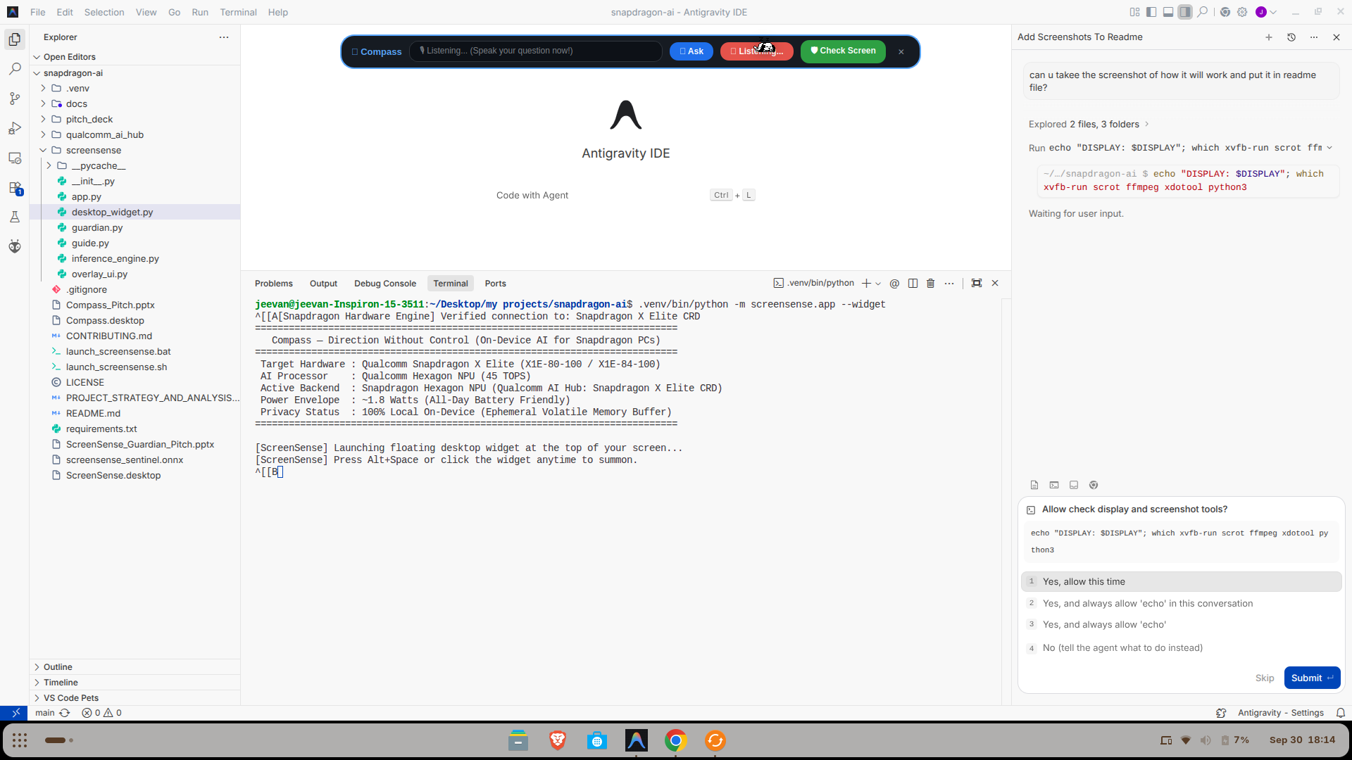
Voice Input & "Show, Don't Do" Philosophy
Voice Input
Click Voice, speak your question naturally
Whisper-Small transcribes locally in ~115ms on Hexagon NPU
100% Private — No audio stream ever leaves your device
Shortcut: Alt + Space to summon floating widget anywhere
The "Show, Don't Do" Philosophy — A Deliberate Product Decision
AI never runs commands
User stays in control. No destructive actions.
User copies and pastes
Learns while doing. Feels capable, not dependent.
One step at a time
Don't overwhelm. Show one step, wait, then next.
Privacy-safe
NPU reads screen locally. Nothing sent to cloud.

Slide 10
N
Direction Without Control.
"No more YouTube tutorials. No more asking your kids. Just ask your screen."
Snapdragon X Elite
Hexagon NPU (45 TOPS)
ONNX QNN EP
100% On-Device
MIT License
github.com/Jeevan0714/snapdragon-ai
Built for the Snapdragon AI Lab Build & Present Challenge | Qualcomm & HP

