Slide 1

SAFESIGHT
AI safety monitoring
for construction sites
YOLO11s detection with zones, tracking, event rules and a live dashboard
PROJECT PRESENTATION
Computer vision prototype | Demo and viva overview
PPE / PEOPLE / MACHINERY
Notes:
Introduce SafeSight as a locally runnable computer vision prototype. It detects people, PPE status classes and site equipment, then applies simple tracking and timing rules to make selected events visible to an operator. Do not describe the system as a certified safety product.

Slide 2
SAFESIGHT / CONSTRUCTION SITE SAFETY
Motivation and problem
Construction monitoring requires more than finding objects in one frame.
Site conditions
Operational need
People, PPE and equipment appear together, often at different scales and under changing light or occlusion.
A supervisor needs to know who is in a configured zone, whether a rule persists, and what evidence supports the alert.
Project question
How can a single camera feed be turned into a clear, time-stamped safety-monitoring workflow?
02
Notes:
Motivation: a detector produces frame-level boxes. Site operations benefit when detections become understandable events with a location, a time and visual evidence. The project explores that integration for a single-camera demonstration.

Slide 3
01 / PROJECT DEFINITION
Project objectives and scope
Core functions
01
Detect
10 construction-safety classes in images, video and camera frames
02
Associate
Person tracks with nearby PPE detections using spatial rules
03
Monitor
Saved zones, dwell time and configurable site closing time
04
Inform
Live counts, alerts and evidence records for review
Scope: local single-camera prototype. It does not identify a worker across cameras or replace a human safety decision.
03
Notes:
State the scope precisely. SafeSight uses one active stream at a time. Track IDs are temporary tracking identifiers, not real worker identities. PPE assignment is an image-position heuristic and can be uncertain.

Slide 4
02 / PROCESSING ARCHITECTURE
System design
One frame passes through detection, association and rules before the interface records an event.
INPUT
DETECT
TRACK
APPLY RULES
PRESENT
Webcam
Image / video
YOLO11s
10 classes
ByteTrack
Person IDs
PPE association
Zones + time
Dashboard
Alerts + evidence
Event record
Timestamp / Track ID / Zone or whole site / PPE assessment / Confidence / Evidence image
Flask serves the local web interface; OpenCV reads camera and video frames; event data and images are stored locally.
04
Notes:
Walk from left to right. OpenCV supplies frames. Ultralytics YOLO11s predicts boxes and classes. ByteTrack maintains short-term person IDs. The rule layer evaluates configured zones, PPE association and closing-time conditions. Flask displays the stream and event data. Records and evidence are local.

Slide 5
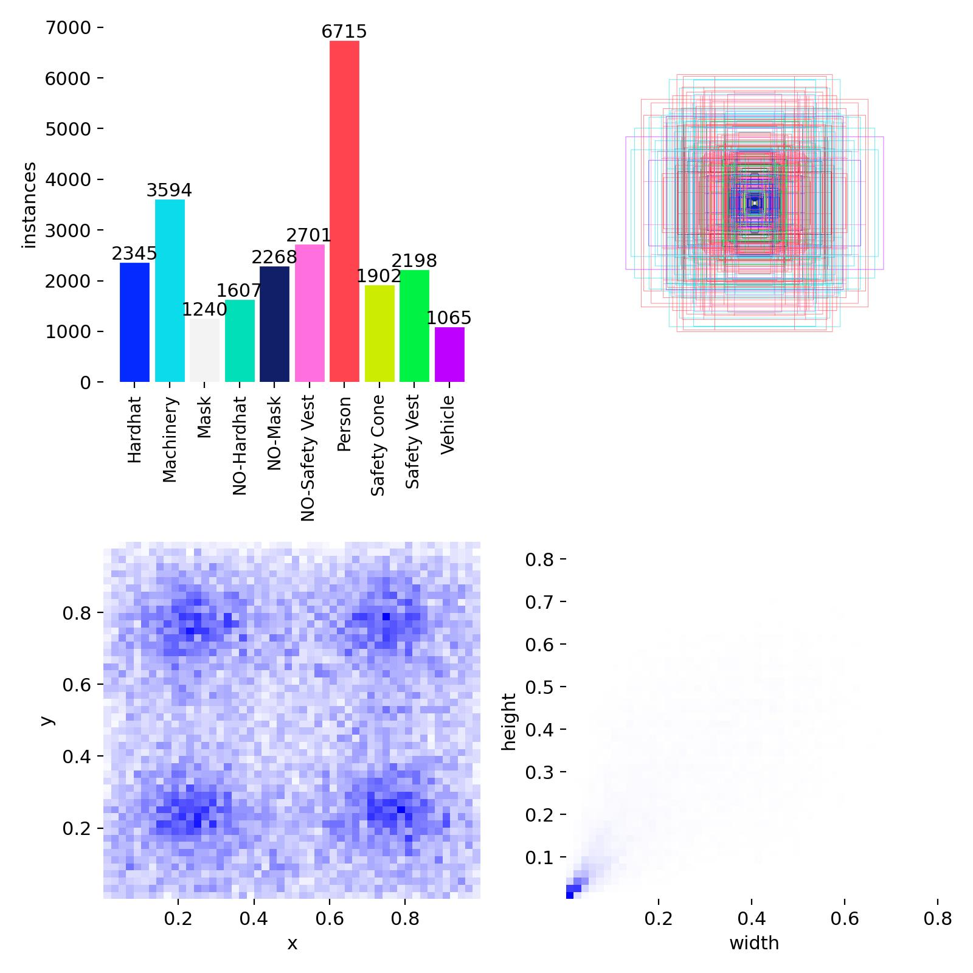
03 / DATA
Dataset and class coverage
Construction PPE dataset
2,597 images reported in project materials
Train
Validation
Test
1,819
518
260
10 labels
Person, Hardhat, NO-Hardhat, Mask, NO-Mask, Safety Vest, NO-Safety Vest, Machinery, Vehicle, Safety Cone
Label distribution and box geometry from the training dataset
05
Notes:
The project report records 1,819 training, 518 validation and 260 test images, for 2,597 total. Confirm against the exact downloaded dataset version if asked, because hosted dataset revisions can change. The ten labels include person and PPE items, missing-PPE categories, and site equipment. The plot shows class counts and annotation geometry.

Slide 6
04 / TRAINING
Model training setup
Training environment
Training configuration
Google Colab GPU runtime (T4 shown in the training session)
Ultralytics YOLO11s initialized from pretrained yolo11s.pt
Roboflow-hosted dataset exported in YOLO format
Epochs
50
Image size
640 × 640
Batch size
16
Optimizer
SGD
Learning rate
0.01 initial; lrf = 0.01
Momentum / weight decay
0.937 / 0.001
Seed / workers
0 / 8
The trained best checkpoint was copied into the local project as YOLO-Weights/ppe.pt.
06
Notes:
Explain the sequence: install Ultralytics and Roboflow in Colab, authenticate, download the selected dataset version, load pretrained YOLO11s weights, train for 50 epochs, and save the run to Google Drive. The checkpoint used by the Flask app was copied into the local weights directory and named ppe.pt. The project uses an SGD optimizer with the listed settings. Runtime dependencies on the local Windows app are CPU-pinned, which is separate from the Colab training GPU. Do not confuse the local CPU runtime with the training device.

Slide 7
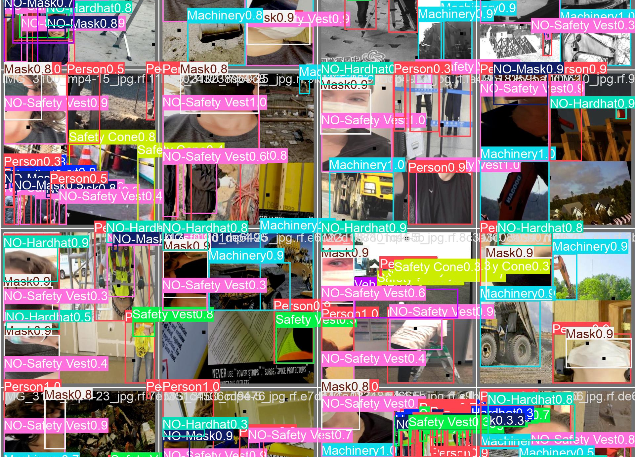
05 / MODEL CHOICE
Why YOLO11s for this prototype
A single-stage detector
Predicts object locations and classes in one inference pass, which fits a live-monitoring workflow.
Small model variant
YOLO11s offers a practical size for local experimentation. The project did not run a controlled benchmark against every model family.
Transfer learning
Pretrained weights provide a starting point, then training adapts the detector to the construction-safety labels.
07
Notes:
YOLO11s was selected as the requested detector and because a relatively small single-stage model is a sensible prototype choice for live use. Avoid claiming it is objectively the best model: the project has not reported a controlled comparison with other models under the same hardware and dataset. Transfer learning starts from pretrained weights, then adjusts to the target classes.

Slide 8
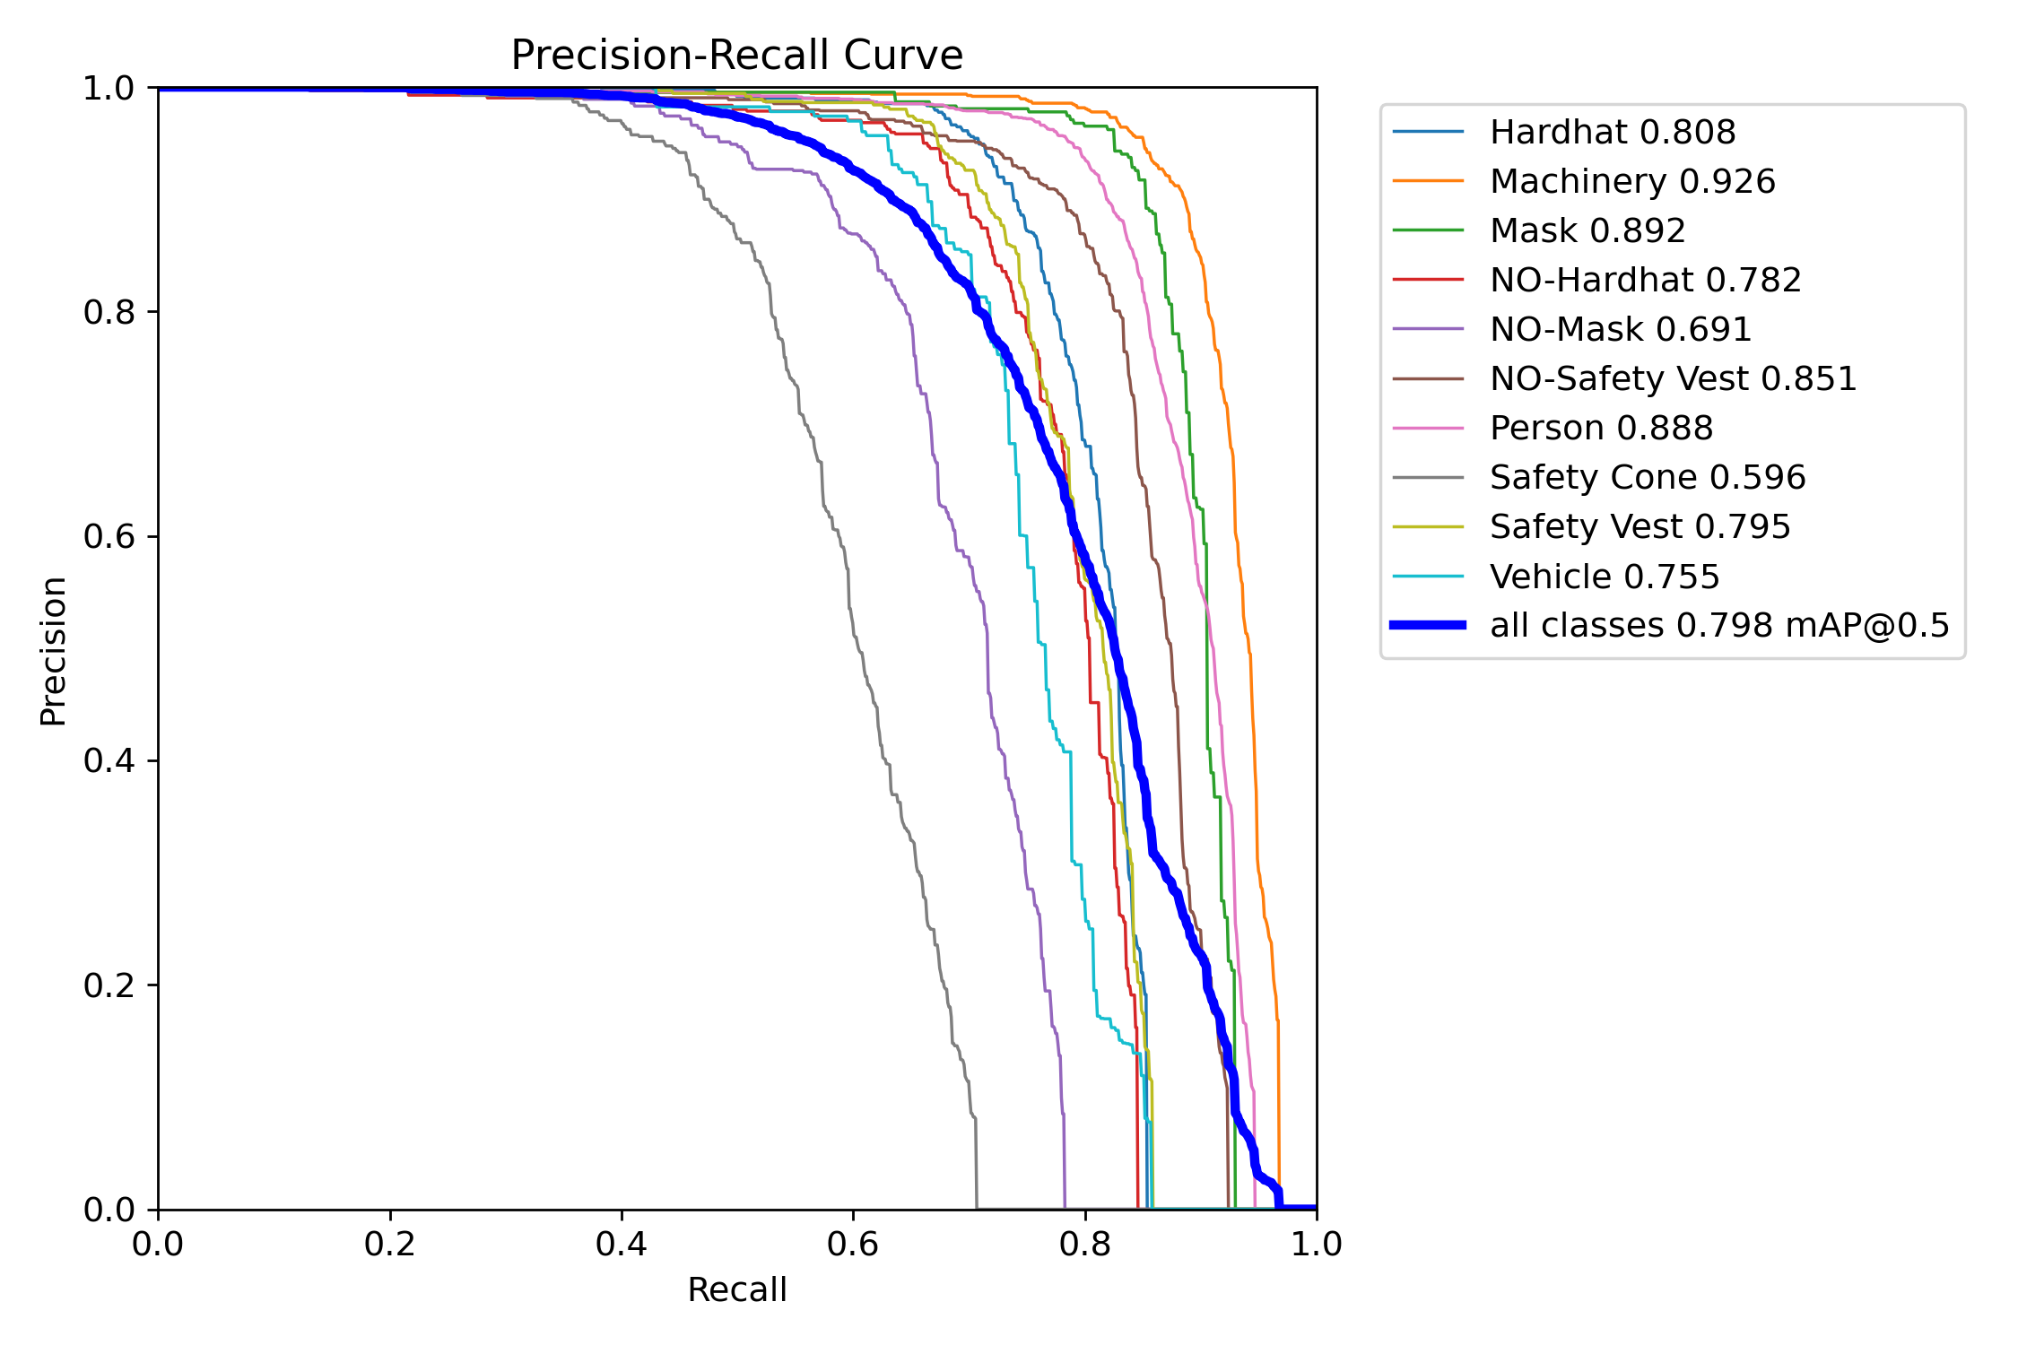
06 / EVALUATION
Detection results
Validation metrics
Precision
0.891
Recall
0.728
mAP@0.5
0.799
mAP@0.5:0.95
0.561
PR curve summarizes the precision–recall trade-off across confidence thresholds.
Metrics are from the recorded training run results, not a separately reported test-set evaluation.
08
Notes:
Use these as the recorded validation results from results.csv at the end of the training run: precision 0.89124, recall 0.72814, mAP50 0.79857 and mAP50-95 0.56089. The slide rounds to three decimals. The PR curve shows class-specific behavior across thresholds. The notebook contains a separate test-split validation call, but a numeric test result was not available in the supplied material, so do not present these as test metrics.

Slide 9
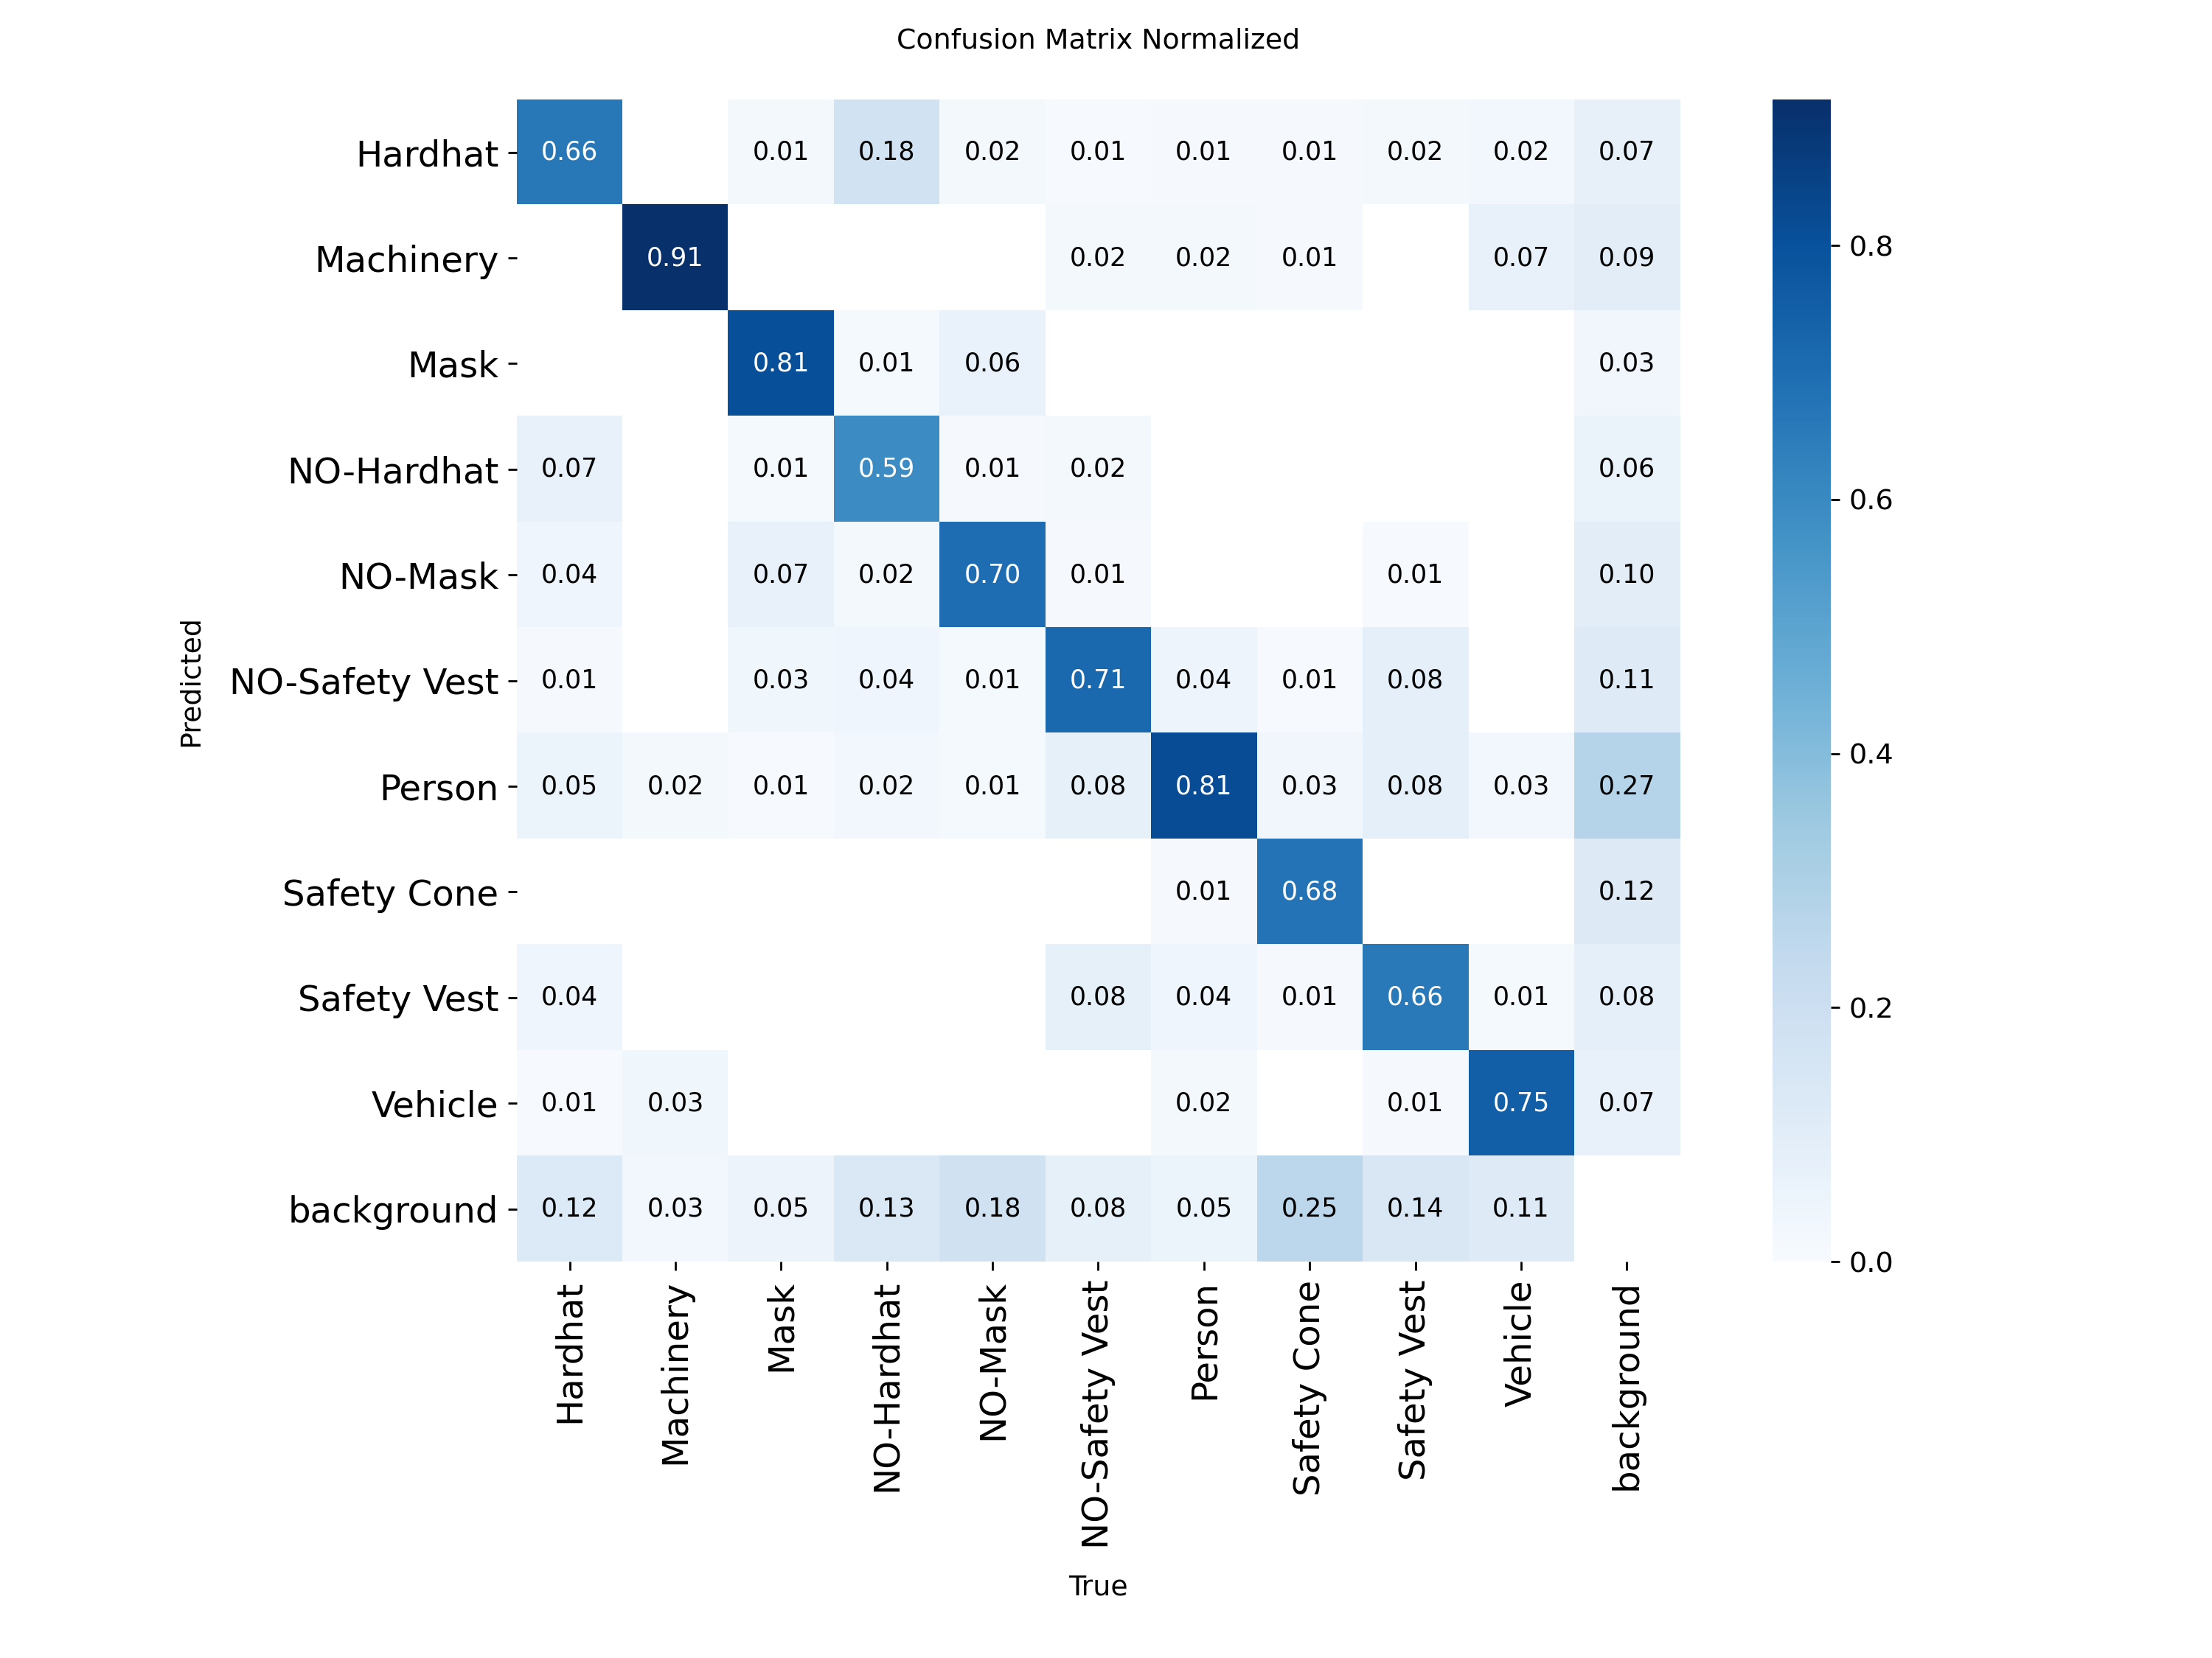
07 / RESULT ANALYSIS
Class performance and errors
Per-class AP@0.5
Machinery
0.926
Hardhat
0.808
Person
0.888
NO-Safety Vest
0.851
NO-Mask
0.691
Safety Cone
0.596
Lowest AP in the supplied curve: Safety Cone. Review small or occluded PPE and background confusions.
09
Notes:
The normalized confusion matrix and class PR curve reveal that a single aggregate score hides class differences. Machinery performs strongly at AP50 0.926, while Safety Cone is lower at 0.596. NO-Mask is 0.691. This suggests annotation review and additional representative data for weaker classes. Confusion matrices include background misses and false detections; they do not directly measure zone-event correctness.

Slide 10
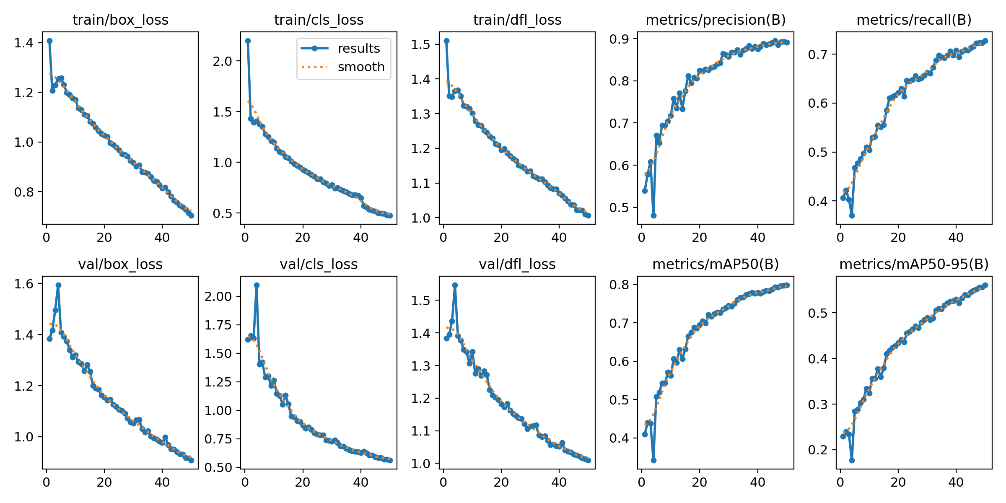
08 / MODEL LEARNING
Training convergence
Observed trend
Training and validation losses fall over the 50 epochs. Precision, recall and mAP rise through training.
Reading the plots
Loss curves show optimization progress. Validation metrics estimate performance on held-out validation images.
A separate test set is required for an unbiased final evaluation.
10
Notes:
Describe the curves without overstating them. Losses trend downward while precision, recall and mAP trend upward. The validation curves show generalization to the validation split, but model selection and threshold choices can influence those values. A test split should remain untouched until final reporting.

Slide 11
09 / APPLICATION RULES
Zone and time-based event logic
For each frame, the application updates tracks, checks locations and evaluates event rules.
1
Detect person
2
Track person
3
Check zone
YOLO box + confidence
ByteTrack temporary ID
Configured polygon + anchor point
4
Assess PPE
5
Apply time rule
6
Record event
Nearby PPE box association
Dwell threshold / closing time
Timestamp + evidence + dashboard alert
Implementation thresholds include 1.5 s zone dwell and a configurable daily closing time.
11
Notes:
The event logic turns frame detections into time-based conditions. Person IDs come from ByteTrack and are temporary. Zone presence depends on a point or anchor derived from the person box and polygon inclusion. PPE association uses relative position/overlap heuristics and is therefore not person-level certainty. The prototype uses a 1.5-second dwell condition. Closing time is configured in the dashboard and interpreted in the computer’s local time.

Slide 12
10 / OPERATOR WORKFLOW
Live monitoring and event evidence
The interface brings the camera view and safety events into one local workflow.
LIVE VIEW
Annotated camera feed and current detections
SITE STATUS
Tracked people, zone occupancy, PPE alerts and machinery counts
HEAD ENGINEER ALERTS
Browser alert prompts for configured conditions
EVENT TIMELINE
Time, track, zone, PPE assessment and saved evidence image
Notifications shown in the prototype are browser-side. External email, SMS or Telegram delivery is not configured.
12
Notes:
Explain the dashboard view: live detections and counts, zone occupancy, PPE alerts, machinery count, closing-time status, and a list of alerts/evidence. The project prototype can request browser notifications, subject to browser permission and the dashboard being open. It does not currently send email, SMS or Telegram messages to a head engineer. Event evidence is saved locally.

Slide 13
11 / LITERATURE
Research context and base paper
Selected base paper
Project distinction
Cheng et al. (2022)
Cheng et al. study cross-camera worker re-identification. SafeSight uses single-camera ByteTrack IDs and geometric PPE-to-person association.
Vision-based monitoring of site safety compliance based on worker re-identification and personal protective equipment classification
Related directions
Why it is relevant
Temporal alarm confirmation (Zaidi et al., 2024)
Automated reporting (Wen et al., 2024)
Vision-language monitoring with YOLO11s (Sivanraj et al., 2026)
It links worker identity with PPE status and incident logging, the key association challenge in this project.
[5] base paper | [6] temporal analysis | [7] reporting | [8] recent monitoring
13
Notes:
Base paper: Cheng, Wong, Luo, Wang and Leung, Automation in Construction 139 (2022), article 104312. Their framework combines worker re-identification and PPE classification and reports improvements over comparison methods on its study data. SafeSight does not reproduce the cross-camera method. It uses ByteTrack single-camera IDs and spatial association rules. Zaidi et al. (2024) is a related reference on temporal confirmation and alarm reduction. Wen et al. (2024) addresses automated safety reporting. Sivanraj et al. (2026) is particularly relevant to avoid an unsupported novelty claim around YOLO11 or alerts.
Sources: [5], [6], [7], [8]

Slide 14
12 / POSITIONING
Research gap and project contribution
What the literature already covers
What this prototype integrates
PPE and equipment detection
Worker tracking and PPE association
Temporal alarm filtering
Automated safety reporting
A local single-camera workflow where an operator configures zones and required PPE, while track-based dwell and closing-time rules create dashboard events with evidence.
Defensible contribution
Integration and implementation of detection, configurable zones, track-associated PPE checks, timing rules and local event evidence. The literature review is limited to eight selected papers.
14
Notes:
Do not claim YOLO11, tracking, temporal confirmation, alerts or dashboards as individually novel. The defensible project framing is an implementation-focused integration into a configurable local demo. The literature review examines eight selected studies and cannot establish that no other paper implements a similar system. The open research problem is event-level reliability and evaluation in real site conditions.
Sources: [1]-[8]

Slide 15
13 / NEXT STEPS
Limitations and evaluation still needed
Current limitations
Recommended evaluation
Single camera; IDs can switch after occlusion
PPE assignment uses geometric proximity, not true identity
Small or hidden PPE can be missed
Alert quality depends on camera angle, light and threshold settings
Annotate unseen site videos and keep a held-out test set
Measure person-track continuity and PPE association accuracy
Report zone-event precision, recall and false alarms per hour
Measure alert delay, evidence completeness and live FPS
Treat alerts as decision support for a human reviewer, not as proof of a violation.
15
Notes:
This slide is important for a technically honest discussion. The current system does not establish real worker identity, and PPE-to-person assignment can be wrong under occlusion or unusual camera angles. The detector metrics do not evaluate complete event quality. A stronger study should annotate event ground truth and report event-level precision/recall, false alarms per hour, latency, track continuity, FPS and evidence completeness.

Slide 16
14 / PRESENTATION FLOW
Suggested live demo sequence
01
Open the local Flask application
Show the landing page and confirm the model checkpoint loads.
02
Start one camera or sample video
Point out person, PPE and machinery detections.
03
Draw and save a zone
Explain polygon location and required PPE settings.
04
Trigger a rule condition
Demonstrate dwell timing or the closing-time setting with a sample clip.
05
Review the dashboard and evidence
Show counts, alert entry, timestamp, track ID and saved image.
If a rule does not trigger live, explain the configured threshold and show a previously recorded event as evidence.
16
Notes:
Use a short representative clip and test the camera before the presentation. There should be only one active camera stream at a time. If the room lighting or camera framing gives weak PPE detections, explain that the model can return uncertain observations and show saved event evidence. Do not stage or claim a violation from a single low-confidence frame.

Slide 17
15 / SELECTED LITERATURE
References | Detection and PPE monitoring
[1] Fang et al. (2018). Automated detection of workers and heavy equipment on construction sites: A CNN approach. Advanced Engineering Informatics, 37, 139–149. DOI: 10.1016/j.aei.2018.05.003
[2] Delhi, Sankarlal & Thomas (2020). Detection of PPE compliance on construction site using computer vision based deep learning techniques. Frontiers in Built Environment, 6, 136. DOI: 10.3389/fbuil.2020.00136
[3] Wang et al. (2021). Fast PPE detection for real construction sites using deep learning approaches. Sensors, 21(10), 3478. DOI: 10.3390/s21103478
[4] Ferdous & Ahsan (2022). PPE detector: a YOLO-based architecture to detect PPE for construction sites. PeerJ Computer Science, 8, e999. DOI: 10.7717/peerj-cs.999
17
Notes:
The eight cited papers were selected for relevance to worker/equipment detection, PPE compliance, worker identity, temporal event confirmation and reporting. Publisher and DOI details are listed for traceability.
Sources: [1]-[4]

Slide 18
16 / SELECTED LITERATURE
References | Identity, events and reporting
[5] Cheng et al. (2022). Vision-based monitoring of site safety compliance based on worker re-identification and PPE classification. Automation in Construction, 139, 104312. DOI: 10.1016/j.autcon.2022.104312
[6] Zaidi et al. (2024). Vision-Based Construction Safety Monitoring Utilizing Temporal Analysis to Reduce False Alarms. Buildings, 14(6), 1878. DOI: 10.3390/buildings14061878
[7] Wen et al. (2024). Automated construction safety reporting integrating real-time detection and visual question answering. Advances in Engineering Software, 198, 103779. DOI: 10.1016/j.advengsoft.2024.103779
[8] Sivanraj, Uduwage & Tripathi (2026). Real-time safety detection on construction sites using a vision-language and NLP-based model. Advanced Engineering Informatics, 69, Part A, 103889. DOI: 10.1016/j.aei.2025.103889
18
Notes:
Base paper: reference [5]. The project positioning also draws on temporal event work [6], automated reporting [7] and recent vision-language safety monitoring [8]. DOI metadata follows the project literature survey.
Sources: [5]-[8]

