Slide 1




Q U A D C O D E
DRUG LAUNCH ANALYSIS
G R O U P 1

Slide 2


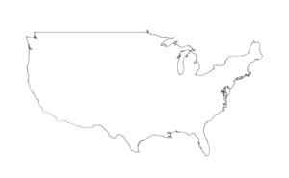

WHO ARE WE ?
A pharmacy company wanting to launch a drug primarily for diabetes
in one of the following states: CA, TX, FL, and NY.
WHAT HAVE WE ANALYZED ?
10 measures for chronic disease
related to unhealthy behaviors, health outcomes, and use of preventive services.
AIM OF VISUALIZATIONS
Provide insights into the prevalence of unhealthy behaviors, preventive measures taken by the population, and the trend of diabetes in four states for the year of 2016.
INTRODUCTION
500 BIGGEST CITIES
GOAL
The project aims to identify the top state with the highest number of people with diabetes and
recommend a city for the launch of the medicine.
Q U A D C O D E

Slide 3


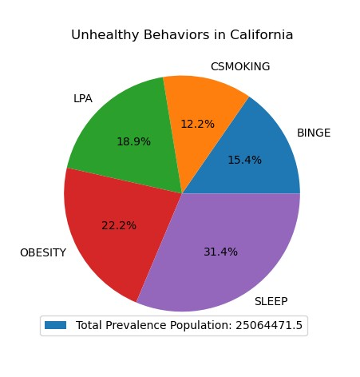
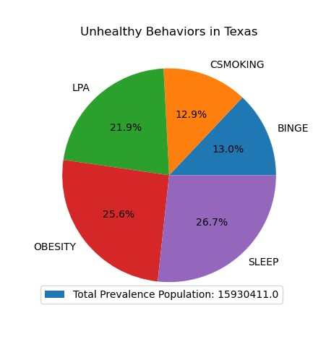

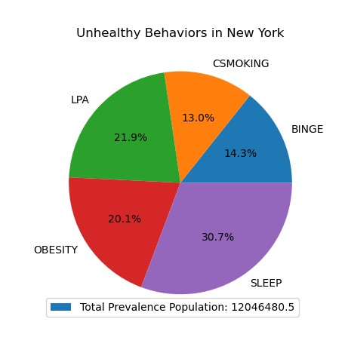

Understanding the Unhealthy behaviors within the states :
California Texas Florida
New York
LPA + Obesity + Sleep (72.5%)= 18.1 million
LPA + Obesity + Sleep (74.2%)= 11.8 million
LPA + Obesity + Sleep (73%)= 5 million
LPA + Obesity + Sleep (72.7%)= 8.7 million
Created four pie charts to display all the unhealthy behaviors for four states: CA, TX, FL, and NY. Each pie chart shows the percentage of people engaging in unhealthy behaviors such as smoking, excessive alcohol consumption, and lack of physical activity.
The distribution of three key health behaviors - obesity, lack of physical activity, and lack of sleep - are important factors to consider for the drug being launched, as it has the potential to improve all of these behaviors.

Slide 4


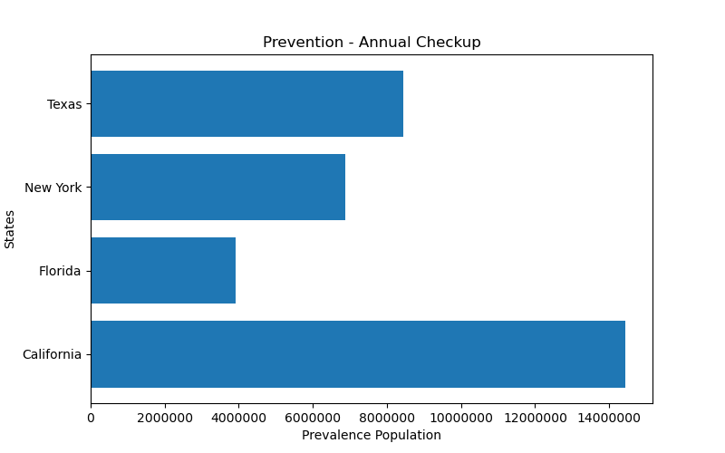
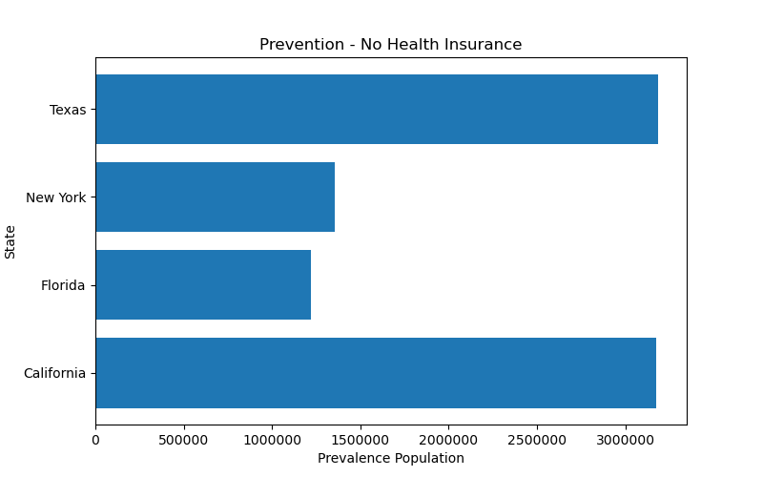

Understanding the health prevention trends within the states :
Population going for Annual Check ups Population having no health insurances
The Bar graphs show the prevalence population with insurance and those who go for annual checkups.
We compare the states based on the prevalence population of people who get annual checkups and those who lack health insurance. This will provide insights into the potential market for the new low-cost drug, as even those without insurance may be interested in purchasing it.

Slide 5

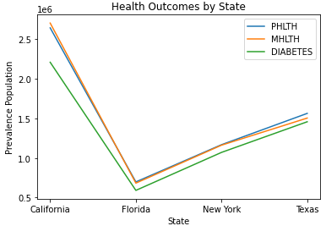
HEALTH
OUTCOMES
A line graph is used to plot the trend of diabetes for the four states. The disease with a higher count can be selected based on the prevalence population of diabetes in the states.
The line graph illustrates that California has a higher prevalence of physical health issues, mental health problems, and diabetes. However, as our new drug primarily treats diabetes, we have conducted further analysis specifically
for diabetes using scatterplot, boxplot, and visualizations.
histogram, heatmap

Slide 6

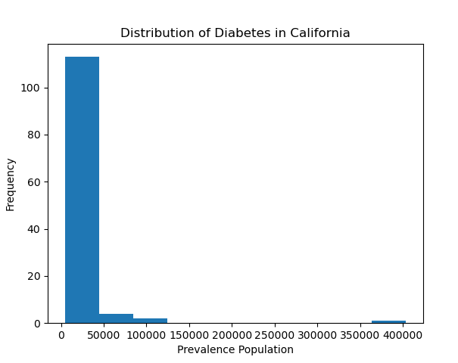

DISTRIBUTION OF DIABETES IN CALIFORNIA
A histogram is created to show the distribution of data for diabetes for California.
The histogram is skewed to the left, showing that over 100 cities in California fall within the 0-40,000 prevalence population range for diabetes.
Q U A D C O D E

Slide 7

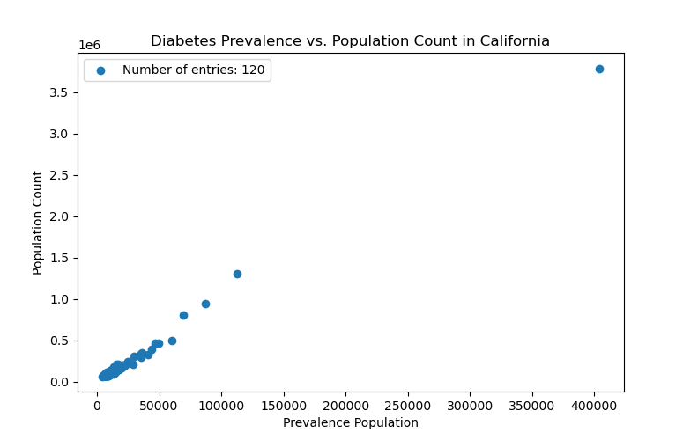

Understanding the trend between prevalence population and population count for diabetes in California :
The scatter plot shows a positive and approximately linear correlation between the diabetes prevalence population and population count. The increase in diabetes prevalence is proportional to the increase in population count. So as the population count increases, the diabetes prevalence also increases.
Q U A D C O D E

Slide 8

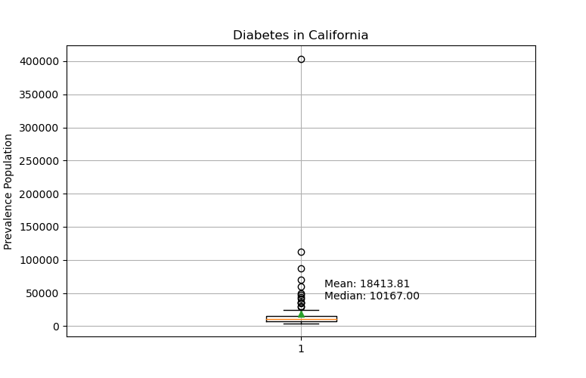
DISTRIBUTION OF THE DIABETIC POPULATION
Created a boxplot to show the distribution of data, outlier(s), mean, and median for the cities in California based on the prevalence population of diabetes.
The boxplot analysis revealed that there are approximately 14 outlier cities with a higher prevalence population of diabetes that falls outside the 0-25,000 range.
These cities are likely to have a higher number of people with diabetes compared to other cities.
We can visualize these cities on a heat map, where the darker shades represent higher prevalence population.

Slide 9

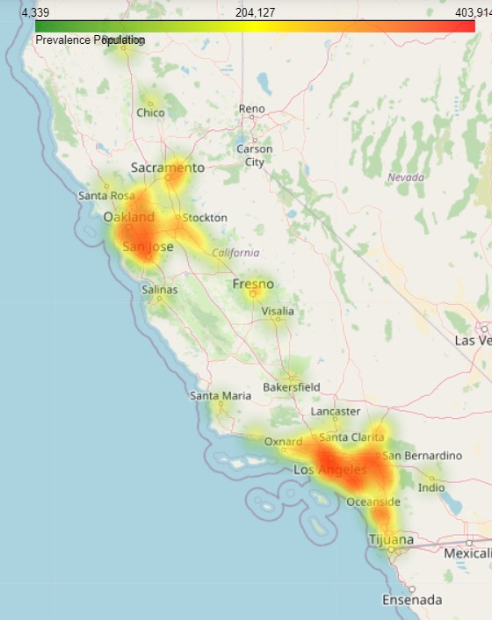
MOMENT OF TRUTH : REVEALING THE CITY TO LAUNCH THE DRUG
A heat map is created to identify the top city in California with the highest number of people with diabetes to launch the drug
When we look at the heat map, the darkest concentration of the diabetic population can be seen in the city of
' Los Angeles '.
That is where our company is now planning to launch the drug !

Slide 10


CONCLUSION
Based on the analysis of health data for the states of TX, CA, NY, and FL, California appears to be the state with the highest prevalence of diabetes, poor physical health, and poor mental health.
Additionally, when compared to the respective prevalence population, California has the highest percentage of people who are obese, have insufficient sleep, and lack physical activity.
Los Angeles, in particular, has been identified as the city with the highest prevalence of diabetes in California. Therefore, it would be a wise decision to launch the new drug in Los Angeles, California.
Furthermore, a significant portion of the population lack health insurance and goes for annual checkups. This information suggests that there is a potential market for low-cost drugs in Los Angeles where a large number of people fall into this category.
Q U A D C O D E

Slide 11

RECOMMENDATION
City and Tract FIPS: These columns provide the Federal Information Processing Standards (FIPS) codes for the city and census tract, respectively. These codes could be useful if you want to merge this data with other datasets or if you want to analyze the data at a more granular level.
Household Income: The average household income in California could be an important factor to consider since low- income individuals may be at a higher risk of developing chronic diseases due to a lack of access to healthy foods and healthcare.
Ethnicity and Race: Including data on the ethnic and racial composition of California's population could help identify groups that may have higher rates of certain chronic diseases, allowing for targeted outreach and promotion of your medicine.
Environmental factors: Adding data on environmental factors such as pollution levels, access to green spaces, and availability of healthy food options could help identify areas where interventions to improve the environment could help reduce the prevalence of chronic diseases.
Q U A D C O D E

Slide 12


DEBRA GOSS KATHY TANG JEEVAN GEDELA SHREYA JOSHI
THANK YOU
Q U A D C O D E

