Slide 1
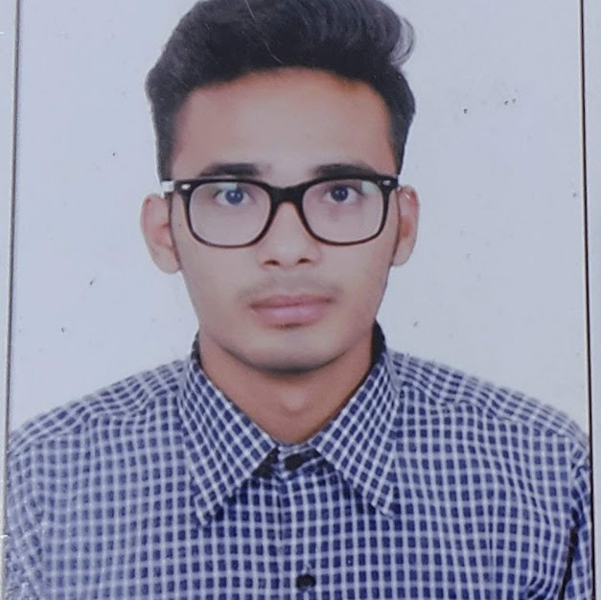


JEEVAN CHAUDHARY
Analyst/Software Engineer
Bachelor of Engineering
Computer Science : 2017 - 2021
Skills Java 8
Spring Boot
Spring Core
Micro Services
Backend
Spring Boot
Spring Core
Rest API
Node Js
Database
SQL database
PostgreSQL
Web Technologies
HTML5
CSS3
Javascript,ES6
Bootstrap
AddOns
Github
Gradle
Swagger,Eclipse
Additional Details
Leadership
Proficient Communication
Team player
Bangalore
jeevan.chaudhary@capgemini.com
9113892687
A4
Ready to learn new technologies and implement them to further improve my skill and knowledge.
Has working knowledge of SQL, React, and Java Development using Spring framework on an intermediate level.
Software Engineer who is Strong in design and integration with intuitive problem-solving skills. Passionate about implementing and launching new projects.
https://github.com/JeevanChaudhary
News-app
Created a new application using a microservices architecture with spring boot as the backend and React as the frontend.
E-Vehicle-Service and the Enquiry system
Created a Service management system with spring boot as backend long, with swagger for testing.
React as frontend, used HTML5, CSS ,ES6 and bootstrap for designing responsive web pages .

