Slide 1


PLANT DISEASE IMAGE CLASSIFIER USING CNN
Presented By : Jeevan EG Pranav P Kulkarni Manoj YN Nandeesh Kantli
RV University

Slide 2

Introduction Importance of plant disease classification Project objectives
Dataset Dataset description Data preprocessing
Methodology CNN architecture Training process
Results Performance metrics Training and validation curves Correctly and incorrectly classified examples
Challenges and Limitations
Future Work
Conclusion
AGENDA

Slide 3
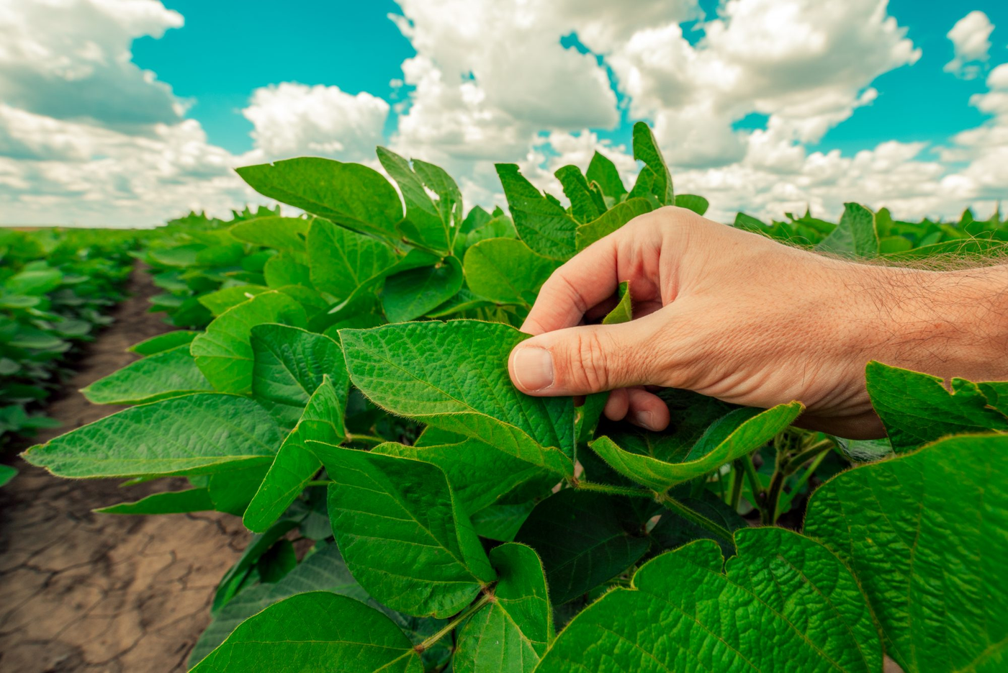

Introduction
Importance of plant disease classification
Crucial for crop management and food security
Enables timely treatment and prevention
Challenges of traditional methods
Time-consuming and subjective
Difficulties in distinguishing similar symptoms
Project objectives
Develop accurate and efficient CNN model
Automated plant disease classification
Overcome limitations of traditional methods
Contribute to precision agriculture

Slide 4

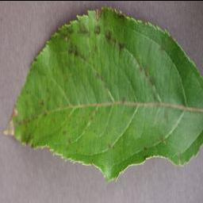
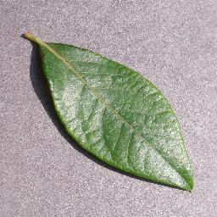
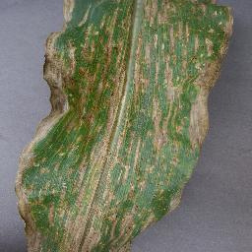
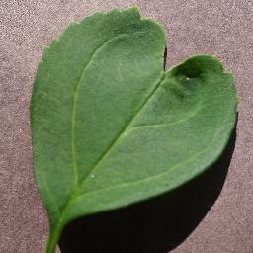

DataSet Details
NUMBER OF IMAGES | 87,000 Images, The total dataset is divided into 80/20 ratio of training and validation set preserving the directory structure
IMAGE DIMENSION | 256 x 256
NUMBER OF CLASSES | 38
Source: Kaggle

Slide 5

DATA PREPROCESSING
tf.keras.utils.image_dataset_from_directory(
'Directoy_Path',
labels="inferred",
label_mode="categorical",
class_names=None,
color_mode="rgb",
batch_size=32,
image_size=(128, 128),
shuffle=True,
seed=None,
validation_split=None,
subset=None,
interpolation="bilinear",
follow_links=False,
crop_to_aspect_ratio=False
)
1. Loading and Organizing Data
- Utilize `image_dataset_from_directory` to load images from specified directory.
- Organize data into subdirectories, each representing a different class or label.
2.Data Labeling and Encoding
- Set `labels="inferred"` for automatic label inference from subdirectory names.
- Use `label_mode="categorical"` to encode labels into categorical format.
3. Image Preprocessing
- Specify `color_mode="rgb"` for RGB image conversion.
- Resize images uniformly using `image_size=(128, 128)` and `interpolation="bilinear"`.
4. Data Augmentation and Batch Processing
- Augment data for increased diversity and better generalization.
- Control dataset shuffling (`shuffle=True`), seed for reproducibility, and batch size (`batch_size`) for efficient processing.

Slide 6
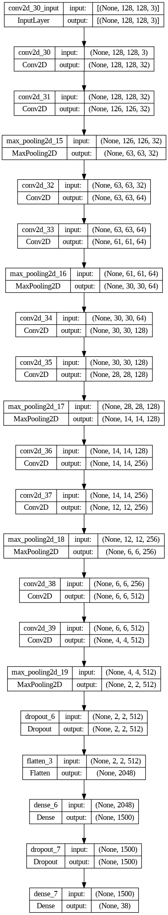
METHODOLOGY
CNN ARCHITECTURE
Convolutional layers (Conv2D): These are essential for capturing spatial features in images, crucial for disease identification.
Max pooling layers: They reduce image size and computational cost while retaining important features
Flatten layer: Transforms the 2D convolutional feature maps into a 1D vector for feeding into fully connected layers
Dense layers: These layers learn complex relationships between the features and class labels.
Softmax activation: Suitable for multi-class classification (38 disease classes) as it outputs probabilities for each class

Slide 7
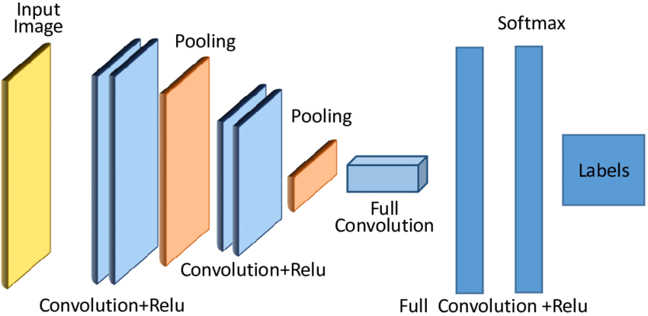
CNN Architecture

Slide 8
METHODOLOGY -TRAINING PROCEESS
Optimizer: Adam
Number of epochs: 10 epochs
Activation Function: Relu function
Regularisation Method: Dropout Layer
Loss function:Cross-entropy loss function

Slide 9
PERFORMANCE METRICS
Accuracy: 0.97
Precision:0.97
Recall:0.97
F1-Score:0.97

Slide 10
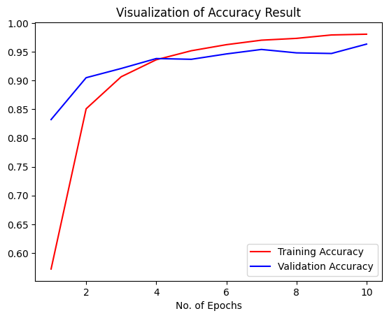
Graph between Training Accuracy and Validation Accuracy of Sequential Model

Slide 11
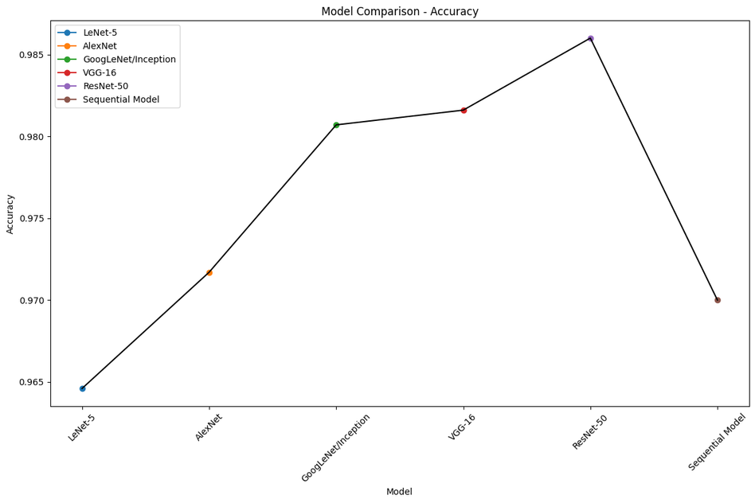
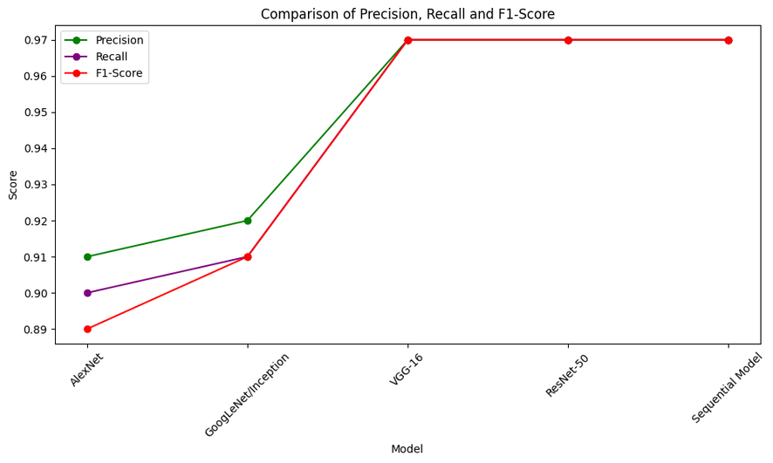
Model Comparison - Accuracy
Comparison of Precision, Recall and F1-Score

Slide 12
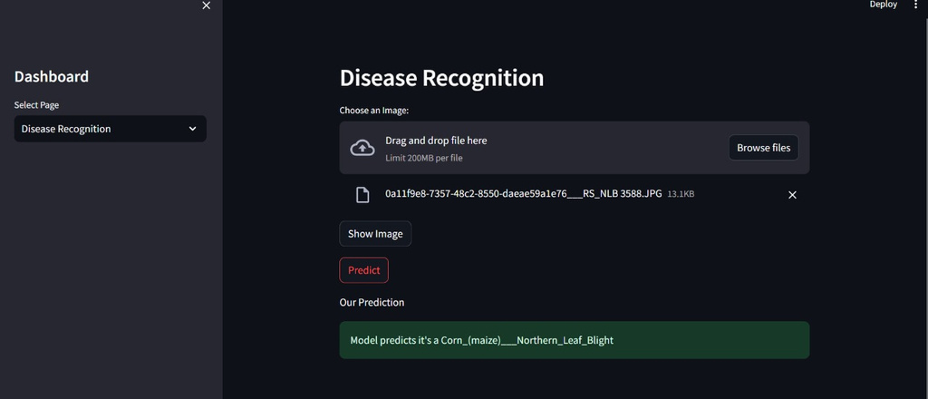
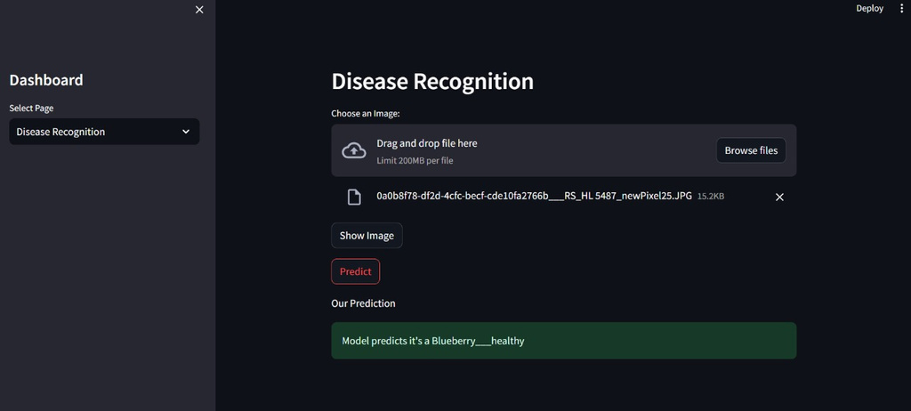
Successful Classification: Accurate Predictions of Plant Leaf Diseases

Slide 13
Challenges and Limitations
1. Large Dataset Size: The dataset consists of 87,000 images with 32 classes. Handling such a large dataset requires significant computational resources, particularly GPU, for efficient training.
4.Overfitting and Generalization: The model may suffer from overfitting, particularly with a limited number of epochs. As a result, it may not generalize well to unseen data, leading to poor performance in predicting images outside the training dataset.
2. Limited Training Epochs: The experiment utilized only 10 epochs for training the model. With a complex dataset and architecture, this may not be sufficient for the model to learn the intricate patterns present in the data fully.
5.Difficulty in Predicting Unseen Images: Due to the limited training and potential overfitting, the model may struggle to accurately classify images that are substantially different from those in the training dataset. This lack of robustness can limit its real-world applicability.
3. Sequential Model Architecture: The model architecture used in the experiment is sequential. While sequential models are straightforward to implement and understand, they may not capture complex relationships and patterns present in the data as effectively as more sophisticated architectures like ResNet or Inception
6.Limited Class Representation: With 32 classes, there might be class imbalances within the dataset, which can affect the model's ability to learn and generalize across all classes equally.

Slide 14
Future Works
1.Enhanced Model Architectures: Experiment with more advanced CNN architectures or even explore other deep learning approaches such as recurrent neural networks (RNNs) or transformers. This could involve using pre-trained models like EfficientNet or developing custom architectures tailored to the specific characteristics of plant disease images.
2.Data Augmentation and Balancing: Further improve the dataset by applying advanced data augmentation techniques to increase its diversity and balance class representation. Techniques like rotation, scaling, flipping, and color jittering can help augment the dataset and improve model generalization.
3.Real-time Disease Monitoring: Extend the project beyond image classification to develop a real-time disease monitoring system. This could involve deploying the model on edge devices or integrating it with drones or agricultural robots for on-the-fly disease detection in fields.

Slide 15
Conclusion
1. Deep Learning for Plant Disease Detection:
- Utilizes Convolutional Neural Networks (CNNs) for feature extraction.
- Fully connected layers for prediction.
2.Strong Performance and Generalization:
- Achieves high accuracy on a dataset of 87,000 images.
3. Practical Applications in Agriculture:
- Potential integration into mini-drones for live disease detection.
- Scalable and adaptable for real-world agricultural use.
4. Future Enhancements:
- Incorporate more diverse images to improve accuracy.
- Expand capabilities to classify a broader range of plant diseases.

