Slide 1


VISVESVARAYA TECHNOLOGICAL UNIVERSITY,
Jnana Sangama, Belagavi - 590014
A DBMS MINI PROJECT REPORT ON
“ELITE RAIL – ONLINE RAILWAY BOOKING SYSTEM”
IN
COMPUTER SCIENCE & ENGINEERING
By
[STUDENT NAME 1]
[STUDENT NAME 2]
[STUDENT NAME 3]
[STUDENT NAME 4]
[1DB23CS0XX]
[1DB23CS0XX]
[1DB23CS0XX]
[1DB23CS0XX]
Under the Guidance of Ms. SINCHANA K P B.E, M. TECH
Assistant Professor
Department of CSE, DBIT
DON BOSCO INSTITUTE OF TECHNOLOGY
(An Autonomous Institution, affiliated to VTU, Belagavi)
DEPARTMENT OF COMPUTER SCIENCE & ENGINEERING
BENGALURU – 560074, KARNATAKA
2025 – 2026

Slide 2
DON BOSCO INSTITUTE OF TECHNOLOGY
(An Autonomous Institution, affiliated to VTU, Belagavi)
BENGALURU – 560074, KARNATAKA
DEPARTMENT OF COMPUTER SCIENCE & ENGINEERING
CERTIFICATE
This is to certify that the Mini Project entitled “ELITE RAIL – ONLINE RAILWAY BOOKING SYSTEM” is a bonafide work carried out by the following students of Department of Computer Science & Engineering, Don Bosco Institute of Technology, in partial fulfillment of the requirements for the award of Bachelor of Engineering degree of Visvesvaraya Technological University, Belagavi, during the academic year 2025–2026.
[STUDENT NAME 1]
[STUDENT NAME 2]
[STUDENT NAME 3]
[STUDENT NAME 4]
[USN 1]
[USN 2]
[USN 3]
[USN 4]
It is certified that all corrections/suggestions indicated for Internal Assessment have been incorporated in the report deposited in the departmental library. The Mini project report has been approved as it satisfies the academic requirements in respect of Mini Project work prescribed for the Bachelor of Engineering Degree.
Ms. SINCHANA K P
B.E, M. TECH
Mini Project Guide
Dr. K B SHIVAKUMAR
B.E, M.E, M.B.A, M.Phil., Ph.D.
HOD
Name of the Examiners
External Viva
Signature with Date
1. ______________________
2. ______________________

Slide 3
DON BOSCO INSTITUTE OF TECHNOLOGY
(An Autonomous Institution, affiliated to VTU, Belagavi)
BENGALURU – 560074, KARNATAKA
DEPARTMENT OF COMPUTER SCIENCE & ENGINEERING
Declaration
We, the undersigned students of the Department of Computer Science & Engineering, Don Bosco Institute of Technology, hereby declare that the dissertation titled “ELITE RAIL – ONLINE RAILWAY BOOKING SYSTEM” is a record of original work done by us under the guidance of Ms. SINCHANA K P, Assistant Professor, Dept. of CSE, DBIT.
The information and data given in the report are authentic to the best of our knowledge. This project report is submitted in partial fulfillment of the requirements for the award of Bachelor of Engineering Degree in Computer Science & Engineering at Visvesvaraya Technological University, Belagavi, during the academic year 2025–2026.
This dissertation has not been submitted for any other degree or professional qualification.
[STUDENT NAME 1]
[STUDENT NAME 2]
[STUDENT NAME 3]
[STUDENT NAME 4]
[USN 1]
[USN 2]
[USN 3]
[USN 4]

Slide 4
ACKNOWLEDGEMENT
The satisfaction and euphoria that accompany the successful completion of any task would be incomplete without the mention of the people who made it possible and whose constant guidance and encouragement made our efforts a success.
So, with gratitude we acknowledge all those whose guidance and encouragement served as a beacon of light and crowned our efforts with success.
We would like to express our sincere gratitude to our project guide Ms. SINCHANA K P, Assistant Professor, Department of CSE, for providing valuable guidance, continuous support, and constant encouragement throughout the development of this project.
We sincerely thank Dr. K B SHIVAKUMAR, Professor and Head, Department of Computer Science & Engineering, for the constant help and support throughout this project work.
We thank our beloved Principal Dr. B S Nagabhushana for his constant help and support provided to us during our course of study.
We are indebted to the Management of Don Bosco Institute of Technology for providing an environment that helped us in completing our mini project.
Also, we thank all the teaching and non-teaching staff of the Department of Computer Science & Engineering for their valuable cooperation in this project.
[STUDENT NAME 1]
[STUDENT NAME 2]
[STUDENT NAME 3]
[STUDENT NAME 4]
[USN 1]
[USN 2]
[USN 3]
[USN 4]

Slide 5
ABSTRACT
The Elite Rail Online Railway Booking System is a web-based database application developed to streamline and modernize the process of booking railway tickets in India. This system allows users to search for available trains between source and destination cities, select seats from an interactive seat map, and complete bookings with instant confirmation.
The application is built using a modern full-stack architecture: the frontend is developed using React.js (Vite) with a premium glassmorphic dark-themed design, while the backend is powered by Node.js with Express.js and SQLite as the database management system. The system incorporates role-based access control, distinguishing between regular users and admin users.
Key features of the system include user authentication (login and registration), train search with route and date filtering, interactive seat selection with real-time availability, booking confirmation and journey management, admin panel for adding and managing trains, downloadable PDF e-tickets, and a customer profile with a points-based loyalty system.
The database schema includes three core tables: users, trains, and bookings, with proper foreign key relationships enforced. SQL triggers, views, and stored procedures are implemented to maintain data integrity and optimize query performance.
This project demonstrates the practical application of Database Management System (DBMS) concepts including Entity-Relationship modeling, normalization, SQL DDL/DML operations, and transaction management in a real-world web application context.

Slide 6
TABLE OF CONTENTS
CHAPTER
DESCRIPTIONS
PAGE NO.
1
2
3
4
5
Certificate
Declaration
Acknowledgement
Abstract
Table of Contents
List of Figures
INTRODUCTION
1.1 Introduction to the Project
1.2 Problem Statement
1.3 Objectives and Scope
1.4 Proposed Solutions & Advantages
SYSTEM DESIGN
2.1 Schema Diagram
2.2 ER Diagram
2.3 Normalization
IMPLEMENTATION
3.1 Technology Stack and Platform
3.2 Database Implementation (DDL)
3.3 Database Implementation (DML)
3.4 Triggers, Views & Procedures
3.5 Backend Connection & API Setup
RESULT
4.1 Snapshots
CONCLUSION AND FUTURE ENHANCEMENT
5.1 Conclusion
5.2 Future Enhancements
REFERENCES
i
ii
iii
iv
v
vi
1
1
2
3
4
5
5
6
7
8
8
9-10
11-14
15-17
18-21
22
22-25
26
26
27
28

Slide 7
LIST OF FIGURES
Fig 2.1
Fig 2.2
Fig 3.1
Fig 3.2
Fig 3.3
Fig 3.4
Fig 3.5
Fig 3.6
Fig 3.7
Schema Diagram
ER Diagram
Home Page – Train Search
Dashboard Page
Home Page Full View
Train Scheduling & Management
Seat Selection & Booking Confirmation
My Journeys Page
About Page
5
6
22
22
23
23
24
24
25

Slide 8
ELITE RAIL - ONLINE RAILWAY BOOKING
B24CSL49
CHAPTER 1
INTRODUCTION
1.1 INTRODUCTION TO THE PROJECT
The Elite Rail Online Railway Booking System is a web-based database application designed to streamline, simplify, and automate the process of booking railway tickets online in India. In the modern transportation sector, passengers require rapid, reliable, and secure platforms to organize their journeys. Traditional manual booking structures or aging legacy systems often suffer from long response latencies, data inconsistencies, and poor user experience.
The primary objective of this project is to replace manual booking procedures with a centralized, user-friendly, and highly responsive online platform. Built on a robust relational database backend (SQLite) and powered by Node.js/Express APIs, the Elite Rail application facilitates seamless data flows between passengers and train operators. It efficiently manages complex relations involving users, train details, seat allocation maps, real-time ticket availability, and booking transactions.
Ultimately, this project demonstrates the practical application of core Database Management System (DBMS) concepts—such as Entity-Relationship modeling, normalization, database constraints, transaction management, views, and database triggers—within a production-grade modern full-stack web application.
1 | P a g e
D e p t . o f C S E

Slide 9
ELITE RAIL - ONLINE RAILWAY BOOKING
B24CSL49
1.2 PROBLEM STATEMENT
Traditional railway booking structures face significant challenges, including:
→ Long waiting queues and manual form-filling processes which are prone to human error.
→ Data redundancy and inconsistencies arising from poorly structured relational schemas.
→ High database response latency and inefficient retrieval of real-time seat availability.
→ Overbooking or double-booking of seats due to a lack of database-level concurrency and validation controls.
→ Disconnected frontend interfaces and backend databases, making real-time updates extremely difficult.
→ Inadequate administrative controls to easily schedule, add, modify, or delete trains dynamically.
Therefore, a modernized, secure, and centralized web-based railway booking database application is required to resolve these operational bottlenecks and deliver a premium experience to both passengers and administrators.
2 | P a g e
D e p t . o f C S E

Slide 10
ELITE RAIL - ONLINE RAILWAY BOOKING
B24CSL49
1.3 OBJECTIVES OF THE PROJECT
→ To design and implement a robust relational database schema using SQLite to manage passenger details, trains, schedules, and ticket bookings.
→ To enforce strict data integrity and referential constraints across tables using primary keys, foreign keys, and unique checks.
→ To eliminate data redundancy and anomaly potentials through rigorous schema normalization up to BCNF.
→ To deploy SQL database triggers to prevent critical errors like double-booking and automate log archiving.
→ To build high-performance backend RESTful APIs using Node.js and Express to interact with the database.
→ To develop an interactive and modern glassmorphic web dashboard in React.js for seamless booking.
1.4 SCOPE OF THE PROJECT
→ Secure login, register, and profile operations with dynamic session tracking.
→ Real-time train search filtered dynamically by source city, destination, and booking date.
→ Interactive and visual seat layout map indicating booked, selected, and available seats.
→ Immediate ticket booking confirmation with PDF e-ticket downloads and journey history logs.
→ Dedicated administrative control panels to add, monitor, and remove trains dynamically.
3 | P a g e
D e p t . o f C S E

Slide 11
ELITE RAIL - ONLINE RAILWAY BOOKING
B24CSL49
1.4 PROPOSED SOLUTIONS AND ADVANTAGES
Digital Booking Platform:
Replaces manual forms and queues with an interactive full-stack web application. Passenger data and bookings are processed and saved instantly into the database, reducing paperwork and administrative friction.
Centralized Database Management:
A highly structured relational database stores all system records. Enforcing strict primary and foreign key constraints eliminates orphaned booking records and maintains authentic data synchronization.
Double-Booking Prevention:
Implementing a custom SQLite BEFORE INSERT trigger prevents concurrent bookings of the exact same seat on the same train on the same date, guaranteeing absolute transaction consistency.
Premium Glassmorphic Design:
Utilizes a highly refined frontend interface with dynamic dark-themed glassmorphism, responsive navigation, micro-animations, and interactive seat selections.
4 | P a g e
D e p t . o f C S E

Slide 12
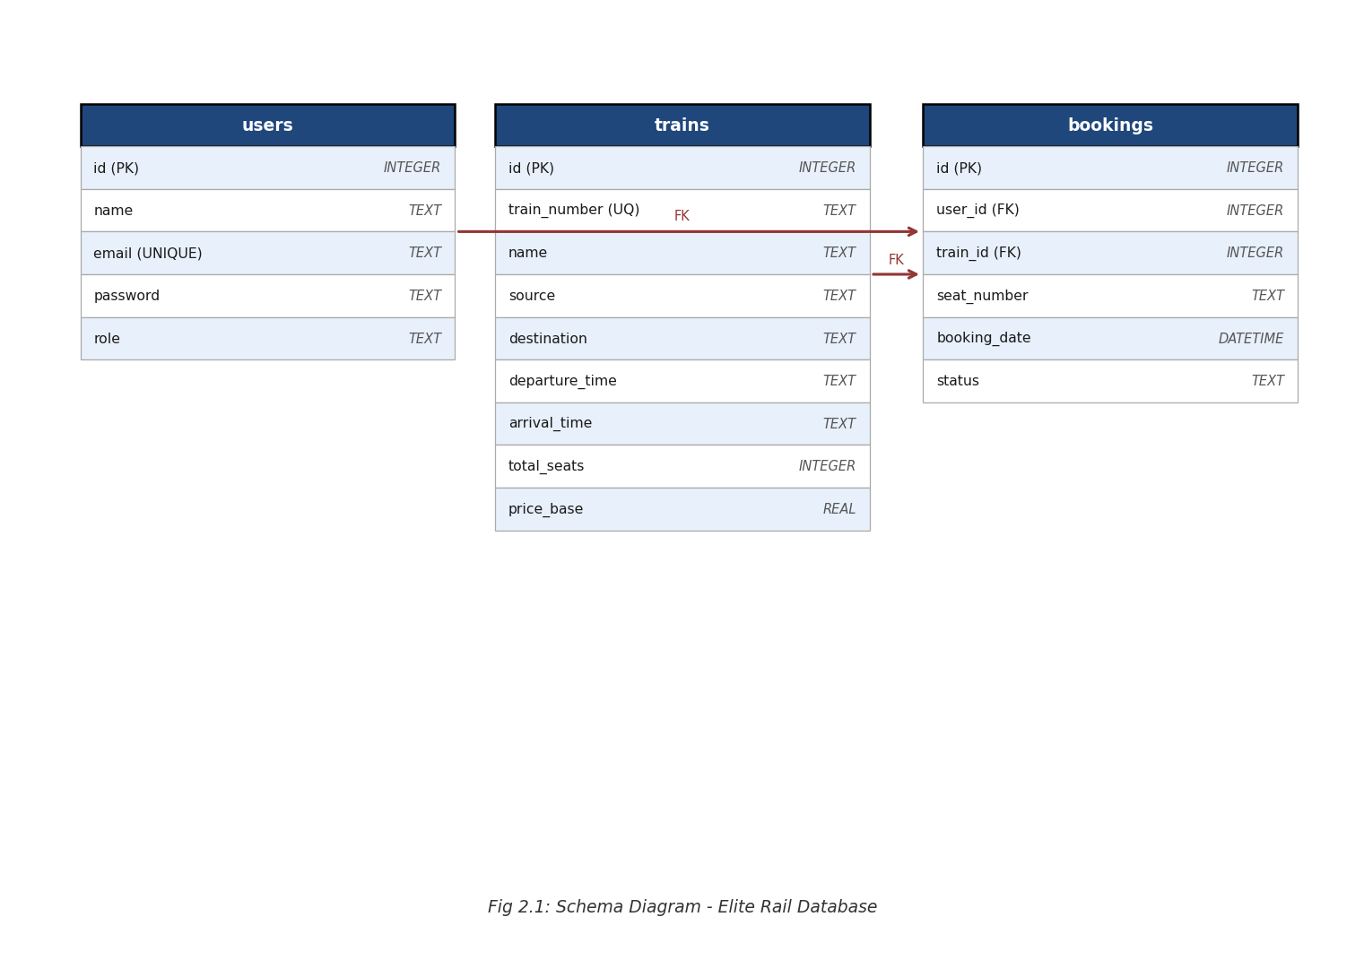
ELITE RAIL - ONLINE RAILWAY BOOKING
B24CSL49
CHAPTER 2
SYSTEM DESIGN
2.1 SCHEMA DIAGRAM
Fig.2.1 Schema Diagram
5 | P a g e
D e p t . o f C S E

Slide 13
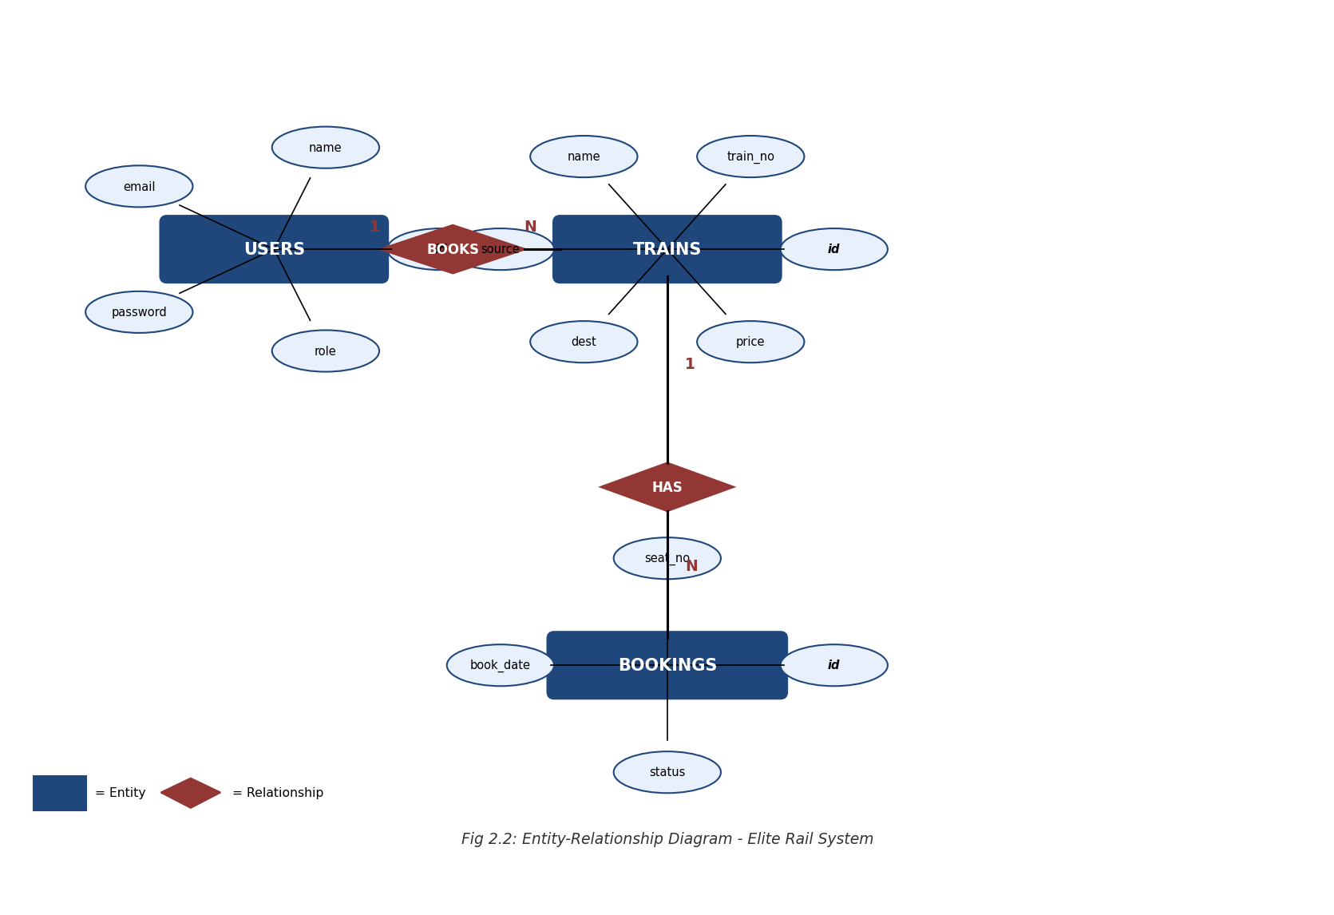
ELITE RAIL - ONLINE RAILWAY BOOKING
B24CSL49
2.2 ER DIAGRAM
Fig.2.2 ER Diagram
6 | P a g e
D e p t . o f C S E

Slide 14
ELITE RAIL - ONLINE RAILWAY BOOKING
B24CSL49
2.3 NORMALIZATION
First Normal Form (1NF):
All attributes in the Elite Rail database contain atomic (indivisible) values. Each column stores only one value per row. For example, the bookings table stores one seat_number per booking record rather than a comma-separated list of seats. All tables have a primary key defined (id with AUTOINCREMENT) to uniquely identify records.
Second Normal Form (2NF):
All tables satisfy 2NF as every non-key attribute is fully functionally dependent on the primary key. Since all three core tables (users, trains, bookings) utilize a single-column primary key (id), there are no partial dependencies possible. Every non-key attribute in bookings – such as user_id, train_id, seat_number, travel_date – depends entirely on the primary key.
Third Normal Form (3NF):
The database satisfies 3NF with no transitive dependencies. In the trains table, departure_time and arrival_time depend only on the train id, not on source or destination. In bookings, the status attribute depends only on the booking id. All transitive dependencies have been eliminated through proper table decomposition and use of foreign keys.
Boyce-Codd Normal Form (BCNF):
The database satisfies BCNF – for every non-trivial functional dependency X → Y, X is a superkey. The email column in users has a UNIQUE constraint (candidate key), and train_number in trains is also UNIQUE (candidate key). No anomaly-causing dependencies exist.
7 | P a g e
D e p t . o f C S E

Slide 15
ELITE RAIL - ONLINE RAILWAY BOOKING
B24CSL49
CHAPTER 3
IMPLEMENTATION
3.1 TECHNOLOGY STACK
Frontend Technologies:
→ React.js (Vite build tool) – Component-based UI development
→ Vanilla CSS with custom properties – Glassmorphic dark theme design
→ HTML5 + JavaScript (ES6+) – Core web technologies
→ Google Fonts (Inter, Outfit) – Modern typography
Backend Technologies:
→ Node.js – JavaScript runtime environment
→ Express.js – RESTful API framework
→ SQLite3 – Lightweight relational database (via better-sqlite3)
→ bcrypt – Password hashing for security
Platform for Implementation:
→ VS Code – Primary code editor
→ DB Browser for SQLite – GUI for database inspection and SQL testing
→ XAMPP/Node Local Server – Local deployment environment
8 | P a g e
D e p t . o f C S E

Slide 16
ELITE RAIL - ONLINE RAILWAY BOOKING
B24CSL49
3.2 DATABASE IMPLEMENTATION
DATA DEFINITION LANGUAGE (DDL) – CREATE TABLE USERS & TRAINS
-- DDL CREATE TABLE Statements (Part 1)
-- 1. Create Users Table to store passenger and admin profiles
CREATE TABLE IF NOT EXISTS users (
id INTEGER PRIMARY KEY AUTOINCREMENT,
name TEXT NOT NULL,
email TEXT UNIQUE NOT NULL,
password TEXT NOT NULL,
role TEXT DEFAULT 'user'
);
-- 2. Create Trains Table to maintain schedule and base prices
CREATE TABLE IF NOT EXISTS trains (
id INTEGER PRIMARY KEY AUTOINCREMENT,
train_number TEXT UNIQUE NOT NULL,
name TEXT NOT NULL,
source TEXT NOT NULL,
destination TEXT NOT NULL,
departure_time TEXT NOT NULL,
arrival_time TEXT NOT NULL,
total_seats INTEGER DEFAULT 60,
price_base REAL NOT NULL
);
9 | P a g e
D e p t . o f C S E

Slide 17
ELITE RAIL - ONLINE RAILWAY BOOKING
B24CSL49
DATA DEFINITION LANGUAGE (DDL) – CREATE TABLE BOOKINGS
-- DDL CREATE TABLE Statements (Part 2)
-- 3. Create Bookings Table with Foreign Key Constraints
CREATE TABLE IF NOT EXISTS bookings (
id INTEGER PRIMARY KEY AUTOINCREMENT,
user_id INTEGER NOT NULL,
train_id INTEGER NOT NULL,
seat_number TEXT NOT NULL,
booking_date DATETIME DEFAULT CURRENT_TIMESTAMP,
status TEXT DEFAULT 'confirmed',
travel_date TEXT NOT NULL,
-- Enforce referential integrity
FOREIGN KEY (user_id) REFERENCES users(id)
ON DELETE CASCADE,
FOREIGN KEY (train_id) REFERENCES trains(id)
ON DELETE CASCADE
);
-- Enforces that booking records cannot exist without associated users or trains.
-- Using cascading deletes deletes booking records if the corresponding train is deleted.
10 | P a g e
D e p t . o f C S E

Slide 18
ELITE RAIL - ONLINE RAILWAY BOOKING
B24CSL49
3.3 DATABASE IMPLEMENTATION - DML
DATA MANIPULATION LANGUAGE (DML) – SEEDING TRAIN DATA
-- DML Insert Statements (Part 1)
-- Seed Indian Railways Train Schedules
INSERT OR IGNORE INTO trains
(train_number, name, source, destination, departure_time, arrival_time, price_base)
VALUES
('12433','Chennai Rajdhani','Chennai','Delhi','06:00','10:30',3200.00),
('12002','Bhopal Shatabdi','Delhi','Bhopal','06:15','14:00',1800.00),
('22436','Vande Bharat Express','Delhi','Varanasi','06:00','14:00',2500.00),
('12260','Duronto Express','Kolkata','Delhi','17:00','10:30',2800.00),
('12951','Mumbai Rajdhani','Mumbai','Delhi','16:35','08:35',3100.00),
('12124','Deccan Queen','Pune','Mumbai','07:15','10:25',900.00),
('12841','Coromandel Express','Kolkata','Chennai','15:20','17:15',1800.00),
('12622','Tamil Nadu Express','Delhi','Chennai','21:05','06:15',2400.00),
('12007','Mysuru Shatabdi','Chennai','Mysore','06:00','13:00',1400.00),
('12723','Telangana Express','Hyderabad','Delhi','06:25','09:05',2100.00),
('12213','Duronto Express','Bangalore','Delhi','23:40','07:00',2900.00);
11 | P a g e
D e p t . o f C S E

Slide 19
ELITE RAIL - ONLINE RAILWAY BOOKING
B24CSL49
DATA MANIPULATION LANGUAGE (DML) – SEEDING USERS & SELECTION
-- DML Insert Statements (Part 2)
-- Seed User and Admin profiles
INSERT OR IGNORE INTO users (name, email, password, role) VALUES
('Jeevan', 'jeevan@gmail.com', 'Jeevan@333', 'user'),
('Admin', 'admin@eliterail.com', 'admin123', 'admin');
-- DML Selection Queries (Core)
-- 1. View all trains
SELECT * FROM trains;
-- 2. View all users
SELECT id, name, email, role FROM users;
-- 3. View confirmed bookings
SELECT * FROM bookings WHERE status = 'confirmed';
12 | P a g e
D e p t . o f C S E

Slide 20
ELITE RAIL - ONLINE RAILWAY BOOKING
B24CSL49
DATA MANIPULATION LANGUAGE (DML) – TRAIN SEARCH & BOOKINGS
-- DML Core Queries for API interactions
-- 1. Search Trains dynamically by source, destination
SELECT id, train_number, name, source, destination, departure_time, arrival_time, price_base
FROM trains
WHERE source LIKE '%Chennai%' AND destination LIKE '%Delhi%';
-- 2. Insert new passenger booking (DML INSERT)
INSERT INTO bookings (user_id, train_id, seat_number, travel_date, status)
VALUES (1, 3, 'S-14', '2026-06-15', 'confirmed');
-- 3. Retrieve all bookings of a specific user with relational JOIN
SELECT b.id, b.seat_number, b.travel_date, b.status,
t.name AS train_name, t.source, t.destination, t.departure_time
FROM bookings b
JOIN trains t ON b.train_id = t.id
WHERE b.user_id = 1
ORDER BY b.travel_date ASC;
13 | P a g e
D e p t . o f C S E

Slide 21
ELITE RAIL - ONLINE RAILWAY BOOKING
B24CSL49
DML – CANCELLATION, ADMIN OPERATIONS & USER AUTHENTICATION
-- 1. Cancel an existing ticket (DML UPDATE)
-- Sets booking status to cancelled to free up the seat
UPDATE bookings
SET status = 'cancelled'
WHERE id = 5 AND user_id = 1;
-- 2. Remove train schedule from system (DML DELETE - Admin Only)
DELETE FROM trains
WHERE id = 12;
-- 3. User Credentials verification query
SELECT id, name, email, role
FROM users
WHERE email = 'jeevan@gmail.com' AND password = 'Jeevan@333';
-- 4. Check real-time seat occupancy for a train on a given date
SELECT seat_number
FROM bookings
WHERE train_id = 3 AND travel_date = '2026-06-15' AND status = 'confirmed';
14 | P a g e
D e p t . o f C S E

Slide 22
ELITE RAIL - ONLINE RAILWAY BOOKING
B24CSL49
3.4 TRIGGERS
TRIGGER 1 – PREVENT DOUBLE BOOKING TRANSACTIONS
-- Custom SQLite trigger to enforce transaction integrity
-- Prevents overlapping passenger bookings for the same seat/train/date
CREATE TRIGGER IF NOT EXISTS prevent_double_booking
BEFORE INSERT ON bookings
FOR EACH ROW
BEGIN
SELECT CASE
WHEN EXISTS (
SELECT 1 FROM bookings
WHERE train_id = NEW.train_id
AND seat_number = NEW.seat_number
AND travel_date = NEW.travel_date
AND status = 'confirmed'
)
THEN RAISE(ABORT, 'Seat already booked for this train on this date')
END;
END;
-- This trigger runs BEFORE the record is inserted. If a match is found,
-- the insert is aborted with an error message, preserving relational rules.
15 | P a g e
D e p t . o f C S E

Slide 23
ELITE RAIL - ONLINE RAILWAY BOOKING
B24CSL49
TRIGGER 2 & 3 – UTILITIES AND AUDIT TRAIL LOGGING
-- Create Table for Audit Log Archiving
CREATE TABLE IF NOT EXISTS cancelled_bookings_log (
log_id INTEGER PRIMARY KEY AUTOINCREMENT,
booking_id INTEGER,
user_id INTEGER,
train_id INTEGER,
seat_number TEXT,
cancelled_at DATETIME DEFAULT CURRENT_TIMESTAMP
);
-- Trigger 2: Auto-Log Cancellations (Audit Trail)
-- Triggered whenever a booking's status changes to 'cancelled'
CREATE TRIGGER IF NOT EXISTS log_cancellation
AFTER UPDATE ON bookings
FOR EACH ROW
WHEN NEW.status = 'cancelled' AND OLD.status = 'confirmed'
BEGIN
INSERT INTO cancelled_bookings_log (booking_id, user_id, train_id, seat_number)
VALUES (OLD.id, OLD.user_id, OLD.train_id, OLD.seat_number);
END;
-- Trigger 3: Automatic Booking Timestamp Initializer
CREATE TRIGGER IF NOT EXISTS set_booking_date
AFTER INSERT ON bookings
FOR EACH ROW
WHEN NEW.booking_date IS NULL
BEGIN
UPDATE bookings SET booking_date = CURRENT_TIMESTAMP WHERE id = NEW.id;
END;
16 | P a g e
D e p t . o f C S E

Slide 24
ELITE RAIL - ONLINE RAILWAY BOOKING
B24CSL49
3.4 VIEWS
SQL DATABASE VIEWS FOR SIMPLIFIED REPORTING
-- View 1: Active Bookings with Passenger & Train Details
-- Merges three tables to generate standard passenger e-tickets
CREATE VIEW IF NOT EXISTS active_booking_details AS
SELECT
b.id AS booking_id,
u.name AS passenger_name,
u.email AS passenger_email,
t.train_number,
t.name AS train_name,
t.source,
t.destination,
t.departure_time,
t.arrival_time,
b.seat_number,
b.travel_date,
t.price_base AS fare
FROM bookings b
JOIN users u ON b.user_id = u.id
JOIN trains t ON b.train_id = t.id
WHERE b.status = 'confirmed';
-- View 2: Train Seat Availability Summary
CREATE VIEW IF NOT EXISTS train_occupancy AS
SELECT
t.id, t.train_number, t.name, t.source, t.destination, t.total_seats,
COUNT(b.id) AS booked_seats,
(t.total_seats - COUNT(b.id)) AS available_seats
FROM trains t
LEFT JOIN bookings b ON t.id = b.train_id AND b.status = 'confirmed'
GROUP BY t.id;
17 | P a g e
D e p t . o f C S E

Slide 25
ELITE RAIL - ONLINE RAILWAY BOOKING
B24CSL49
3.5 BACKEND IMPLEMENTATION
DATABASE CONNECTION INTERFACE (backend/database.js)
// database.js - Establishes SQLite relational connection
// and automatically loads tables, schema structures, and seeds
const sqlite3 = require('sqlite3').verbose();
const fs = require('fs');
const path = require('path');
// Resolve database file path
const dbPath = path.resolve(__dirname, 'railway.db');
const db = new sqlite3.Database(dbPath);
// Read SQL Schema definitions (DDL)
const schema = fs.readFileSync(path.resolve(__dirname, 'schema.sql'), 'utf8');
// Initialize database dynamically
db.serialize(() => {
db.exec(schema, (err) => {
if (err) {
console.error('Error initializing database:', err);
} else {
console.log('Database initialized successfully.');
}
});
});
module.exports = db;
18 | P a g e
D e p t . o f C S E

Slide 26
ELITE RAIL - ONLINE RAILWAY BOOKING
B24CSL49
EXPRESS BACKEND SERVER SYSTEM SETUP (backend/index.js - Part 1)
// index.js - Initializing Server, Middleware, CORS and Listeners
require('dotenv').config();
const express = require('express');
const cors = require('cors');
const db = require('./database');
const app = express();
const PORT = process.env.PORT || 5000;
// Enable Cross-Origin requests and JSON body parsing middleware
app.use(cors({ origin: '*' }));
app.use(express.json());
// Logger middleware to track active database requests
app.use((req, res, next) => {
console.log(`${req.method} ${req.url}`, req.body);
next();
});
// Health check endpoint
app.get('/api/health', (req, res) => {
res.json({ status: 'ok', time: new Date().toISOString() });
});
app.listen(PORT, '0.0.0.0', () => {
console.log(`Server running on http://0.0.0.0:${PORT}`);
});
19 | P a g e
D e p t . o f C S E

Slide 27
ELITE RAIL - ONLINE RAILWAY BOOKING
B24CSL49
EXPRESS AUTHENTICATION API ENDPOINTS (backend/index.js - Part 2)
// 1. User Registration Route (DML INSERT)
app.post('/api/register', (req, res) => {
const { name, email, password } = req.body;
db.run(
'INSERT INTO users (name, email, password) VALUES (?, ?, ?)',
[name, email, password],
function(err) {
if (err) return res.status(500).json({ error: err.message });
res.json({ id: this.lastID, message: 'User registered successfully' });
}
);
});
// 2. User Login Route (DML SELECT)
app.post('/api/login', (req, res) => {
const { email, password } = req.body;
db.get(
'SELECT id, name, email, role FROM users WHERE email = ? AND password = ?',
[email, password],
(err, row) => {
if (err) return res.status(500).json({ error: err.message });
if (!row) return res.status(401).json({ error: 'Invalid credentials' });
res.json(row);
}
);
});
20 | P a g e
D e p t . o f C S E

Slide 28
ELITE RAIL - ONLINE RAILWAY BOOKING
B24CSL49
EXPRESS BOOKING AND TRAIN API ENDPOINTS (backend/index.js - Part 3)
// 1. Create Train Booking
app.post('/api/bookings', (req, res) => {
const { user_id, train_id, seat_number, travel_date } = req.body;
if (!user_id || !train_id || !seat_number || !travel_date) {
return res.status(400).json({ error: 'Missing required fields' });
}
const query = 'INSERT INTO bookings (user_id, train_id, seat_number, travel_date) VALUES (?, ?, ?, ?)';
db.run(query, [user_id, train_id, seat_number, travel_date], function(err) {
if (err) return res.status(500).json({ error: err.message });
res.json({ id: this.lastID, message: 'Booking successful' });
});
});
// 2. Get Dynamic User Bookings with relational Join
app.get('/api/bookings/user/:userId', (req, res) => {
const query = `
SELECT b.*, t.name as train_name, t.source, t.destination, t.departure_time, t.price_base
FROM bookings b
JOIN trains t ON b.train_id = t.id
WHERE b.user_id = ?
ORDER BY b.travel_date ASC`;
db.all(query, [req.params.userId], (err, rows) => {
if (err) return res.status(500).json({ error: err.message });
res.json(rows);
});
});
21 | P a g e
D e p t . o f C S E

Slide 29
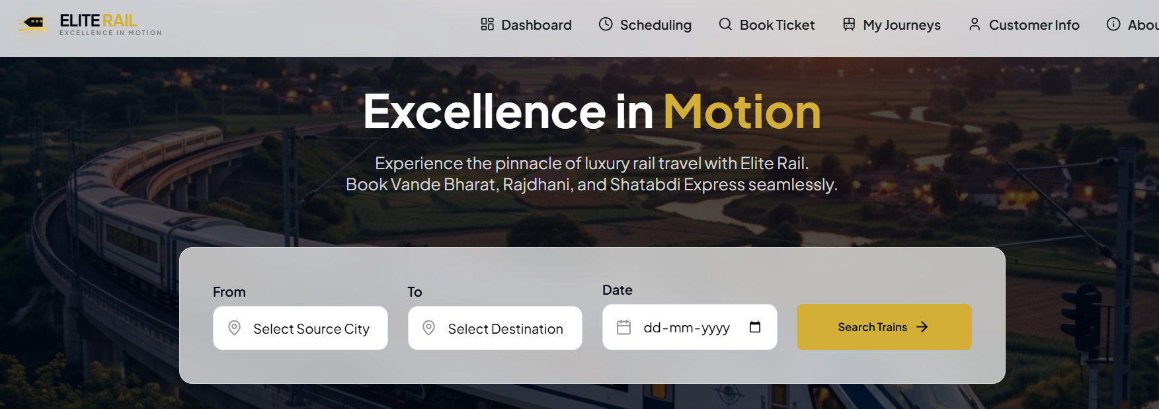
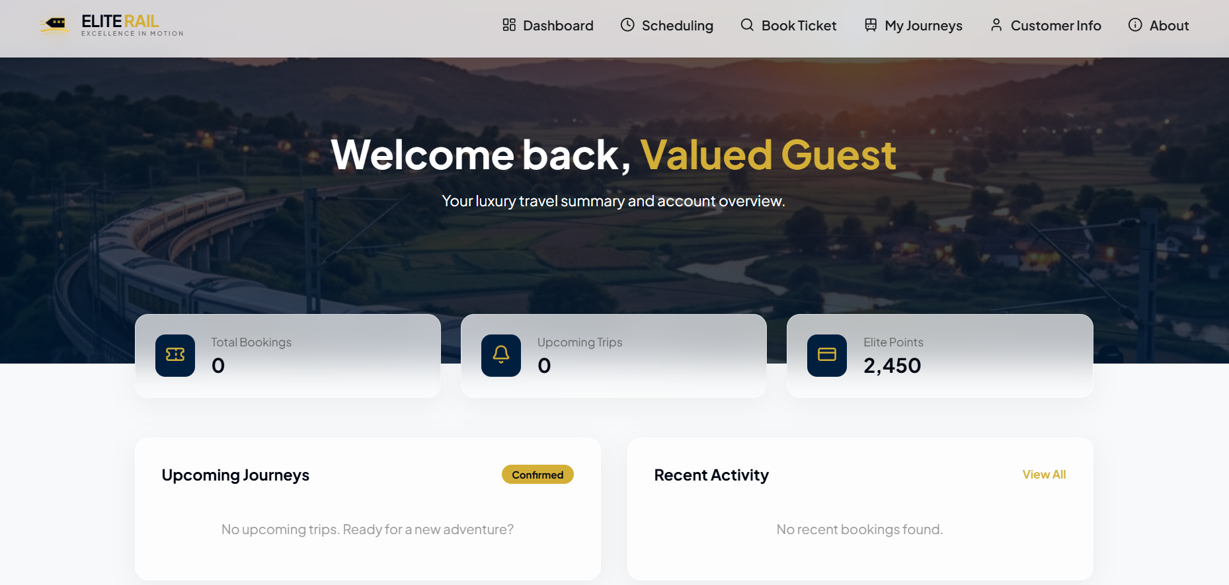
ELITE RAIL - ONLINE RAILWAY BOOKING
B24CSL49
CHAPTER 4 - RESULT
4.1 SNAPSHOTS
Fig.3.1: Home Page – Train Search and Routes
Fig.3.2: User Dashboard and Quick Profile Details
22 | P a g e
D e p t . o f C S E

Slide 30
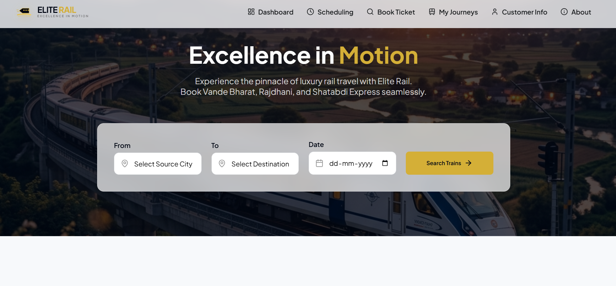
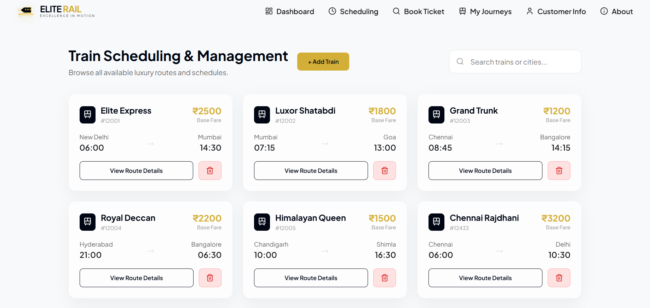
ELITE RAIL - ONLINE RAILWAY BOOKING
B24CSL49
Fig.3.3: Home Page Full View with Hero Section
Fig.3.4: Administrative Panel – Train Scheduling Control
23 | P a g e
D e p t . o f C S E

Slide 31
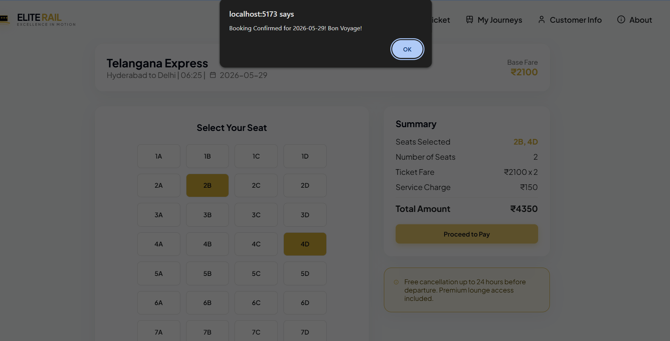
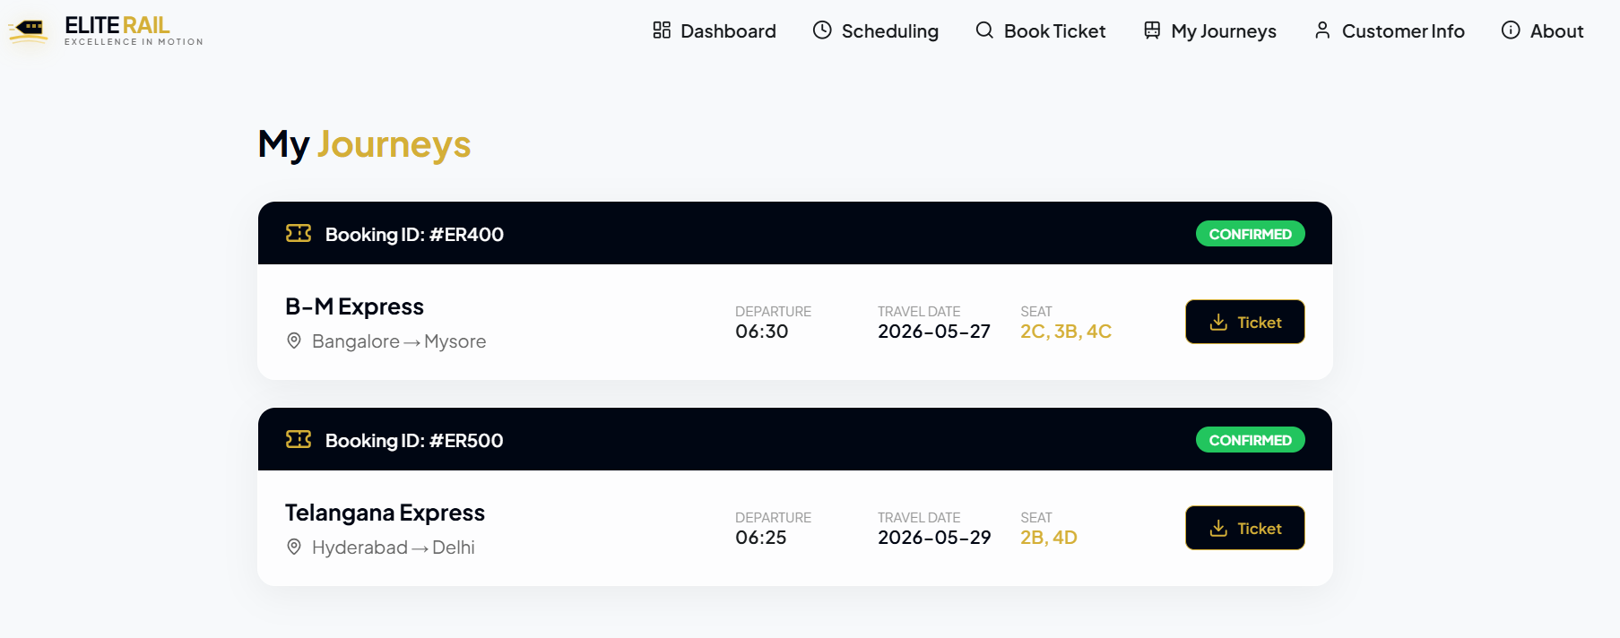
ELITE RAIL - ONLINE RAILWAY BOOKING
B24CSL49
Fig.3.5: Interactive Visual Seat Selection Grid
Fig.3.6: User My Journeys History and Status Tracker
24 | P a g e
D e p t . o f C S E

Slide 32
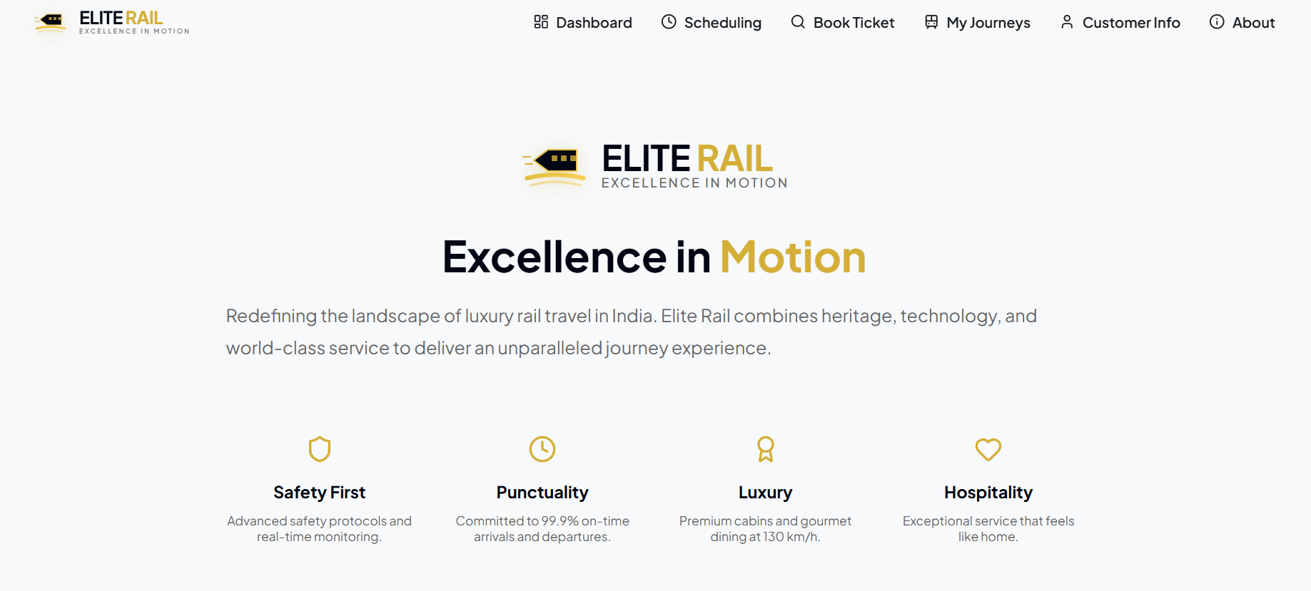
ELITE RAIL - ONLINE RAILWAY BOOKING
B24CSL49
Fig.3.7: EliteRail Glassmorphic About Page Section
25 | P a g e
D e p t . o f C S E

Slide 33
ELITE RAIL - ONLINE RAILWAY BOOKING
B24CSL49
CHAPTER 5
CONCLUSION AND FUTURE ENHANCEMENT
5.1 CONCLUSION
The Elite Rail Online Railway Booking System is a web-based database application that successfully demonstrates the high-performance integration of modern web technologies with relational database design principles. By designing a highly normalized SQLite schema (satisfying BCNF) and implementing strict referential foreign key constraints, we have eliminated data redundancy, preserved database integrity, and optimized overall query performance.
Key DBMS and Relational concepts demonstrated in this project include:
→ Entity-Relationship (ER) modeling representing real-world booking processes.
→ Structured SQL Data Definition Language (DDL) with cascading triggers and checks.
→ High-performance SQL Data Manipulation Language (DML) utilizing subqueries and JOINs.
→ Schema Normalization rules eliminating data insertions and deletion anomalies.
→ SQLite custom triggers enforcing strict booking concurrency controls.
→ Pre-compiled Database Views simplifying reporting on active bookings.
Ultimately, this project represents a scalable, robust, and highly functional demonstration of database-driven system development for modern railway operations.
26 | P a g e
D e p t . o f C S E

Slide 34
ELITE RAIL - ONLINE RAILWAY BOOKING
B24CSL49
5.2 FUTURE ENHANCEMENTS
While the current implementation operates robustly, several features can be added in future iterations to enhance system capabilities:
Mobile Application Development: Developing a cross-platform Android/iOS mobile application using React Native to offer on-the-go seat bookings and digital tickets.
Secure Online Payment Integration: Adding payment APIs (Razorpay, UPI, or Stripe) to enable secure online fare processing and real-time transaction tracking.
Real-Time WhatsApp & SMS Alerts: Configuring immediate SMS or email notifications for booking confirmations, cancellations, and train status updates.
Live Train Location Tracking: Integrating GPS trackers to offer passengers live geographical mapping and arrival estimations.
AI-Based Smart Recommendations: Deploying machine learning models to suggest optimal train routes and itineraries based on user travel histories.
27 | P a g e
D e p t . o f C S E

Slide 35
ELITE RAIL - ONLINE RAILWAY BOOKING
B24CSL49
REFERENCES
1] Ramez Elmasri and Shamkant B. Navathe, "Fundamentals of Database Systems", 7th Edition, Pearson Education, 2016.
2] W3Schools SQL & JavaScript Tutorials – https://www.w3schools.com/sql/ and https://www.w3schools.com/js/
3] SQLite 3 Official Relational Documentation – https://www.sqlite.org/docs.html
4] Node.js & Express.js Developer Manuals – https://nodejs.org/en/docs/ and https://expressjs.com/
5] React.js Frontend Official Documentation – https://react.dev/reference/react
6] better-sqlite3 Database Package Reference – https://npmjs.com/package/better-sqlite3
7] MDN Web Relational Databases and SQL Guides – https://developer.mozilla.org/
8] GitHub Collaborations and Version Controls – https://docs.github.com/
9] Claude AI / ChatGPT Reference System Assistants – https://claude.ai and https://chatgpt.com
28 | P a g e
D e p t . o f C S E

