Slide 1
Puducherry_Police_Hackathon
NEXUS_ALPHA
Problem Statement Title- Intelligent Proposal Management & Precedent Retrieval System
Theme - AI-enabled proposal management
Institution - MVIT, Puducherry
Team Name - NEXUS

Slide 2
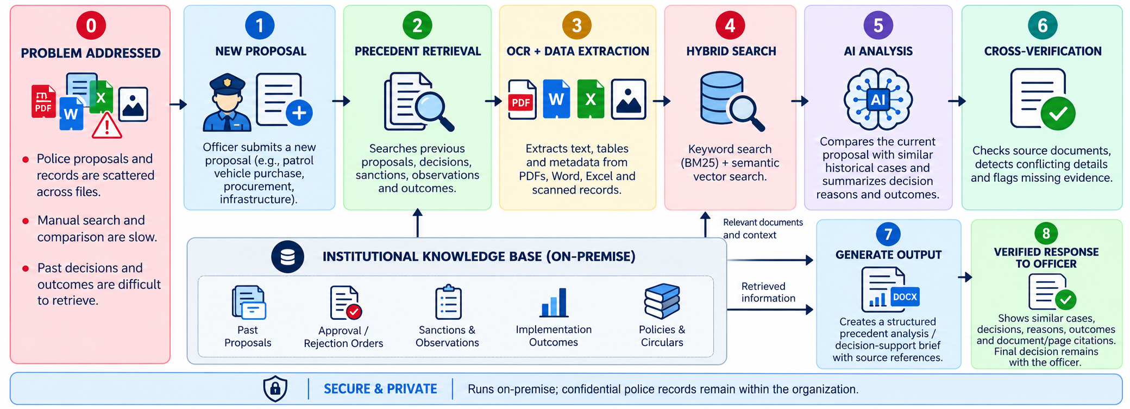
ARIA-IPMPRS: Offline Proposal & Precedent AI
Problem:
Proposals on administrative, technical, procurement and training matters sit across scattered files and departments.
Officers cannot quickly tell whether a similar proposal was already approved, rejected, modified or implemented.
Manual searching causes duplicate proposals and inconsistent decisions.
Knowledge stays with individual officers and is lost on transfers.
No single system tracks a proposal from creation to closure with precedents.
Proposed Solution:
End-to-End Proposal Lifecycle — Tracks each proposal from draft to closure with status history and audit trail.
Precedent Retrieval — Finds similar past proposals with outcome, deciding authority and reasoning.
Live Drafting Assistant — Shows precedents and duplicate alerts while the officer is drafting.
100% Local / Offline AI — Documents, queries and decisions stay within Police infrastructure.
Evidence-Based Search (English & Tamil) — Every result is traced to its source document and page.
Innovation & Uniqueness:
Precedent Intelligence — Explains why past proposals are similar and how they were decided.
Evidence Provenance — Cites the source document, page and decision note for every suggestion.
Contradiction Detection — Flags clashes with earlier decisions for human review, not guesses.
Duplicate & Rejection Alerts — Warns if a similar proposal is active or was rejected before.
Institutional Memory — Turns historical files into a searchable precedent archive.
Puducherry Police Hackathon 2026
2

Slide 3
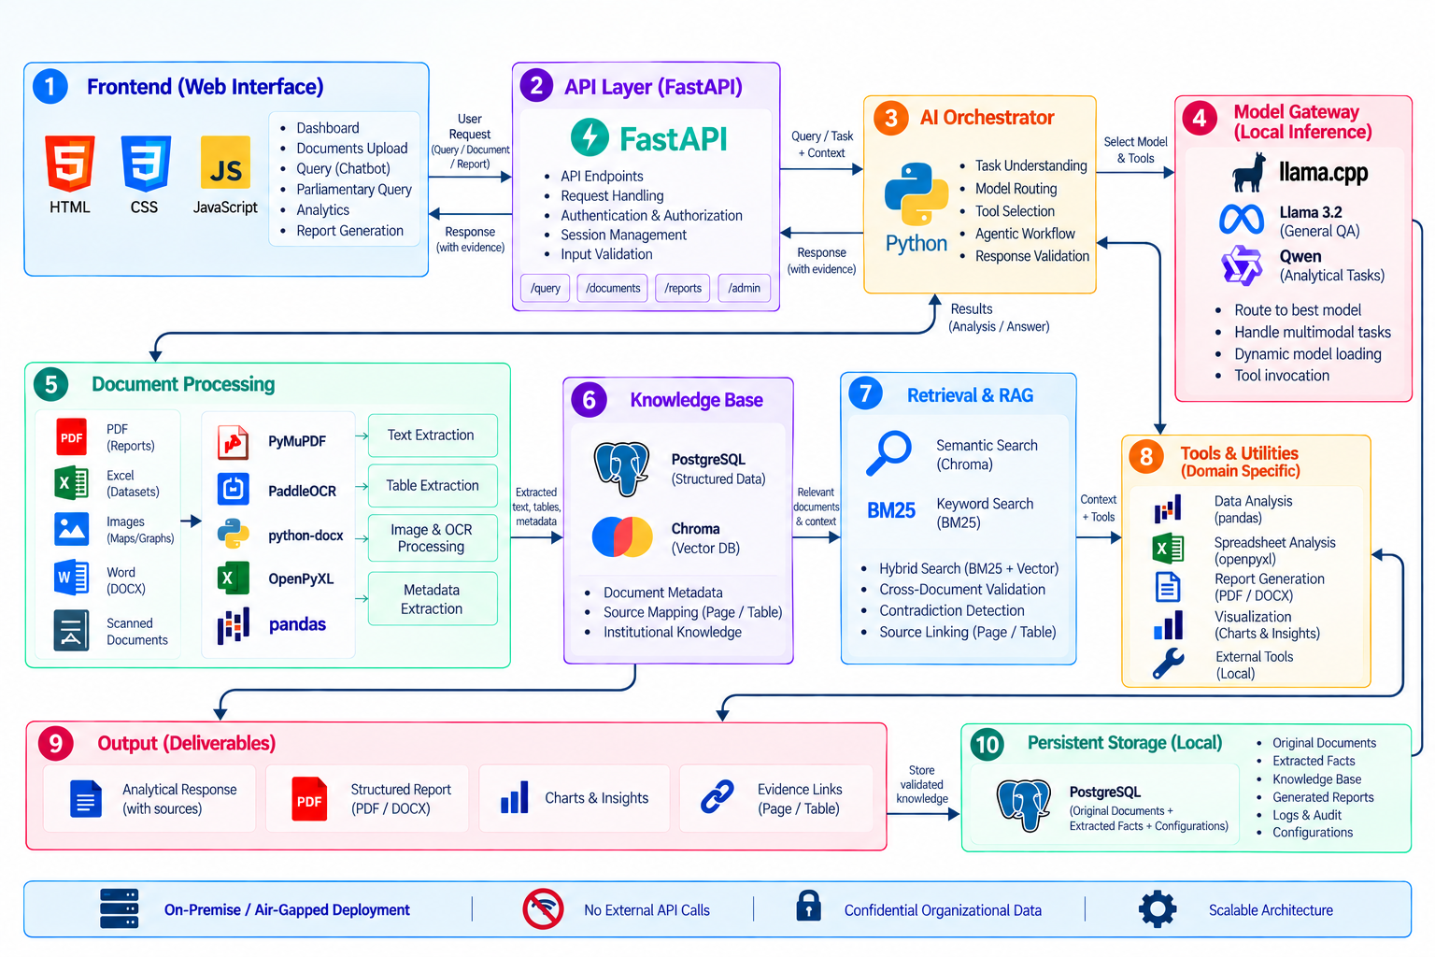
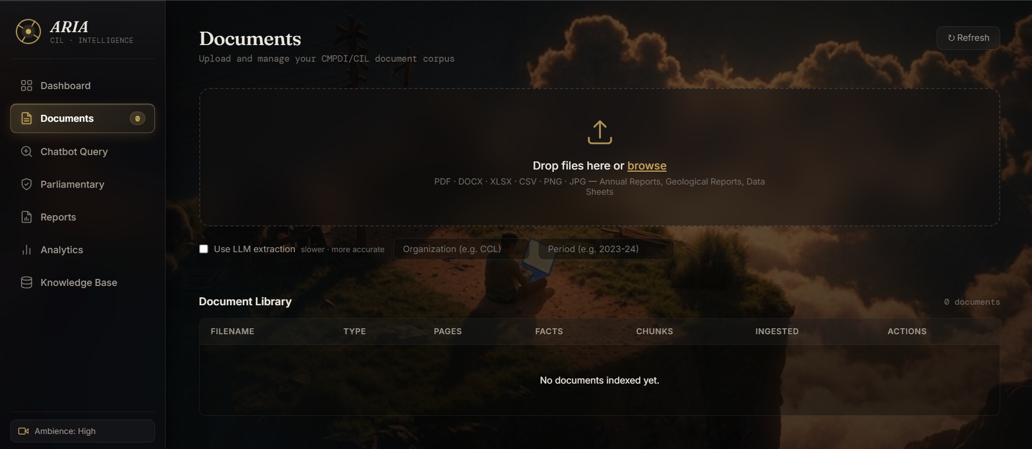
TECHNICAL APPROACH
Proposed Technical Stack
AI / Models
Open-weight LLMs — Llama / Qwen
Local Vision & OCR models
Multilingual embeddings (EN / Tamil)
Similarity & explanation models
Backend / AI Orchestration
Python + FastAPI
Proposal workflow & audit engine
Model Router; llama.cpp inference
Knowledge & Data
PostgreSQL — proposals, decisions
FAISS / Chroma — vector index
BM25 + Vector Search — Hybrid RAG
Metadata filters & provenance store
Document Processing
PaddleOCR
python-docx , PyMuPDF , Openpyxl
Pandas
Frontend
Role-based views: HTML, CSS, JS
Security & Infrastructure
Role-based access & audit log
Private / Air-Gapped Network
Working Prototype:
The prototype demonstrates proposal workflow, precedent search, live drafting alerts, source-cited explanations and offline AI for Puducherry Police proposals.
3
Puducherry Police Hackathon 2026

Slide 4
FEASIBILITY AND VIABILITY
Feasibility:
Open-weight LLMs, embeddings and OCR run on a single local machine (e.g. via Hugging Face).
Existing technologies support LLMs, OCR, RAG and workflow automation.
PyMuPDF, PaddleOCR and python-docx handle the PDF, scanned and Word files police units use.
Modular design lets new proposal categories, departments and models be added without redesign.
Hybrid retrieval combines exact matches (file numbers, names, amounts) with semantic similarity.
Viability:
Protects sensitive police data through local/on-premise AI processing.
Cuts time spent searching old files and reduces duplicate or repeatedly rejected proposals.
Builds a centralized institutional memory from historical and current proposals.
Supports faster, consistent and better-justified decisions backed by precedent.
Scales from a single unit → district → department-wide deployment.
Challenges | Solution to Overcome
GPU/RAM limitations | Use quantized models and dynamic loading to optimize resources.
AI hallucinations | Ground responses with local RAG, verification and human review.
Conflicting past decisions | Flagged side by side for human review, never auto-resolved.
Similar wording, different intent | Hybrid search + metadata filters; officer confirms.
No real police records | Synthetic proposal set now; real archives ingested later.
Complex / poor-quality documents | Combine OCR + Vision, preprocessing and validation.
Puducherry Police Hackathon 2026
4

Slide 5
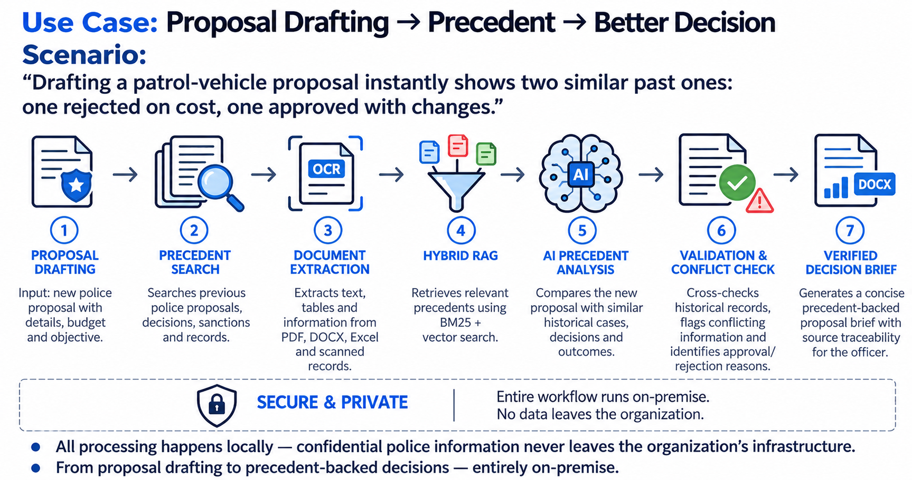
IMPACT AND BENEFITS
Potential Impact
Police Headquarters / Departments — faster, better-informed decisions on proposals.
Reviewing & Approving Officers — instant precedents and past reasoning.
Proposal Initiators — fewer rejections, gaps fixed early.
Administration — standardized handling and clear status tracking.
Organization — preserved institutional knowledge with secure offline AI.
Use Case: Drafting → Precedent → Better Decision
Scenario:
“Drafting a patrol-vehicle proposal instantly shows two similar past ones: one rejected on cost, one approved with changes.”
Benefits
Faster Reviews — reduces time spent searching files and preparing proposals.
Fewer Duplicates — avoids repeating proposals that were already decided.
Secure AI Processing — keeps sensitive police data within the local infrastructure.
Consistent Decisions — precedent-backed outcomes with source-level traceability.
Preserved Institutional Knowledge — makes past proposals searchable and reusable.
Improved Accuracy — identifies conflicts with earlier decisions.
All processing happens locally — confidential police information never leaves the organization's infrastructure.
From scattered files to precedent-backed decisions — entirely on-premise.
Puducherry Police Hackathon 2026
5

Slide 6
RESEARCH AND REFERENCES
Research & References:
Puducherry Police Hackathon 2026 — Problem Statement 01: IPMPRS (problem definition and scope).
NIC e-Office — Government file and proposal management practices.
BM25 + Dense Retrieval — Hybrid keyword and semantic search for precedent matching.
Multilingual Sentence Embeddings — Semantic similarity for English and Tamil text.
Technical References:
FAISS – Facebook AI Research — Dense-vector similarity search and retrieval.
PaddleOCR – Official Repository — OCR, document parsing and table recognition.
PyMuPDF Documentation — PDF extraction and processing.
python-docx Documentation — Automated Word-document generation.
OpenPyXL Documentation — Excel processing and structured-data extraction.
Future Improvements:
Confidence Firewall — automatically flags uncertain or high-risk suggestions for human review.
Evidence Integrity — stores cryptographic hashes of proposals and decisions to detect tampering.
Organizational Memory Graph — links proposals to decisions, budgets, equipment and outcomes.
Outcome Prediction — estimates approval likelihood and common rejection reasons from precedent.
Voice Queries (Tamil / English) — uses ARIA's offline speech pipeline for hands-free search.
Multi-Unit Deployment — securely extends the system across police stations and units.
Puducherry Police Hackathon 2026
6

