Slide 1



CLOUD COMPUTING
MEDIA STREAMING WITH
IBM CLOUD STREAMING
BY:
v. Jeevan prakash

Slide 2
Project Description:
Creating a multimedia streaming application using IBM Cloud Video Streaming that offers an enhanced user experience by incorporating advanced features and customization options.
The project involves creating a virtual cinema platform using IBM Cloud Video Streaming. The objective is to build a platform where users can upload and stream movies and videos on-demand.
This project encompasses defining the virtual cinema platform, designing the user interface, integrating IBM Cloud Video Streaming services, enabling on-demand video playback, and ensuring a seamless and immersive cinematic experience for both content creators and viewers.

Slide 3
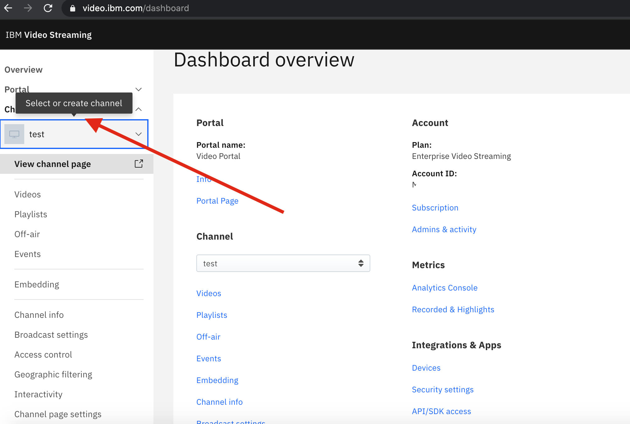
Phase II
Step 1: Creating a streaming channel by using IBM cloud service.
Step 2: Prepare your media content for streaming, ensure that content is in a compatible format.
STREAMING VIDEO TECHNOLOGIES:
CONVERTING ANALOG TO VIDEO SIGNALS AND COMPRESS THE DATA
DIGITAL VIDEO DEVICES THAT CAN CAPTURE IMAGE AND TRANSER TO LA COMPUTER.
Streaming audio technologies relies on:
Sound sequences
Compression scheme

Slide 4
AUDIO FORMAT:
MICROSOFT WINDOWS MEDIA FORMATS
.AVI, .ASF,.ASX,.RMI,.WAV
MOVING PICTURE EXPERTS GROUP(MPEG)
.MP3
MUSICAL INSTRUMENTS DIGITAL INTERFACE(MIDI)
.MID,.RMI
APPLE QUICK TIME MACINTOSH AIFF RESOURCE
.QT,.AIF,.AIFC,.AIFF,.MOV
UNIX FORMATS
.AU,.SND

Slide 5
VIDEO FORMAT AVI & ASF:
DEVELOPED BY MICROSOFT
AVI (AUDIO VIDEO INRELEAVED)
-LIMITED TO 320X240 RESOLUTION
-30 FRAMES PER SECOND
ASF (ADVANCED STREAMING FORMAT)
-HAS BEEN SUBMITTED TO ISO FO STANDARDIZATION
-EXPECTED TO REPLACE AVI FORMAT

Slide 6

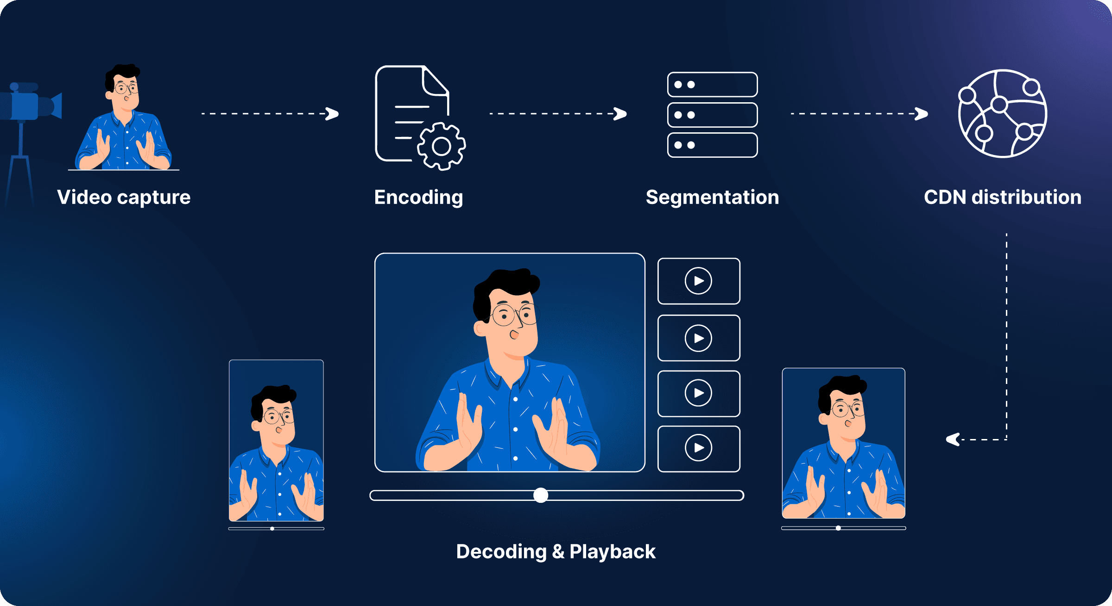
Step 3: Whether the streaming is live or on-demand.
Step 4: Setup encoding and transcoding to ensure that media content is delivered.

Slide 7
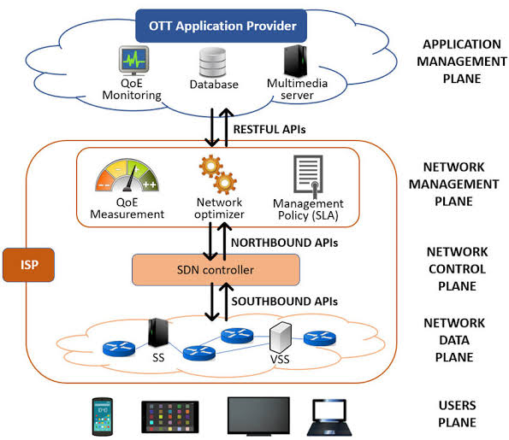
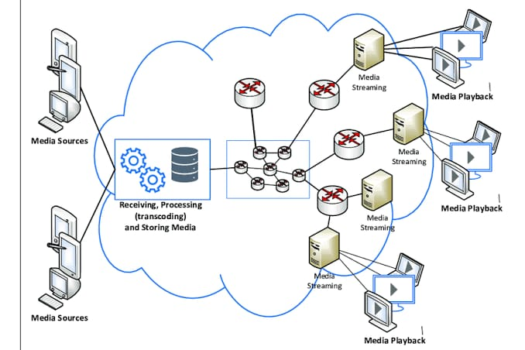
ARCHITECTURE:

Slide 8
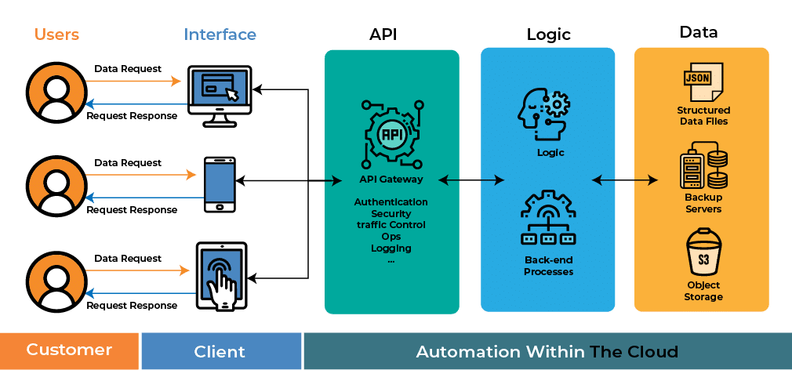
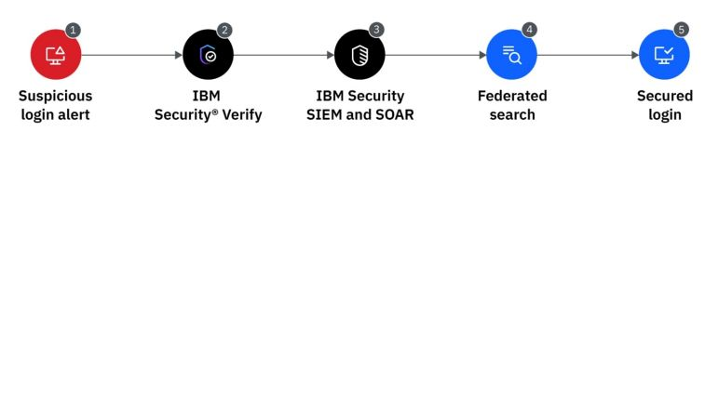
Step 5: Integrate with streaming APIs and SDK into application or website.
Step 6: Implementing required security features.

Slide 9
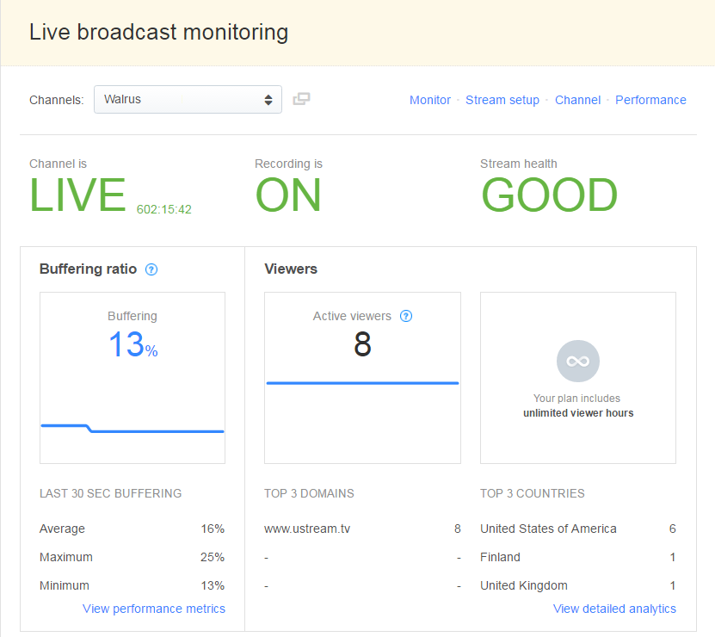
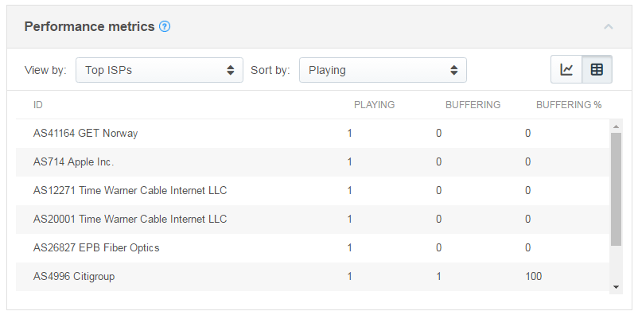
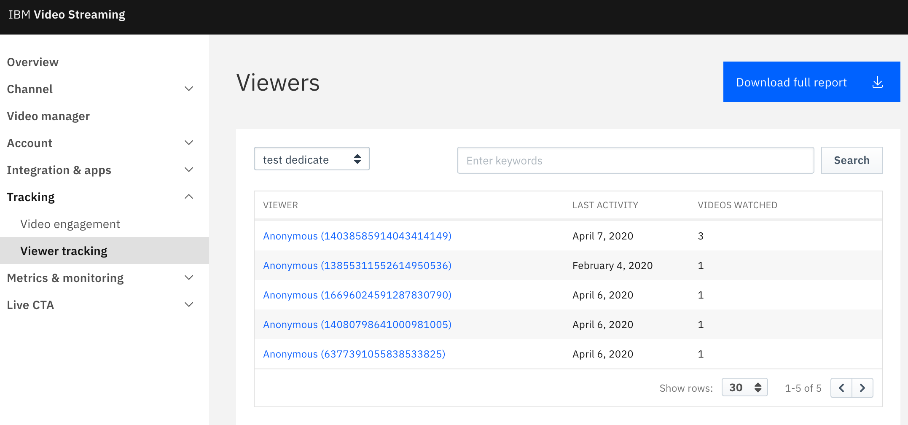
Step 7: Set up monitoring and analytics to track the performance of the streaming service.
Step 8: Testing the streaming setup.

Slide 10
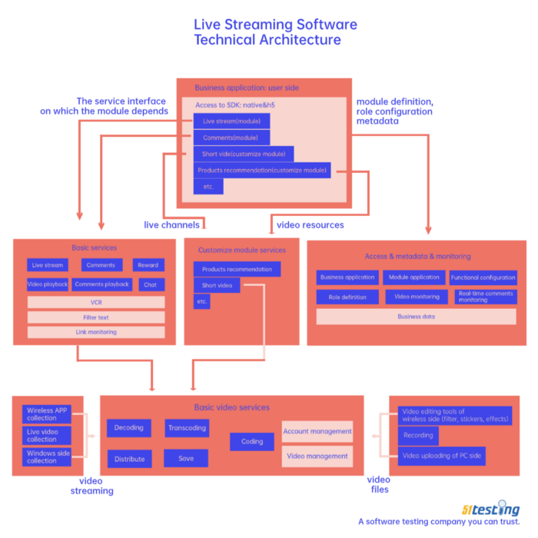
Step 9: Accommodate viewers for the streaming service.
Step 10: Provide user guidelines, once again setup and test streaming project and regularly monitor and maintain streaming service.

Slide 11
Conclusion
the development of a cloud-based live event streaming platform utilizing IBM Cloud Streaming services offers a compelling solution for event organizers and viewers alike. This project combines cutting-edge technology with user-centric features to create an efficient and engaging platform. By focusing on user registration, event management, secure and high-quality streaming, monetization, user experience, analytics, security, and mobile access, this platform addresses the diverse needs of both content creators and consumers.

