Slide 1



CLOUD COMPUTING
MEDIA STREAMING WITH
IBM CLOUD STREAMING
by: M. Deneshwaran

Slide 2
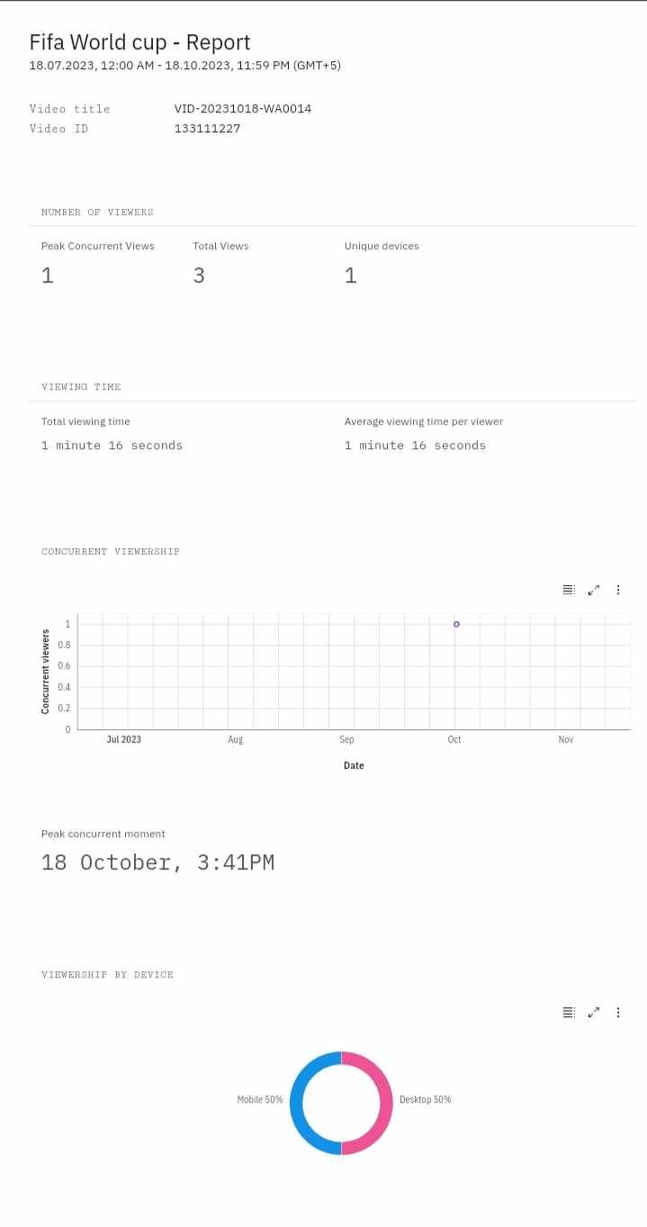
Phase iii

Slide 4
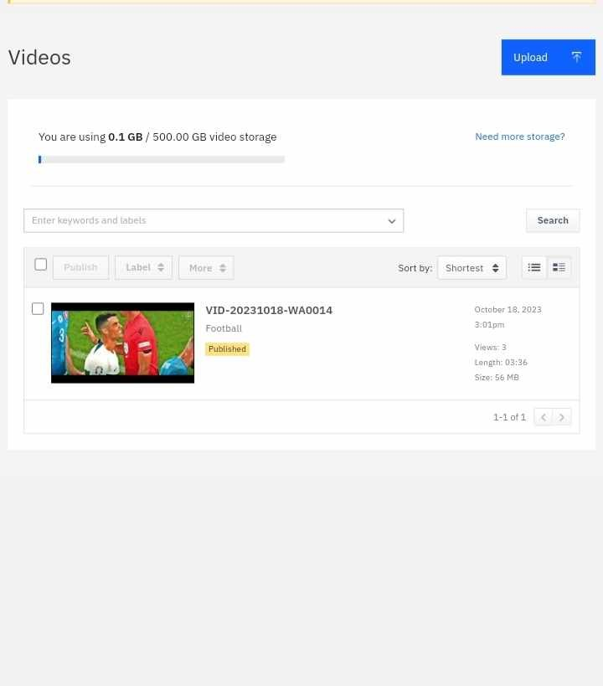

Slide 5
