Slide 1

AC Analysis
Web scrapping project
Presented By :
Komminni Jeevana Sri
Dasari Pravallika

Slide 2
Introduction
The dataset contains detailed information about various Air Conditioner (AC) models from different brands.
Each record represents one AC product with its price, features, ratings, and technical specifications.
Includes important columns such as Product Name, Price, Original Price, Discount, Ratings, Reviews, Brand, Launch Year, Tons, and Star Rating.
Provides data on annual power usage and recommended room size, helping to evaluate energy efficiency.
Combines product specifications with customer feedback metrics like number of ratings and reviews.
Useful for comparing AC performance, cost, and brand popularity.
Helps analyze the relationship between price, energy efficiency, and customer satisfaction.
Suitable for exploratory data analysis, brand comparison, and market trend analysis in the AC industry.

Slide 3
Data Overview
The dataset contains 984 Air Conditioner (AC) product records collected from an online marketplace.
It includes 17 columns covering product details, pricing, technical specifications, energy efficiency, and customer feedback.
Each row represents one unique AC model, enabling accurate product-level comparison.
Data was gathered from 41 pages with 24 products per page, ensuring variety across brands and price ranges.
Key information includes Product Name, Brand, Price, Original Price, Discount, Ratings, Reviews, Tons, Star Rating, and Features.
Combines technical features (power usage, room size, tonnage, energy stars) with customer engagement metrics.
Suitable for EDA, brand comparison, price vs performance analysis, and energy efficiency evaluation in the AC market.

Slide 4
Key Columns Overview
Product_name – Name and model details of the AC.
Brand – Manufacturer of the AC (Daikin, Haier, Voltas, MarQ, etc.).
Price – Current selling price of the AC.
Original_Price – Actual listed price before discount.
Discount / Discount(%) – Price reduction offered on the product.
Ratings – Average customer rating given to the AC.
No_of_Ratings – Total number of customers who rated the product.
No_of_Reviews – Total written reviews by customers.
Features – Technical details like annual power usage and recommended room size.
Tons – Cooling capacity of the AC (room size suitability).
Stars – Energy efficiency rating (power consumption indicator).

Slide 5
Problem Statement
The objective of this analysis is to understand the performance, pricing, and energy efficiency of different Air Conditioner (AC) models by examining key attributes such as price, discount, ratings, reviews, brand, tonnage, star rating, and technical features. The dataset helps identify how these factors vary across products and influence customer preference and market popularity.

Slide 6







Tools & libraries

Slide 7
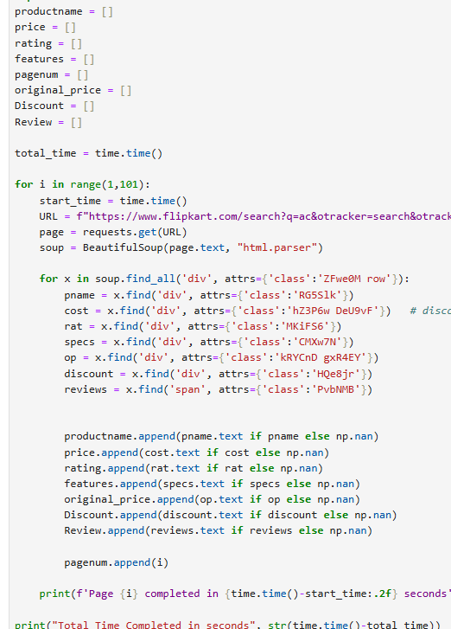
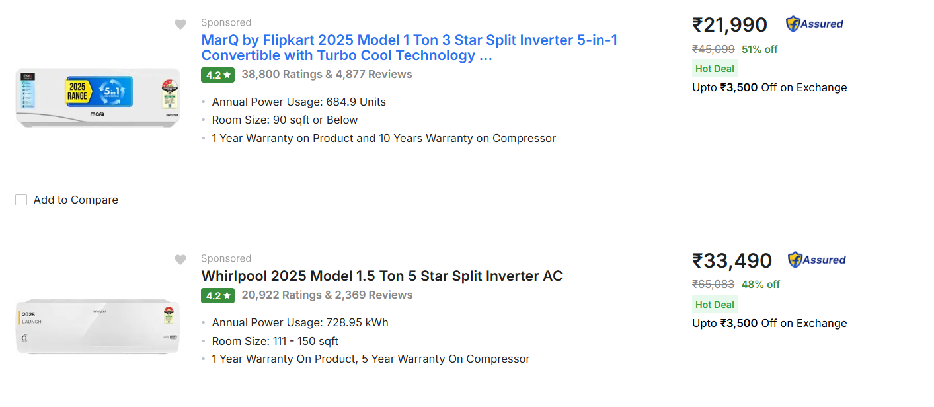
Web Scrapping
Used an online Flipkart product review and listing website as the primary data source and identified required HTML elements using the browser Inspect Element feature.
Followed the Client–Server architecture, where the client (Python script) sent HTTP requests and the web server responded with raw HTML webpage data.
Extracted company-related information such as company name, ratings, reviews, Price, Discount, Warranty, stars, Power usage, and offer details using Requests and BeautifulSoup.
Cleaned, structured, and stored the extracted data in Pandas DataFrames for further analysis.

Slide 8
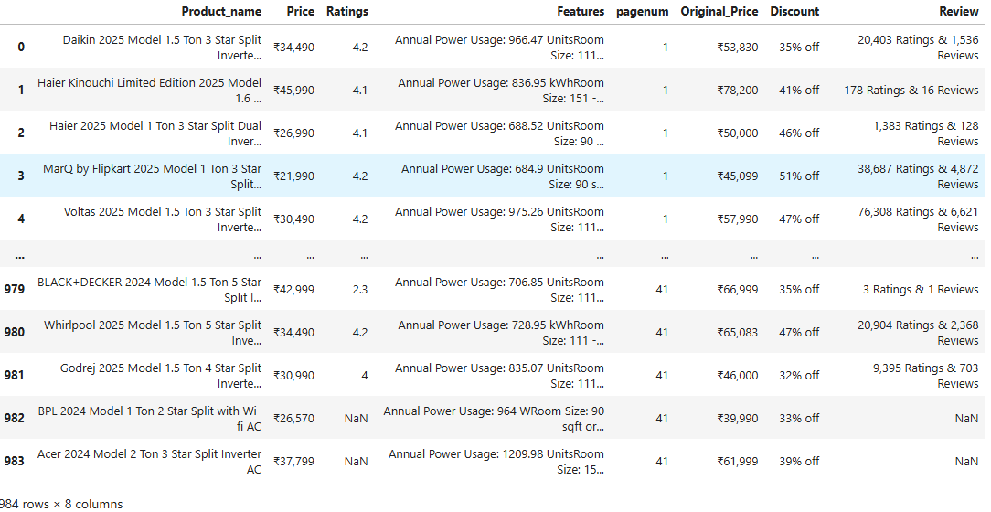
Raw Data Set

Slide 9


Loading to CSV
DataFrame is exported to a CSV file for storage and reuse
CSV format allows easy data sharing and portability
The saved CSV is reloaded into Python for further analysis
Data Reading

Slide 10
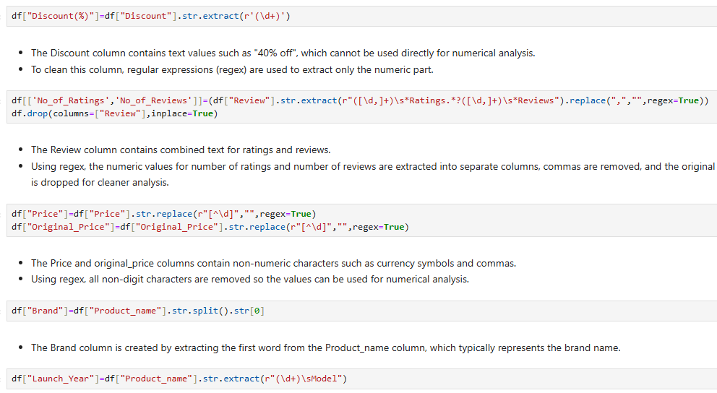
Data Cleaning Using Regex
Text values were converted into numeric format for Discount, Price, and Original Price to enable analysis.
Ratings and reviews were separated into individual columns for clearer insights.
Unnecessary symbols and commas were removed .
Brand and launch year were extracted from product names for better categorization.
Redundant columns were removed to keep the dataset clean and efficient.

Slide 11
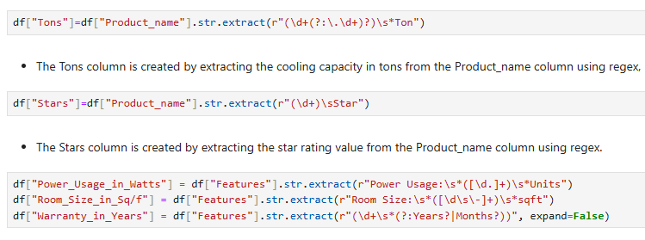
Cooling capacity (Tons) and star rating (Stars) were extracted from product names for technical comparison.
Power usage, room size, and warranty details were extracted from feature text using regex.
Text-based specifications were converted into structured columns for analysis.
Feature engineering improved dataset usability and enabled deeper product insights.

Slide 12
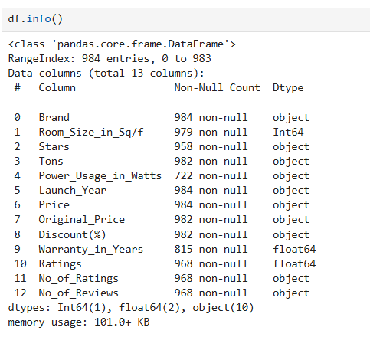
Data Structure
All columns contain 984 data points, indicating a fairly consistent dataset size across features.
The dataset includes object, integer, and float data types, representing both categorical product details and numerical measurements..

Slide 13
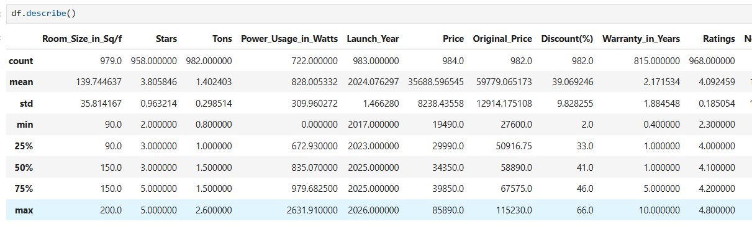
Statistics observation
Most AC models are recent (2023–2025) with strong 3–5 star efficiency
Average selling price ≈ ₹35.7K with high ~39% discount
Customer satisfaction is high with ~4.1 average rating

Slide 14
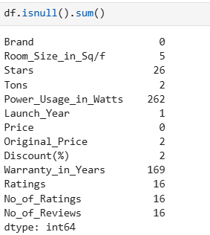
Handling Missing Values
From the null value analysis, it is observed that Power_Usage_in_Watts contains 262 missing values and Warranty_in_Years contains 169 missing values, which are the highest in the dataset.
Other columns such as Stars, Ratings, No_of_Ratings, No_of_Reviews, Room_Size_in_Sq/f, Tons, Original_Price, Discount(%), and Launch_Year have a small number of missing values.

Slide 15
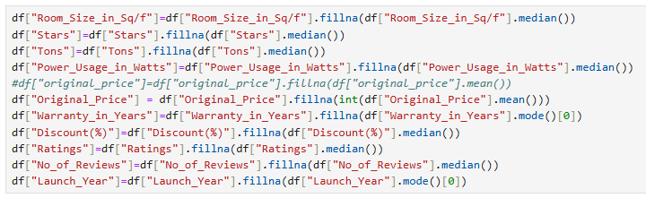
Filling Missing Values
Missing values were handled using median/mean/mode to preserve data distribution
Numerical columns were imputed with median to reduce outlier impact
Categorical/time-based columns used mode to maintain realistic values

Slide 16
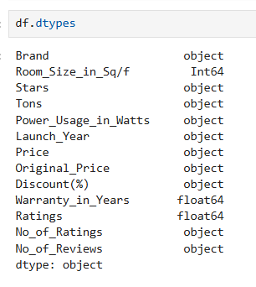
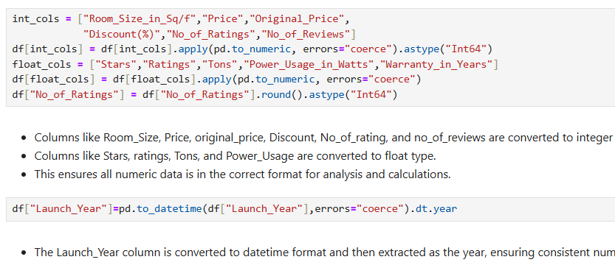
Converting Datatype

Slide 17

Duplicates
The duplicate value check shows a result of 0, indicating that no duplicate records are present in the dataset.
This confirms that each row represents a unique entry, and no duplicate data cleaning is required before analysis.

Slide 18
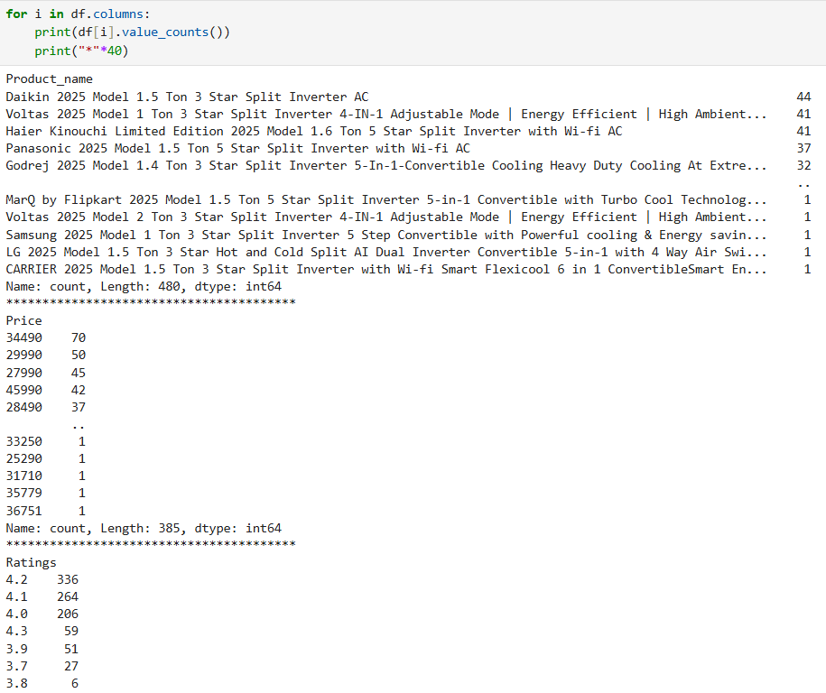
Unique Values
Displays all unique values present in each column
Helps understand data categories and encoding
Identifies binary, categorical, and numerical features

Slide 19
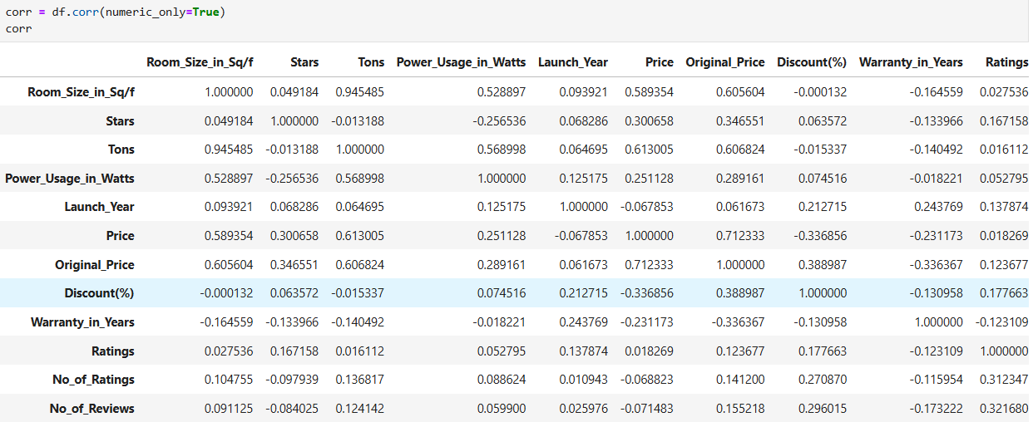
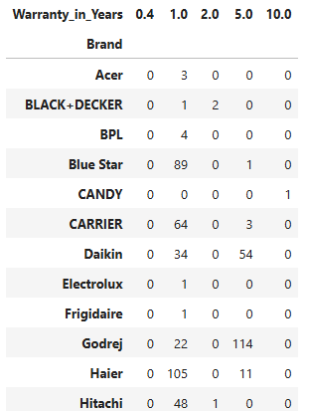
Statistical Summary
Numerical Data
Categorical Data

Slide 20
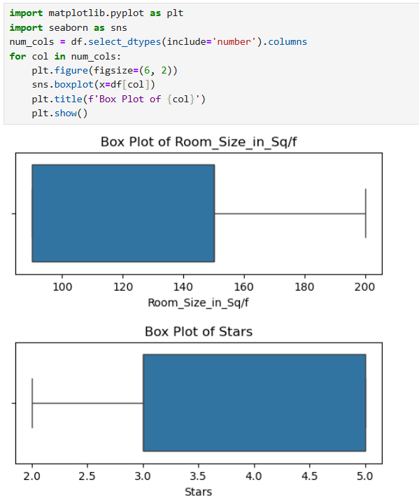
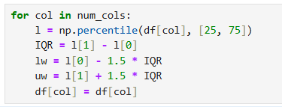
Skewness Observation
Since this is real-time / real-world data, the skewness present in features like Price, Warranty_in_Years, No_of_Ratings, and No_of_Reviews is natural and meaningful.
Removing or heavily transforming this skewness may distort the original data distribution and reduce the authenticity of the dataset.

Slide 21
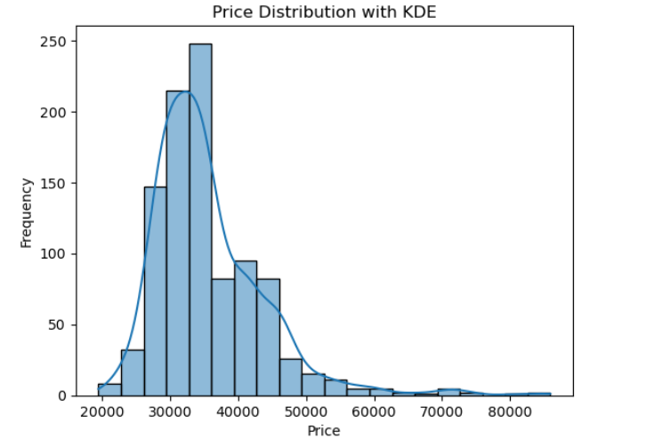
Visualization
Univariate
The price distribution plot shows that the data is not perfectly normally distributed and exhibits right skewness.
Most products are concentrated in the mid-price range (around 30,000–40,000), while a few high-priced products create a long right tail.
This indicates the presence of natural outliers in pricing, which were retained to preserve the real-world characteristics of the dataset for further analysis.

Slide 22
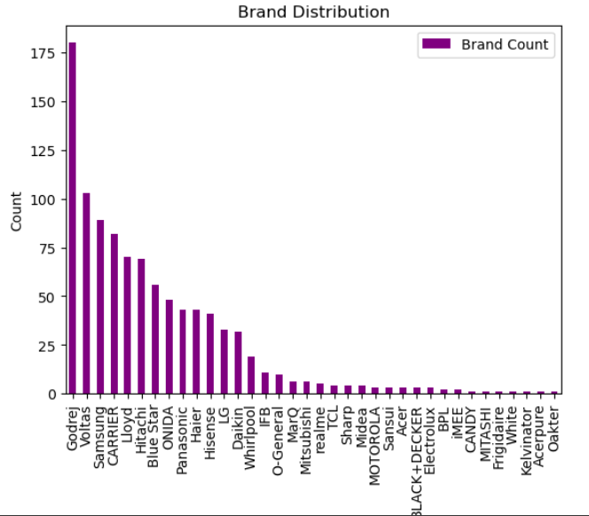
Barplot
Godrej has the highest number of products in the dataset.
A few brands like Voltas, Samsung, CARRIER, Lloyd, Haier also have strong presence.
Many brands have very low counts, showing a long tail of less-represented brands.
Distribution is highly uneven across brands.
Dataset is dominated by top 5–8 brands.
Several brands appear only once or twice.

Slide 23
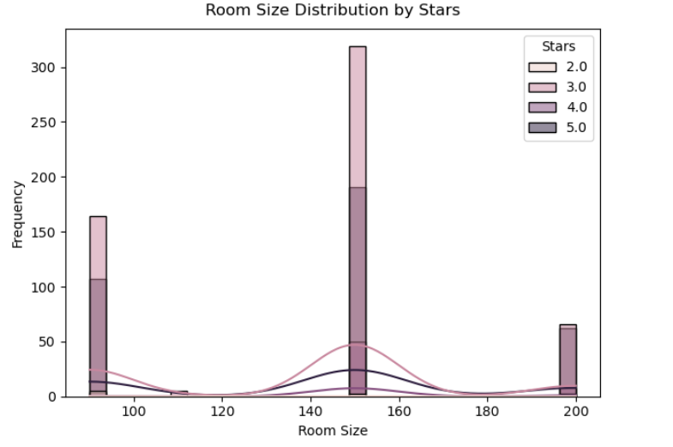
Hist Plot
Most products across all star ratings are designed for around 150 sq.ft rooms.
3-Star models have the highest frequency for common room sizes.
Room sizes around 90 sq.ft and 200 sq.ft appear less frequently.
Distribution pattern is similar across different star ratings.
Star rating does not significantly change the target room size range.

Slide 24
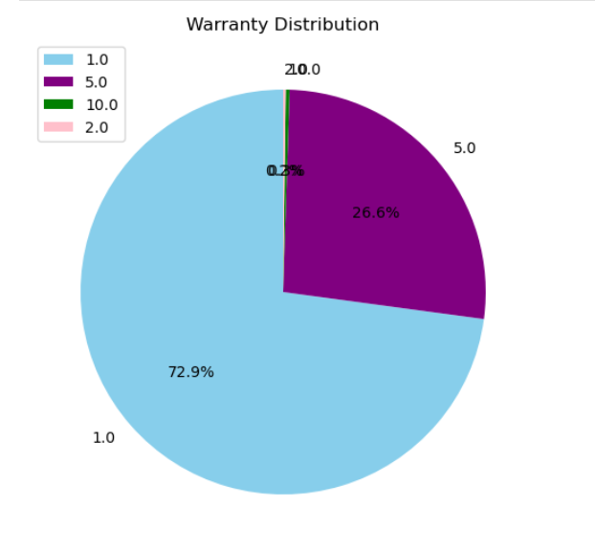
Pie Plot
Majority of products offer 1 year warranty (≈72.9%).
Around 26.6% of products provide a 5-year warranty.Very few products have 2 years or 10 years warranty (almost negligible).
The dataset is heavily concentrated on 1-year warranty products.
Extended warranties (more than 2 years) are rare in the dataset.
Warranty distribution is highly imbalanced toward shorter warranty periods.

Slide 25
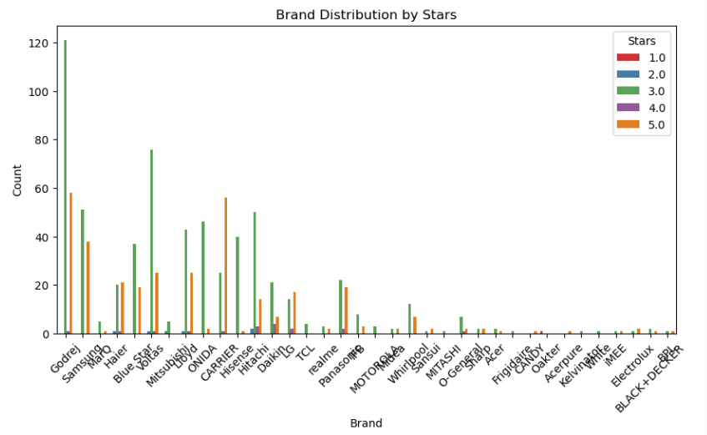
Count Plot
1-Star and 2-Star are very rare.
Top brands mainly offer 3-Star products
5-Star models are fewer than 3-Star.
3-Star models dominate across most brands.
Few brands provide 4-Star/5-Star options.

Slide 26
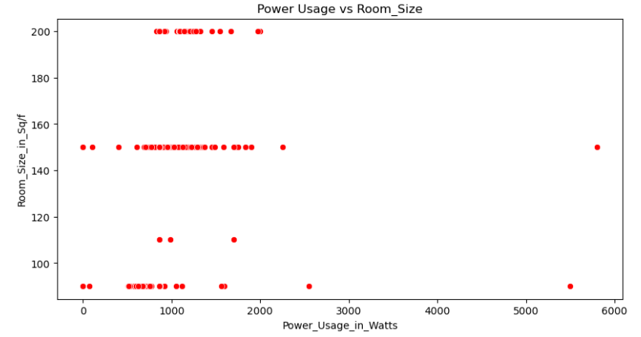
Scatter Plot
Bivariate
Most products are designed for common room sizes (90–200 sq.ft) with moderate power consumption.
A few high power outliers indicate heavy-duty models.
There is a positive relationship between room size and power usage.
Overall, power usage scales with room size but not in a perfectly linear way.

Slide 27
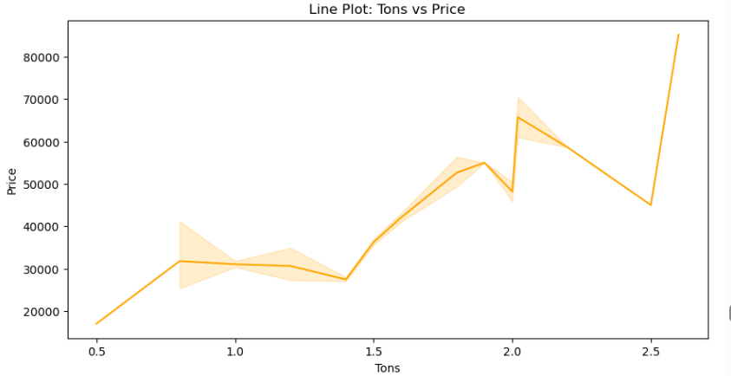
Line Plot
Clear upward trend: price rises with increase in tons.
0.5–1.2 tons fall in the lower price range.
1.5–2 tons show a noticeable price jump.
Above 2 tons are the highest priced models.
Minor fluctuations, but the overall pattern is increasing.

Slide 28
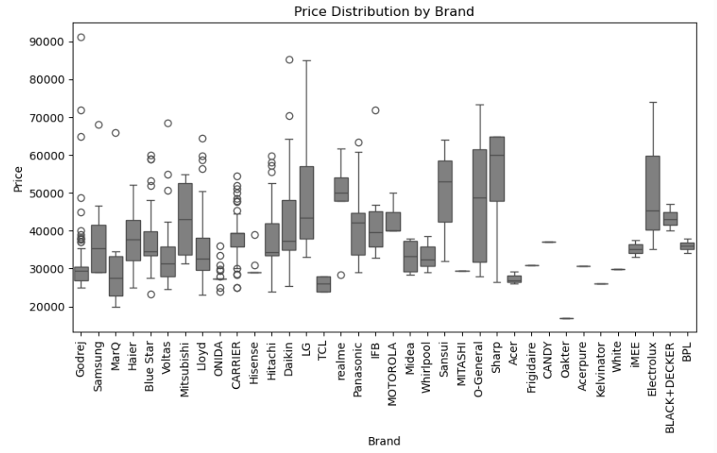
Box Plot
Prices differ widely by brand.
Some brands show higher median prices (premium).
Few brands have wide price ranges (budget to high-end).
Outliers show very high-priced models.
Brand strongly influences price.

Slide 29
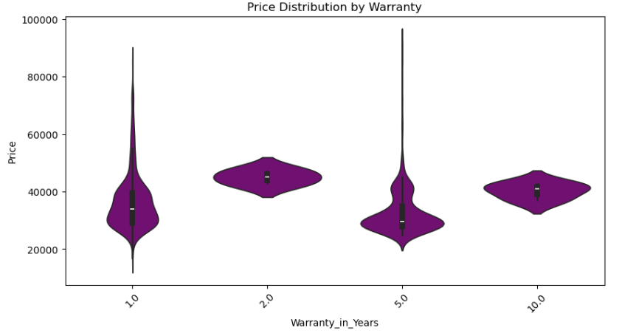
Violin Plot
Products with longer warranties tend to have higher and more consistent prices.
1-year warranty items show the widest price variation.
2-year and 10-year warranties fall in a stable mid-to-high price range.
Overall, warranty length has a noticeable influence on price.

Slide 30
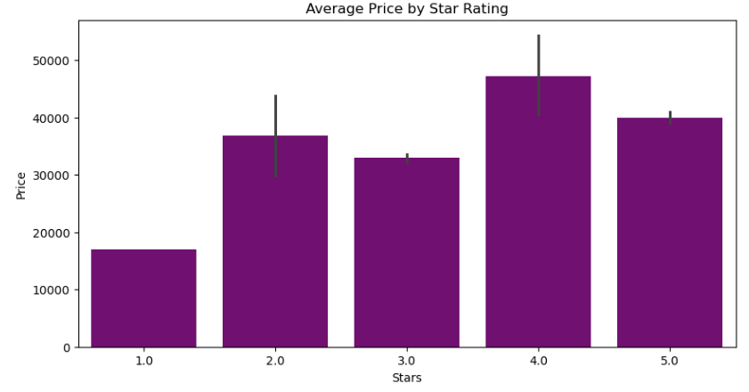
Bar Plot
4-Star models have the highest average price.
1-Star models are the least expensive.
5-Star models are slightly lower than 4-Star but still high-priced.
Average price increases with star rating overall.
Indicates better energy efficiency (higher stars) is associated with higher cost.

Slide 31
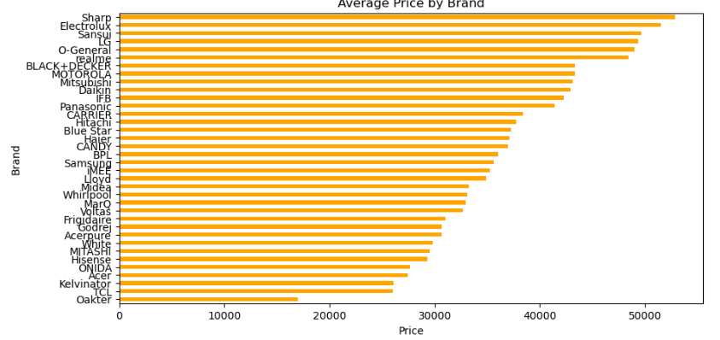
Barh Plot
Brands clearly split into premium, mid-range, and budget groups by average price.
A few brands lead the high-price (premium) segment.
Several popular brands fall in the mid-price range.
Overall, brand positioning strongly determines pricing.

Slide 32
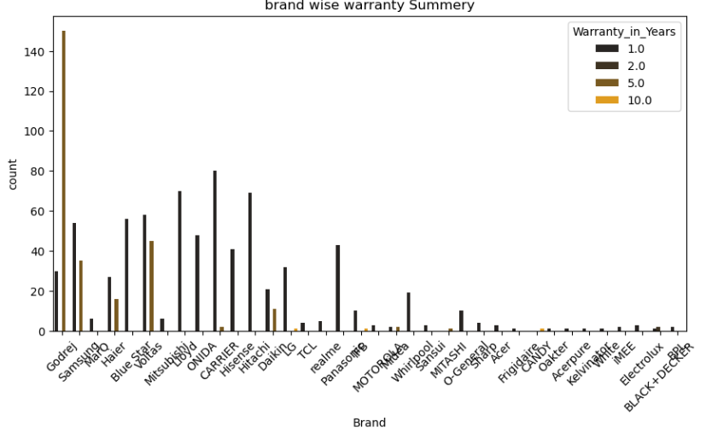
Count Plot
1-year warranty dominates for almost every brand.
Some major brands also offer 2-year and 5-year options.
10-year warranty is very rare.
Top brands show more variety in warranty periods.
Many smaller brands provide only 1-year warranty.

Slide 33
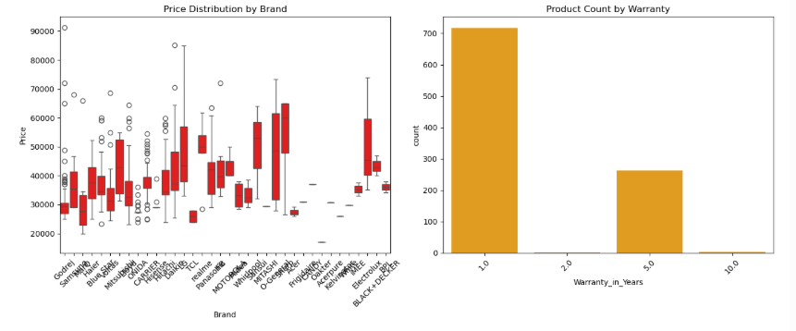
Sub Plot
Clear price variation by brand; some brands are premium, others budget.
A few brands show wide price ranges (mixed segments).
1-year warranty products dominate the count.
5-year warranty is present but much fewer.
10-year warranty is almost absent.

Slide 34
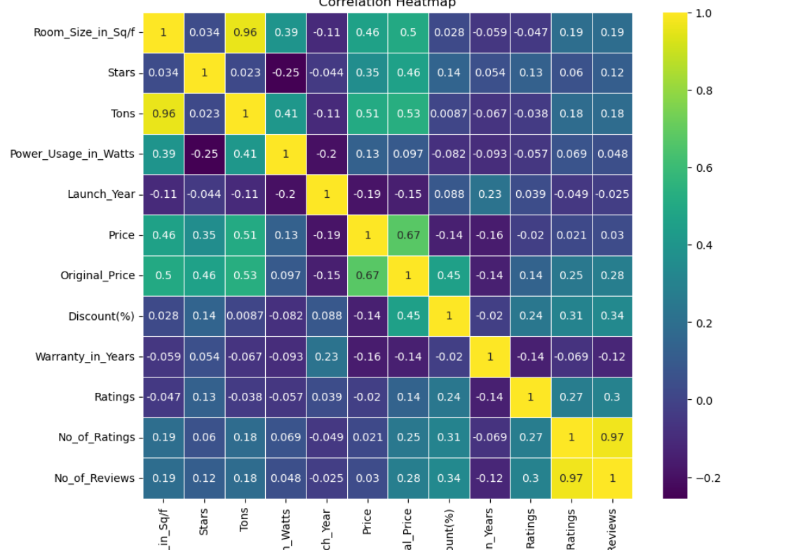
Heat Plot
Multivariate
Room Size and Tons are very strongly correlated (≈0.96).
Price has strong positive correlation with Original Price (≈0.67) and Tons (≈0.51).
Stars moderately correlates with Price and Original Price.
Discount relates more to Original Price than to final Price.
No. of Ratings and No. of Reviews are almost perfectly correlated (≈0.97).
Warranty and Launch Year show very weak correlation with most variables.
Overall, AC capacity (Tons/Room Size) and Original Price are key factors influencing Price.

Slide 35
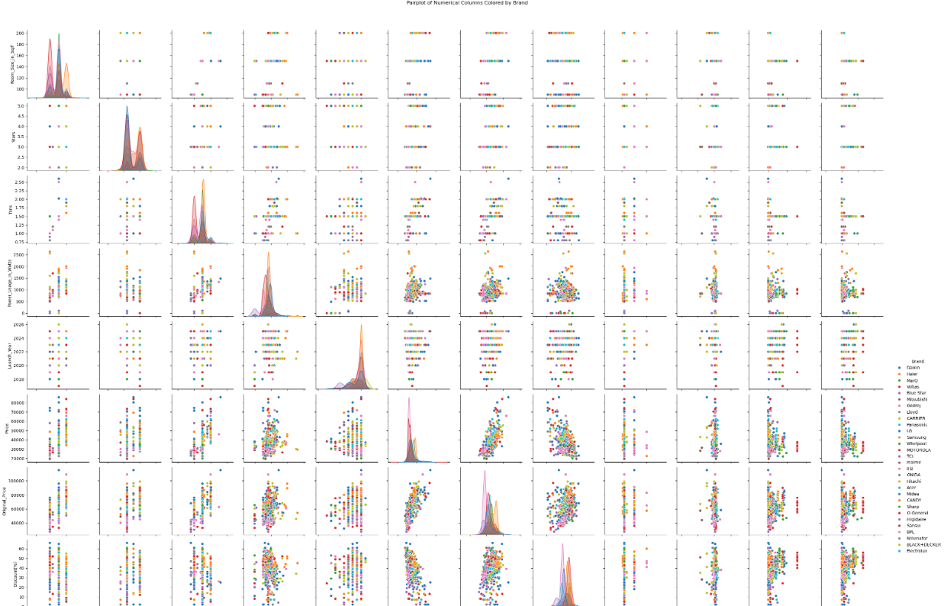
Pair Plot
Strong relationship between Room Size, Tons, and Price.
Original Price and Price move closely together.
Most brands cluster in similar ranges with some brand-specific spread.
Power usage increases with Tons/Room Size.
Ratings, reviews, and warranty show weak relationships with other variables.
Overall, capacity-related features drive most patterns in the data.

Slide 36
Summary
Dataset is dominated by a few major brands; many brands have very low counts.
Most products fall in the mid-price range (₹25k–₹40k) with some high-price outliers.
Tons and Room Size are very strongly related and are key drivers of Price.
Original Price has a strong influence on the final Price; discounts relate more to original price.
Majority of products offer 1-year warranty; longer warranties are rare.
3-Star models are most common; higher stars generally mean higher prices.
Power usage increases with room size and tons, but not perfectly linearly.
Brand positioning clearly splits products into premium, mid-range, and budget segments.
Ratings and reviews are highly correlated with each other but weakly with price/capacity.

Slide 37
Conclusion
Dataset reflects real market behavior with natural price skew and brand imbalance
Capacity (tons/room size) is the strongest predictor of price, more than ratings or warranty
Energy efficiency adds cost, but consumers prefer balanced affordability (3-Star segment)
Customer satisfaction is independent of price tier → expensive ≠ better ratings
Market competition is driven more by brand positioning than technical differences
Cleaned dataset is reliable and ready for future prediction or recommendation modeling
.

Slide 38

Thank You

