Slide 1
Smart Job Portal
Java | Hibernate | MySQL | Console-based

Slide 2
Introduction
Console-based Job Portal Application
Users can register, view and apply for jobs
Companies can register and post jobs
Built using Java (DAO pattern), Hibernate ORM and MySQL

Slide 3
Objectives
Implement a modular console application demonstrating ORM usage
Design relational schema and map entities with Hibernate
Provide CRUD operations via DAO layer

Slide 4
Tech Stack
Language: Java (JDK 8+)
ORM: Hibernate 5
Database: MySQL
Build tool: Maven
UI: Console-based with ANSI Colors
Pattern: DAO (Data Access Object)

Slide 5
System Architecture
Layered architecture:
  Presentation (MainApp, UserMenu, CompanyMenu, ConsoleUI,Color)
  DAO Layer (UserDao, CompanyDao, JobDao, ApplicationDao)
  Entity Layer (User, Company, Job, Application)
  Persistence (Hibernate, hibernate.cfg.xml)
  Database (MySQL)

Slide 6
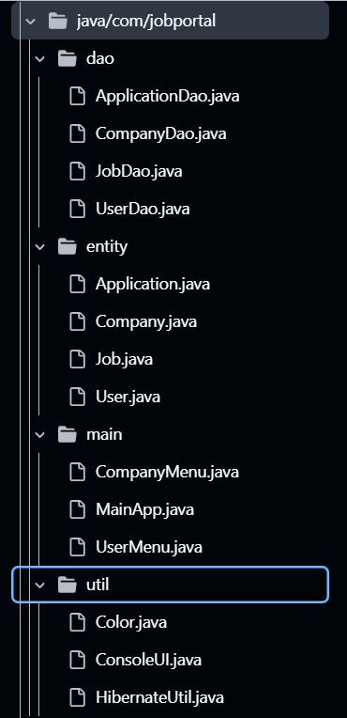
Layered architecture

Slide 7
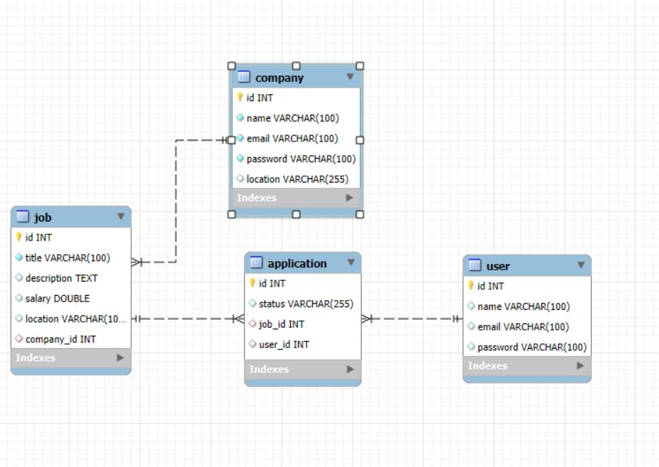
ER Diagram (Schema)
ER Diagram placeholder:
User (1) ← Application (M) → Job (M) ← Company (1)

Slide 8
Entities & Mappings
User, Company, Job, Application
Annotations:
  @Entity,
  @Table,
  @Id,
  @GeneratedValue,
  @ManyToOne,
  @OneToMany

Slide 9
DAO Layer
UserDao: registerUser, login
CompanyDao: registerCompany, login
JobDao: postJob, displayAllJobs, getJobById, getJobsByCompany
ApplicationDao: applyJob, getApplicationsByUser

Slide 10
Sample Console Flow
1. Start Application (MainApp)
2. Company posts job
3. User views and applies
4. Application saved via Hibernate

Slide 11
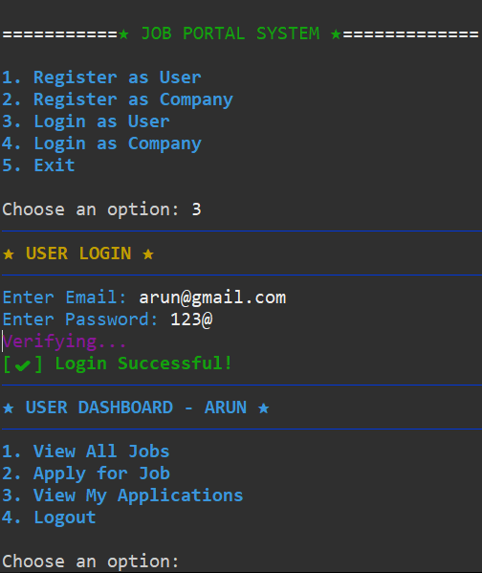
Output
User Login and User Menu

Slide 12
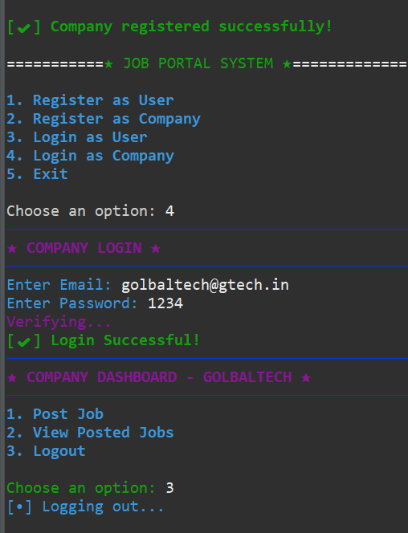
Company Login and Company Menu

Slide 13
Performance & Optimization
Connection pooling with Hibernate
Caching frequently accessed jobs
Optimized queries for large datasets

Slide 14
Summary
Smart Job Portal
  Built with Java, Hibernate, MySQL using DAO pattern
  Provides CRUD operations for Users, Companies, Jobs, and Applications
  Demonstrates layered architecture with clear separation of concerns
  Console-based flow:
  Register → Post/View Jobs → Apply → Persist via Hibernate

Slide 15
Thank You!

