Slide 1
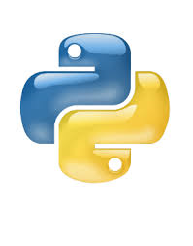
PYTHON
BY
Jeevanantham

Slide 2
Agenda
Types of programming language
History of python
Python and its importance
Feature of python
Basics of python
Python sample program
Python data structures
List consepts and it example
Python libraries
Advantage and disadvantages of pyhthon

Slide 3
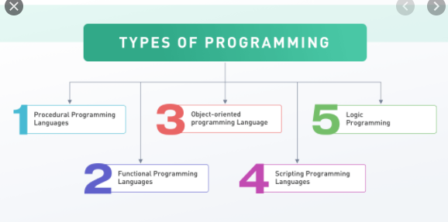
Types of programming language

Slide 4
Python and its importance
What is python ?
Python is an interpreted, high-level and general-purpose programming language. Python's design philosophy emphasizes code readability with its notable use of significant whitespace

Slide 5
History of python
Python was conceived in the late 1980s by Guido van Rossum
at Centrum Wiskunde & Informatica (CWI) in the Netherlands as a successor to ABC programming language.
which was inspired by SETL, capable of exception handling and interfacing with the Amoeba operating system.
Its implementation began in December 1989.

Slide 6
Why we use the python ?
It can use the programming language for developing both desktop and web applications. Also, you can use Python for developing complex scientific and numeric applications

Slide 7
Why we want to learn python ?
Python is highly flexible and extensible.
Python has a library to cater to your every need.
Python makes web development a breeze.
There's plenty for Data Visualization.
Python comes with numerous testing frameworks.
Python is excellent for Enterprise Application Integration (EAI) .
Python is great for scripting.

Slide 8
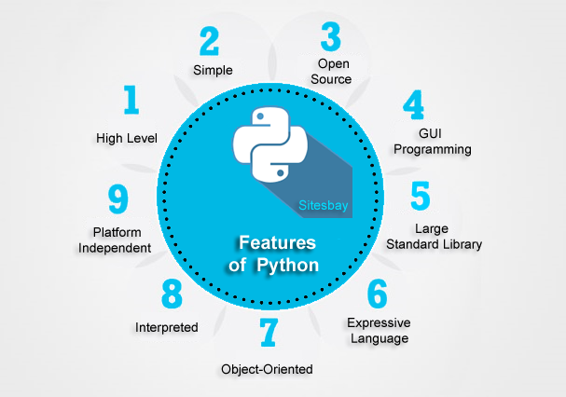
Feature of python

Slide 9
Basics of python
Datatypes
Int
Float
String
Complex
Example
x = 1 - int y = 2.8 - float z = 1j - complex
X=jeeva - string

Slide 10
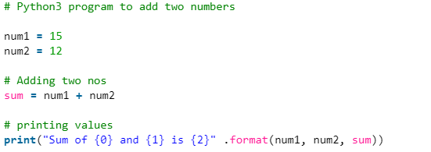
Python simple program

Slide 11
Python data stuctures
List
Tuple
Dictionary
For loop
While loop
If –else

Slide 12
List
Lists are used to store multiple items in a single variable.
And it is changeable .
Sample program
thislist = ["apple", "banana", "cherry"] print(thislist)
output
['apple', 'banana', 'cherry']

Slide 13
Tuple
Tuple are used to store the multiple items in a single variable.
But it can‘t changeable
Simple program
thistuple = ("apple", "banana", "cherry") print(thistuple)
Output
('apple', 'banana', 'cherry')

Slide 14
Dictionary
Dictionaries are used to store data values in key:value pairs.
A dictionary is a collection which is unordered, changeable and does not allow duplicates.
Simple program
thisdict = { "brand": "Ford", "model": "Mustang", "year": 1964 } print(thisdict)
Output
{'brand': 'Ford', 'model': 'Mustang', 'year': 1964}

Slide 15
For loop
A for loop is used for iterating over a sequence (that is either a list, a tuple, a dictionary, a set, or a string).
This is less like the for keyword in other programming languages, and works more like an iterator method as found in other object-orientated programming languages.
Program
fruits = ["apple", "banana", "cherry"] for x in fruits: print(x)
Output
apple banana cherry

Slide 16
While loop
With the while loop we can execute a set of statements as long as a condition is true.
Program
i = 1 while i < 6: print(i) i += 1
Output
1 2 3 4 5

Slide 17
Python If ... Else
These conditions can be used in several ways, most commonly in "if statements" and loops.
An "if statement" is written by using the if keyword.
Program
a = 33 b = 200 if b > a: print("b is greater than a")
Elif
Print (“a is greater than b”)
else
Print(a and b both are equal)
Output
b is greater than a

Slide 18
Python libraries
Python Libraries are a set of useful functions that eliminate the need for writing codes from scratch.
There are over 137,000 python libraries present today. Python libraries play a vital role in developing machine learning, data science, data visualization.
image and data manipulation applications and more.

Slide 19
Important python libraries
Numpy.
Pandas.
Matplotlib.
Scikit-Learn.
Scipy.

Slide 20
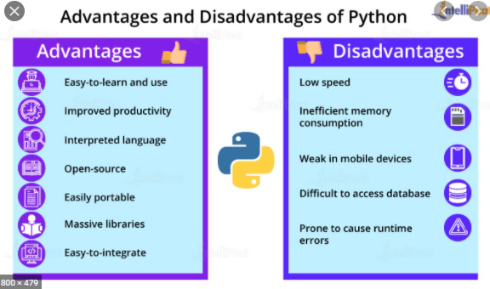
Advantage and disadvantages of pyhthon

Slide 21
I refered this website
W3 schhol
Javatpoint
Programiz

Slide 22


