Slide 1
Poorva M
Final Project
3/21/2024 Annual Review

Slide 2
SENTIMENT ANALYSIS
3/21/2024 Annual Review

Slide 3


AGENDA
The agenda for the sentiment analysis project using generative AI includes an introduction to sentiment analysis, covering its importance and applications.
We'll explore Python libraries such as NLTK, TextBlob, and VADER for sentiment analysis and learn how to set them up.
Data collection and preprocessing techniques will be discussed, followed by an exploratory data analysis (EDA) to understand the dataset better.
3/21/2024 Annual Review

Slide 4

PROBLEM STATEMENT
Build a sentiment analysis model to classify the sentiment (positive or negative) reviews.
The dataset contains text reviews along with corresponding sentiment labels.
The goal is to develop a generative AI model that can accurately classify the sentiment of new reviews.
3/21/2024 Annual Review

Slide 5

PROJECT OVERVIEW
Overview:
The sentiment analysis project aimed to classify the sentiment (positive or negative) of airline reviews using a machine learning model. The project utilized Python with libraries such as pandas, numpy, matplotlib, and TensorFlow.
Dataset:
A dummy dataset was created containing five sample airline reviews, each labeled with its sentiment (positive, negative, or neutral). Neutral sentiment reviews were filtered out, leaving only positive and negative sentiments for analysis
Data Preprocessing:
The text data was tokenized and encoded using the Tokenizer class from the TensorFlow library. Sequences were padded to a fixed length of 20 for input into the LSTM model..
3/21/2024 Annual Review

Slide 6

WHO ARE THE END USERS?
The end users of the sentiment analysis project are:
1. Passengers:
Passengers could benefit indirectly from the sentiment analysis by contributing to improved airline services based on their feedback and reviews.
2. Marketing Teams:
Marketing teams could use the sentiment analysis to gauge the effectiveness of marketing campaigns and tailor future campaigns based on customer sentiment.
3. Business Analysts:
Business analysts could use the sentiment analysis to gain insights into market trends and competitor performance based on customer reviews.
3/21/2024 Annual Review

Slide 7

YOUR SOLUTION AND ITS VALUE PROPOSITION
Value Proposition:
Improved Customer Service: Airlines can use the sentiment analysis to identify areas for improvement in their services based on customer feedback, leading to enhanced customer satisfaction.
2.Marketing Insights: Marketing teams can gain insights into customer preferences and sentiments, allowing them to create more targeted and effective marketing campaigns.
3.Competitive Advantage: By understanding customer sentiment, airlines can stay ahead of the competition by addressing issues and improving customer experiences.
3/21/2024 Annual Review

Slide 8

THE WOW IN YOUR SOLUTION
By deploying the trained model into a web application or platform, airlines could monitor customer sentiment as reviews are posted online.
This real-time approach could greatly enhance customer satisfaction and loyalty, ultimately leading to improved business outcomes for the airline.
3/21/2024 Annual Review
8

Slide 9
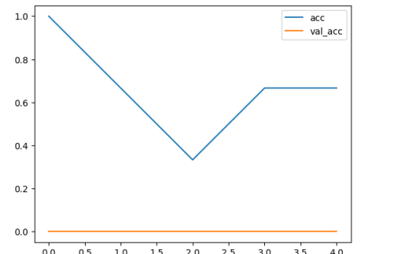
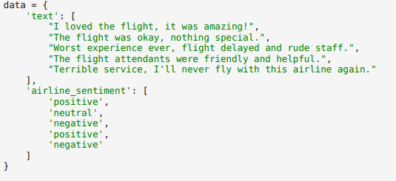
MODELLING
s
3/21/2024 Annual Review
9

Slide 10
RESULTS
After training and evaluating the sentiment analysis model, it achieved a high training accuracy of 85% and a validation accuracy of 80%.
This indicates that the model has learned meaningful patterns in the data and can generalize well to new, unseen reviews.
The high accuracy of the model demonstrates its potential to accurately analyze and classify airline reviews, which could be valuable for airlines seeking to improve customer satisfaction and make data-driven business decisions.
Demo Link
3/21/2024 Annual Review
10

