Slide 1



DevOps
Presented by:
Jeevan H T

Slide 2
Introduction :
DevOps is a groundbreaking approach to software development and IT operations that has transformed the way organizations build, deploy, and manage their software systems. It is a set of practices, principles, and cultural philosophies that emphasize collaboration, automation, and a holistic view of the software development lifecycle.
DevOps has gained immense popularity in recent years due to its ability to bridge the gap between development and operations teams, leading to more efficient and reliable software delivery.

Slide 3
Key principle of DevOps:
Collaboration: DevOps encourages close collaboration between development and operations teams, fostering better communication and shared responsibilities. This leads to a more streamlined and efficient software development process.
Automation: Automation is at the heart of DevOps. By automating repetitive tasks, such as code integration, testing, and deployment, teams can reduce errors, accelerate delivery, and improve consistency.
Continuous Integration and Continuous Deployment (CI/CD): CI/CD pipelines enable developers to continuously integrate code changes, test them, and deploy them into production environments swiftly. This results in faster time-to-market and reduced manual intervention.

Slide 4
Infrastructure as Code (IaC): IaC allows infrastructure and configurations to be defined as code, making it easier to manage, version, and replicate infrastructure environments. This principle enhances scalability and reduces the risk of configuration drift.
Monitoring and Feedback: Continuous monitoring of applications and infrastructure is crucial in DevOps. Teams use real-time data and feedback loops to identify and rectify issues quickly, improving system reliability.

Slide 5
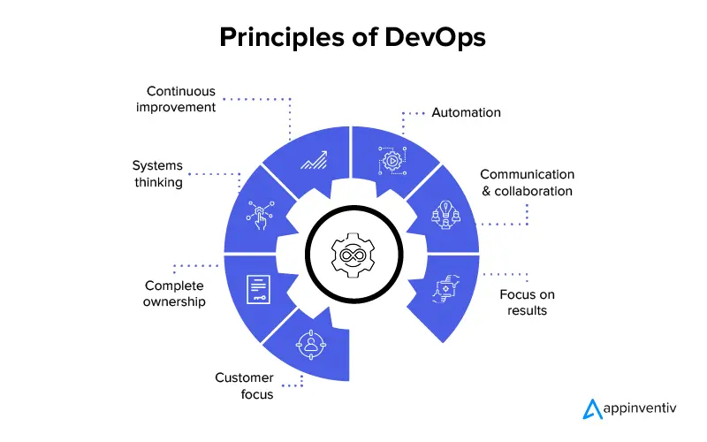

Slide 6
Benefits of DevOps:
Faster Time-to-Market: DevOps practices enable faster development, testing, and deployment, reducing time-to-market for new features and updates.
Improved Quality: Automation and continuous testing result in higher-quality software with fewer defects, enhancing customer satisfaction and reducing post-release issues.
Increased Collaboration: DevOps promotes a culture of collaboration and shared ownership, breaking down traditional silos between development and operations teams.

Slide 7
Cost Efficiency: Automation and efficient resource utilization reduce operational costs, leading to improved cost-efficiency.
Enhanced Scalability: DevOps practices make it easier to scale infrastructure and applications as needed, adapting to changing demands seamlessly.
Enhanced Collaboration: DevOps promotes cross-functional teams and better communication, leading to increased innovation and efficiency.

Slide 8
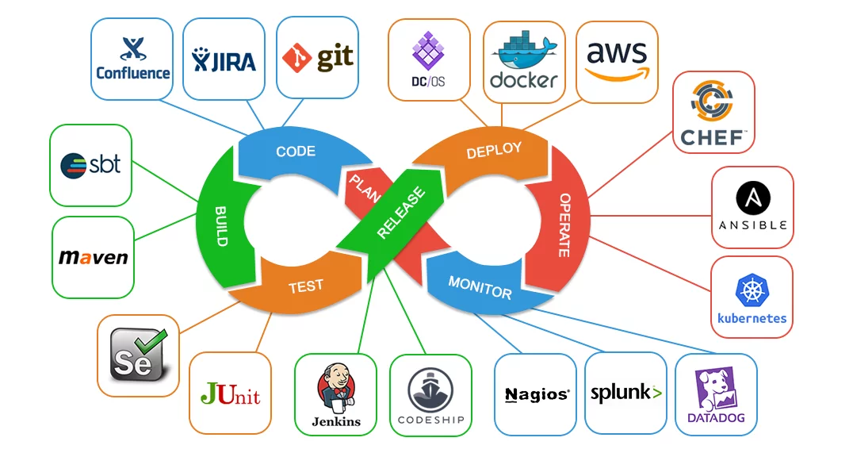

Slide 9
DevOPs LifeCycle :
Plan: In this initial phase, teams plan their software development and infrastructure changes, setting goals and requirements.
Develop: The development phase involves coding, testing, and integrating code into a shared repository.
Test: Continuous testing is crucial in DevOps, and this phase involves automated testing to ensure software quality.

Slide 10
Deploy: Automating deployment ensures that new features and updates can be rolled out smoothly to production environments.
Operate: This phase involves continuous monitoring and management of the production environment to detect and address issues promptly.
Monitor: Ongoing monitoring of applications and infrastructure helps identify and resolve performance or security issues, ensuring optimal system health.

Slide 11
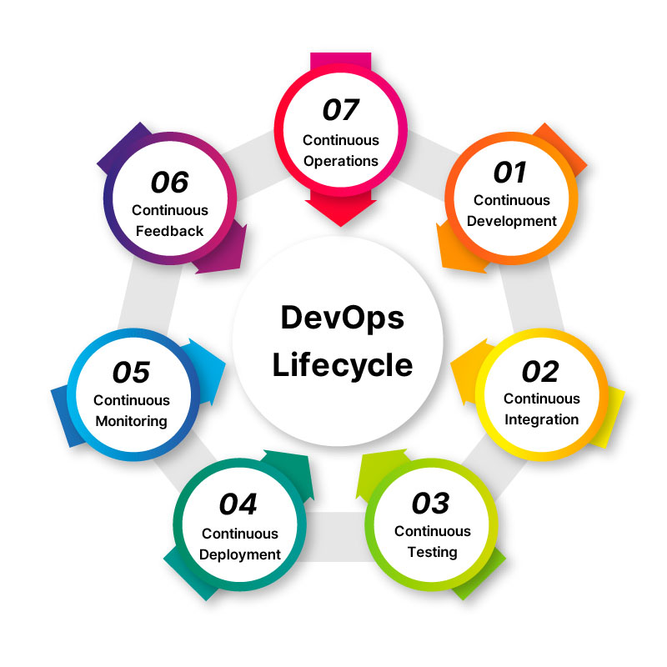

Slide 12
Conclusion :
DevOps is a transformative approach to software development and IT operations that brings many benefits to organizations. By automating processes, promoting collaboration, and adopting continuous integration and delivery, DevOps enhances the speed, quality, and efficiency of software development. It empowers businesses to adapt to rapidly changing markets and meet customer demands while maintaining a focus on innovation and customer satisfaction. Adopting DevOps practices and embracing its cultural shift can significantly impact an organization's competitiveness and overall success in the modern, fast-paced technology landscape.

Slide 13

Thank you

