Slide 1

Agentic RAG Chatbot for Multi-Format Document QA using MCP
Coding Round Problem Statement
Task Title:
Presented by
Jeevan KIran

Slide 2
Introduction :
This project is a smart chatbot that lets users upload documents and ask questions about them. It uses an agent-based design where each agent has a specific job like reading documents, finding answers, or generating responses. The system works using the Model Communication Protocol (MCP), making it easy for the agents to talk to each other. It supports multiple file formats and gives natural, AI-powered answers using Google’s Gemini model. The whole thing runs in a clean, simple Streamlit interface.

Slide 3
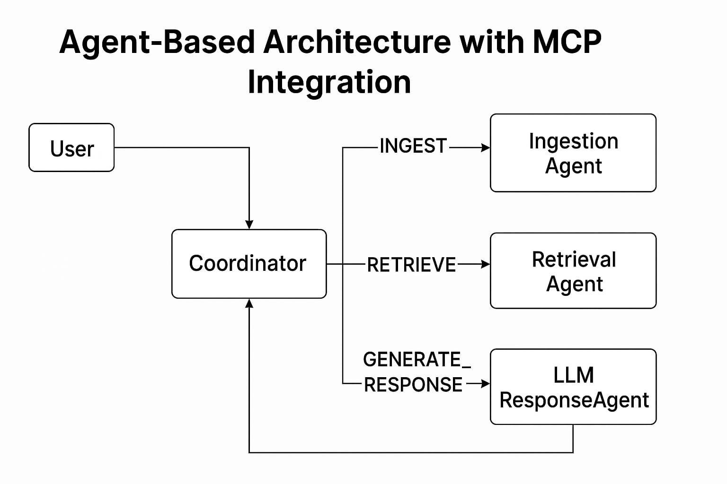

Slide 4
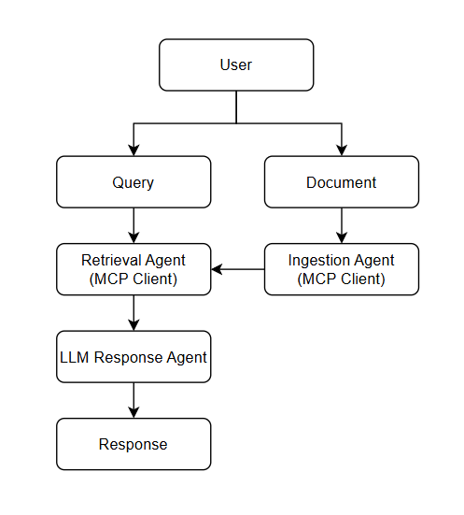
System Flow Diagram :

Slide 5
Tech Stack used :
Frontend :
Streamlit: Interactive web interface for document upload and chatbot interaction.
Backend & Core Logic
Python: Primary programming language for agent orchestration.
Agent-based Architecture with MCP: Modular agents communicate via MCP
uuid / os / shutil: For session handling, file operations, and directory management.
Document Processing
PyMuPDF: PDF text extraction
python-docx: DOCX file reading
python-pptx: PPTX file parsing
pandas: CSV file loading and formatting
open(): TXT and Markdown file handling
Embedding, Vector Storage & LLM Integration
SentenceTransformers (all-MiniLM-L6-v2): Generates semantic embeddings
ChromaDB: Vector database used to store and retrieve embedded document chunks.
Gemini 2.5: Large Language Model used to generate responses based on retrieved context.

Slide 6
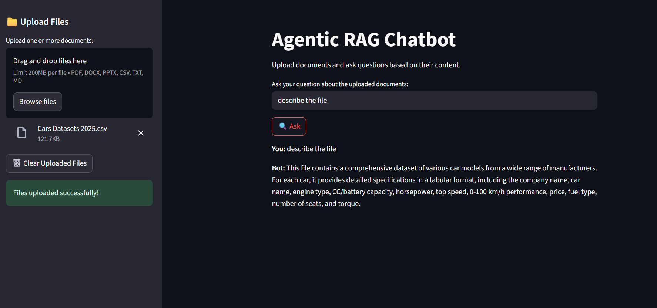
User Interface :

Slide 7
Challenges faced:
ChromaDB Session Management Ensuring the vector database resets cleanly for each new session was tricky, especially during development. It required careful handling of persistent storage and chunk IDs to avoid stale or duplicate embeddings.
Message Coordination Between Agents Designing a clean agent communication protocol using MCP required careful planning to manage message flow, trace IDs, and payload consistency between modular agents.

Slide 8
Thank you..

