Slide 1

IMDB MOVIE DATA ANALYSIS

Slide 2
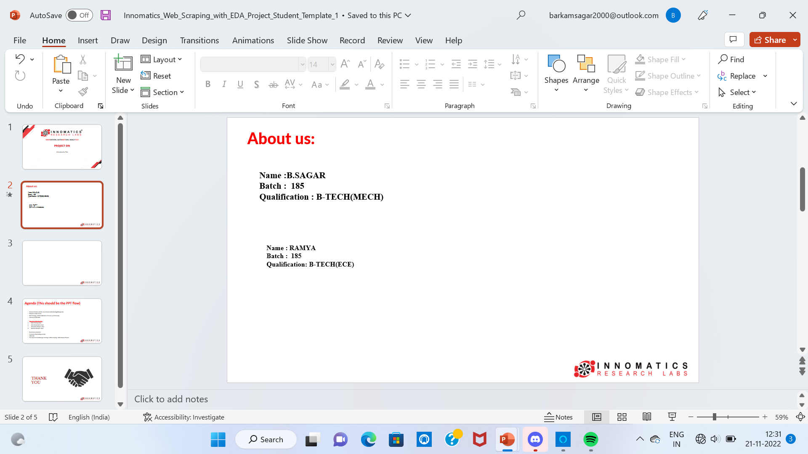
About Me:
Name : JEEVAN KRANTH
Batch : 190
Qualification : BTECH(MECH)
Any work experience : Fresher

Slide 3
Agenda
Objective of the Project
Web Scraping – Details (Websites, Processor you followed)
Summary of the Data
Exploratory & Data Analysis:
Data Cleaning
Data Manipulation
Univariate Analysis
Bivariate Analysis
Multi variate
Conclusion (Key finding overall)
Q&A Slide
Your Experience/Challenges working on Web Scraping – Data Analysis Project.

Slide 4
Objective:
.
Analyzing the movie’s data
IMDb ( Internet Movie Database) is an online database of information related to films

Slide 5
What is Web Scraping ?
Web scraping is a software technique of extracting information from the website .It takes the unstructured data into structured data that can be stored and analyzed.
We have to send a request to the URL of the webpage we want to access. The server responds to the request by returning the HTML content of the webpage. If we get the status code as 200 we can scrap the HTML context from webpage.
BeautifulSoup is a python library that makes easy to scrape information and extracting the data from HTML files.

Slide 6
LIBRARIES
Requests
BeautifulSoup
Regex (re)
Pandas
NumPy
Matplotlib
Seaborn

Slide 7
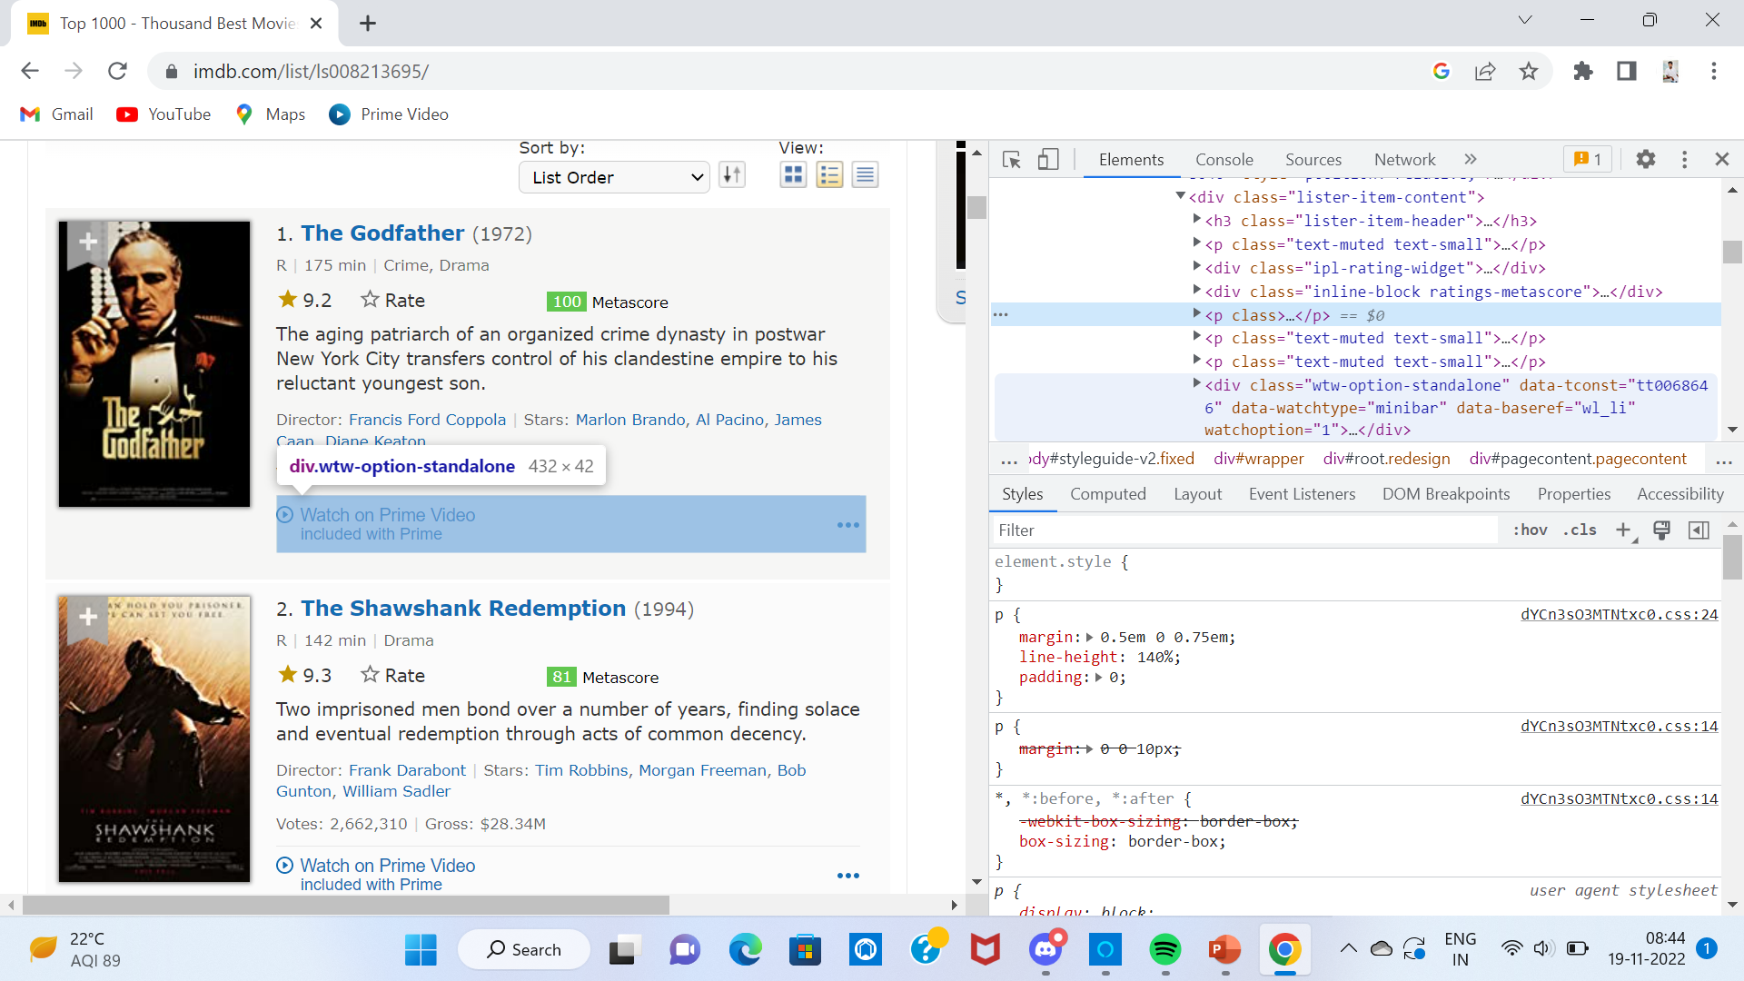
Website Used for Scraping

Slide 8
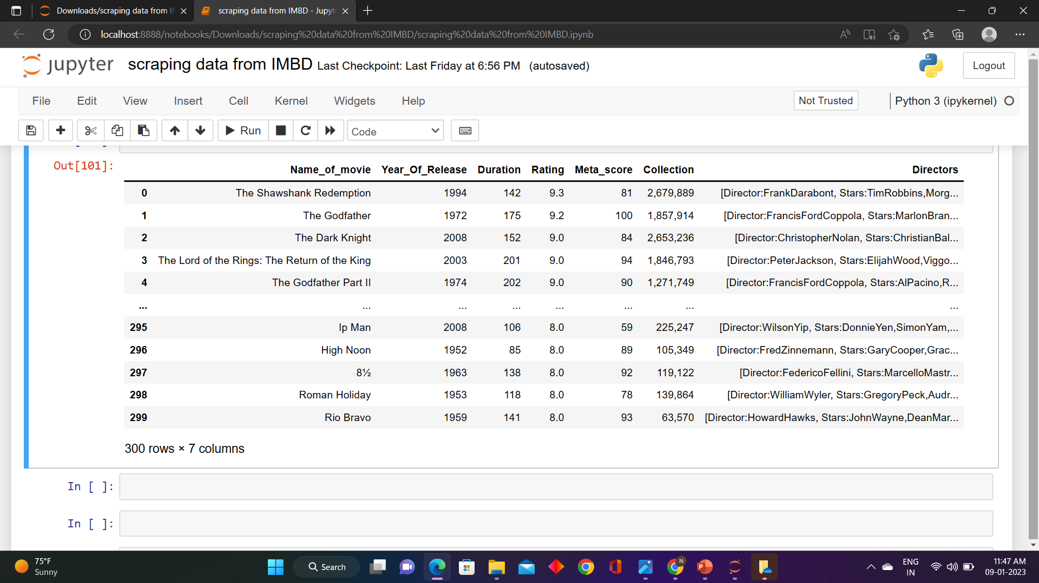
Raw Data

Slide 9
Data Cleaning Process :
Remove any Special characters
Units conversion
Identification & imputing of missing values
Type conversion
Drop the duplicate column

Slide 10
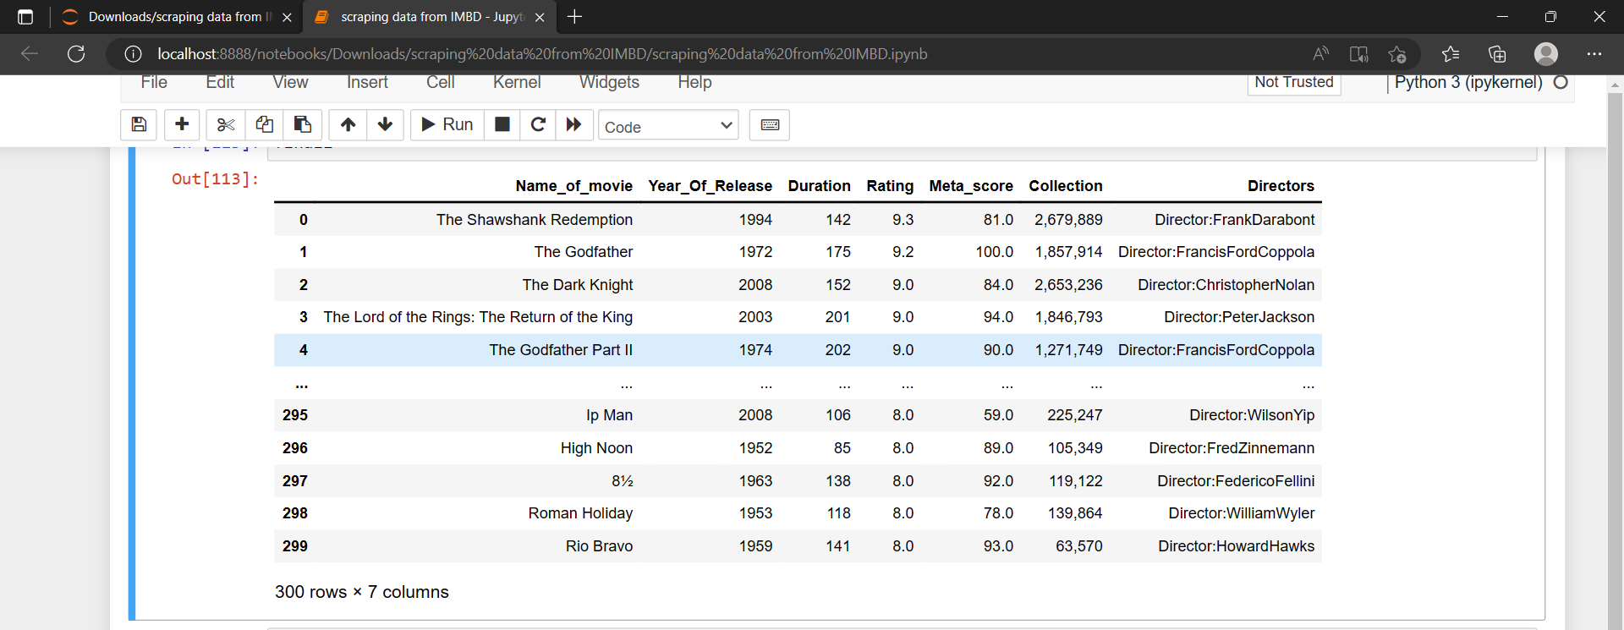
Cleaned Data

Slide 11
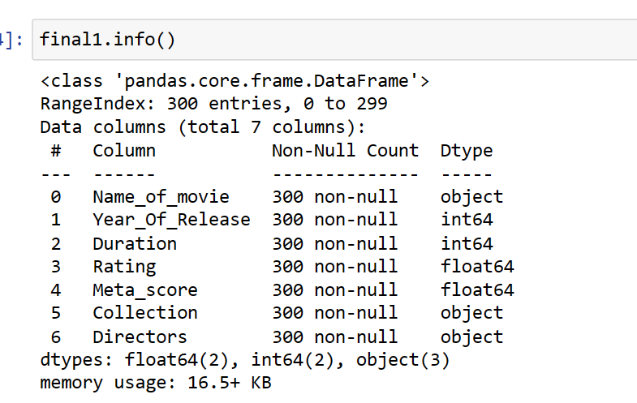
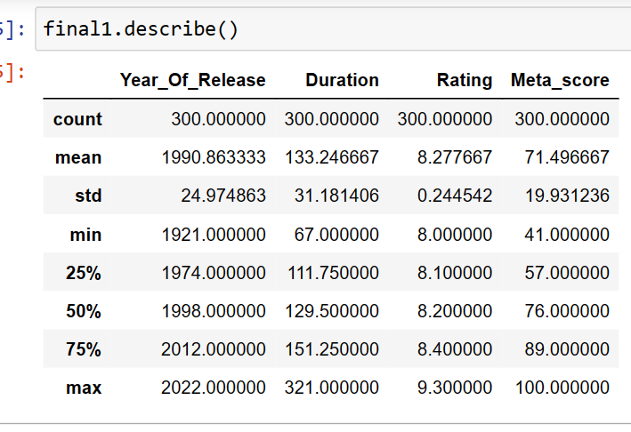
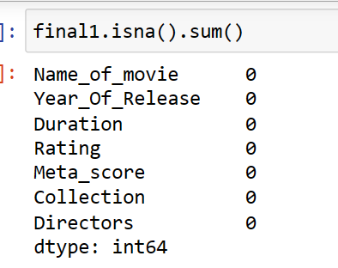
Data exploration

Slide 12
DATA VISUALZATION
UNI-VARIENT
BI-VARIENT
MULTI-VARIENT

Slide 13
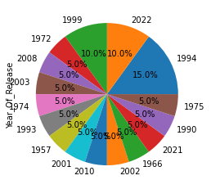
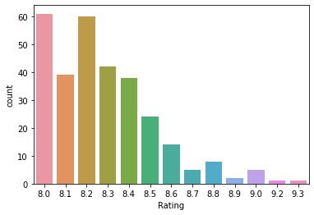
Univariate analysis
Rating of movie
Year of release
From the graph we say maximum count of movies got 8.2&8.0 rating
And the minimum count of movies got 9.2&9.3 rating
We have high percentage (15%) of the movies are in 1994 year
Max movies are having same percentage in most of years

Slide 14
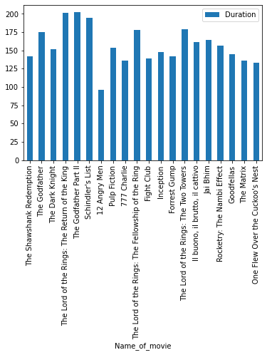
Movie vs Time duration
From the above graph we observe that time duration according to movie

Slide 15
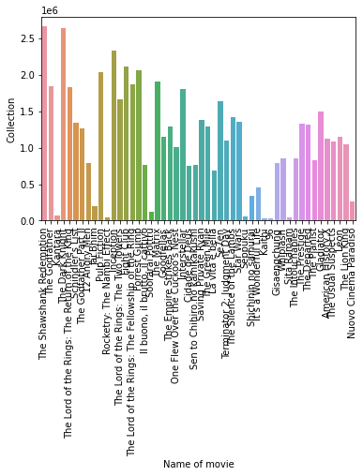
Bivariate analysis
Movie vs collection
From the graph we can observe the collection according to movies
According to this graph only two movies got high collection

Slide 16
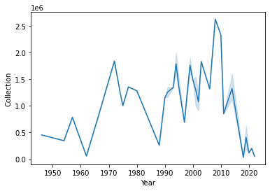
Year vs collection
From the line graph we observe that collection of movies varying according to years
The highest collection is in 2009

Slide 17
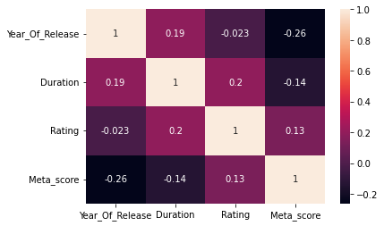
Correlation
Rating and collection has positive correlation

Slide 18
Conclusion :
We have high percentage (15%) of the movies are in 1994 year
The maximum count of movies got 8.2&8.0 rating
The highest collection is in 2009
Finally we can conclude that we can analysis the data with help of web scraping

Slide 19

THANK YOU

